Slide 1



Taiwan-India Professional Expertise and Organization Cooperation Platform
https://embedded.cs.ccu.edu.tw/center/

Slide 2
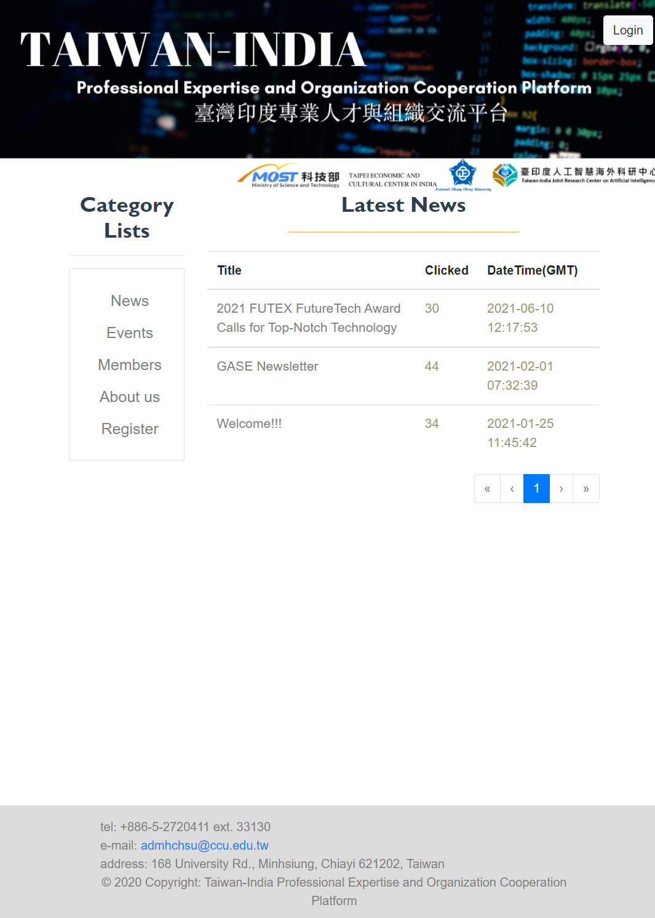
https://embedded.cs.ccu.edu.tw/center/

Slide 3
Account Registration

Slide 4
Register

Slide 5
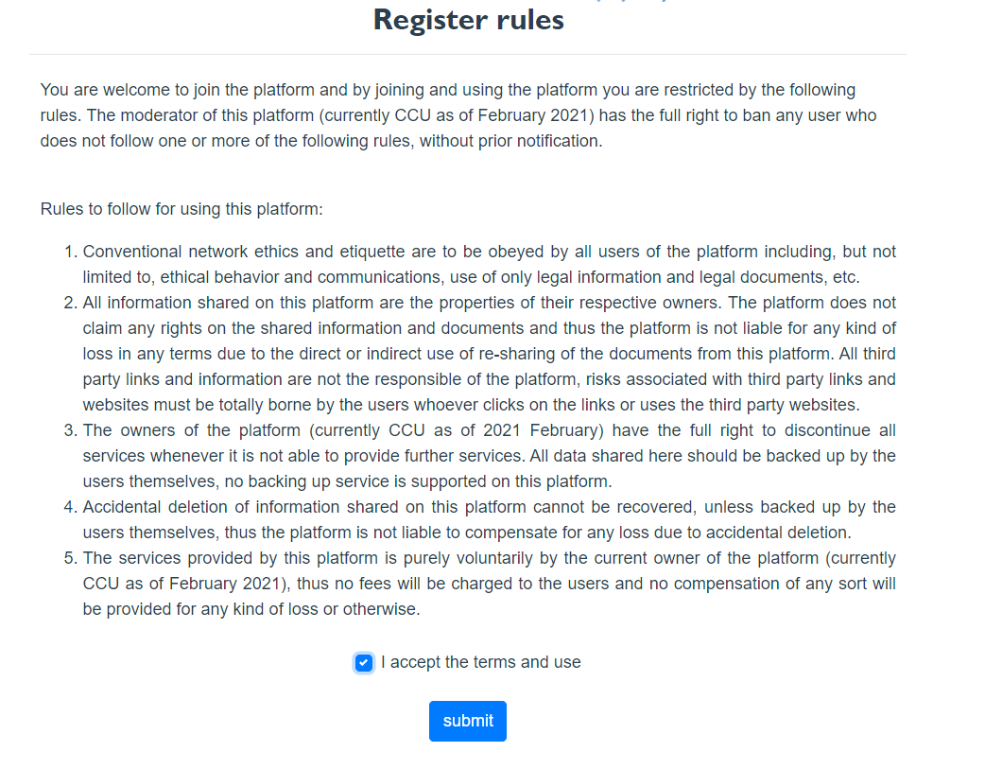
Register Rules

Slide 6
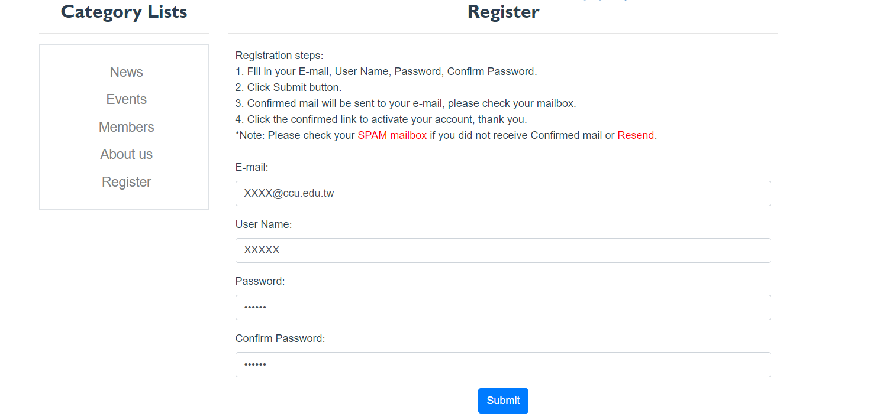
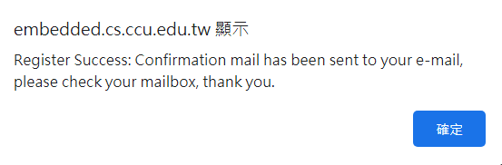
Register

Slide 7
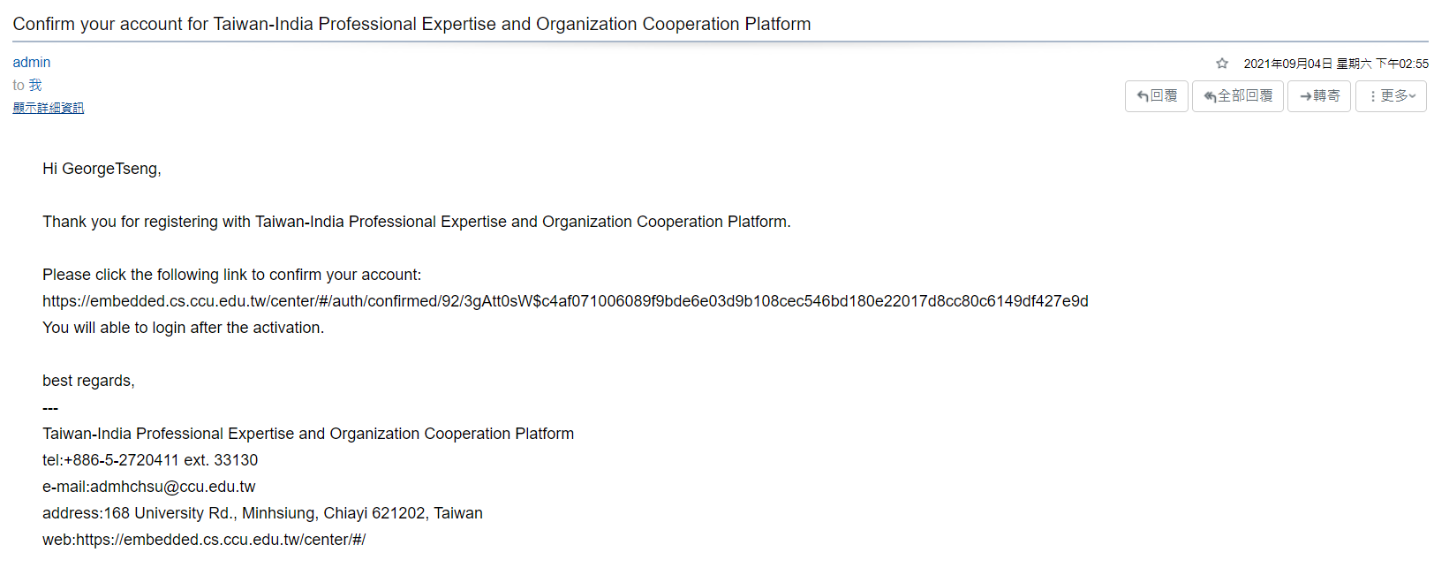
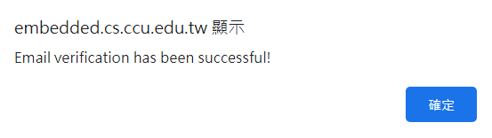
Email Verification

Slide 8
Account Login

Slide 9
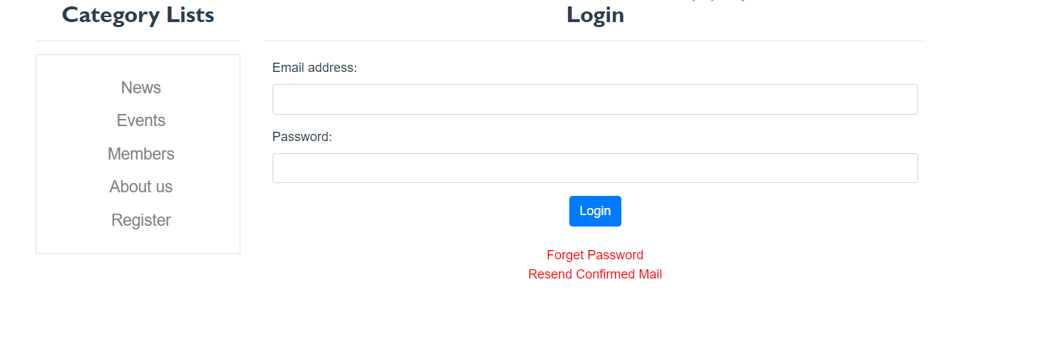
Login
Login options

Slide 10
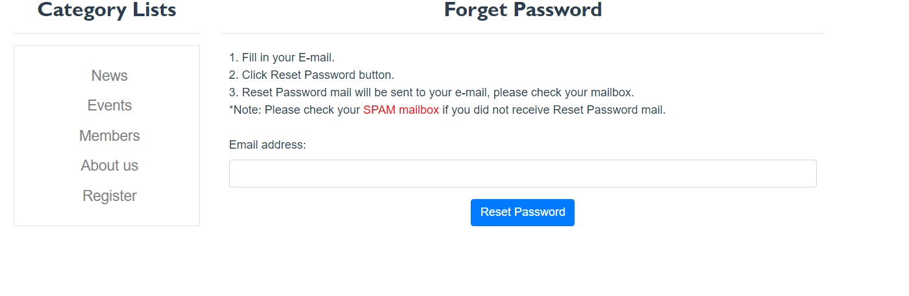
Reset Password

Slide 11
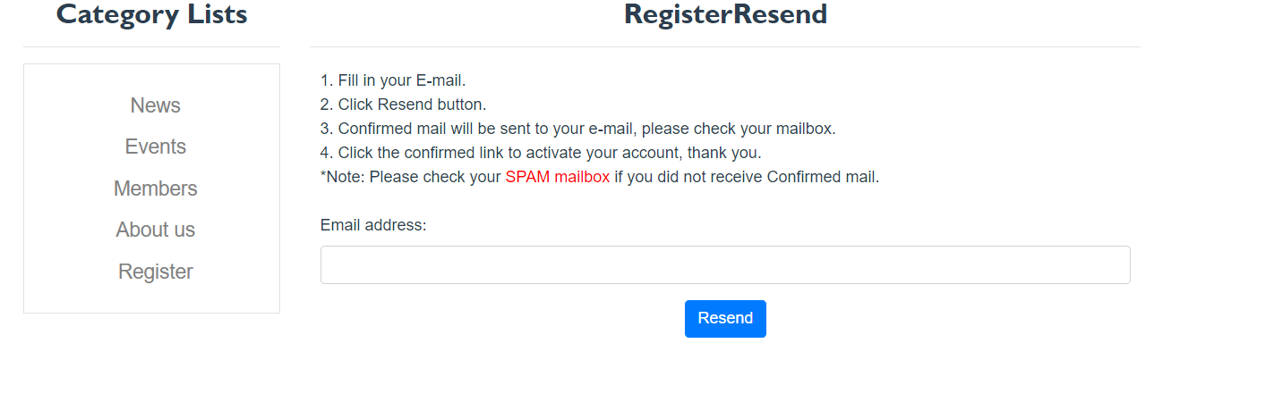
Resend the email

Slide 12
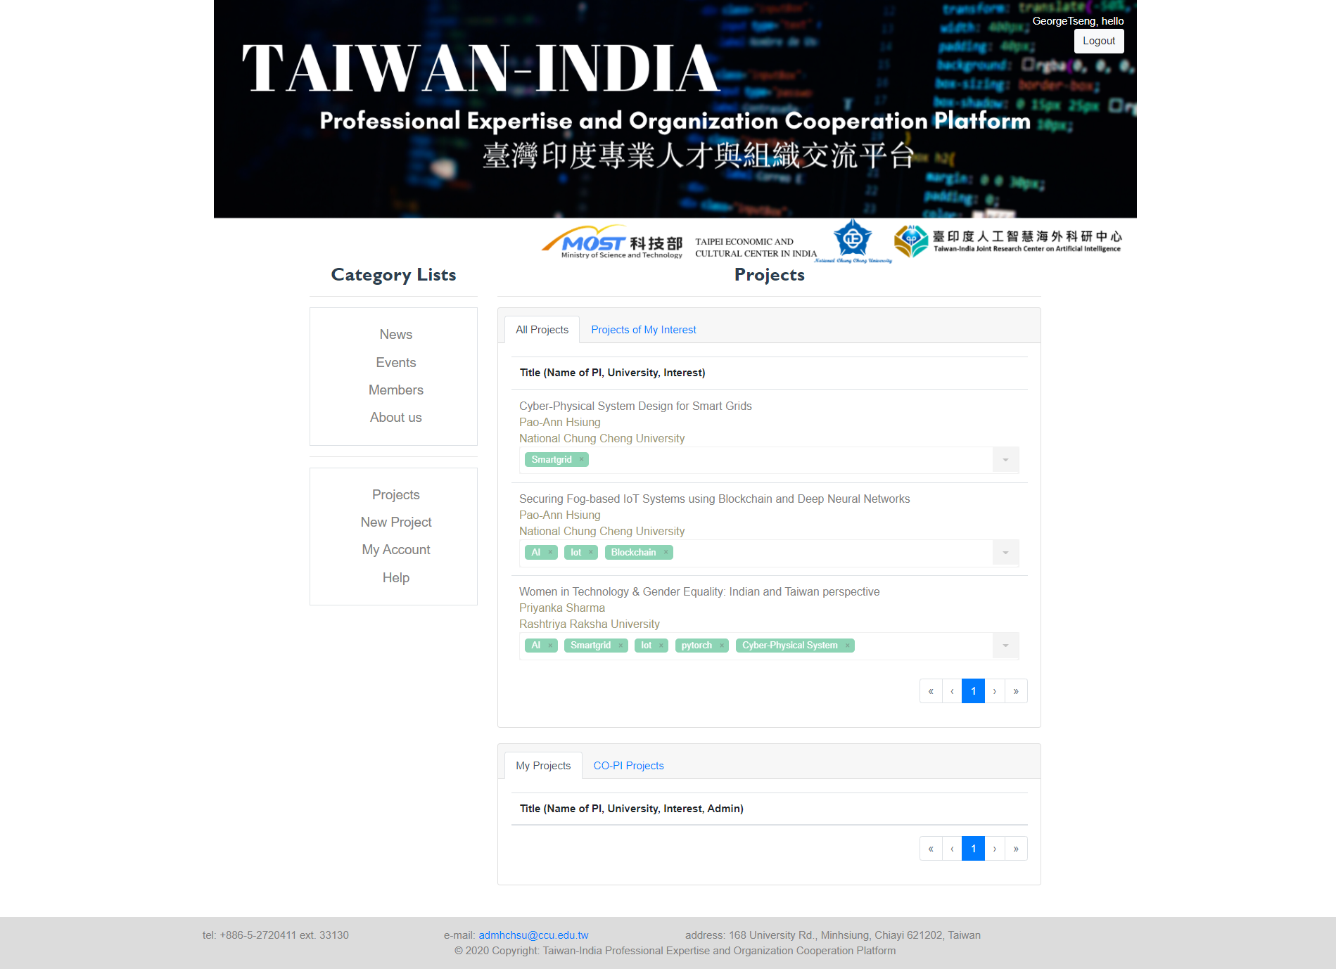
Logged-in

Slide 13
Account Settings

Slide 14
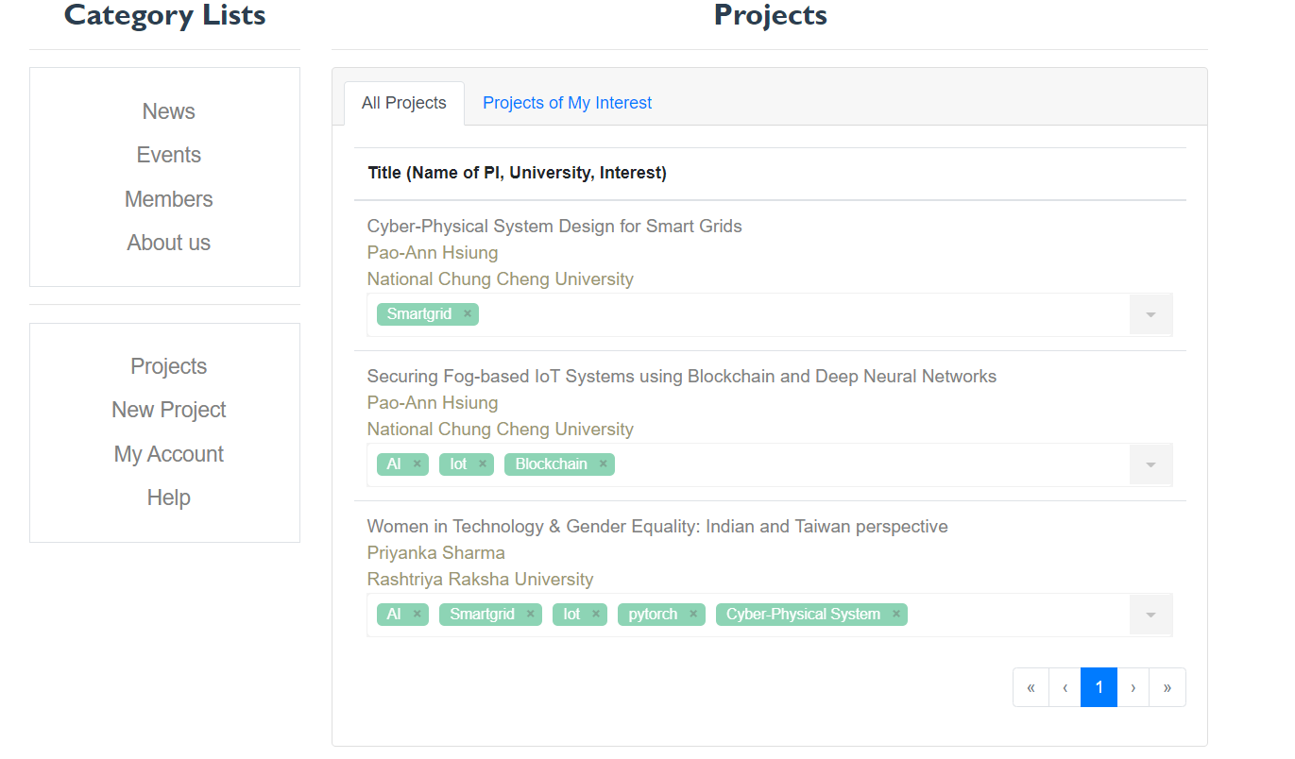
Account Settings

Slide 15
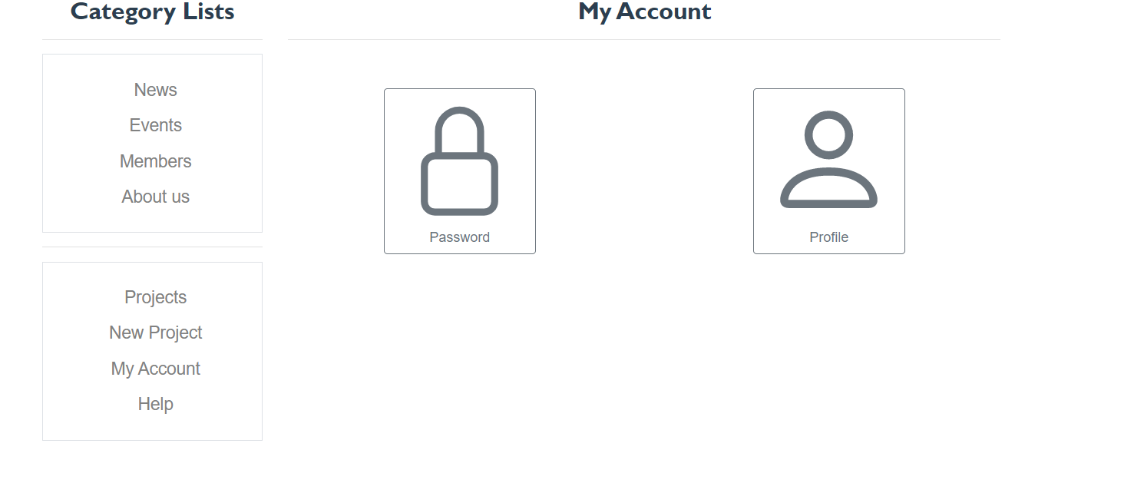
Change Password

Slide 16
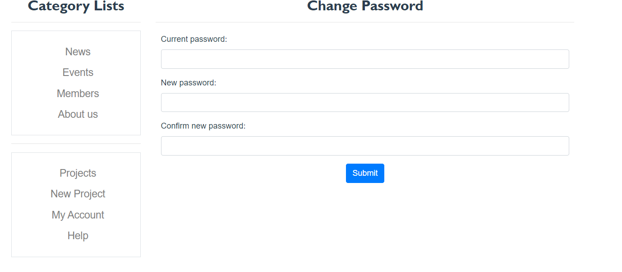
Change Password

Slide 17
Profile

Slide 18
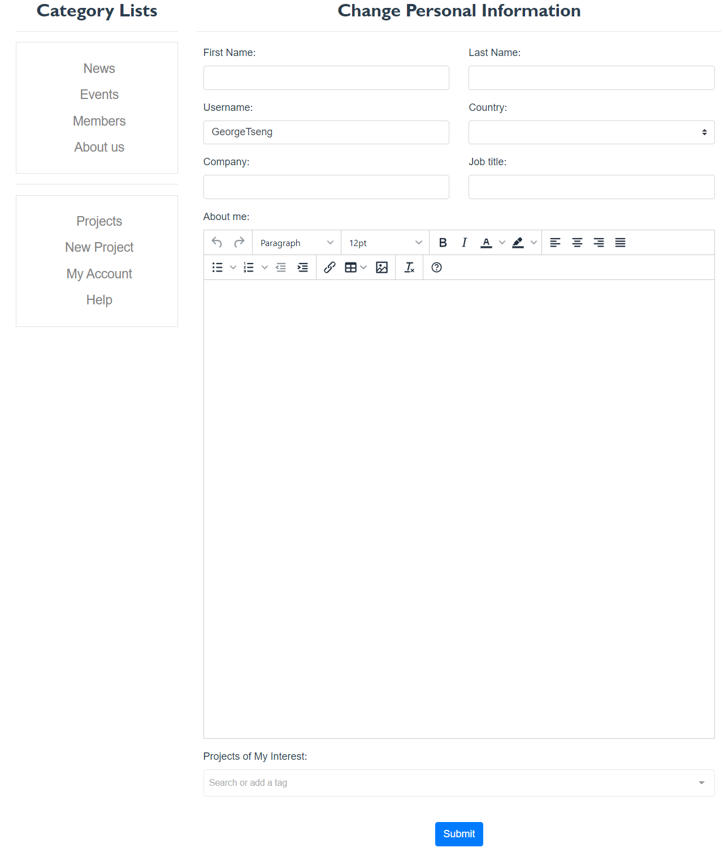
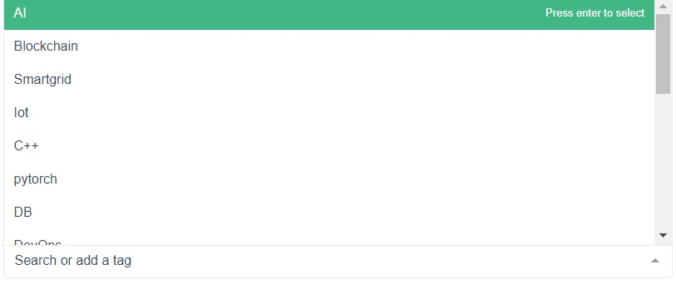
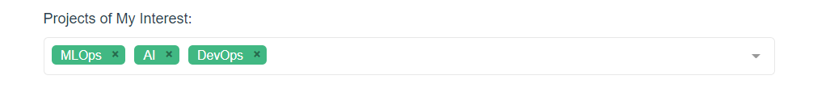
Personal Information
You can add your research area

Slide 19
Project list

Slide 20
Project list

Slide 21
Project list

Slide 22
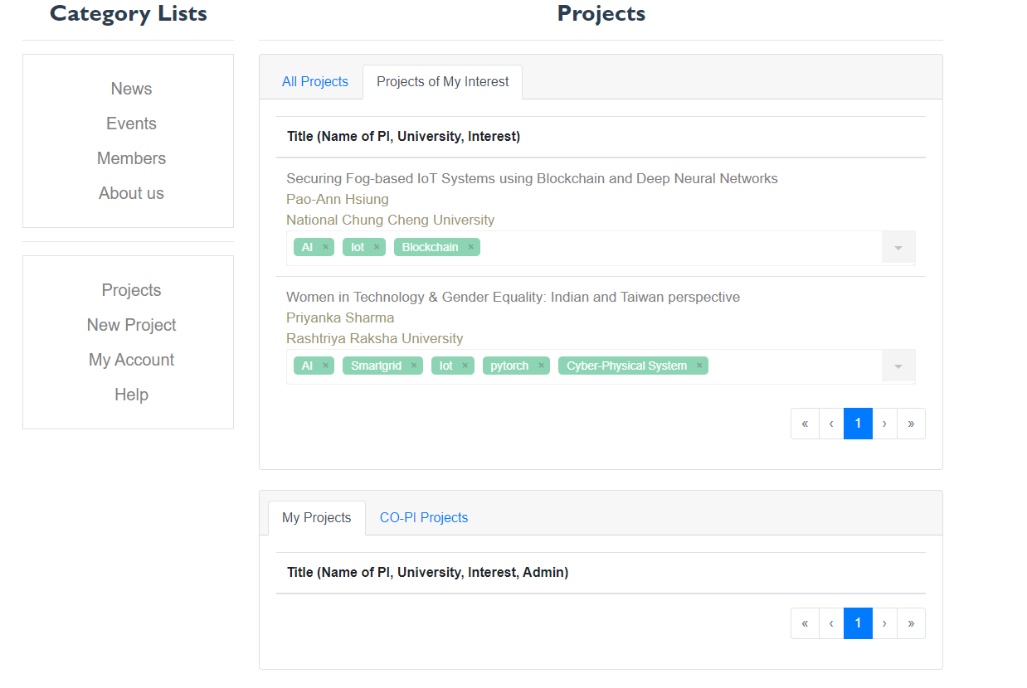
Research Area Match
Research Area
Profile settings

Slide 23
Project Information and CO-PI Application

Slide 24
Project Information
Click

Slide 25
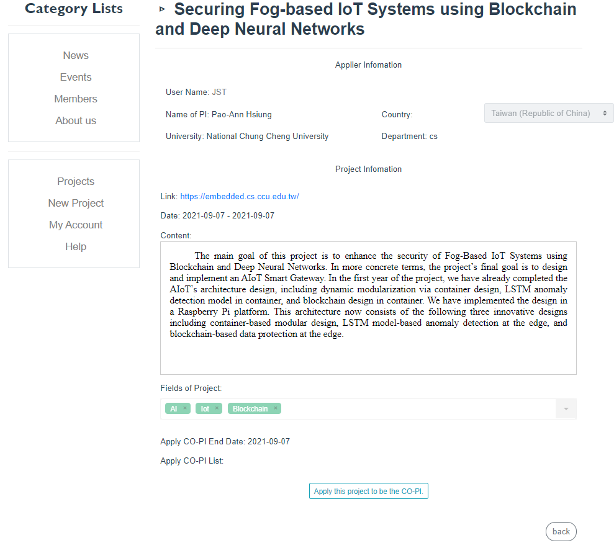
Project Information
You can apply to be a CO-PI

Slide 26
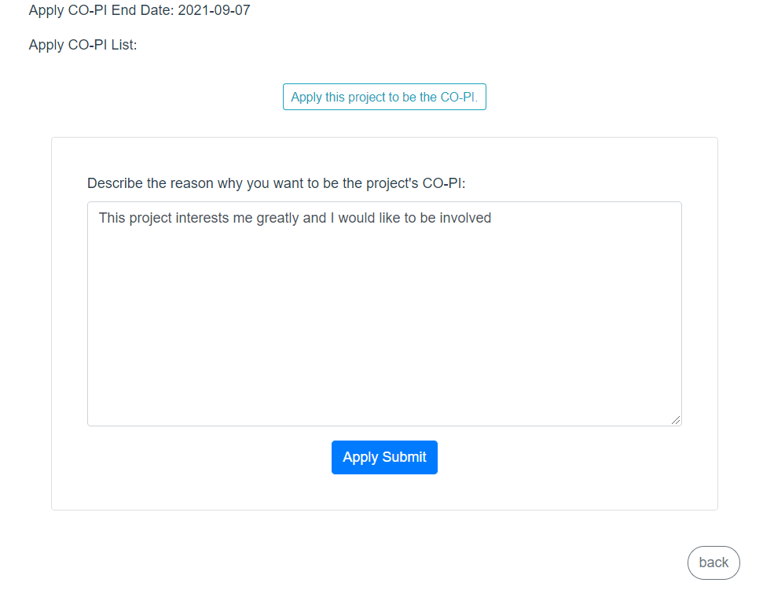
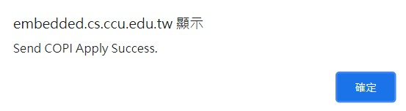
Apply this project to be the CO-PI.

Slide 27
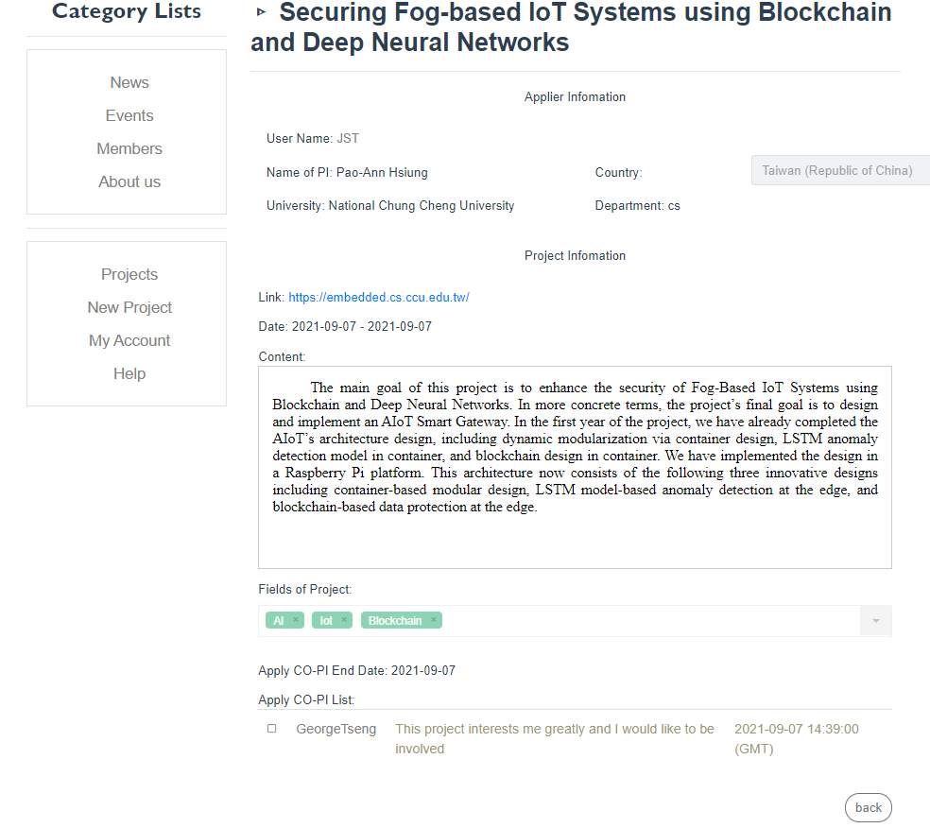
Apply this project to be the CO-PI.
Awaiting PI’s approval

Slide 28
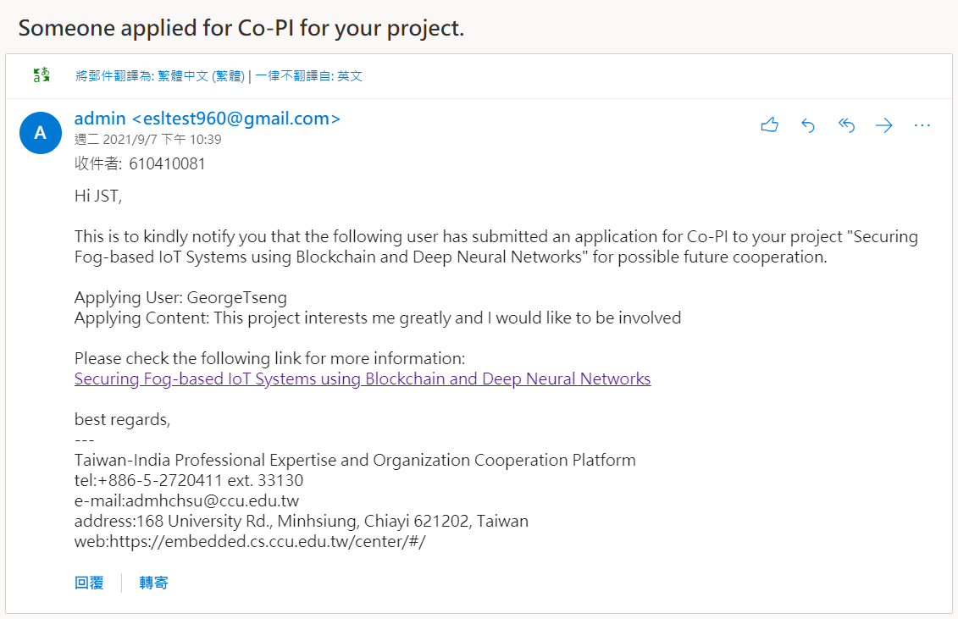
Email notification sent to PI

Slide 29
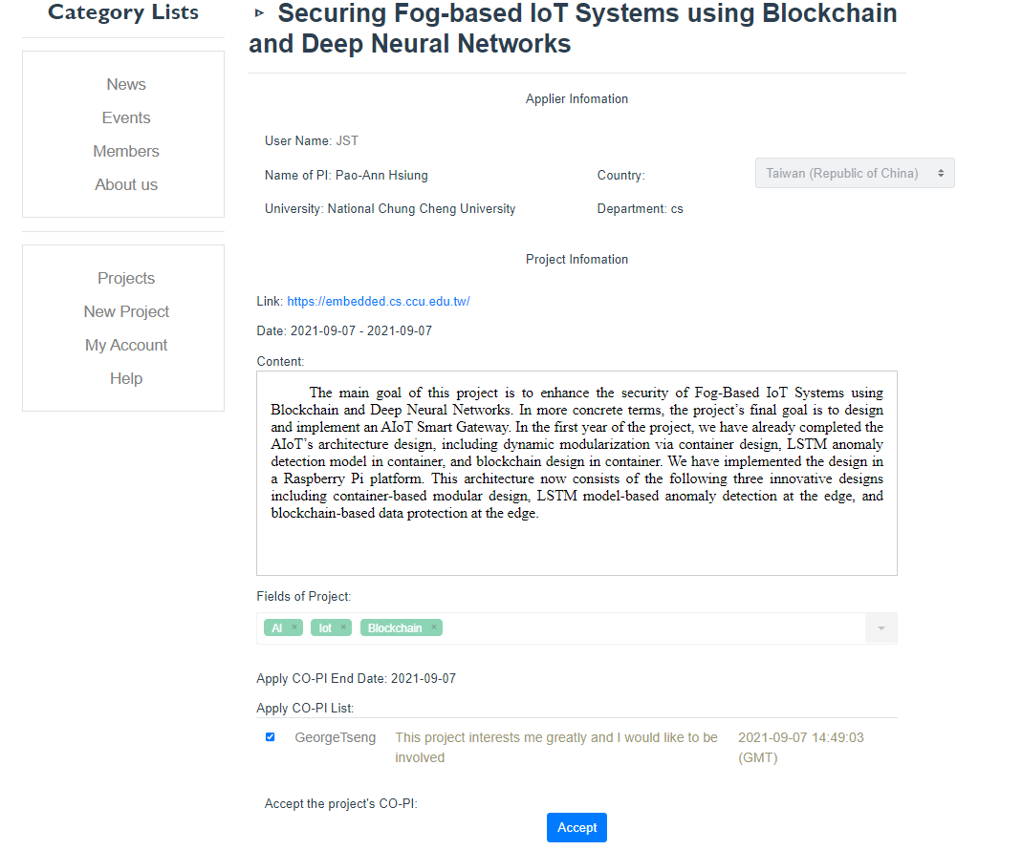
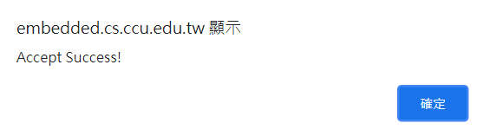
PI’s view
Decide to agree or not

Slide 30

Applicant’s view
Application has been accepted

Slide 31
Applicant’s view
Return to Project list

Slide 32
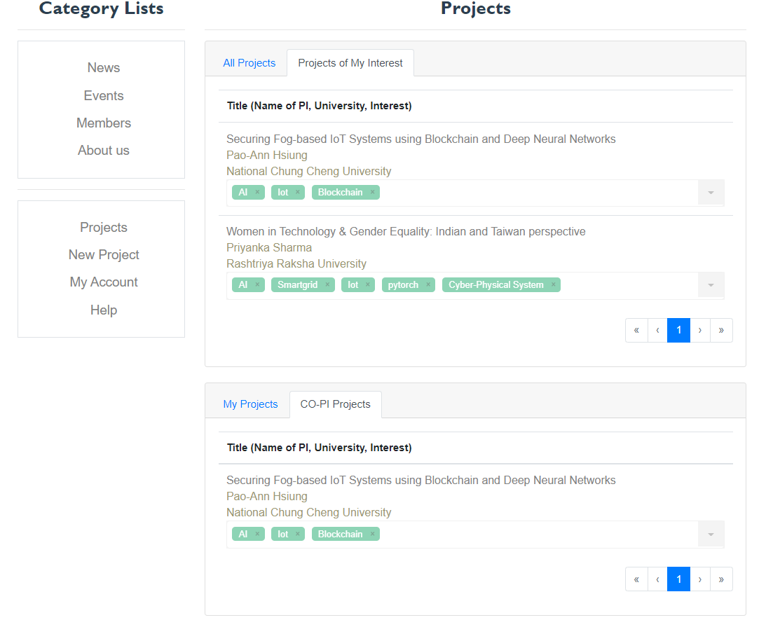
Applicant’s view
Done!

Slide 33
New Project

Slide 34
Create New Project

Slide 35
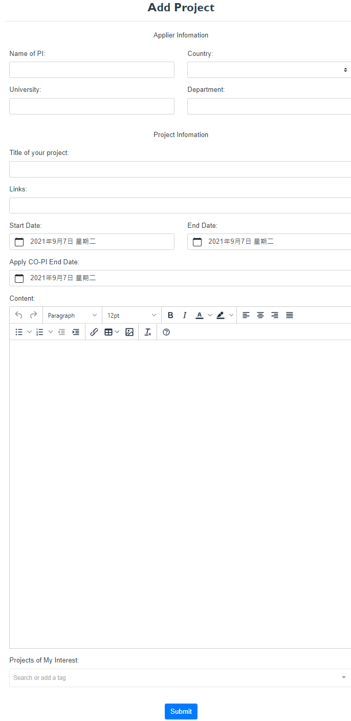
Create New Project

Slide 36
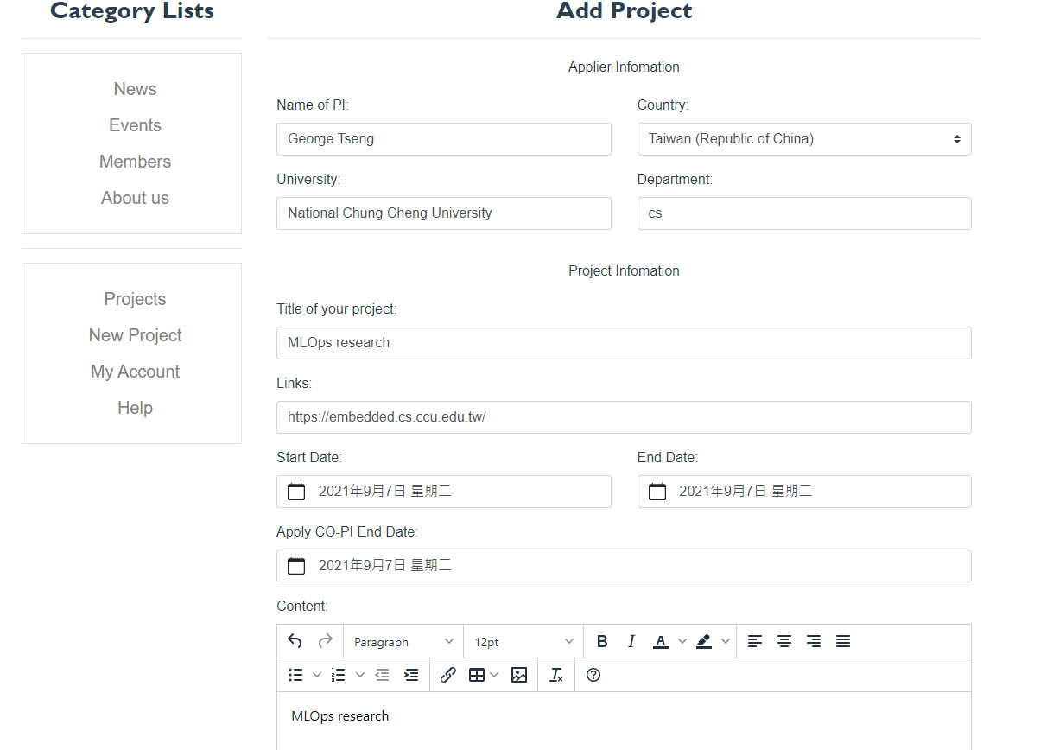

Slide 37
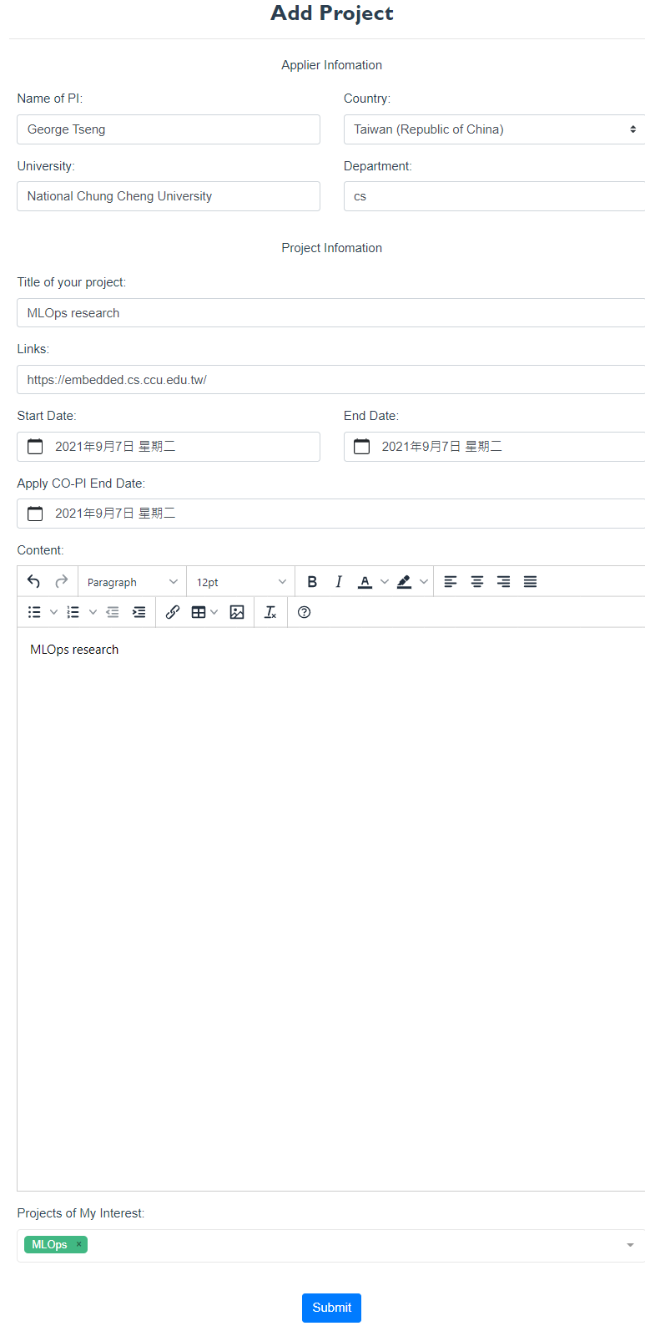
Create New Project
research area

Slide 38
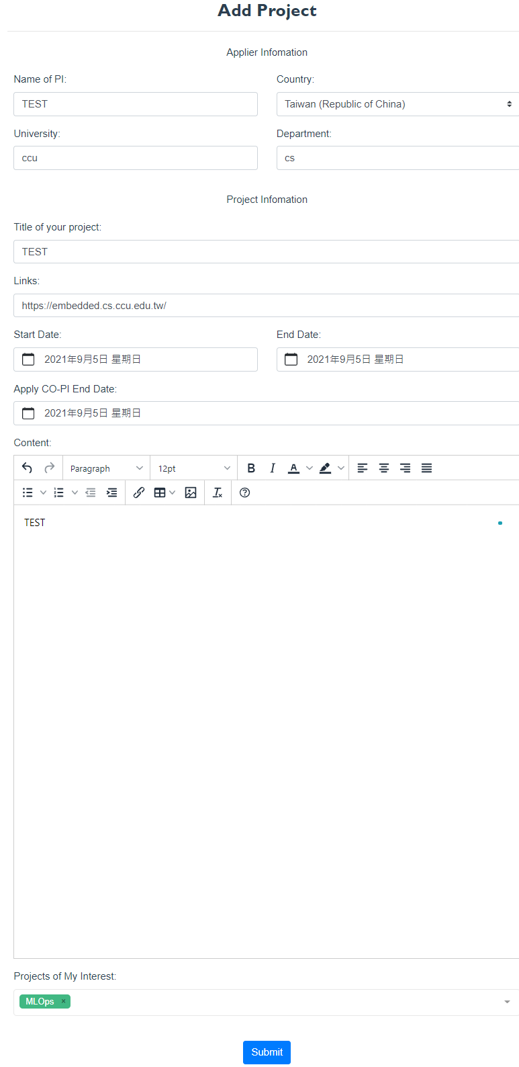
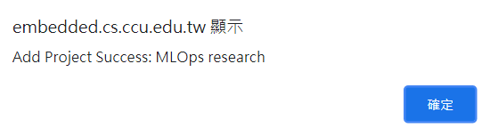
Create New Project

Slide 39
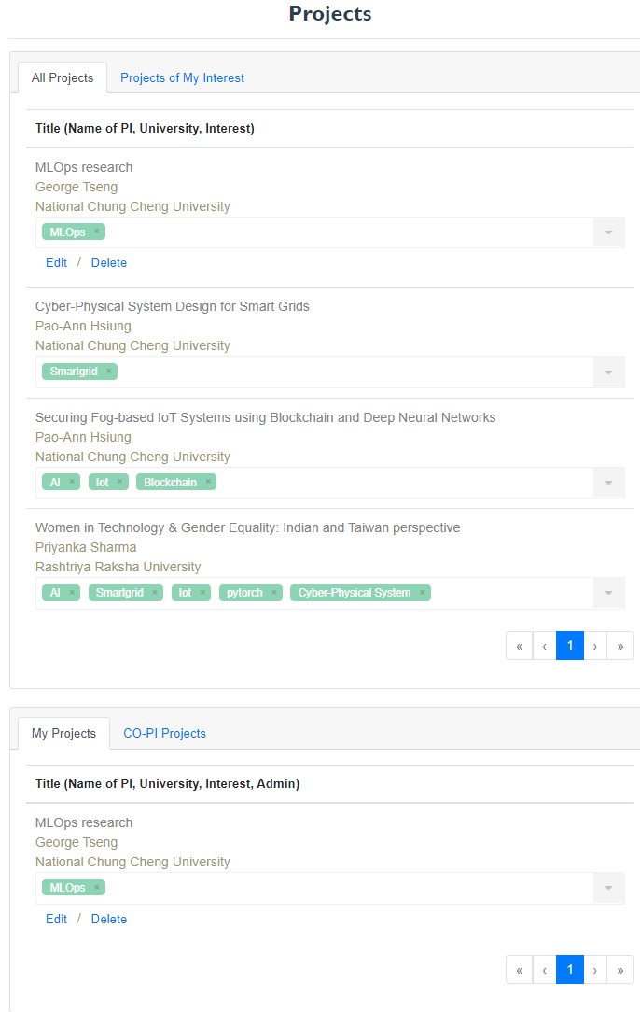
Done

Slide 40
Edit and Delete Project

Slide 41
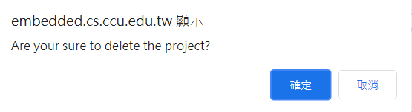
Delete Project

Slide 42
Edit Project

Slide 43
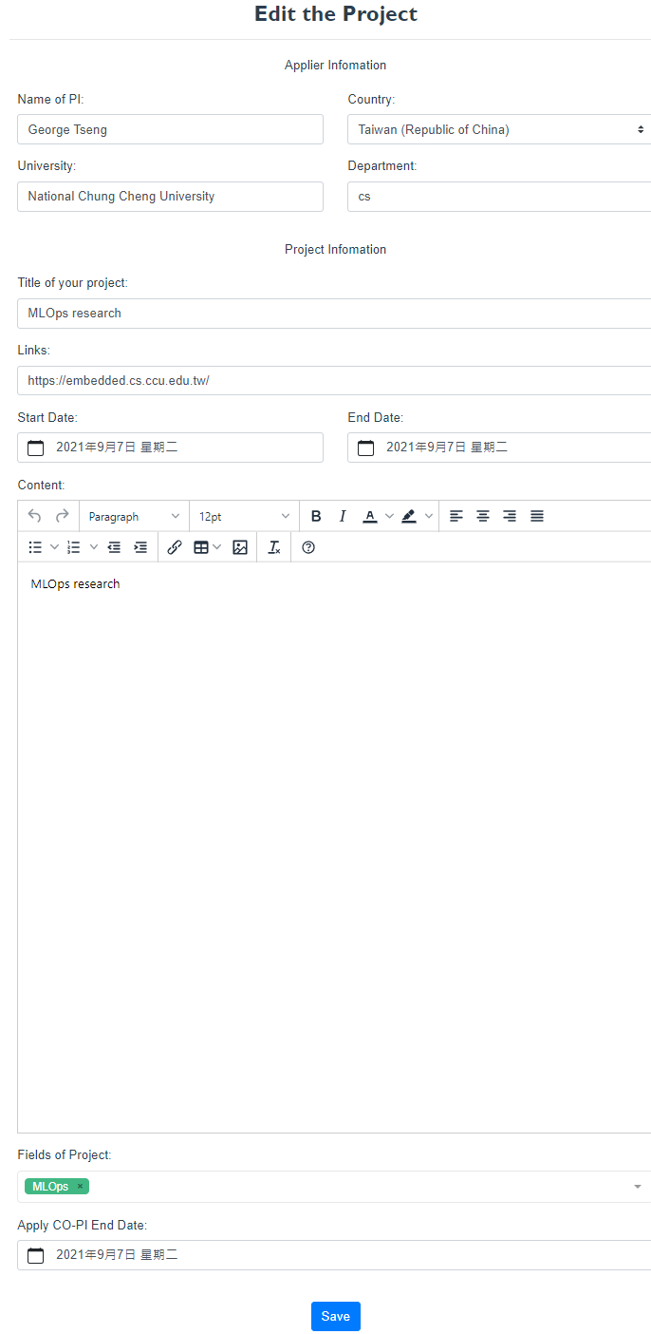

Slide 44
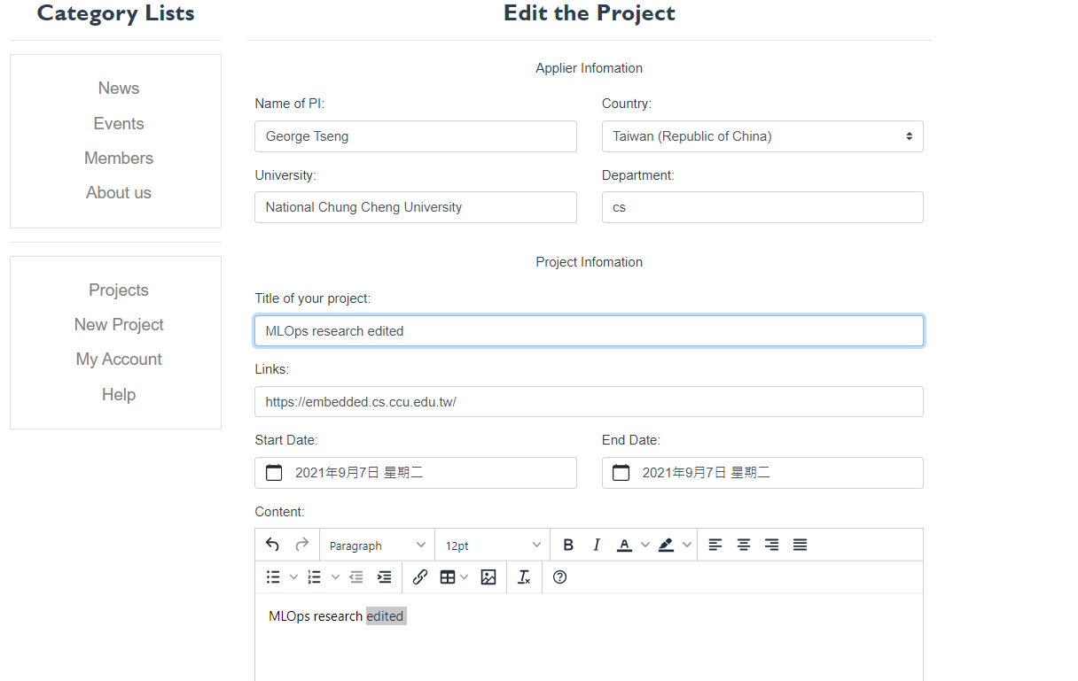

Slide 45
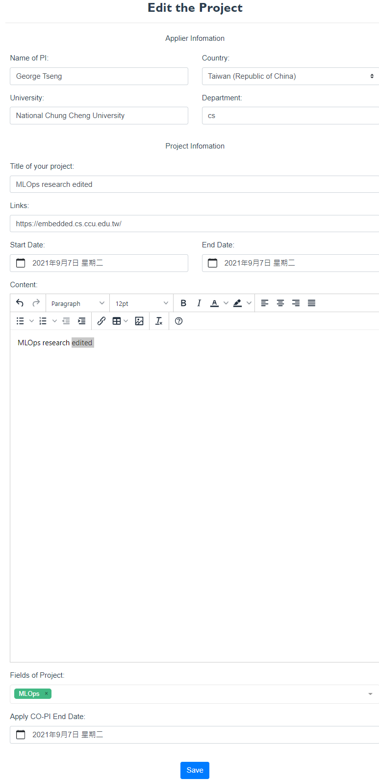
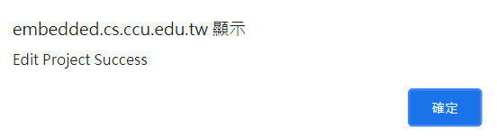

Slide 46
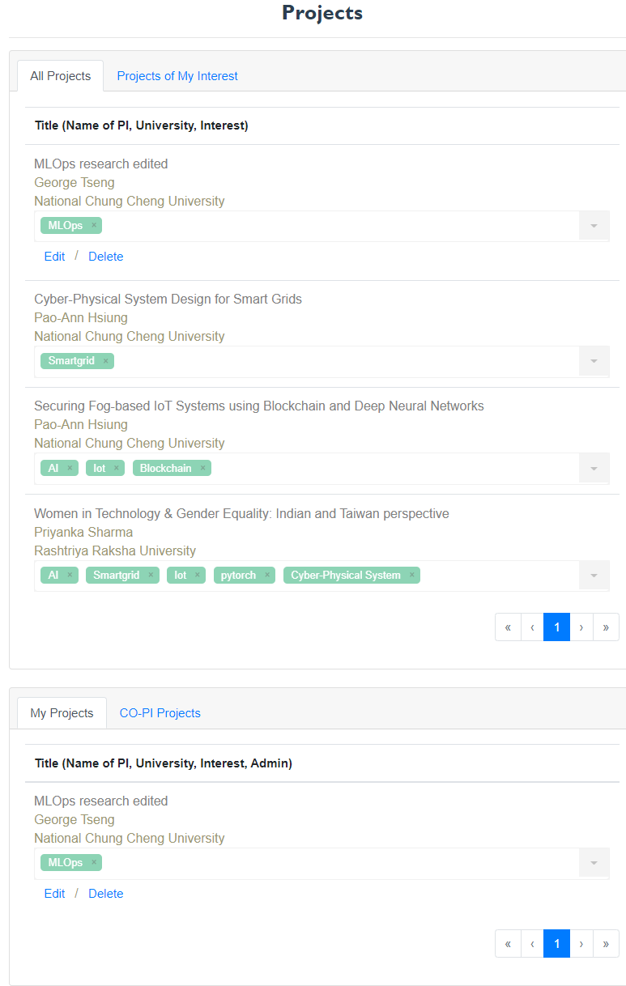
Done

