Slide 1

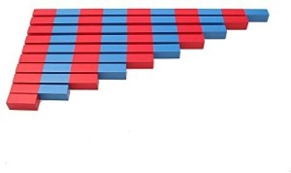
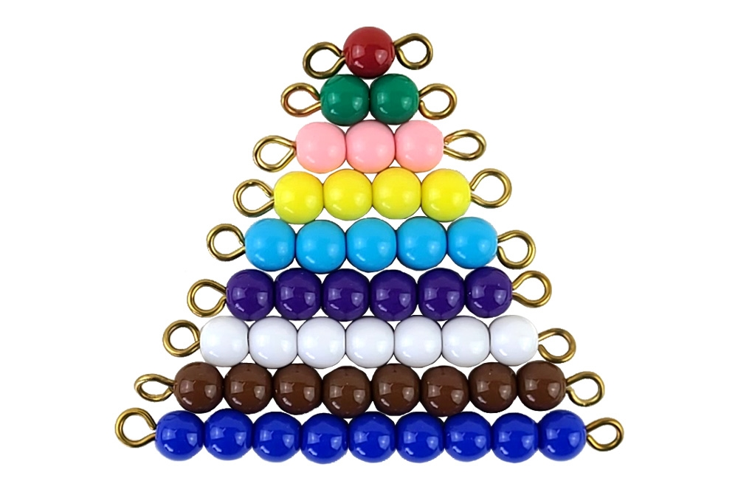
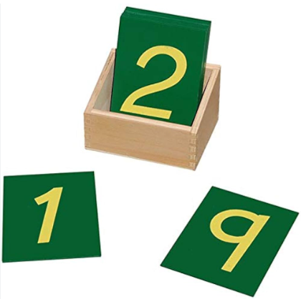
EC2 Math
Review what you know

Slide 2
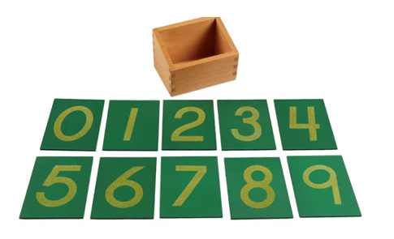
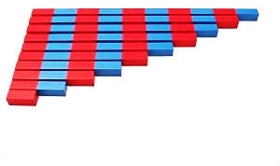
Writing Our Numbers
We'll trace sandpaper numbers to feel the shape of each number.

Slide 3
Counting with Colored Beads
These beads help us count up to 10.
Can you count the beads with me?

Slide 4
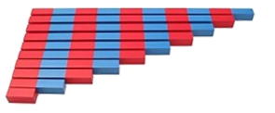
Counting with Number Rods
These rods help us count.
Let's count the sections on this rod together.

Slide 5





Adding with Colored Beads
We can add groups of beads together.
Let's add 4 beads and 3 beads!

Slide 6
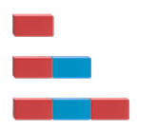

Adding with Number Rods
We can add two rods to find a total.
Let's add 3 and 2 together!

