Slide 1

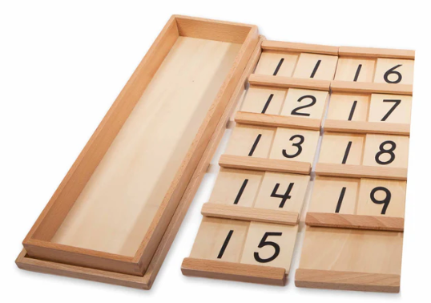
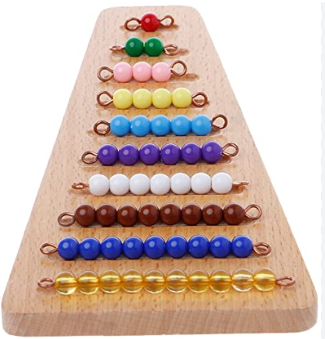
EC2 Math
Chapter 1 Lesson 1
Numbers 11,12,13,14,15

Slide 2


Welcome to Our Number Journey!
Today, we will learn about the numbers 11, 12, 13, 14, and 15.

Slide 3
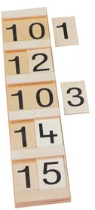
The Seguin Board
This board helps us see how numbers are built with tens and units.

Slide 4
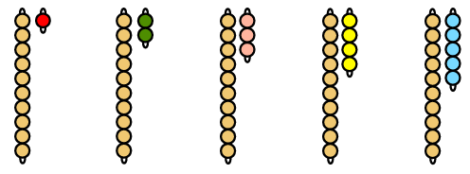
Counting with Colored Beads
Let's count the beads for each number.

Slide 5
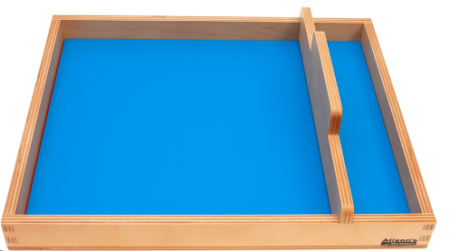
Trace the number
Let's trace each number in the sand!

Slide 6
Match the Beads to the Numbers
Can you find the right number of beads for each number?

Slide 7
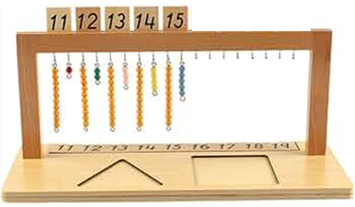
Let's Hang the Beads!
Pick a number and hang the matching beads on the correct hook.

