Slide 1

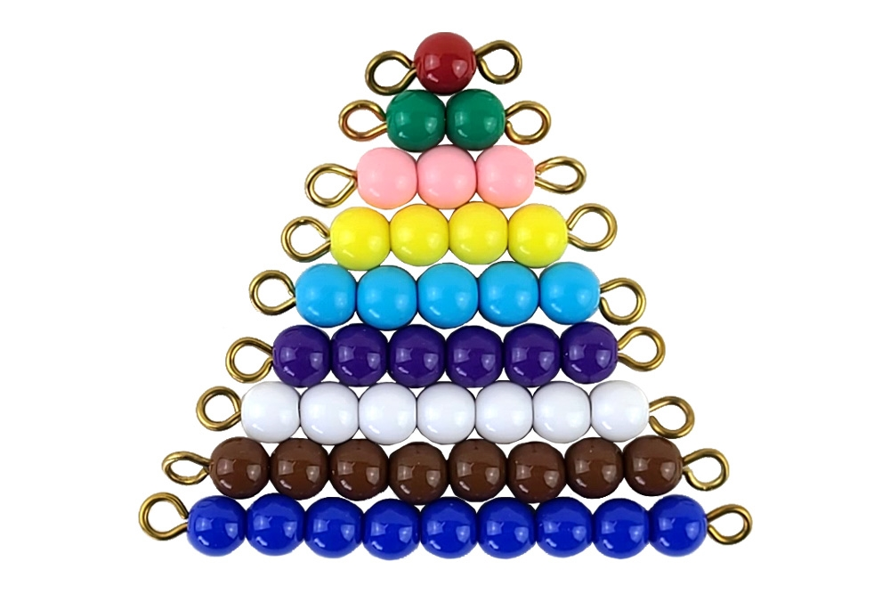
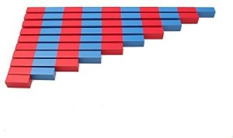
EC2 Math
Chapter 1 Lesson 3
Adding with Number Rods & Colored Beads

Slide 2
Addition with Number Rods & Colored Beads
Today, we will learn how to add numbers using Number Rods and Colored Beads.

Slide 3







Matching Number Rods to Number Cards
Let's match the correct number cards to the Number Rods then add them together.
?

Slide 4



Matching Colored Beads to Number Cards
Let's match the correct number cards to the each bead bar then add them together.
4
3
?

Slide 5

Addition with Number Rods
Find the correct number rod for each addend then add them together.
5
2
7
?

Slide 6

Addition with Colored Beads
Find the correct bead bar for each addend then add them together.
3
1
4
?

Slide 7
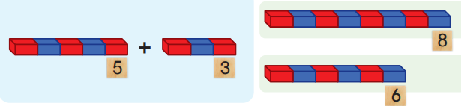
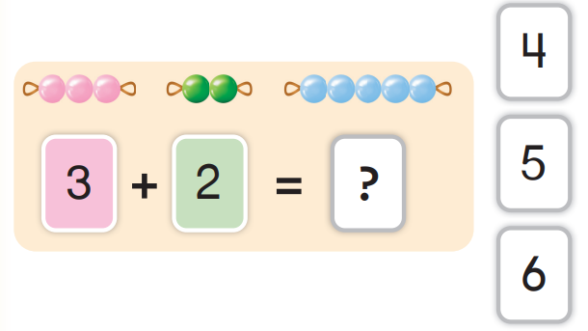
Let's Review!
Choose the correct answer.

