Slide 1

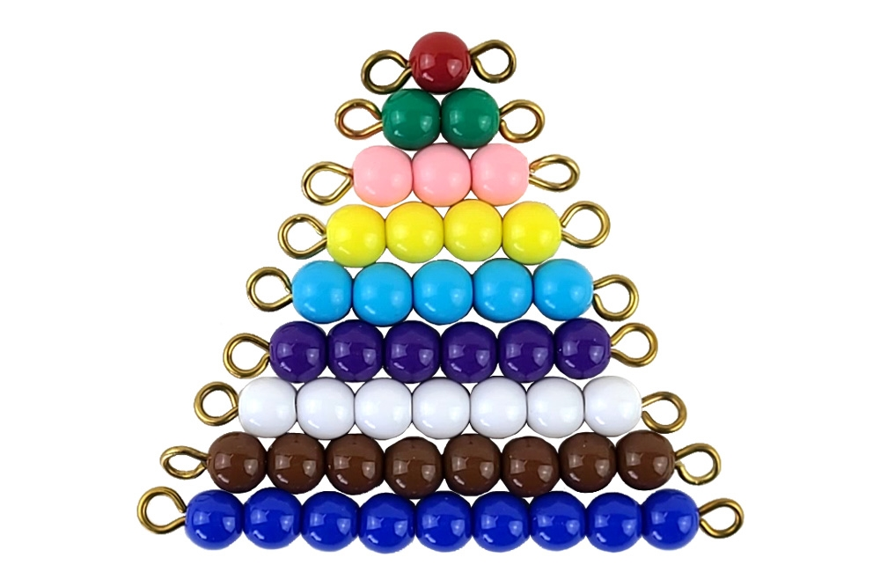
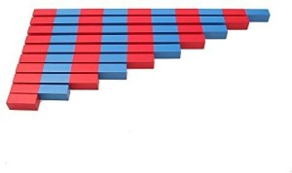
EC2 Math
Chapter 1 Lesson 4
Adding 3 Addends

Slide 2
Addition with Number Rods & Colored Beads
Today, we will learn how to add numbers using Number Rods and Colored Beads.

Slide 3









Matching Number Rods to Number Cards
Let's match the correct number cards to the Number Rods then add them together.
?

Slide 4



Matching Colored Beads to Number Cards
Let's match the correct number cards to each bead bar then add them together.
3
3
4
?

Slide 5


Addition with Number Rods
Find the correct number rod for each addend then add them together.
5
3
2
10
?

Slide 6

Addition with Colored Beads
Find the correct bead bar for each addend then add them together.
2
4
3
9
?

Slide 7
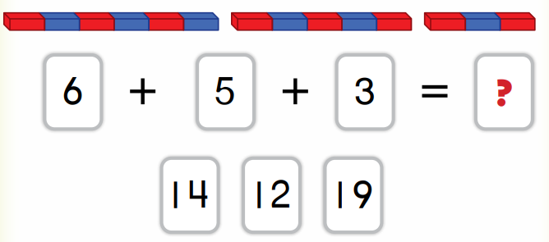
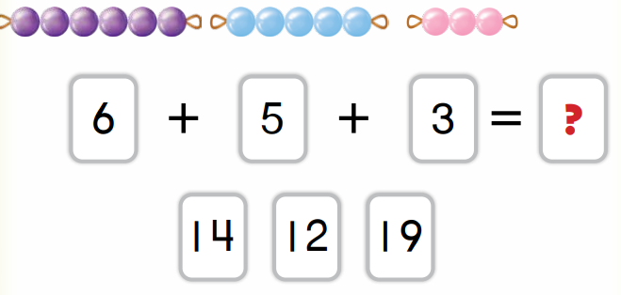
Let's Review!
Choose the correct answer.

