Slide 1

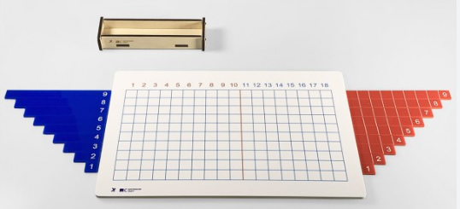
EC2 Math
Chapter 1 Lesson 5
Addition Strip Board

Slide 2
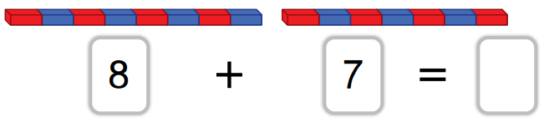
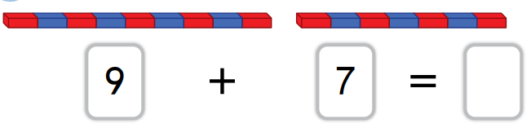
Addition with Number Rods
Find the sums of the following.
?
?

Slide 3
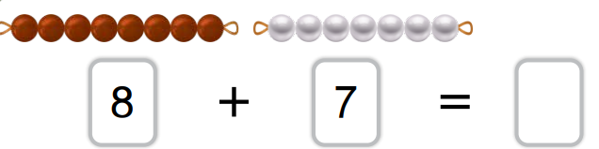
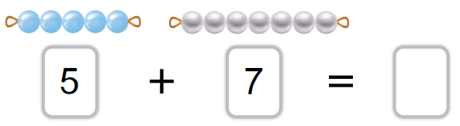
Addition with Colored Beads
Find the sums of the following.
?
?

Slide 4
"What is the Addition Strip Board?"
"The Addition Strip Board helps us add two numbers together using strips of different lengths."

Slide 5
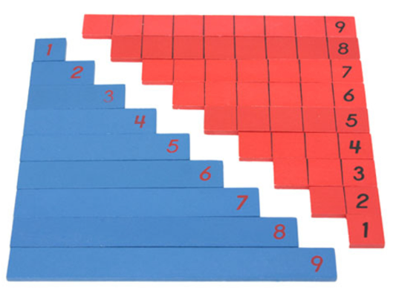
Understanding the Strips
Each strip represents a number.
The longer strip is the bigger number.

Slide 6
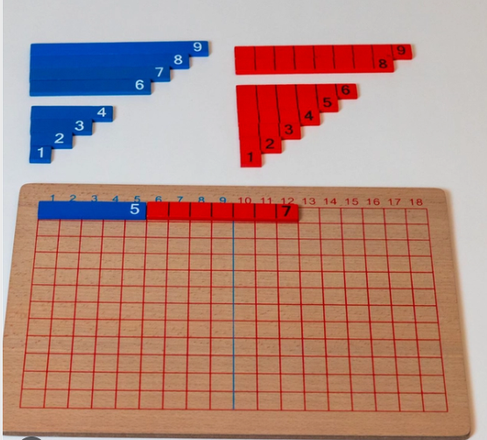
How to Use the Addition Strip Board
Pick blue strip for the first addend and the red strip for the second addend that represent the numbers you want to add.
Place the strips next to each other on the board.
The total length of the strips shows the sum.
5 + 7 = ?

Slide 7
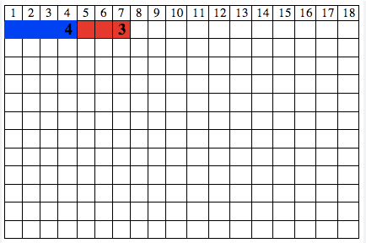
Can you find the sum of 4 + 3

