Slide 1

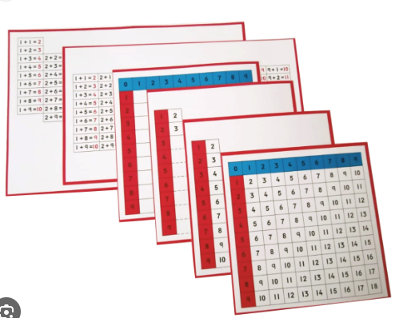
EC2 Math
Chapter 1 Lesson 6
Addition Charts

Slide 2
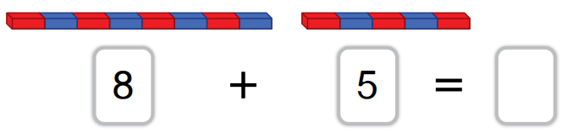
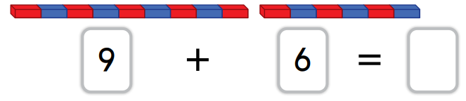
Addition with Number Rods
Find the sums of the following.
?
?

Slide 3
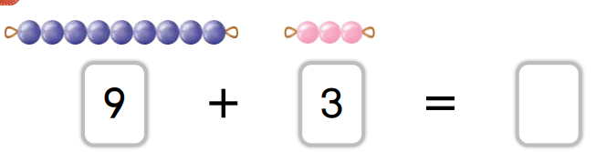
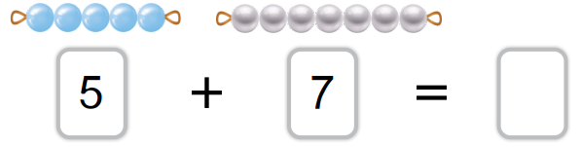
Addition with Colored Beads
Find the sums of the following.
?
?

Slide 4
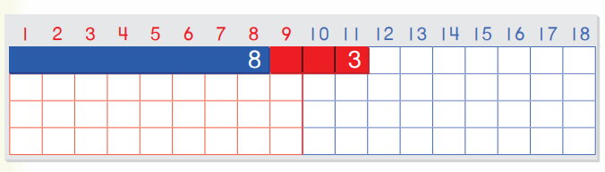
Can you find the sum of 8 + 3
8 + 3 =

Slide 5
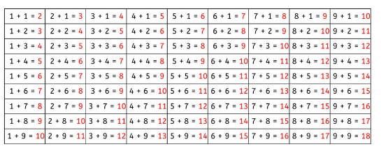
Addition Control Chart
Find the sum of 7 + 6 =

Slide 6
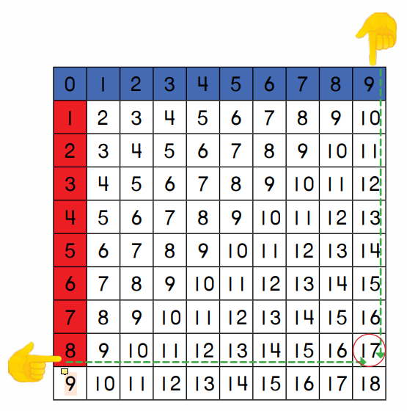
Addition Finger Chart
Find the sum of 8 + 9 =

