Slide 1

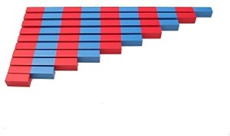
EC2 Math
Chapter 1 Lesson 7
Subtraction with Number Rods

Slide 2
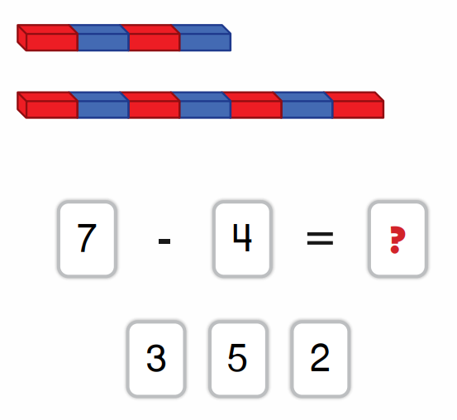
What is Subtraction?
Subtraction means taking away. We start with a bigger number and take away a smaller number to find the difference.

Slide 3


Subtraction with Number Rods
Find the difference.
-
=
?
4
1

Slide 4


Subtraction with Number Rods
Find the correct rod for each number then find the difference.
-
=
?

Slide 5


Subtraction with Colored Beads
Find the difference.
9
-
4
=
?

Slide 6


Subtraction with Colored Beads
Find the correct bead bar for each number then find the difference.
10
-
5
=
?

