Slide 1

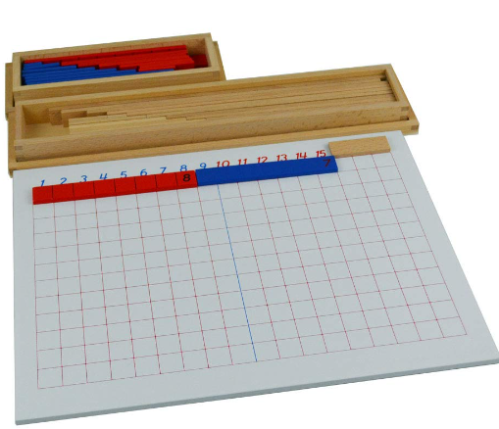
EC2 Math
Chapter 1 Lesson 8
Subtraction strip Board

Slide 2


Subtraction with Number Rods
Find the difference.
-
=
?
4
1

Slide 3


Subtraction with Colored Beads
Find the difference.
9
-
4
=
?

Slide 4
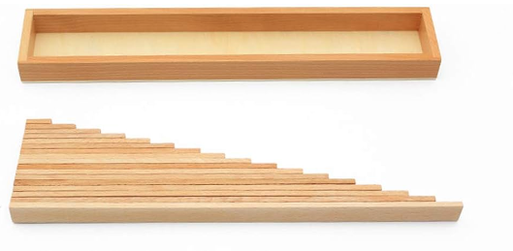
Understanding the Strips
Each strip represents a number.
The longer wooden strip is the smaller number.

Slide 5
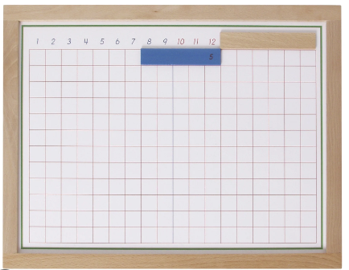
Subtraction Strip Board
Find the difference.
12
-
5
=
?

