Slide 1

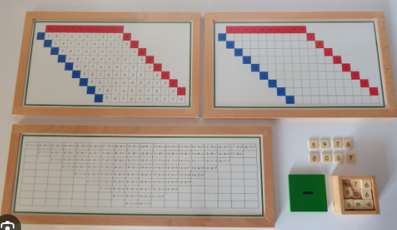
EC2 Math
Chapter 1 Lesson 9&10
Subtraction Charts

Slide 2


Subtraction with Number Rods
Find the difference.
-
=
?
4
1

Slide 3


Subtraction with Colored Beads
Find the difference.
9
-
4
=
?

Slide 4
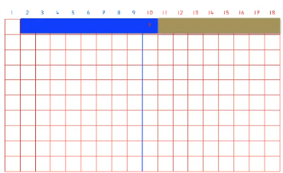
Subtraction Strip Board
Find the difference.
10
-
9
=
?

Slide 5
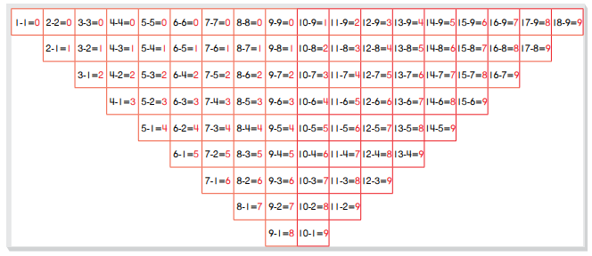
Subtraction Control Chart
Find the difference.
11 - 7 =
?

Slide 6
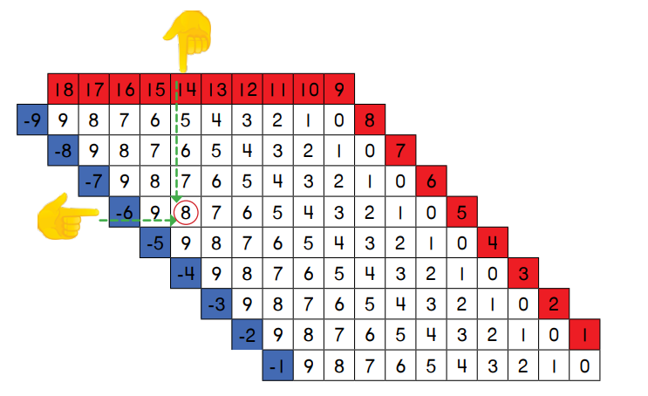
Subtraction Finger Chart
Find the difference.
?
14 - 6 =

