Slide 1
Yet another N-Body simulator...

Slide 2

codeberg.org/pyranota/Z-body

Slide 3


Cool guys do

Slide 4


Slide 5

DX Matters
just
+

Slide 6

Install (W.I.P)
$ nix profile install codeberg:pyranota/Z-body

Slide 7
Develop
# Clone repo
$ git clone https://codeberg.org/pyranota/Z-body
# cd into directory
$ z Z-body
# Enter development shell
$ nix develop
# Compile and run
$ just

Slide 8

Hosting

Slide 9

$ just gotta-go-fast
WE

Slide 10
And we go
O ( n log n)

Slide 11
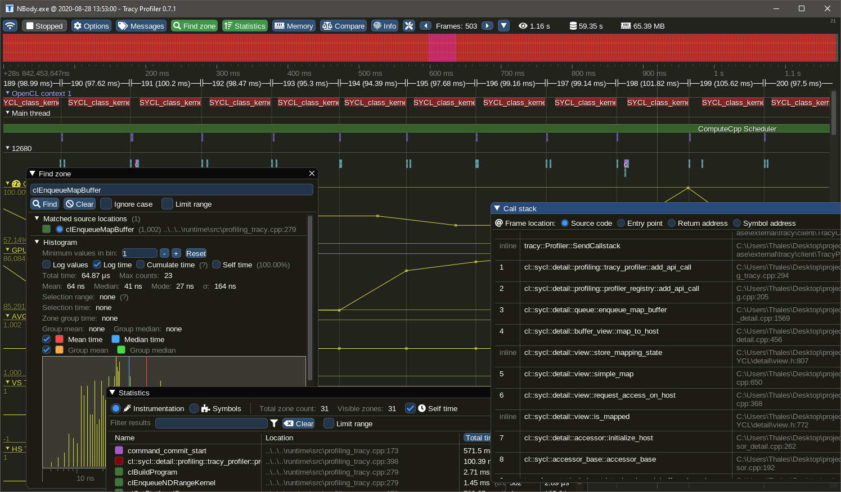
Profiling with Tracy

Slide 12
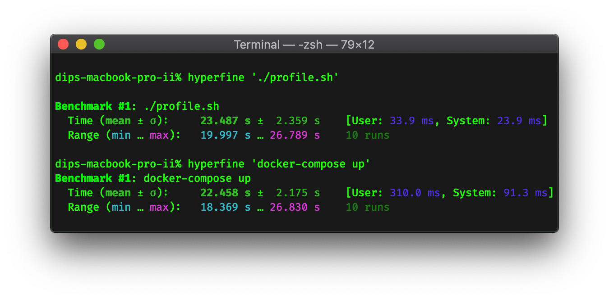
Benchmarking with Hyperfine

Slide 13
./zb-core/engine.zig
fn parallelLoop(self: *Self, thread_id: usize, num_elements: usize, num_threads: usize) !void {
const chunk_size: usize = num_elements / num_threads;
const remainder: usize = num_elements % num_threads;
// std.debug.print("Remainder: {}\n", .{remainder});
const start: usize = thread_id * chunk_size;
// std.debug.print("Start: {}\n", .{start});
const end: usize = start + chunk_size + if (num_threads - 1 == thread_id) remainder else 0;
// std.debug.print("End: {}\n", .{end});
for (self.bodies.items[start..end], start..) |*body, i| {
body.assigned_thread = thread_id;
self.tree.step(0, .{ //
.accel = &self.accels.items[i],
.bodyPos = body.position,
.bodyMass = @intFromFloat(body.mass),
});
}
}
fn stepEachTreeBody(self: *Self) !void {
const zone = ztracy.Zone(@src());
defer zone.End();
const num_threads = self.thread_amount;
// const num_threads: usize = if (self.bodies.items.len < self.thread_amount) 1 else 4; // adjust this to your liking
if (self.bodies.items.len == 0) {
return;
} else if (self.bodies.items.len <= num_threads or num_threads == 1) {
// TODO: Remove
for (self.bodies.items, 0..) |body, i|
self.tree.step(0, .{ //
.accel = &self.accels.items[i],
.bodyPos = body.position,
.bodyMass = @intFromFloat(body.mass),
});
return;
}
const num_elements = self.bodies.items.len; // adjust this to your liking
var threads: std.ArrayList(std.Thread) = std.ArrayList(std.Thread).init(ally);
defer threads.deinit();
for (0..num_threads) |i| {
try threads.append(try std.Thread.spawn(.{}, parallelLoop, .{
self,
i,
num_elements,
num_threads,
}));
}
for (threads.items) |*thread|
thread.join();
}

Slide 14

Cherry on the Cake

Slide 15
There is coming more...

