Slide 1
Yet another N-Body simulator…

Slide 2

codeberg.org/pyranota/Z-body

Slide 3


Cool guys do

Slide 4



Slide 5

DX Matters
just
+
+

Slide 6

Install (W.I.P)
$ nix profile install codeberg:pyranota/Z-body

Slide 7
Develop
# Clone repo
$ git clone https://codeberg.org/pyranota/Z-body
# cd into directory
$ z Z-body
# Enter development shell
$ nix develop
# Compile and run
$ just

Slide 8

Hosting

Slide 9

$ just gotta-go-fast
WE

Slide 10
And we go
O(n^log n)

Slide 11
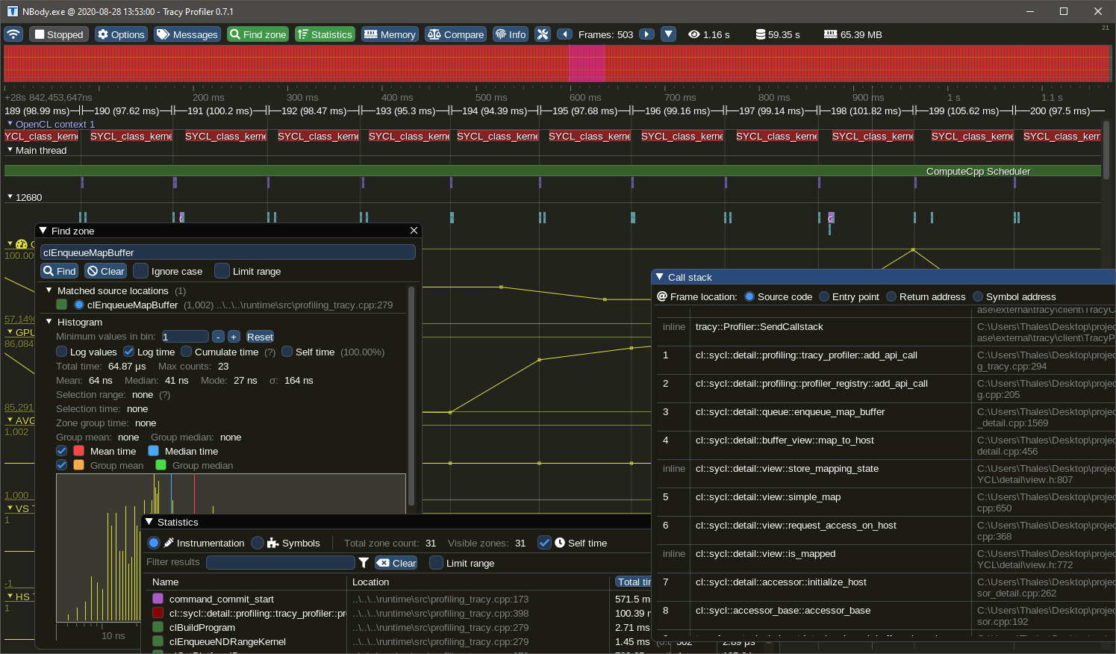
Profiling with Tracy

Slide 12
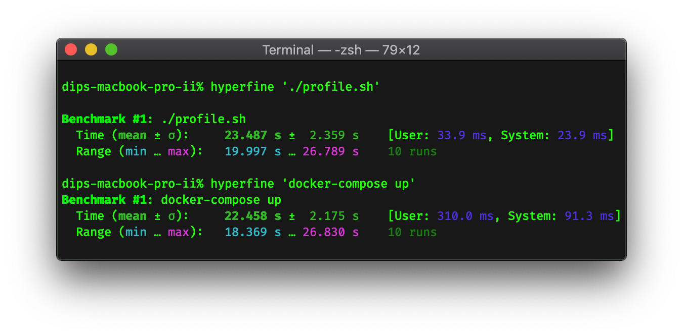
Benchmarking with Hyperfine

Slide 13
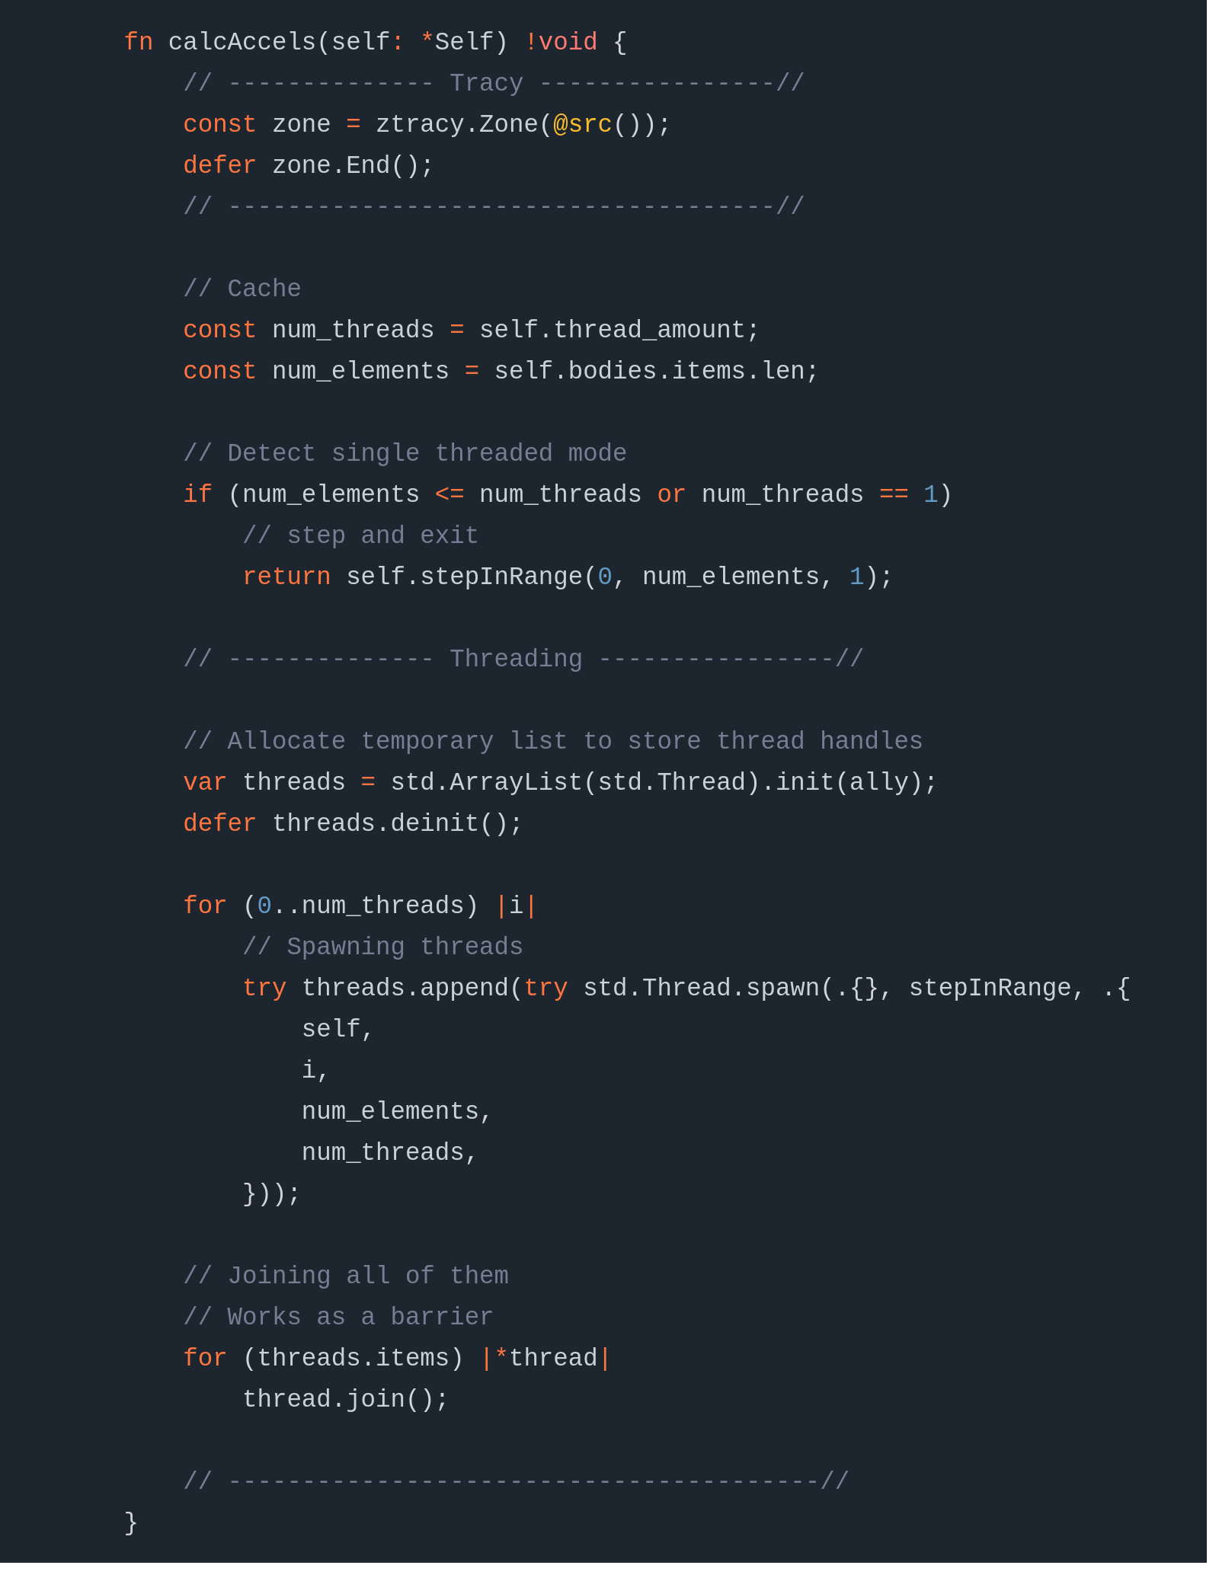
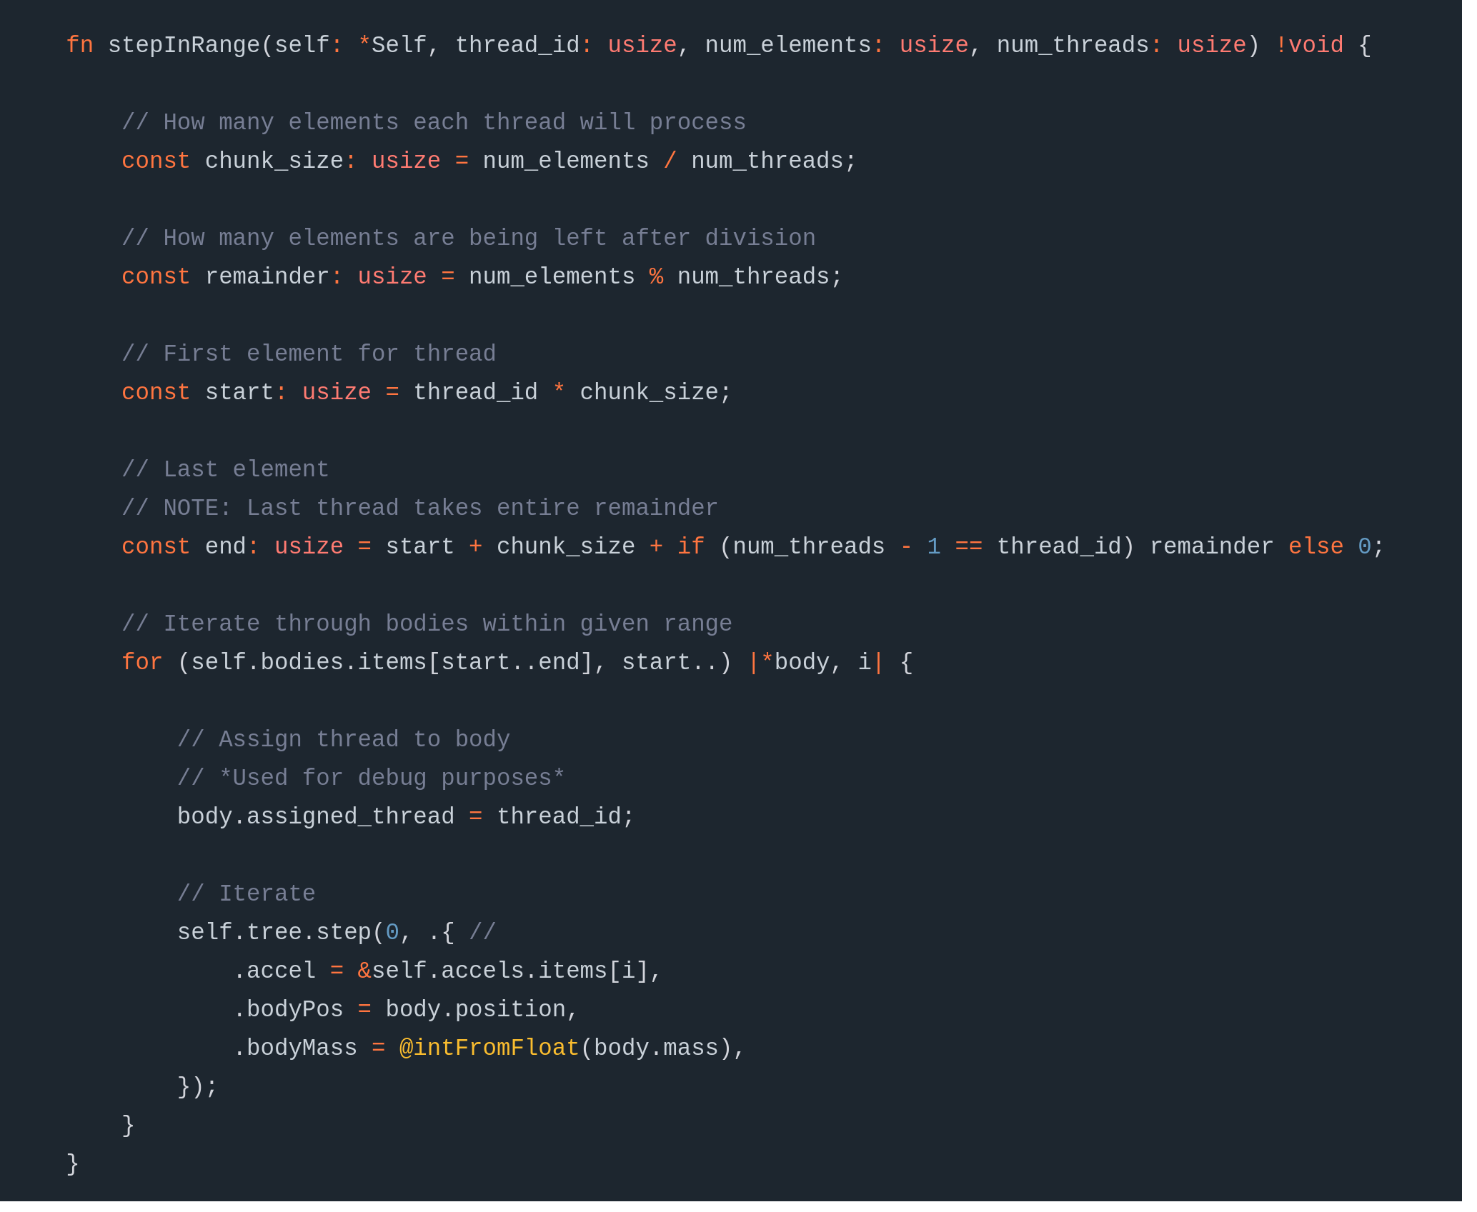
./zb-core/engine.zig

Slide 14

Cherry on the Cake

Slide 15
There is coming more...

