Slide 1
Workshop
Task Management Process
AI-powered planning and execution with SCUD
From PRD to parallel execution

Slide 2
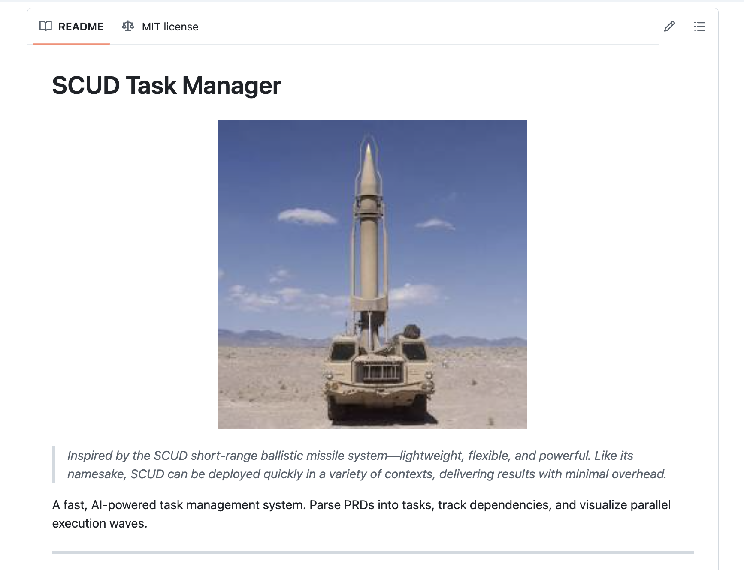

Slide 3
Installation
Prerequisites
Node.js 18+ (npm) or Rust (cargo)
AI API key (xAI, Anthropic, OpenAI)
Option 1: NPM / PNPM
pnpm add -g scud-task
What you get
# or: npm install -g scud-task
+
Fast Rust CLI binary
Option 2: Cargo
+
.scud/ directory for task storage
cargo install scud-cli
+
SCG format (compact text)
+
Claude Code slash commands
Initialize
cd your-project && scud init

Slide 4
INSPIRATION
Claude Task Master
AI-powered task management for complex development projects
github.com/eyaltoledano/claude-task-master
PRD Parsing
Multi-Model
MCP Server
Research Mode
Parse requirements docs into structured tasks with AI
Supports Claude, GPT, Gemini, xAI, OpenRouter
Integrates with Cursor, VS Code, Windsurf
Web research with project context
Task Master Workflow
1
2
3
4
5
6
Write PRD
Initialize
Generate Tasks
Ask "Next?"
Implement
Update Status

Slide 5
SCUD: What's Different?
Task Master
SCUD
JavaScript
Rust
Storage Format
Storage Format
JSON files
SCG (compact text)
Dependency Model
Dependency Model
Simple blockers
Full DAG with edges
Parallel Planning
Parallel Planning
Manual
Automatic waves
Runtime
Runtime
Node.js
Native binary
SCUD Advantages
Fast native CLI
Explicit dependency graph
Wave-based parallelism
Agent orchestration

Slide 6
SCG: SCUD Graph Format
INSPIRED BY JAMS
Token-efficient, human-readable task storage
nikolai.fyi/jams — Nikolai Mushegian (DeFi pioneer)
# SCUD Graph v1
JAMS Philosophy
# Phase: auth
"Actually Minimalist JSON Alternative" — Most alternatives have longer specs than JSON itself. JAMS builds on JSON's foundation, reducing quote noise while keeping parsing simple.
@nodes
auth:1 | Design auth | D | 5 | H
auth:2 | JWT tokens | P | 3 | M
auth:3 | Rate limits | P | 3 | L
@edges
auth:2 -> auth:1
auth:3 -> auth:2
@details
SCG Design Goals
auth:1 | description |
Graph-native structure with explicit @nodes and @edges. Single-char status codes (P/I/D/B). Pipe-delimited rows. Git-friendly diffs.
Design REST endpoints...
Benefits
Compact text format. Human-editable. Git-friendly diffs. Reduced context for LLMs.

Slide 7
Agent Skills & Commands
Teaching AI agents how to use the SCUD CLI effectively
SKILL FILES
SLASH COMMANDS
SKILL.md
/scud:list
/scud:show
/scud:status
Entry point - when to use SCUD, essential commands, workflow overview
/scud:next
/scud:waves
/scud:stats
task-commands.md
Why Skills Matter
+
Agents understand task structure without prompting
Full CLI reference - tags, viewing, status updates, AI commands
+
Consistent command usage across sessions
+
Proper status updates after completing work
+
Awareness of dependencies and waves
graph-concepts.md
DAG structure, SCG format, waves algorithm, complexity scoring
Location:.claude/commands/scud/
Location:.claude/skills/scud-tasks/

Slide 8
STEP 1
scud init
Initialize SCUD in your project directory
$ scud init
Created .scud/
Created .scud/tasks/tasks.scg
Created .scud/config.toml
SCUD initialized successfully!
Creates .scud/ directory for task storage
Configures AI provider (xAI, Anthropic, OpenAI)
Ready to parse your first PRD

Slide 9
STEP 2
OUTPUT: .scud/tasks/tasks.scg
scud parse
@nodes
auth:1 | Design auth | P | 5 | H
auth:2 | JWT tokens | P | 3 | H
Convert PRD to structured tasks
auth:3 | OAuth flow | P | 5 | M
auth:4 | Rate limit | P | 3 | M
@edges
$ scud parse feature.md --tag auth
auth:2 -> auth:1
auth:3 -> auth:1
auth:4 -> auth:2
AI-Powered - Extracts tasks from natural language
Dependencies - Auto-detects task relationships
Complexity - Fibonacci estimates (1,2,3,5,8...)

Slide 10
STEP 3
scud expand
Break complex tasks into actionable subtasks
$ scud expand
PROCESSES IN PARALLEL
Result
->
12 new subtasks
auth:1
All complex tasks broken down
Design auth (13pts) -> 3 subtasks
auth:4
OAuth flow (13pts) -> 4 subtasks
api:2
API routes (21pts) -> 5 subtasks

Slide 11
STEP 4
scud waves
Plan parallel execution based on dependencies
$ scud waves --tag auth
WAVE 1
WAVE 2
WAVE 3
auth:1.1 Define schema
auth:1.3 API design
auth:3 OAuth flow
auth:1.2 Plan tokens
auth:2 JWT tokens
auth:4 Rate limit
RUN IN PARALLEL
RUN IN PARALLEL
RUN IN PARALLEL
6
3
2x
Total Tasks
Waves
Speedup

Slide 12
STEP 4: VALIDATE
Smart Review with Opus
Use a stronger model to validate expanded tasks against the PRD
Why Review with a Smarter Model?
SCUD uses fast models for parsing. A stronger model (Opus/GPT-5) catches gaps, validates dependencies, and refines the plan before execution.
OPUS 4.5
> /cl:create_plan_nt
@.scud/tasks/tasks.scg
@.scud/docs/prd/h-init.md
# Prompt:
Create an implementation plan based
Review Checklist
on the tasks in PRD. Make sure tasks
and dependencies make sense. We want
+
All PRD requirements have tasks
to run in parallel as much as we can.
Usescud waves to see the plan.
+
Dependencies are correctly ordered
+
Parallel waves are well-structured
SCG
PRD
WAV
+
No missing edge cases or tests
Task Graph
Requirements
Parallel Plan
+
Complexity estimates are realistic

Slide 13
Complete Workflow
->
->
->
->
1
2
3
4
5
Init
Parse
Expand
Waves
Execute
scud init
scud parse
scud expand
scud waves
scud next
Task Execution
Visibility
scud next
scud list
Find next ready task
List all tasks
scud set-status <id> in-progress
scud stats
Mark task as started
Show progress stats
scud set-status <id> done
scud view
Complete the task
Open web dashboard

Slide 14
OPEN QUESTION
Is any of this even necessary?
As models improve, hyper-granular task breakdown may add more rigidity than value. Finding the sweet spot between thorough planning and over-constraining remains an open challenge.
Thorough Planning
Over-Constrained
?
sweet spot shifts as models evolve

