Slide 1
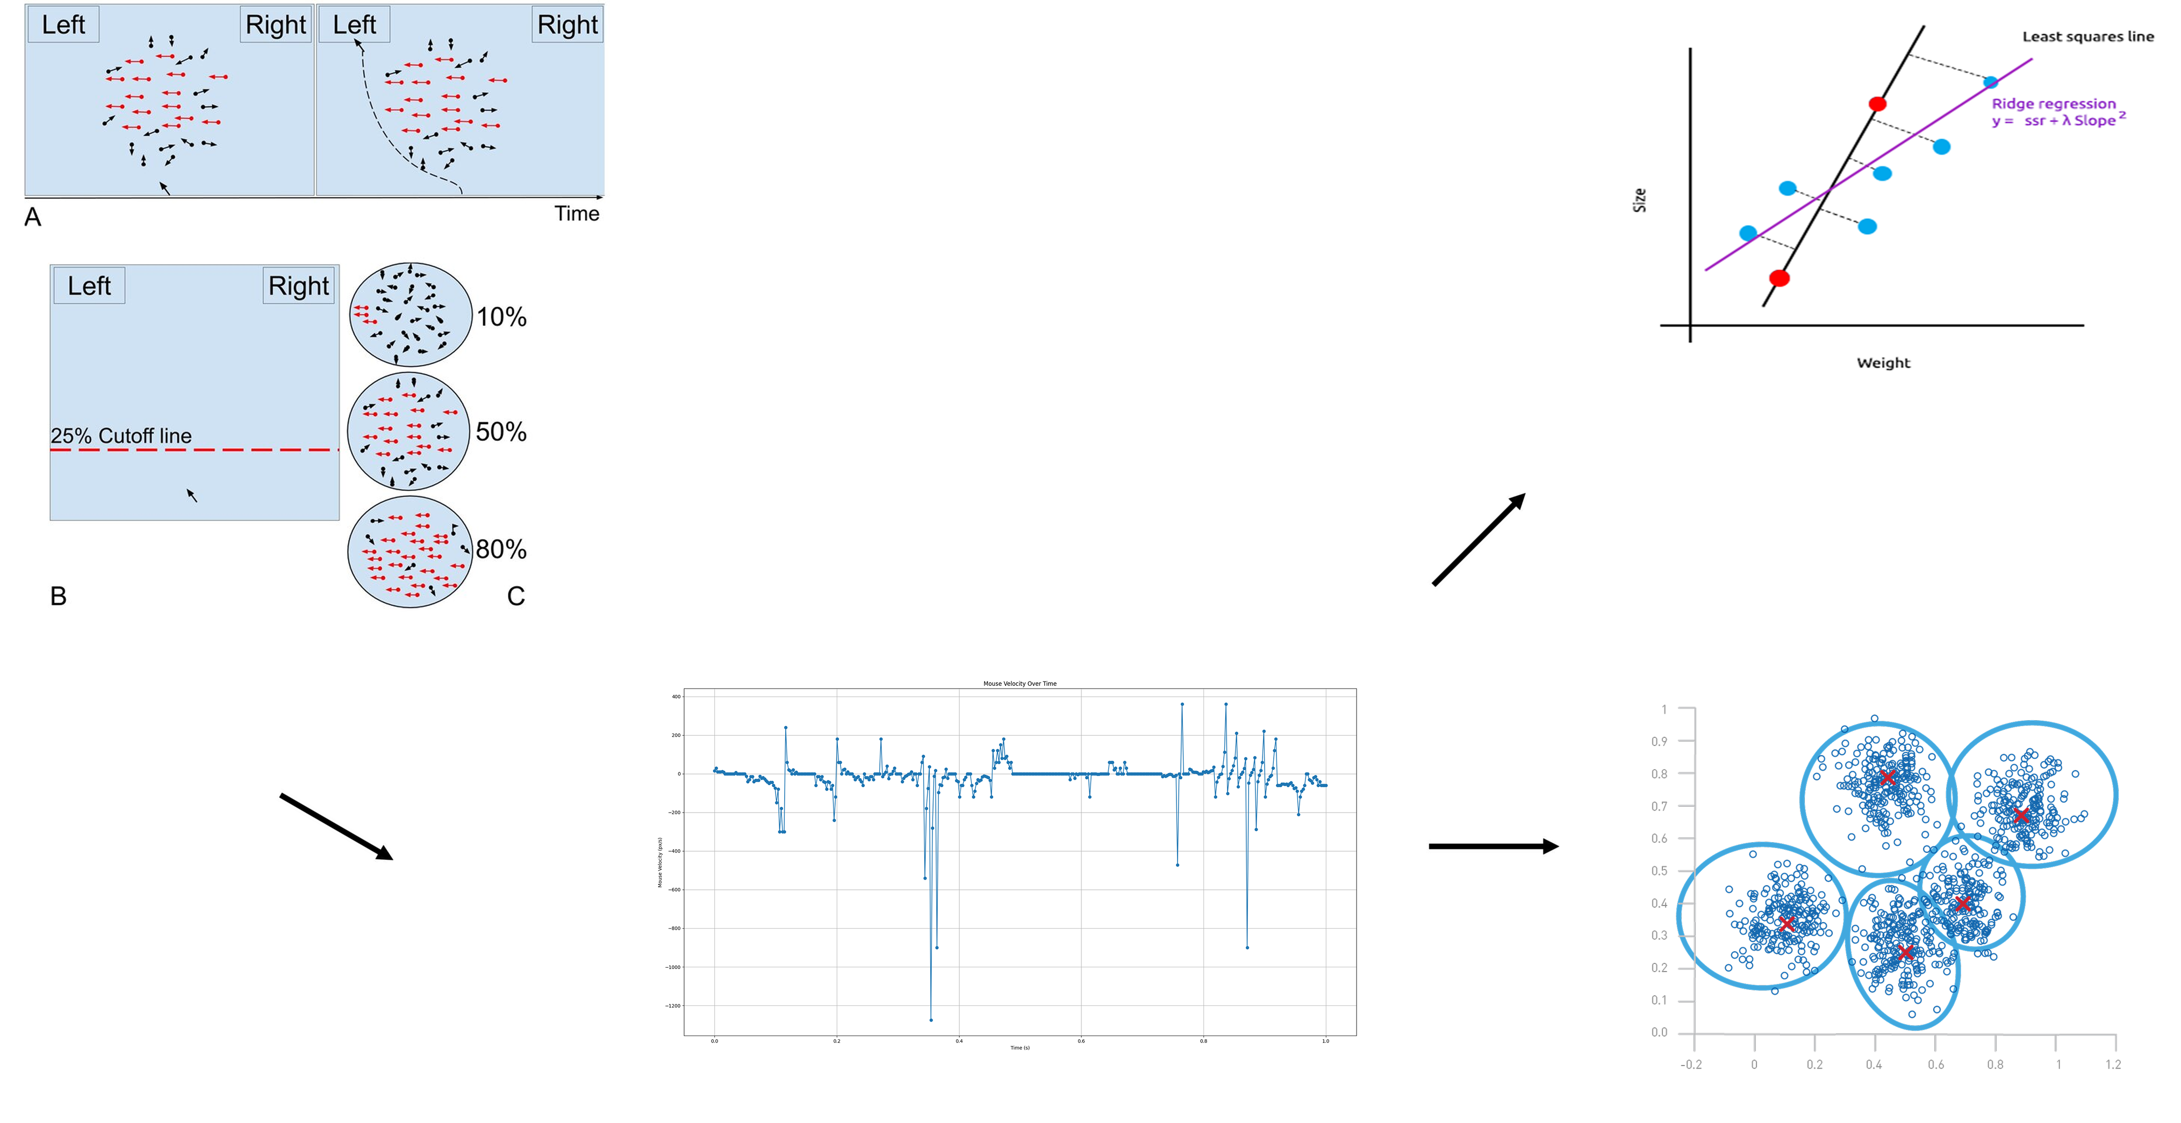
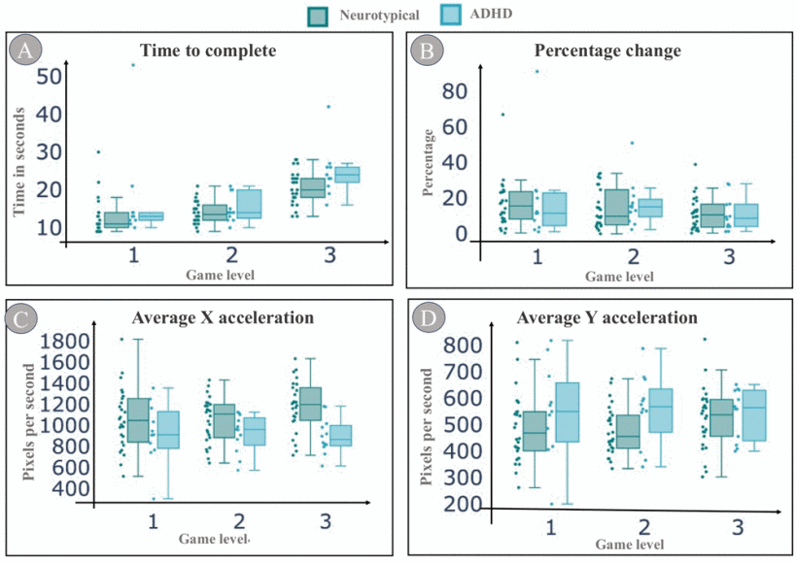
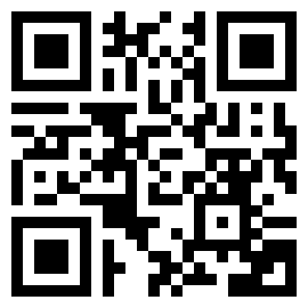


Machine Learning Analysis of Mouse Movements for Detecting ADHD
By: Joshua Marthand
Abstract:
Accurately detecting late-onset or mild Attention-Deficit/Hyperactivity Disorder (ADHD) is a major challenge in behavioral health. Research shows that machine learning (ML) can enhance digital ADHD testing by analyzing mouse tracking data to identify behaviors consistent with ADHD.
SST
Ridge Regression
Impact:
Overall, advances in machine learning augmented ADHD testing pave the way for an efficient software application that can be used on a laptop to aid detection of more elusive forms of ADHD.
Mouse Tracking Data
K-Means Clustering
References:
Leontyev, A., & Yamauchi, T. (2019). Mouse movement measures enhance the stop-signal task in adult ADHD assessment. PloS one, 14(11), e0225437. https://doi.org/10.1371/journal.pone.0225437
S. Sadhu, E. Castillo, L. Weyandt, D. Solanki and K. Mankodiya, "Feasibility of a Digital Health Puzzle Game for Detecting Computer Mouse Behavioral Patterns in ADHD,"2024 IEEE 20th International Conference on Body Sensor Networks (BSN), Chicago, IL, USA, 2024, pp. 1-4, doi: 10.1109/BSN63547.2024.10780663
Approach:
The Leontyev study demonstrates that ridge regression ML models applied to the SST have similar findings to ADHD questionnaires on a small sample size. These findings indicate the potential for ML models to detect ADHD. Building on this research by implementing similar experiments with a larger sample size and the ADHD diagnosis of each participant can confirm the viability of this tool for catching ADHD while also helping tune model parameters.
Furthermore, studies link certain mouse tracking features with subtypes of ADHD indicating that ML models may be able to identify subtypes and possibly other statistical trends. Applying unsupervised ML models such as K-Means Clustering to the SST is a novel approach to classifying subcategories of the ADHD population that requires deeper research.
This research lays the groundwork for a lightweight, accessible application that can aid ADHD detection in concert with questionnaires. The point is not to replace doctors, but to shift the burden of noticing ADHD away from overextended teachers and parents while also being accessible in underprivileged settings.
Background:
Studies demonstrate that behavioral data collected in digitized ADHD testing shows distinct patterns in patients with ADHD
The Stop Signal Task (SST) is a behavioral test that measures a patient’s inhibitory control by challenging them to withhold a reaction to stimuli.
Machine learning analysis applied to digital test data has been show to predict ADHD questionnaire scores
Demo:

