Slide 1
The Art of Free Throws:
A Data-Driven Perspective
Presented by: Tayo Castro, Harsh Vibhuti & Annie Dale
Notes:
Things to touch on
What our data looked like (ie, was it all complete? Anything weird? etc)
Background in basketball (ie, what is a freethrow? teams/conferences? Players? etc)
Make sure anything we include actually adds to understanding, but don’t distract from figures/showing our story
Also don’t be too wordy
Need to have a clear take-away/what did the audience learn (focus our presentation)

Slide 2
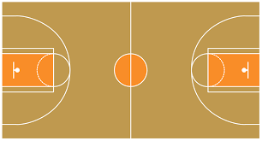
A Bit of Background
NBA
Usually 48 Minutes in 4 Periods
Max. 8 Periods
Free Throws Awarded
Max. 3 Free Throw Attempts
Notes:
https://www.masterclass.com/articles/free-throw-basketball-shots-explained
Free throw is awarded when opposing team fouls
Free throw is outside of shot clock time (clock no longer running)
Depending on nature of the foul, player can get up to three foul shot attempts
Four players from each team lined up on each side alternating
Taken at the free throw line

Slide 3

Our Data
Free throws attempted: ~620k
Free throws made: ~470k
Players: 1,098
Teams: 34 (2 disbanded, 2 conferences)
Seasons: 2006 to 2015

Slide 4
Some insights:
~470k (76%) Shots were made in total
~42k playoff shots in total
~32k (7%) shots were made during playoffs
~76% of shots during playoffs were successful
Home team won ~370k times

Slide 5
Looking Into:
What is the impact of home vs away on free throws?
What is the impact of playoffs on free throws?
What is the impact of how far into the game we are (in minutes) on free throws?
Which players seem to be especially consistent in all situations? Meaning they always make/miss at about the same rate, regardless of any factors.
How important are free throws in terms of winning/losing the game?

Slide 6
Q: How do home vs. away games affect free throws?

Slide 7
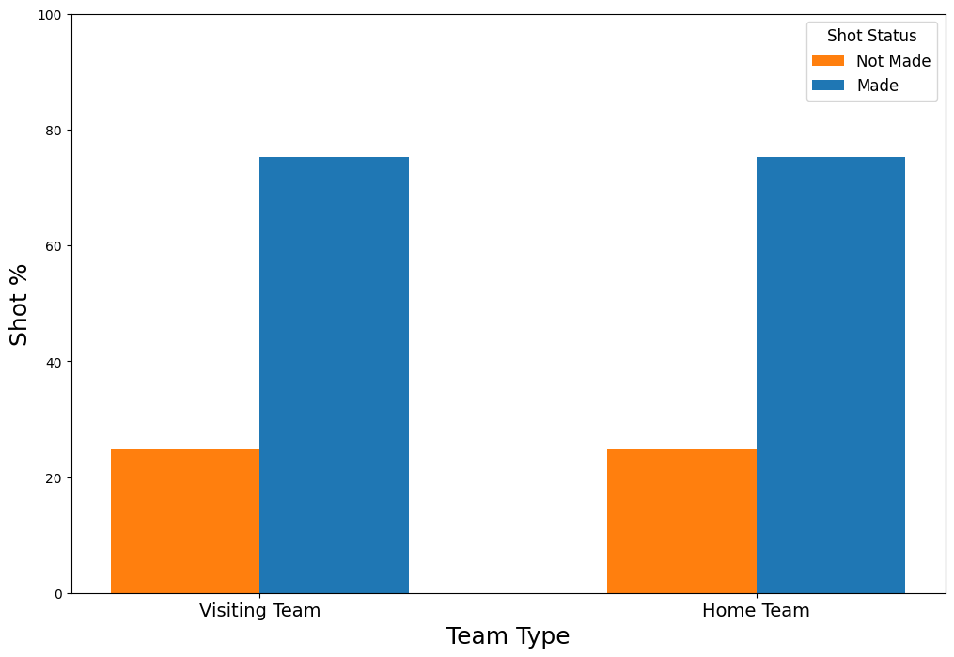
Home vs. Away
Notes:
Visit: 75.2 v. 24.8
Home: 75.25 v. 25.75

Slide 8
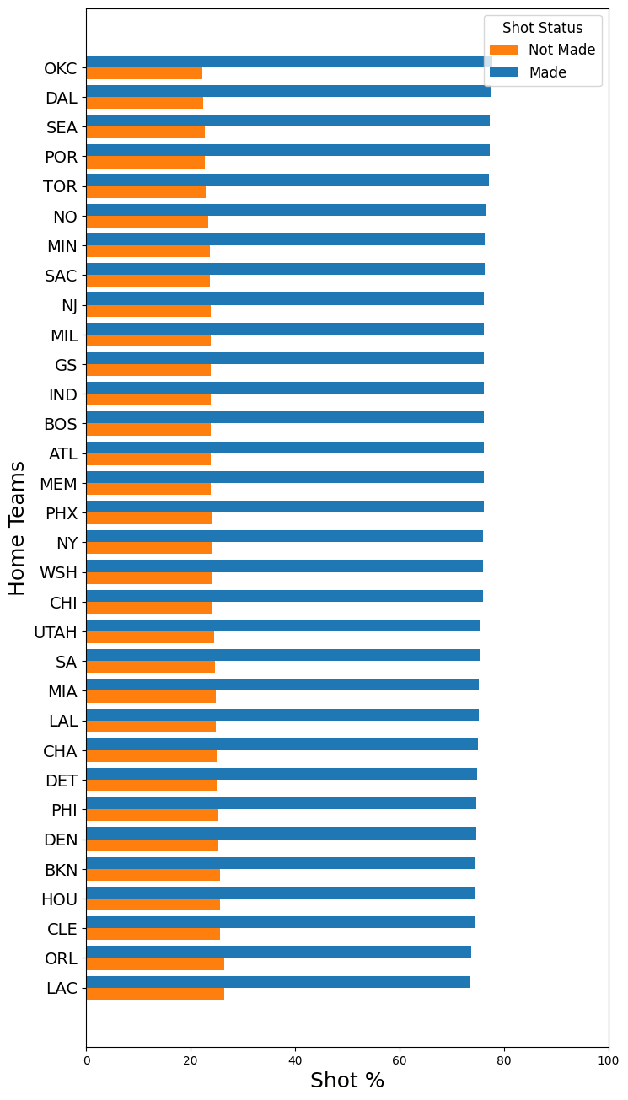

Home vs. Away
Notes:
Could look at eastern v. western conferences
Find teams that make more when they’re home v. away or just overall
Code wise: maybe drop the eastern v. western conferences categories so we only look at the teams

Slide 9
Q. How important are free throws in terms of winning/losing the game?

Slide 10
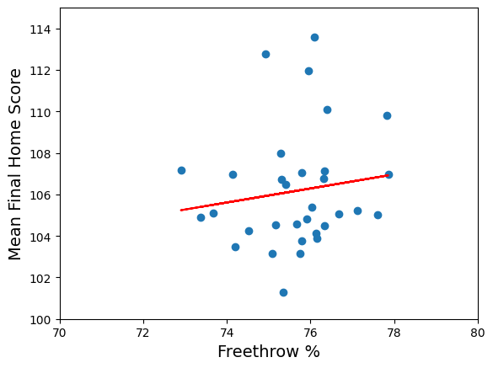
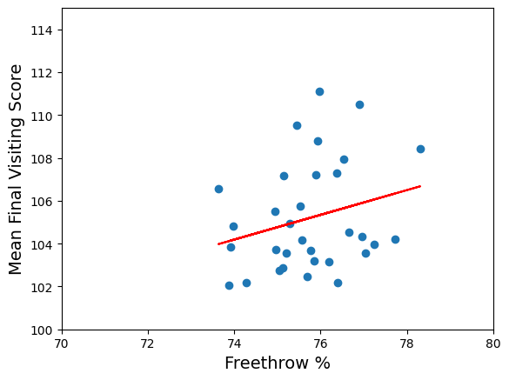
Free Throws Impact on Win Status
Notes:
R^2 ~ 0.02
R^2 ~ 0.07

Slide 11
Q. What is the impact of playoffs on free throws?

Slide 12

Game Status on Free Throws
Notes:
Not Playoffs: 75.7 v. 24.3
Playoffs: 75.26 v. 24.24
Could look at playoffs by team, or see which teams make the most playoffs
Boxplot?

Slide 13
Q. What is the impact of how far into the game we are (in minutes) on free throws?

Slide 14
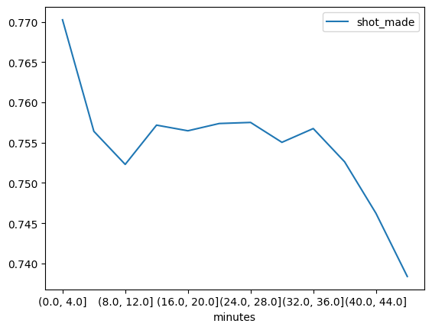
Percentage of Shots Made vs. Time Left in Game
Notes:
Not Playoffs: 75.7 v. 24.3
Playoffs: 75.26 v. 24.24
Could look at playoffs by team, or see which teams make the most playoffs

Slide 15
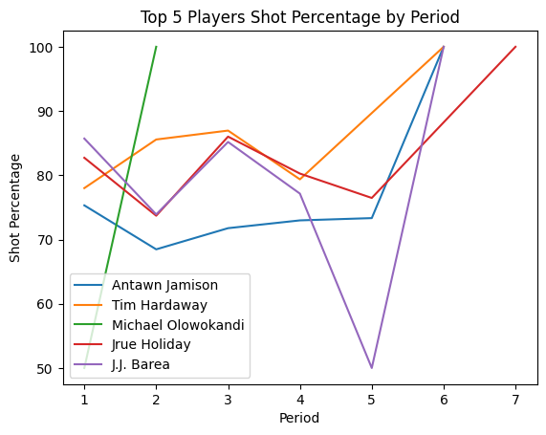
Notes:
Not Playoffs: 75.7 v. 24.3
Playoffs: 75.26 v. 24.24
Could look at playoffs by team, or see which teams make the most playoffs

Slide 16
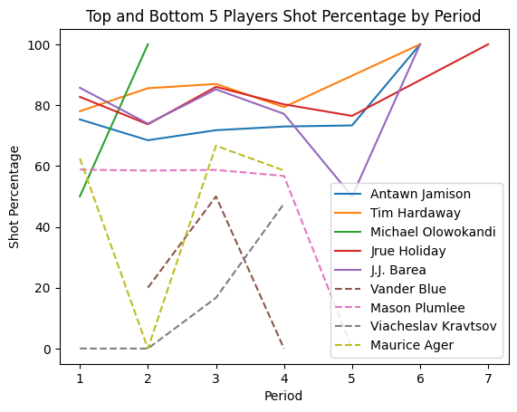
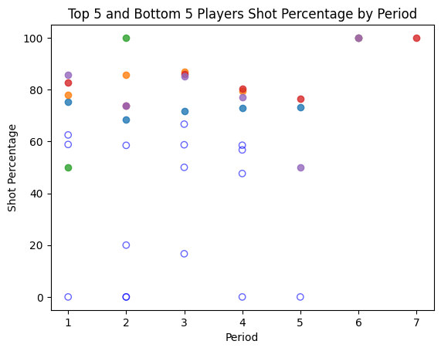
Top 5 and bottom 5 Players Success rates
Notes:
Not Playoffs: 75.7 v. 24.3
Playoffs: 75.26 v. 24.24
Could look at playoffs by team, or see which teams make the most playoffs

Slide 17
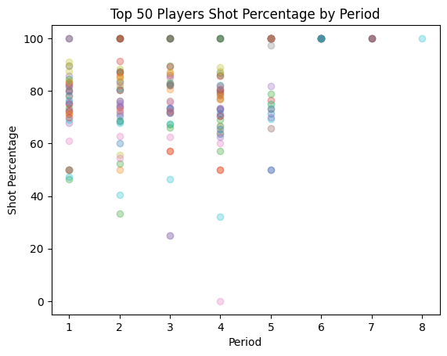
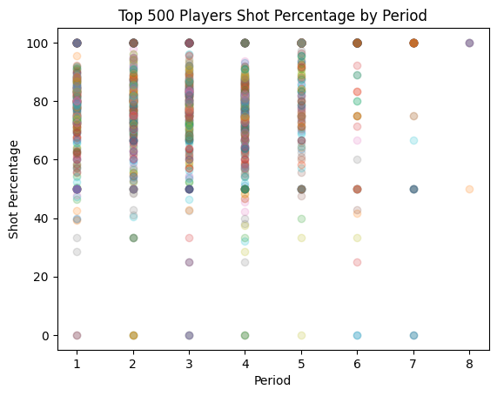
Top Player Shot Percentages in Different Periods
Notes:
Not Playoffs: 75.7 v. 24.3
Playoffs: 75.26 v. 24.24
Could look at playoffs by team, or see which teams make the most playoffs

Slide 18
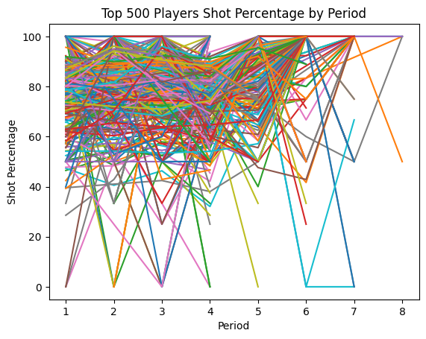
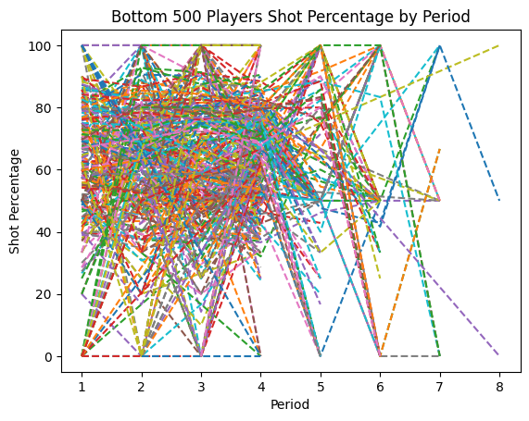
Player Shot Percentage in Different Periods
(Line graphs)
Notes:
Not Playoffs: 75.7 v. 24.3
Playoffs: 75.26 v. 24.24
Could look at playoffs by team, or see which teams make the most playoffs

Slide 19
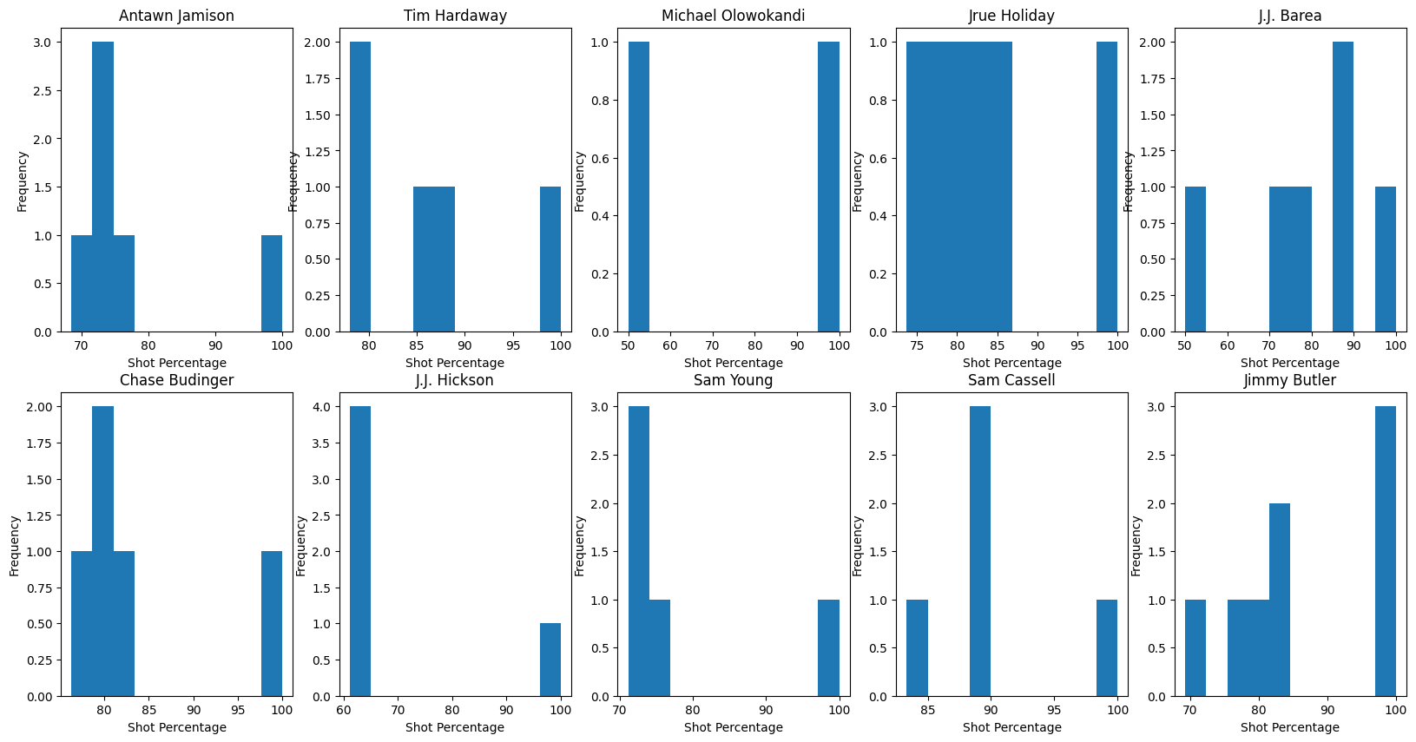
Top 10
Notes:
Not Playoffs: 75.7 v. 24.3
Playoffs: 75.26 v. 24.24
Could look at playoffs by team, or see which teams make the most playoffs

Slide 20
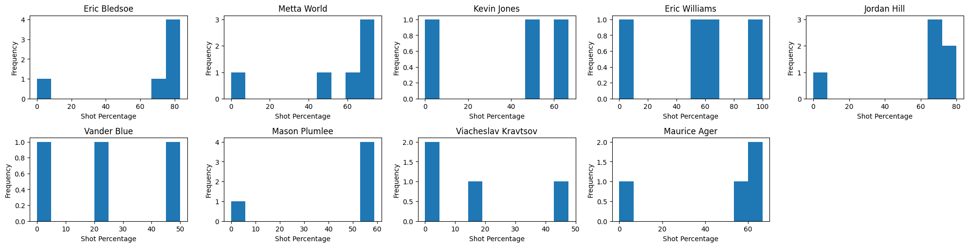
Bottom 10
Notes:
Not Playoffs: 75.7 v. 24.3
Playoffs: 75.26 v. 24.24
Could look at playoffs by team, or see which teams make the most playoffs

Slide 21
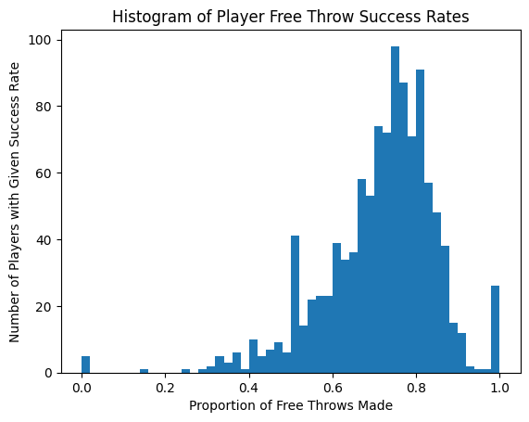
Percentage of shots Made vs. Number of Players
Notes:
Not Playoffs: 75.7 v. 24.3
Playoffs: 75.26 v. 24.24
Could look at playoffs by team, or see which teams make the most playoffs

Slide 22
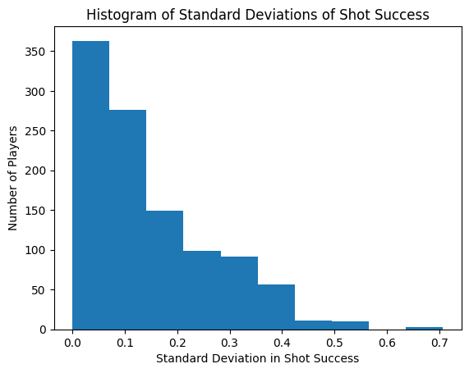
Standard Deviations of Player Success Rates

Slide 23
Key Takeaways
Home v. Away does not impact free throw success rates
Free throw success rates do not seem to decide the game
Game status does not impact free throw success rates
Player shot success clusters around 75-80% with a slight left-hand skew

Slide 24
Thank You

