Slide 1
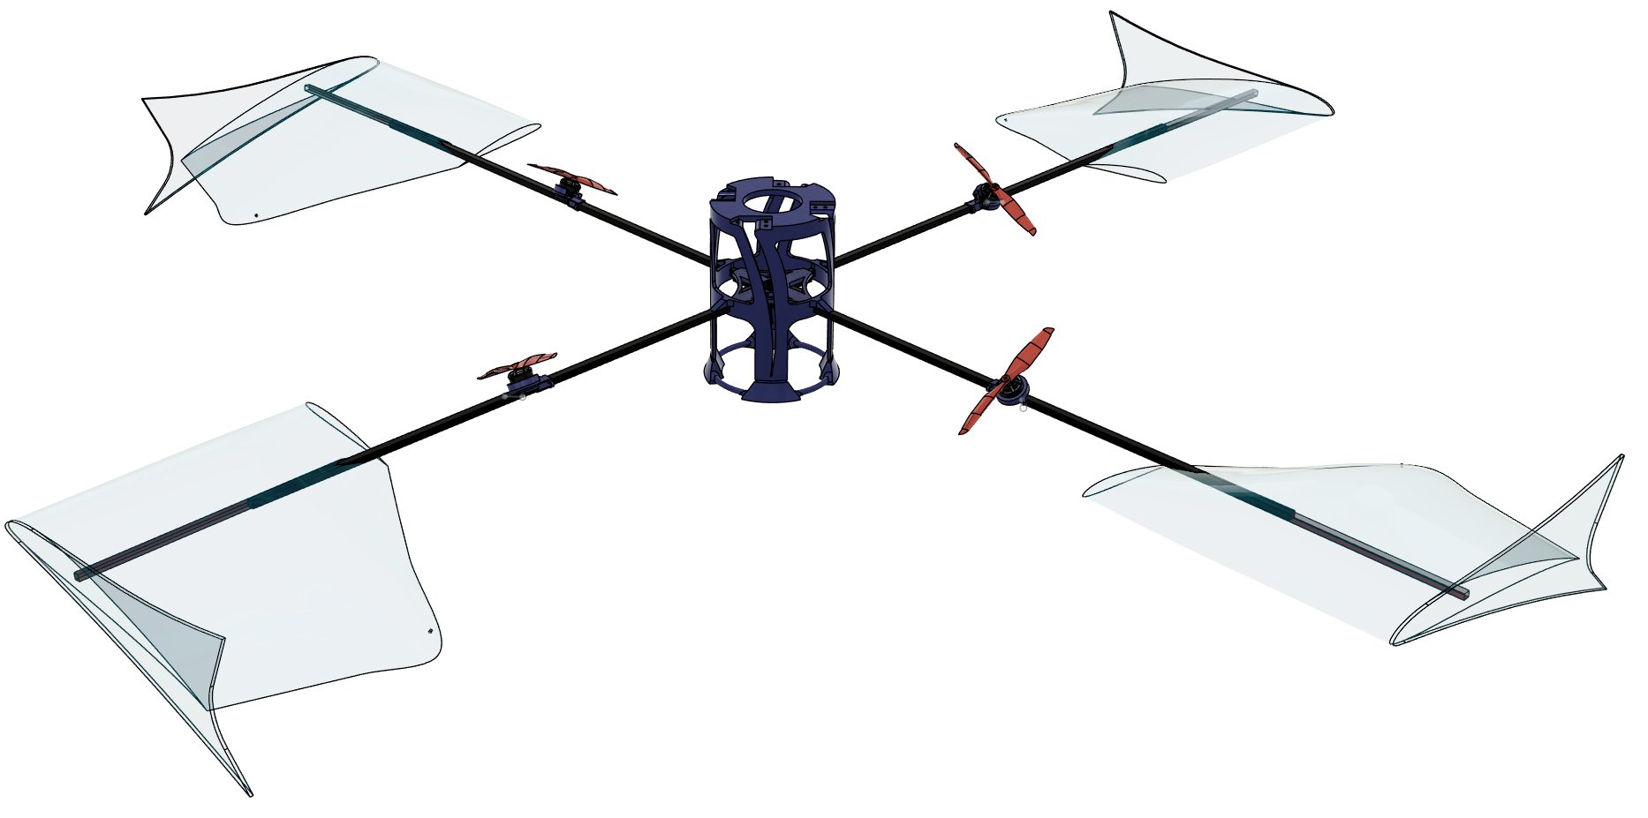
ICUAS 2026 — INTERNATIONAL CONFERENCE ON UNMANNED AIRCRAFT SYSTEMS
Spinning Quadrotor
Hover Thrust Augmentation
with Passive Lifting Surfaces
Aniketh Parkala ● Harikumar Kandath
Robotics Research Center, IIIT Hyderabad, India
Supported by MeitY, Govt. of India — HRD in Unmanned Aircraft Systems
Notes:
[~20s] OPENING
"Hi — I'm Aniketh Parkala from the Robotics Research Center at IIIT Hyderabad. In the next five minutes I'll show you how we took the rotation a quadrotor normally fights to suppress, and harvested it as real aerodynamic lift."
→ Transition: "Let me start with why this matters."

Slide 2
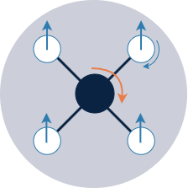
THE PROBLEM
Quadrotors Burn Power Fighting Yaw
In conventional hover, every gram of lift comes from the props alone — and a constant share of that power goes to fighting the airframe's own reaction torque just to hold yaw steady.
Yaw control is a constant power tax in hover
Props: 100% of lift
Props do 100% of the lifting work, unaided
Yaw control tax
Swept air is wasted — no surface harvests it
Swept air – no lifting surface
Spinning Quadrotor • ICUAS 2026 • RRC, IIIT Hyderabad
2

Slide 3
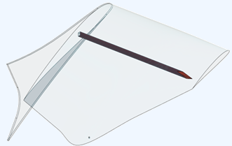
THE INSIGHT
What If We Let It Spin?
Stop suppressing yaw — embrace it.
Let the quadrotor rotate steadily at 8–10 rad/s. The spin drives tangential airflow over radially-mounted passive wings, which generate real lift and offload the propellers.
LIFT FROM A SPINNING WING
L = ½ ρ (ω² r²) S C_{L}
Lift grows with the square of spin rate ω and radius r — for free.
22%
57%
≈ one full motor's worth of lift
≈ one full motor's worth of lift
The wings supply about 22.3% of the vehicle's weight — equivalent to retiring one of the four motors entirely.
less thrust needed (hardware)
power cut (simulation bound)
Spinning Quadrotor • ICUAS 2026 • RRC, IIIT Hyderabad
3

Slide 4
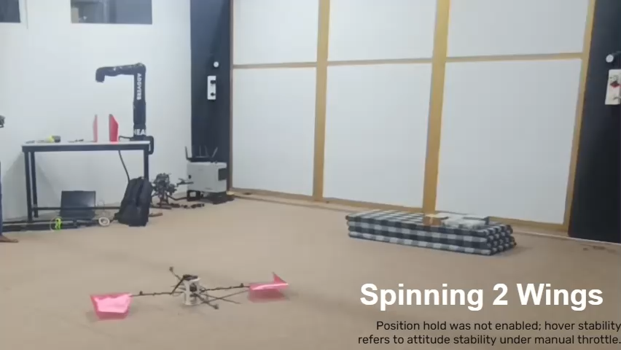
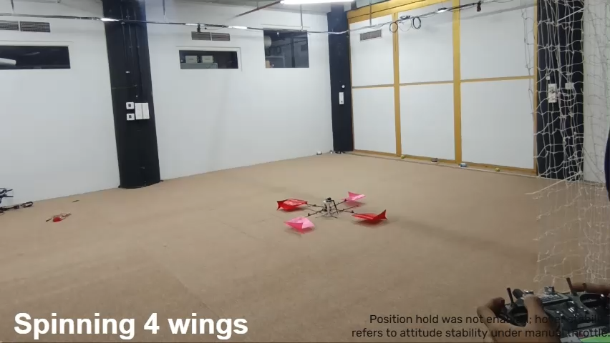
SEE IT FIRST
Watch the Vehicle in Flight
Config I
Config II
Asymmetric • 2 wings (r = 0.40–0.65 m)
Symmetric • 4 wings (r = 0.40–0.65 m)
▶ demonstration

Slide 5
METHODOLOGY
Spin Rate ω Drives Lift — Quadratically
Letting the vehicle spin at 8–10 rad/s drives clean tangential airflow over each wing. Lift scales with ω²r² — so a steady spin produces real aerodynamic work for free.
TANGENTIAL VELOCITY
V(r) = ω_{z} · r
DESIGN CEILING
ω ≤ 10 rad/s , l ≤ 0.65 m
OPTIMIZATION Rotors spin clockwise; motor position l and cant angle γ are tuned jointly for the optimal lift-to-spin ratio.
MOTOR POSITION (l)
MOTOR CANT ANGLE (α)
Larger l increases yaw-torque lever arm, but lowers the air velocity the wing sees — reducing its lift. The optimum l balances yaw authority against aerodynamic efficiency.
A larger cant angle redirects thrust into spin-up torque, but diverts it away from vertical and wing lift. The optimum α balances yaw torque against total lift.
Spinning Quadrotor • ICUAS 2026 • RRC, IIIT Hyderabad
5

Slide 6
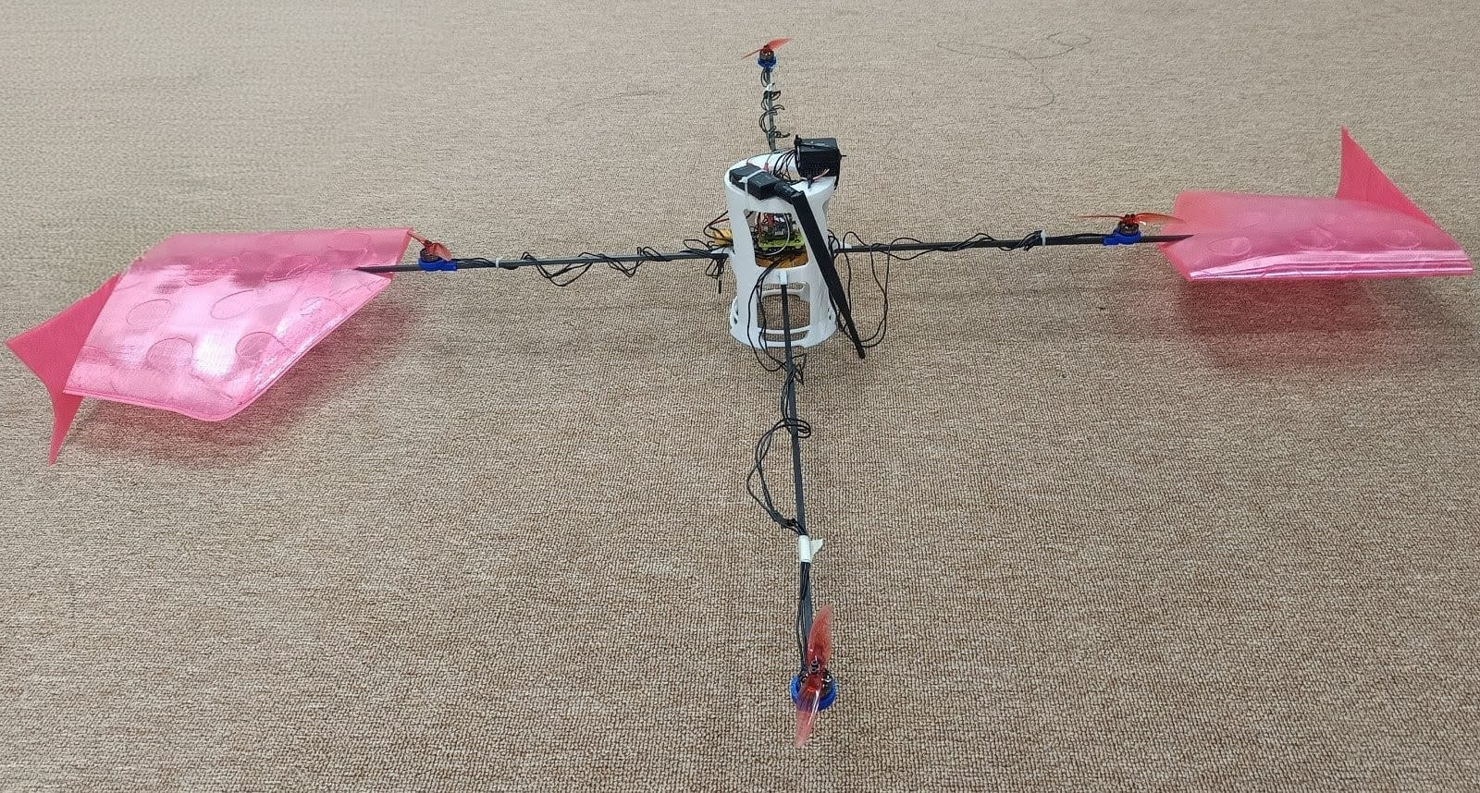
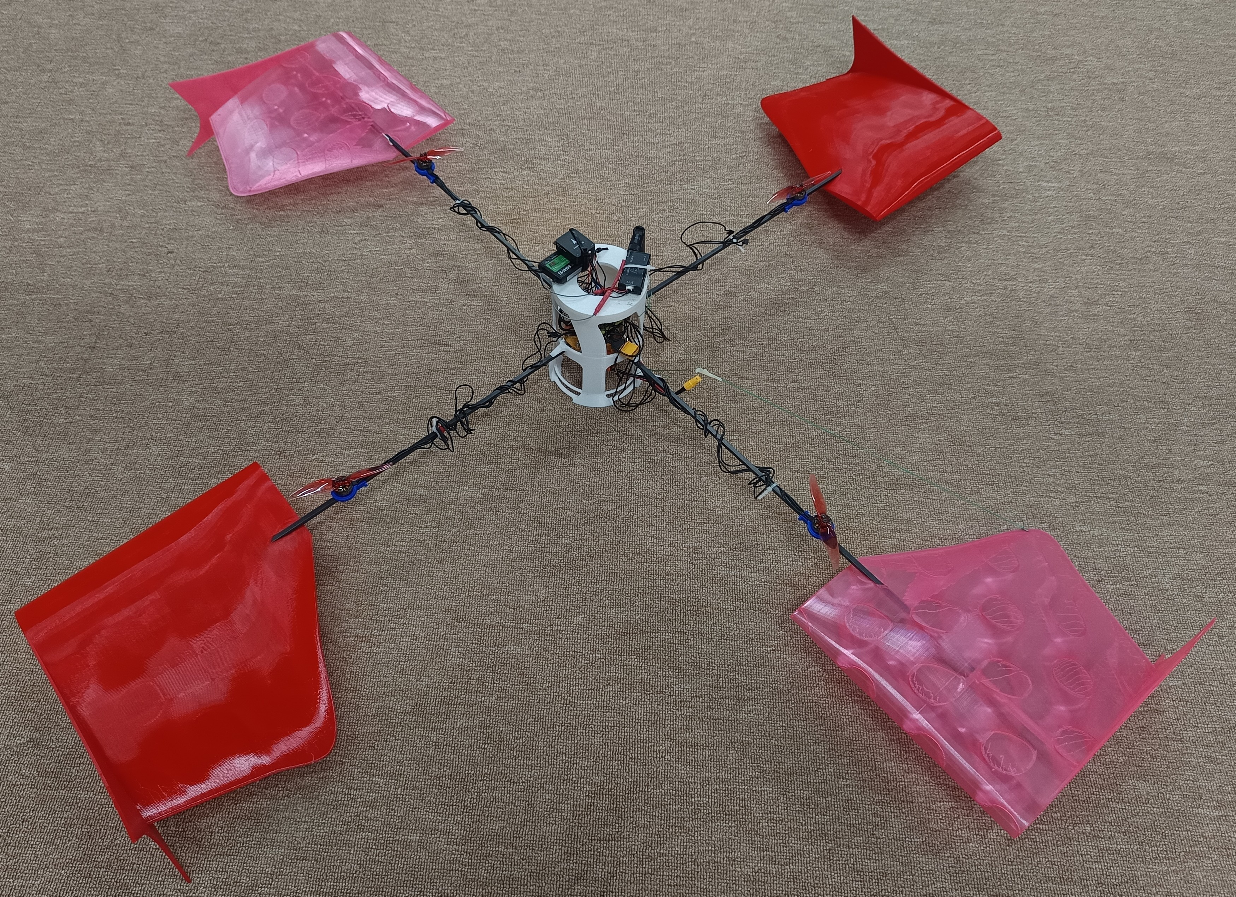
METHODOLOGY
Hardware Design: Two Configurations
Config I — Asymmetric
Config II — Symmetric
2 motors at r = 0.5 m (10° cant)
2 motors at r = 0.3 m
2 wings spanning r = 0.40–0.65 m
All 4 motors at r = 0.3 m (10° cant)
4 wings spanning r = 0.40–0.65 m
Balanced mass & aerodynamic loading
Compact two-wing test rig
Full four-wing platform
Shared geometry: wings span r = 0.40–0.65 m with chord ≈ 0.25–0.30 m; motor cant angles tilt thrust to sustain the spin.
Spinning Quadrotor • ICUAS 2026 • RRC, IIIT Hyderabad
6

Slide 7
METHODOLOGY
Airfoil Selection: Meet 'Franky'
Scored 8 low-Re candidates
AG-14, RG-14, RG-15, S1223, SD7032, SD7037, SD7062, NACA 4412
RADIAL OPERATING POINTS (TABLE I)
r (m) | V (m/s) | Re | Airfoil | α | Cl | Cl/Cd
0.40 | 3.2 | 2.2×10⁴ | SD7037 | 8.6° | 0.83 | 9.3
0.45 | 3.6 | 4.6×10⁴ | Franky | 10.5° | 1.00 | 6.3
0.50 | 4.4 | 8.5×10⁴ | Franky | 10° | 1.79 | 39.6
0.65 | 5.6 | 9.1×10⁴ | Franky | 10° | 1.79 | 39.6
PERFORMANCE SCORE
J = 0.50 (C_{l}/C_{d}) + 0.30 C_{l} + 0.20 C_{p,min}
SD7037 wins up to Re = 6.0×10⁴; the custom Franky — a 26% blend of S1223 + SD7037 — wins above it.
L/D peaks at 39.6 on the outer span — where tangential speed is highest and Franky operates at its design point.
Why blend? S1223 brings high camber & lift; SD7037 brings clean low-Re behavior. Franky keeps both across the spinning span.
26%
Re ~ 10⁵
S1223 + SD7037 blend
low-Re spinning regime
Spinning Quadrotor • ICUAS 2026 • RRC, IIIT Hyderabad
7

Slide 8
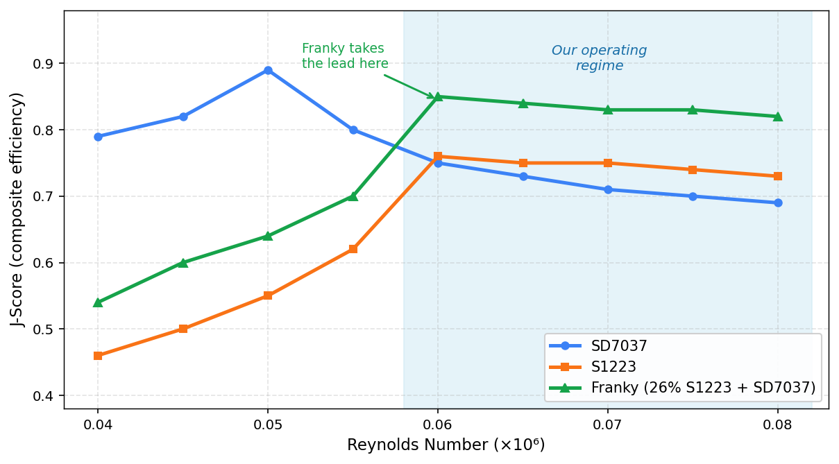
METHODOLOGY
Franky Wins Where We Fly
SD7037 leads at low Re, but Franky dominates above Re ≈ 6×10⁴ — exactly our operating regime.
Spinning Quadrotor • ICUAS 2026 • RRC, IIIT Hyderabad
8

Slide 9
VALIDATION
Three-Stage Validation
STAGE 1
STAGE 2
STAGE 3
BEMT Simulation
CFD (MRF)
Hardware
5.27 N
4.50 N
2.10 N
wing lift
wing lift
wing lift
Blade-element momentum model of the full spinning vehicle
k-ω SST, ANSYS Fluent, moving reference frame
Instrumented spinning test stand, Config II
Idealized BEMT sets the upper bound; CFD resolves the real flow; hardware proves it flies. The consistent downward trend reflects un-modeled losses, interference, and structural realities.
Spinning Quadrotor • ICUAS 2026 • RRC, IIIT Hyderabad
9

Slide 10
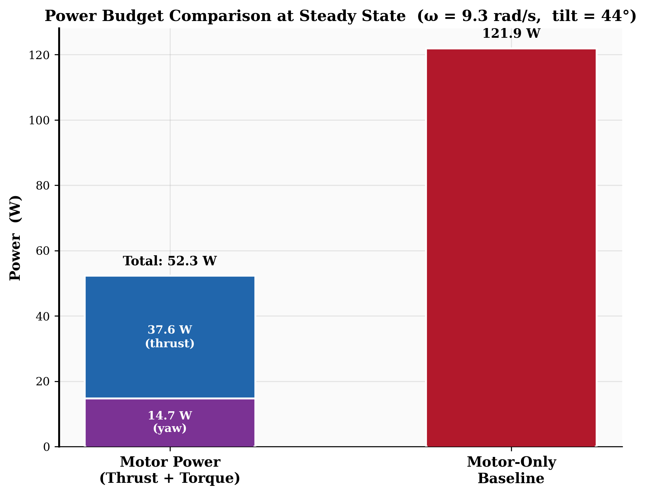
RESULTS
Simulation: An Idealized Upper Bound
67.2%
57.1%
of weight carried by wings (5.27 N of 7.85 N)
electrical power reduction vs. motor-only
WHERE THE 52.3 W GOES
37.6 W carries the residual 32.8% of weight (2.58 N) on motor thrust
14.7 W sustains the spin against 1.043 N·m of wing drag
Motor yaw torque tracks wing drag within 1% (1.033 vs 1.043 N·m) — the spin is self-sustaining.
Spinning Quadrotor • ICUAS 2026 • RRC, IIIT Hyderabad
10

Slide 11
RESULTS
Hardware: 22% Less Thrust, In Reality
22%
8–10
53.5 g
73.4 g
reduction in required thrust
Limit of stable spin rate ω (rad/s)
lift per wing (4-wing rig)
lift per wing (2-wing rig)
HARDWARE RESULTS (TABLE II)
Test case | Mass (g) | DSHOT | Thrust (g) | Wing lift (g) | Wing share
Stationary, 4 wings | 960 | 1809 | 960 | 0 | 0%
Spinning, 4 wings | 960 | 1487 | 758 | 214 | 22.3%
Stationary, 2 wings | 658 | 1339 | 658 | 0 | 0%
Spinning, 2 wings | 658 | 1133 | 511 | 147 | 22.3%
Bottom line: spinning drops DSHOT demand from 1809→1487 (4-wing) and 1339→1133 (2-wing). Both rigs converge on the same 22.3% weight offset — the wings reliably retire roughly one motor's lift.
Spinning Quadrotor • ICUAS 2026 • RRC, IIIT Hyderabad
11

Slide 12
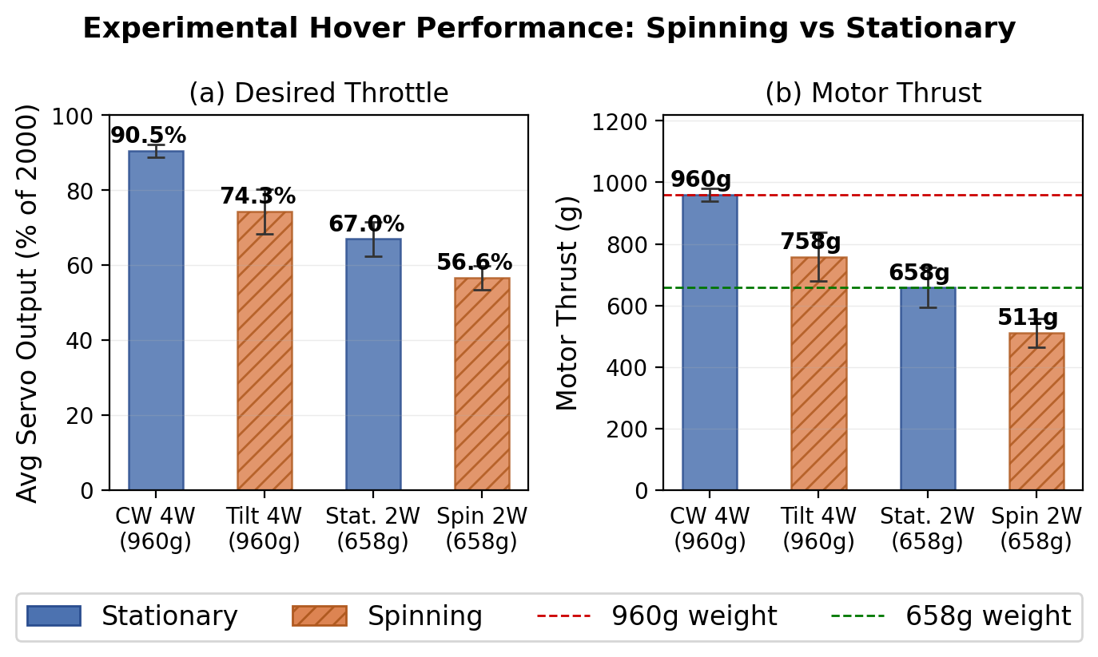
RESULTS
Hardware: Experimental Hover Performance
Spinning Quadrotor • ICUAS 2026 • RRC, IIIT Hyderabad
12

Slide 13
WRAP-UP
Conclusion & Future Work
WHAT WE SHOWED
WHERE IT GOES NEXT
A spinning-hover architecture that replaces yaw suppression with intentional rotation + passive lift.
A custom low-Re airfoil, 'Franky' (26% S1223 + SD7037), tuned for the spinning span.
Multi-fidelity validation: BEMT → CFD → hardware, all confirming meaningful wing lift.
22% thrust reduction in flight; up to 57% power bound in idealized simulation.
Control systems built to leverage and stabilize the system, (taking gyroscopic /Coriolis terms into account)
Higher stable spin rates.
Fault tolerance of the system to single motor loss
RESOURCES
Video: youtu.be/q07RIcLkxVw Code: github.com/pyromania99/spinning-quadrotor-hover
Spinning Quadrotor • ICUAS 2026 • RRC, IIIT Hyderabad
13

Slide 14
Thank You
Questions & Discussion
Aniketh Parkala
anikethparkala@gmail.com
Robotics Research Center, IIIT Hyderabad
github.com/pyromania99/spinning-quadrotor-hover
22%
less thrust needed
in hardware tests
Supported by MeitY, Govt. of India — HRD in Unmanned Aircraft Systems
Notes:
[~10s] Q&A
"Thank you. Happy to take questions."
LIKELY QUESTIONS — be ready:
• "How do you control yaw while spinning?" — Differential motor thrust for pitch/roll; net spin rate controlled by overall torque balance.
• "What about prop-wash interference with the wings?" — Config II isolates this; interference reduces effective lift ~15% but net gain remains positive.
• "How does it transition from stationary to spinning?" — Gradual spin-up via asymmetric throttle; takes ~3 s to reach steady-state spin.
Leave this slide displayed during Q&A.

