Slide 1

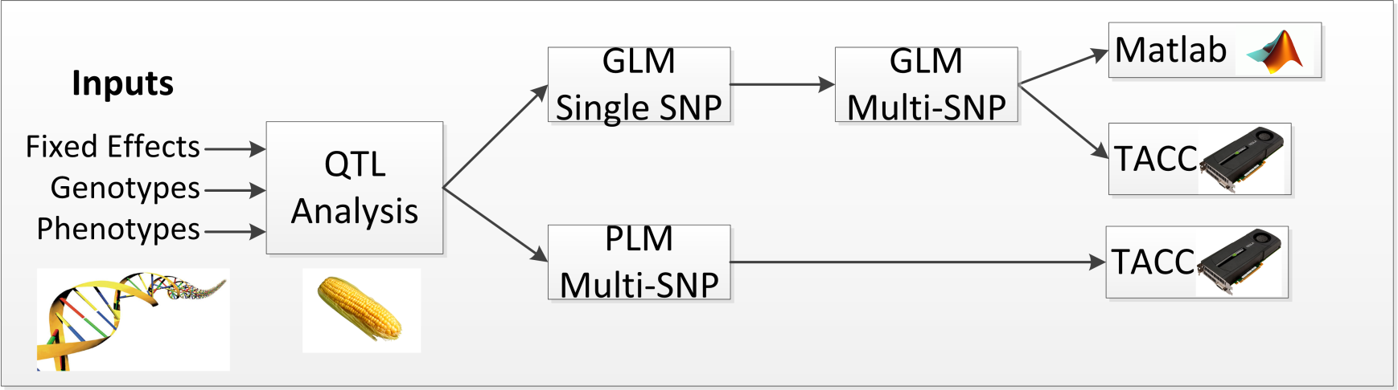
QTL Analysis
Quantitative Trait Locus (QTL)
  Statistical method for estimating phenotypic effects of genotypic markes
GLM-based QTL
  First implementation of QTL analysis on the GPU
  How many threads were running on a single GPU?
PLM-based QTL
  Equivalent to GLM, without redundant computations
  Version 1: How many threads were runing on the origianlimpllemenation?
  Version 2: How many threads are we running now with Greg’s modifications?
Ongoing work:
  -list
Notes:
I would like to show the progress of the implementation and quantify the progress, for each version implemented by giving the thread utilization per GPU could be a good measure.

Slide 2
Optimizations
Implement PLM instead of GLM
  Avoid using the design matrix X in calculations
Approximate (X^{t}X)⁻¹ with SVD
Precompute intermediate terms to avoid recomputing at each iteration
Compute only one p-value per iteration, for the SNP with the maximal F-value
TACC code utilizes 16+ GPUs and 7,000+ threads
  Additional GPU parallelism remains untapped
Notes:
Is 7k per node or per gpu? First three bullets are too low level, i suggest merging data with the first slide. I don;t think Steve will be comfortable discussing the optimziation strategies.

Slide 3
PLM Performance
16 GPUs are 2.5 orders of magnitude faster than Matlab
  Matlab processes 5.5E+3 SNPs per second
Notes:
Please increas the font size for the chart

