Slide 1

Causes of death –Data Analysis
Ramesh Pyru

Slide 2


INTRODUCTION
Problem Statement
EDA (Exploratory Data Analysis)
Conclusion/Summary

Slide 3



Introduction
We have Historical Data of different cause of deaths for all ages around the World where Disability Adjusted Life Years‘ (DALYs) are measuring lost health & a standardized metric that allow for direct comparisons of disease burdens of different diseases across countries, between different populations, and over time.
One DALY is the equivalent of losing one year in good health because of either premature death or disease or disability.
One DALY represents one lost year of healthy life
Expectation→
We need data analysis which influence Cause of Death (Both Mortality & Morbidity)
Mortality + Morbidity ➔Measured by ‘Disability Adjusted Life Years‘

Slide 4

Problem Statement
Sum of mortality and morbidity ➔Measured by metric called ‘Disability Adjusted Life Years‘ (DALYs).We need to assess health outcomes by both mortality & morbidity (the prevalent diseases) which provides a more encompassing view on health outcomes.
DALYs Measure lost health and are a standardized metric that allow for direct comparisons of disease burdens of different diseases across countries, between different populations, and over time.
We need data analysis which influence Cause of Death (Both Mortality & Morbidity)

Slide 5
EXPLORATORY DATA ANALYSIS (EDA) & VISUALIZATION
Univariate Analysis
Bi-Variate Analysis
Multi Variate Analysis
Correlation of Data

Slide 6
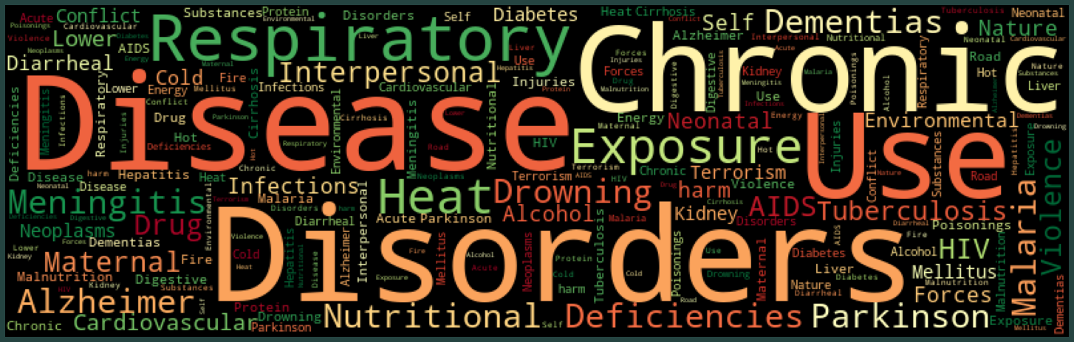
Feature Engineering

Slide 7
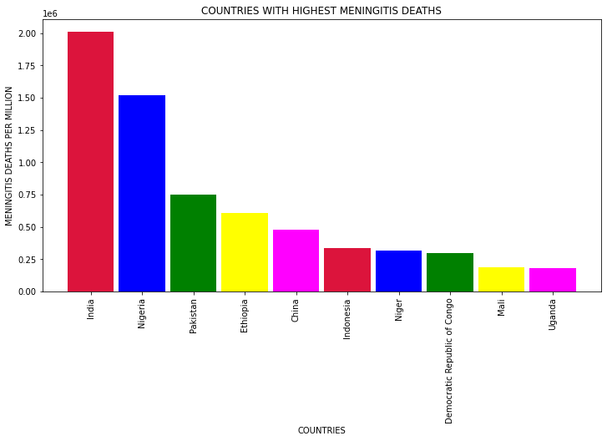
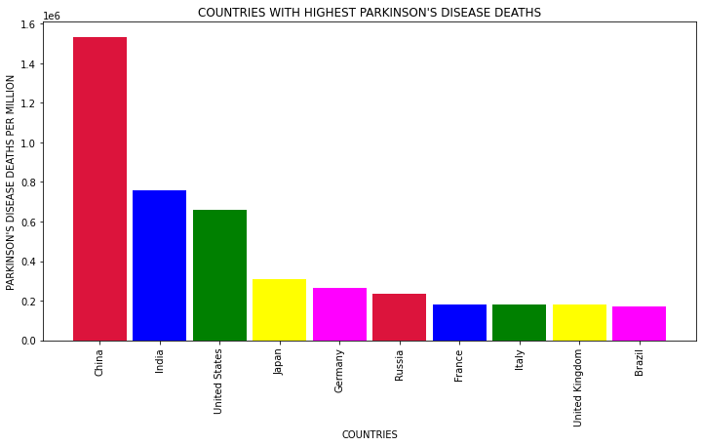
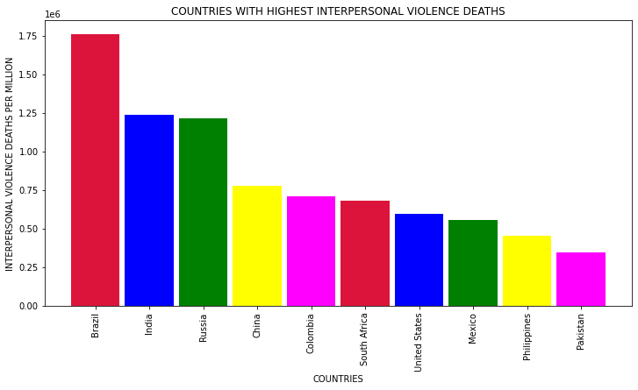
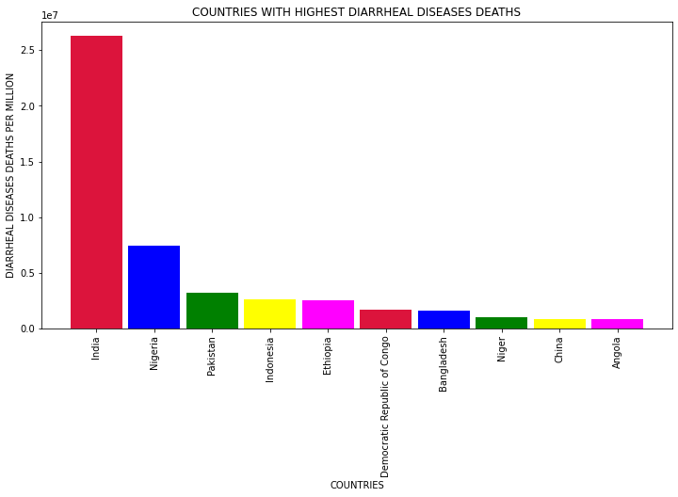
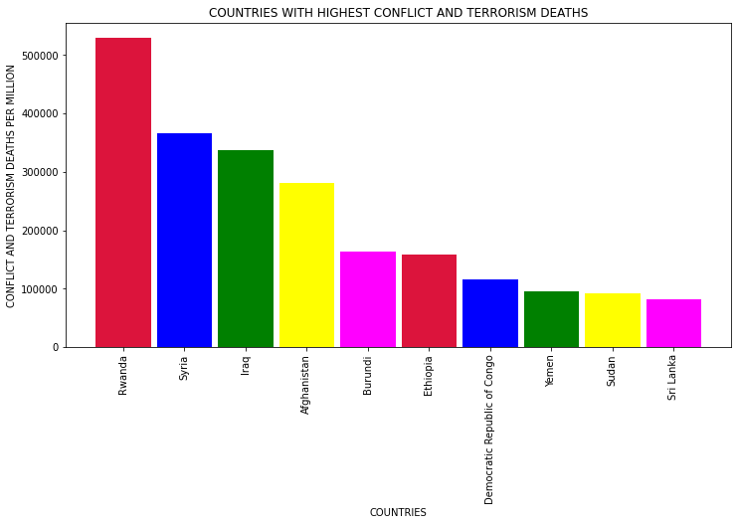
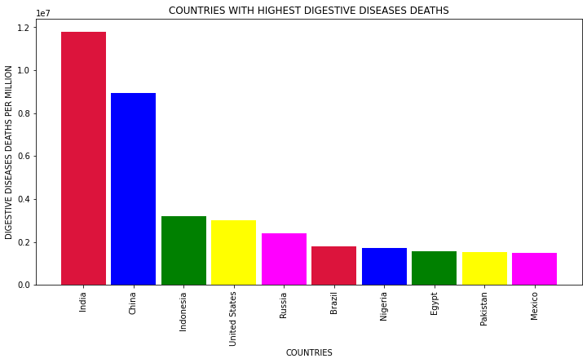
Cause of Death by Country/Territory

Slide 8
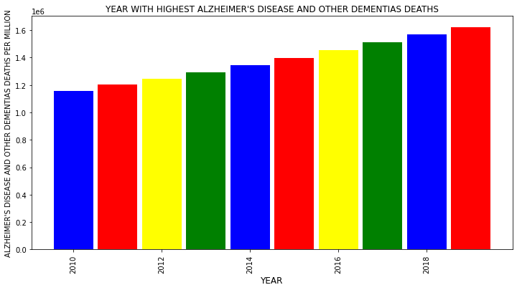
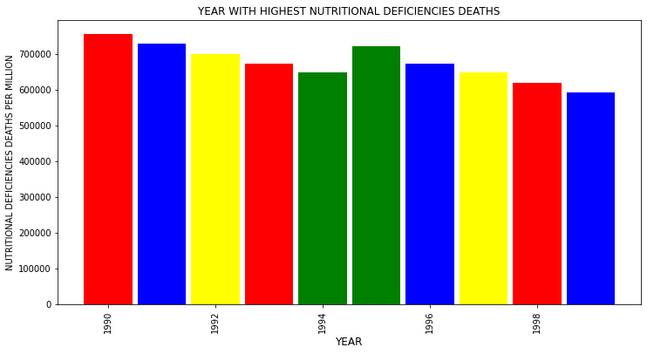
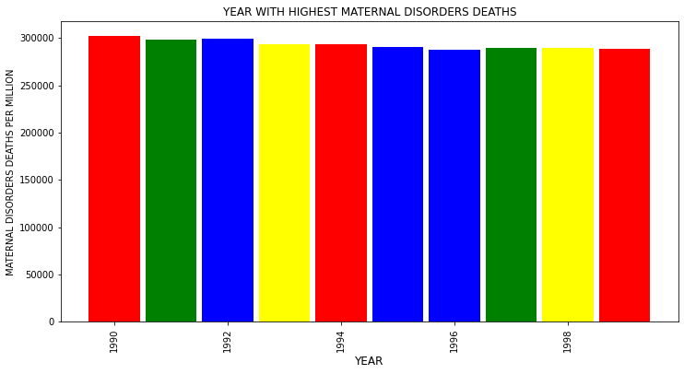
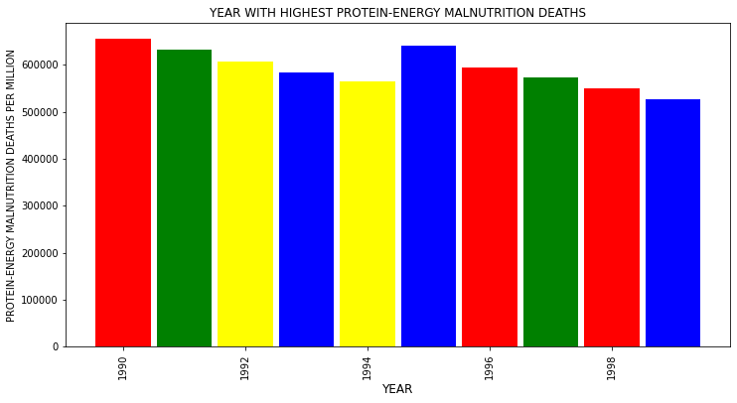
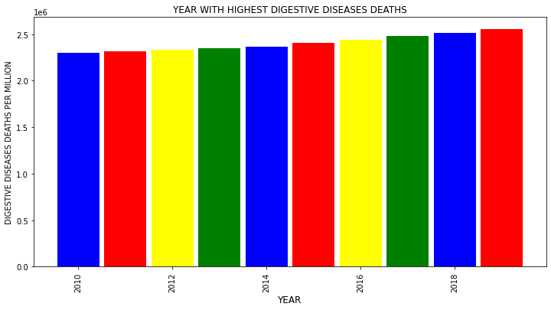
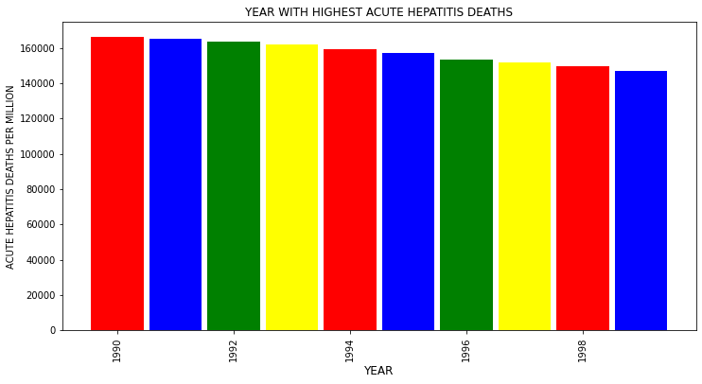
Cause of Death by Year

Slide 9
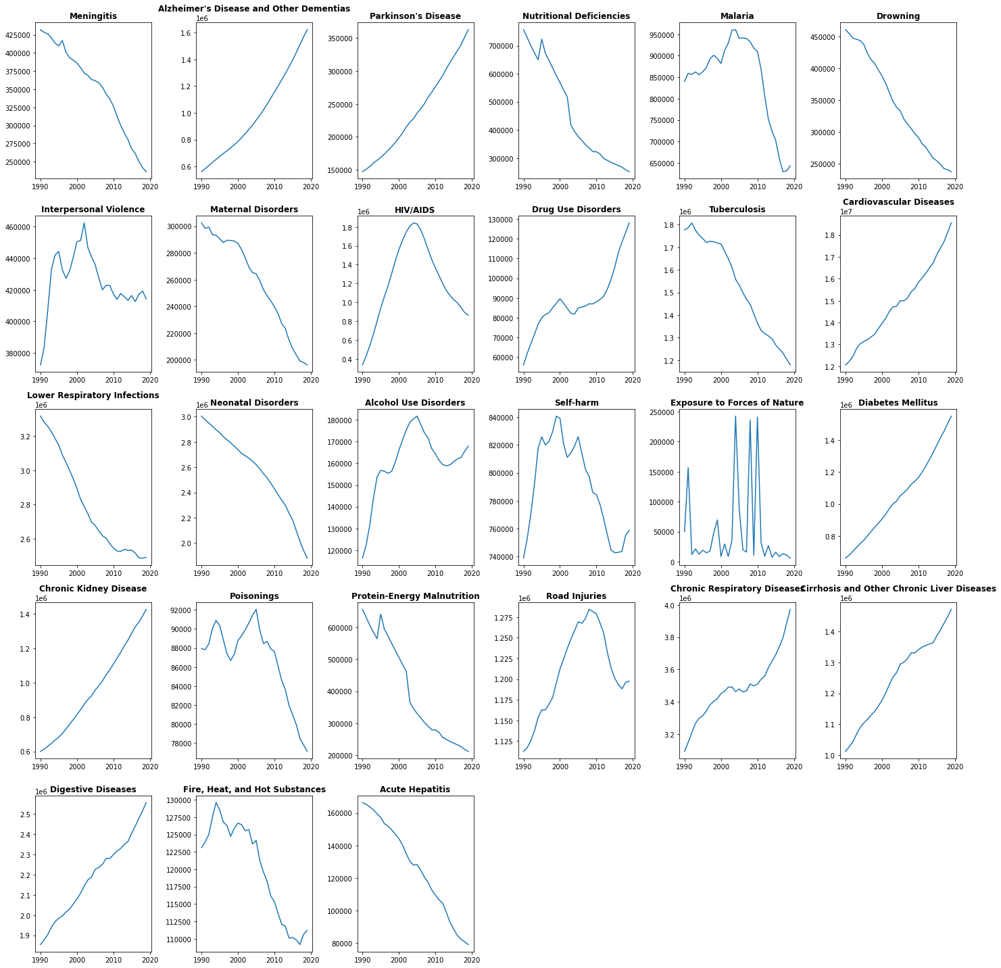

Cause of Death –Year

Slide 10
Observations
Following are the death causes exhibiting an increasing or no trend over time:
Dementia, Kidney, Cancer, Parkinson, and Diabetes diseases have been increasing since the beginning of our data span (1990)
Drug and alcohol use disorders are correlated with Liver disease trend
HIV/AIDS related deaths rate started to decline since 2005
Natural disasters show no trend as expected

Slide 11
Divide the causes of death into 3 main categories:
Communicable diseases
Non-communicable diseases
Injures
communicable_diseases_df = ["Nutritional Deficiencies", "Malaria", "Maternal Disorders", "HIV/AIDS","Drug Use Disorders","Tuberculosis","Neonatal Disorders","Alcohol Use Disorders","Diarrheal Diseases"]
non_communicable_diseases_df = ["Meningitis","Alzheimer's Disease and Other Dementias", "Parkinson's Disease",
"Cardiovascular Diseases","Lower Respiratory Infections", "Acute Hepatitis", "Digestive Diseases", "Cirrhosis and Other Chronic Liver Diseases",
"Chronic Respiratory Diseases", "Diabetes Mellitus","Chronic Kidney Disease"]
injures_df = [“Drowning", "Interpersonal Violence", "Fire, Heat, and Hot Substances", "Road Injuries", "Poisonings" ,
"Protein-Energy Malnutrition", "Conflict and Terrorism", "Self-harm", "Exposure to Forces of Nature",
"Environmental Heat and Cold Exposure"]

Slide 12
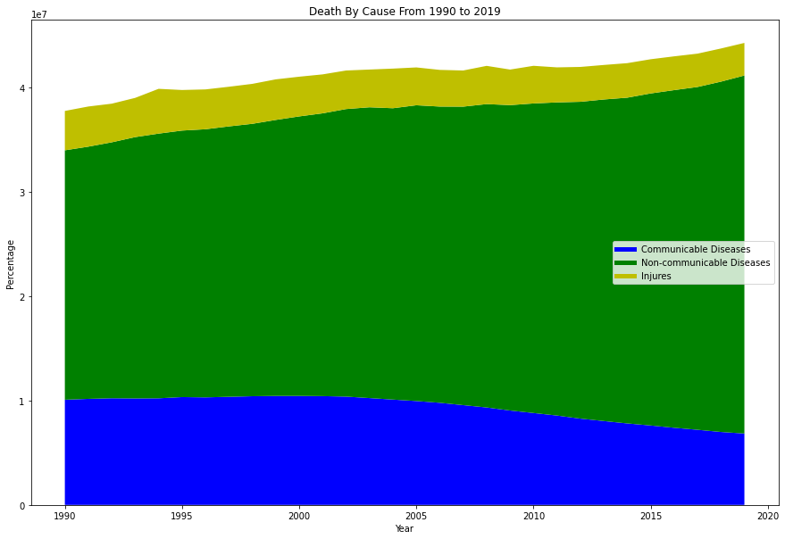
Death By Cause From 1990 to 2019 ( based on Categories)
During the 30 years from 1990 to 2019, the following trends were observed:
The number of deaths from non-communicable diseases always accounts for the highest rate and tends to increase gradually.
The number of deaths from communicable diseases accounts for the lowest rate, and maintains a fairly stable number over the years.
The number of deaths from injures accounts for a high rate, but tends to decrease.

Slide 13
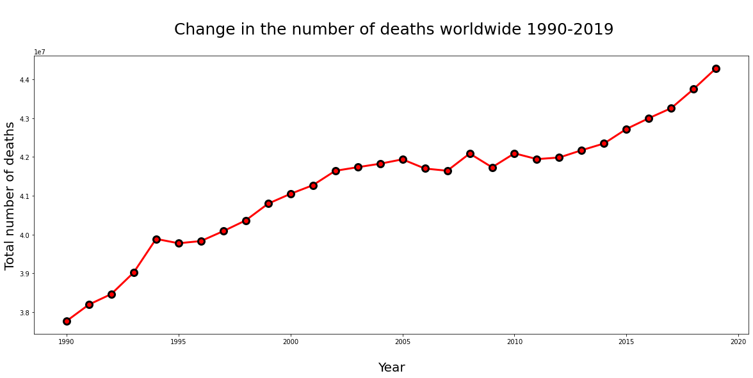
number of deaths worldwide 1990-2019
The number of deaths in the world tends to increase each year, proportional to the population growth. Realizing that countries with a large population have a died and vice versa.
Leading in the world in the number of deaths is: China, India, United States, Russia, Indonesia (whether in 1990 or 2019, these countries are still at the top of the number of deaths).
The countries/territories with the highest or lowest number of deaths in 2019 are directly proportional to their population. This is considered reasonable.

Slide 14
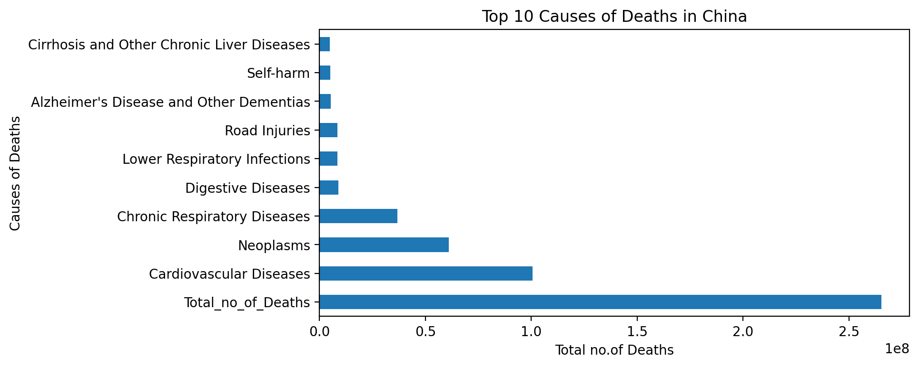
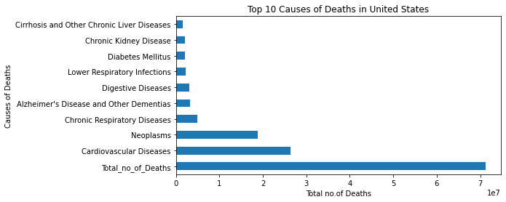
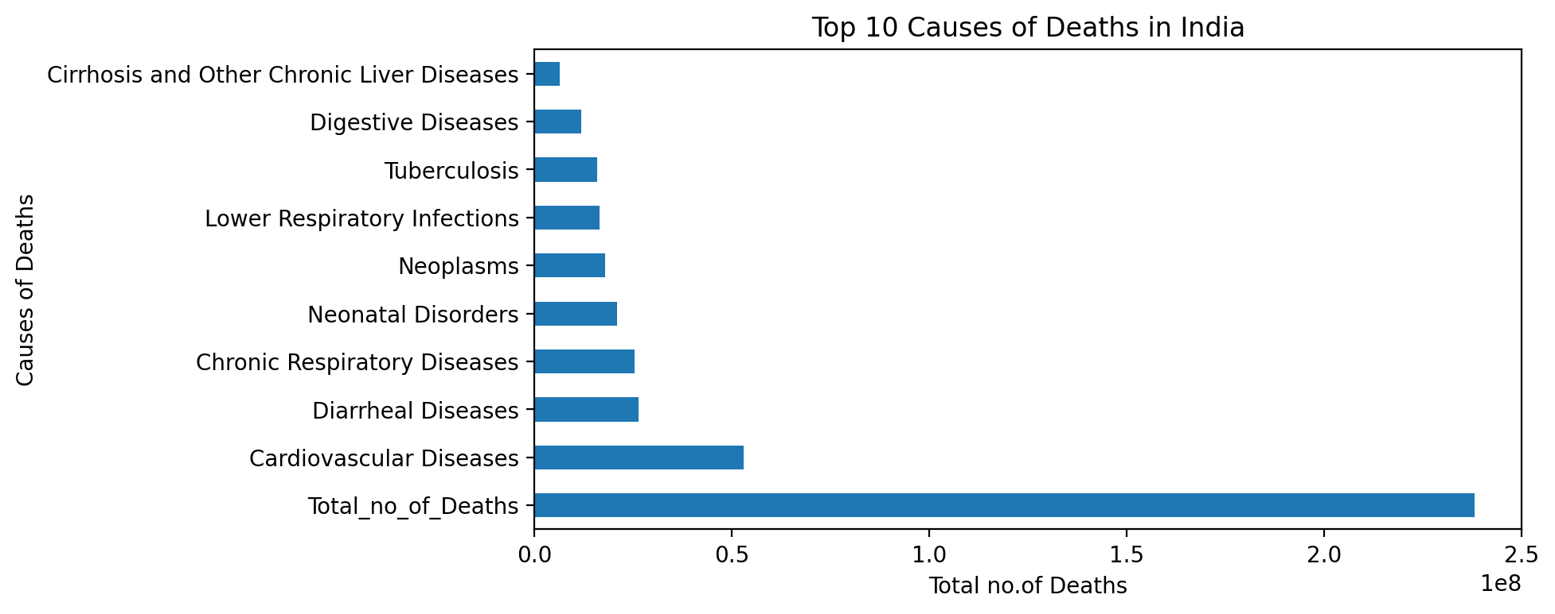
Top 10 Causes of Deaths – (China, India, USA)

Slide 15
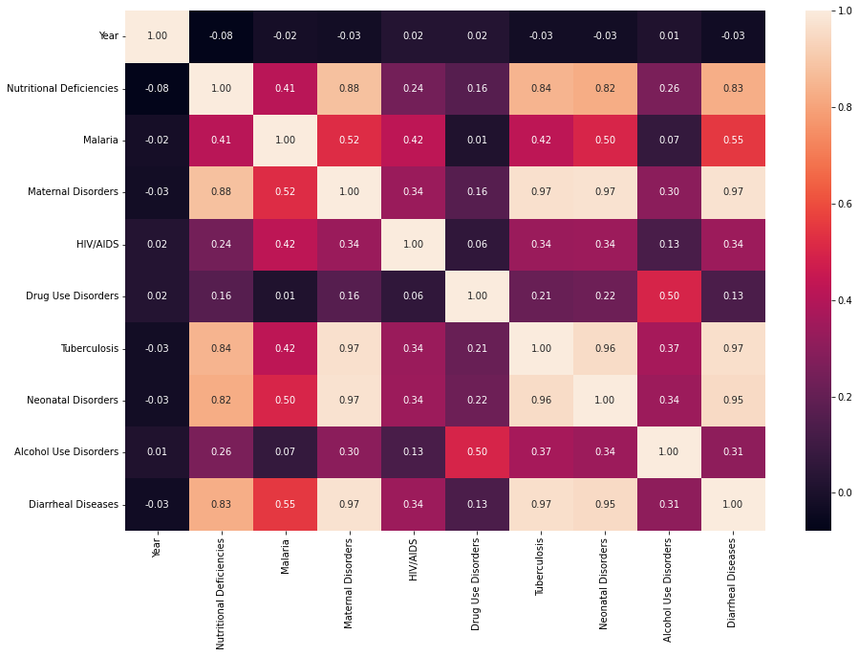
Correlation -communicable diseases

Slide 16
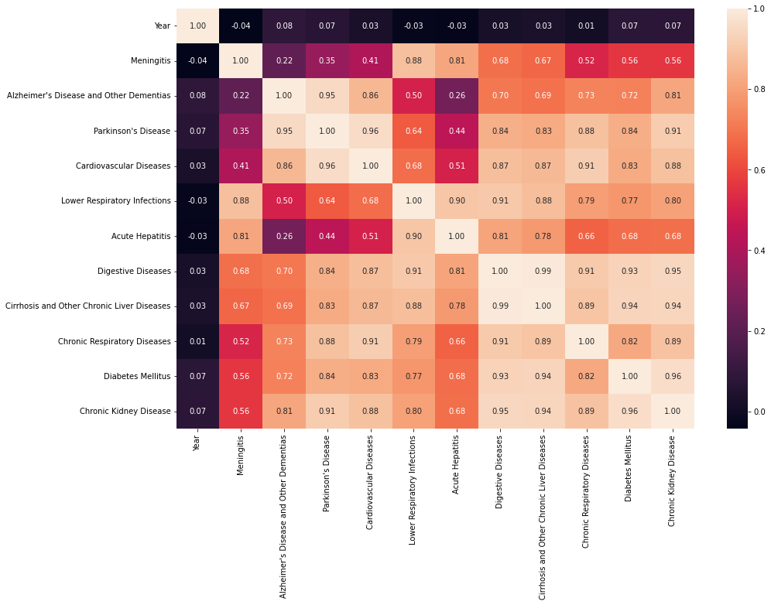
Correlation -noncommunicable diseases

Slide 17
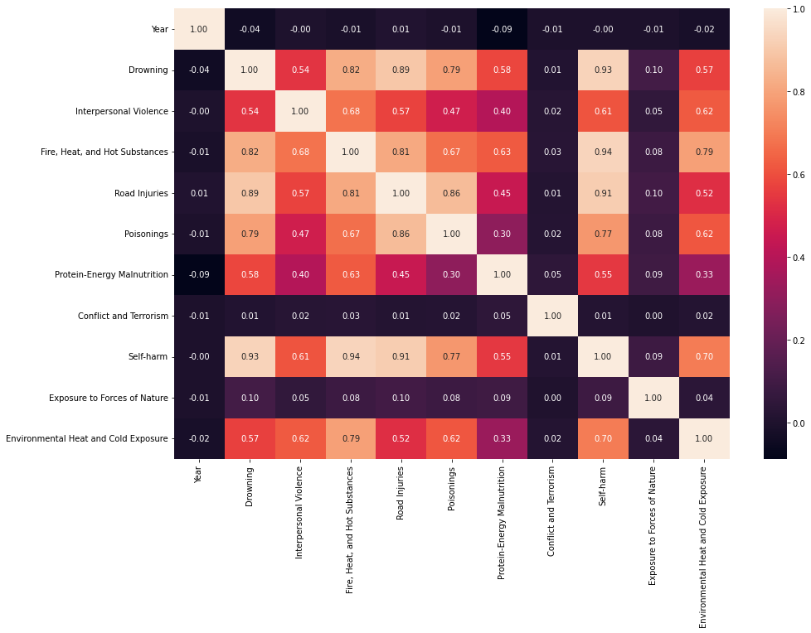
Correlation -injures

Slide 18
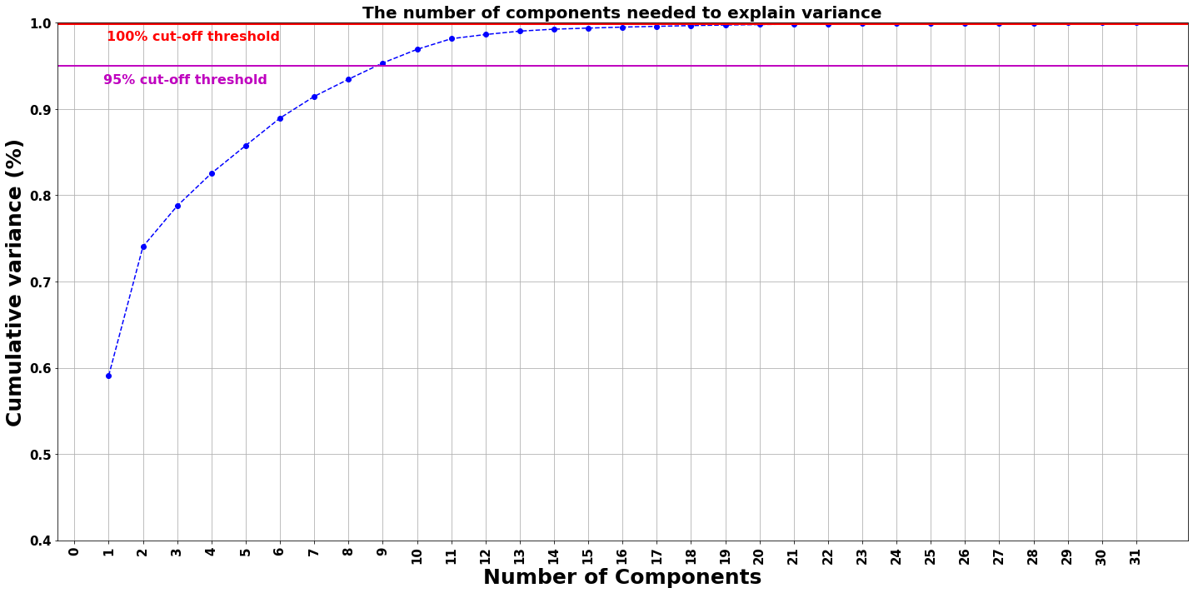
Principal Component Analysis (PCA)
As per the graph, we can see that 8 principal components attribute for 95% of variation in the data & will use 8 features as no. of components in PCA to reduce the dimensions

Slide 19




Summary
Most dreadful disease which causes more than 300k deaths are Neoplasms, Cardiovascular diseases, Tuberculosis and HIV/AIDS.
The disease which causes 0 deaths are Exposure to forces of nature and Malaria. India and China has the highest self-harming death rates.
CHINA , INDIA AND USA face the largest brunt of deaths due to diseases in the world Cardiovascular diseases , Neoplasms (Malignancy/Cancer) and Lower Respiratory Tract Infections (for example : Pneumonia) are the top 3 killer diseases in the world.

Slide 20

Thank you
Internship batch# 34

