Slide 1


A Python Library for Trace Analysis
Dennis Dams (TNO-ESI, The Netherlands)
Klaus Havelund (Jet Propulsion Laboratory, USA)
Sean Kauffman (Aalborg University, Denmark)

Slide 2
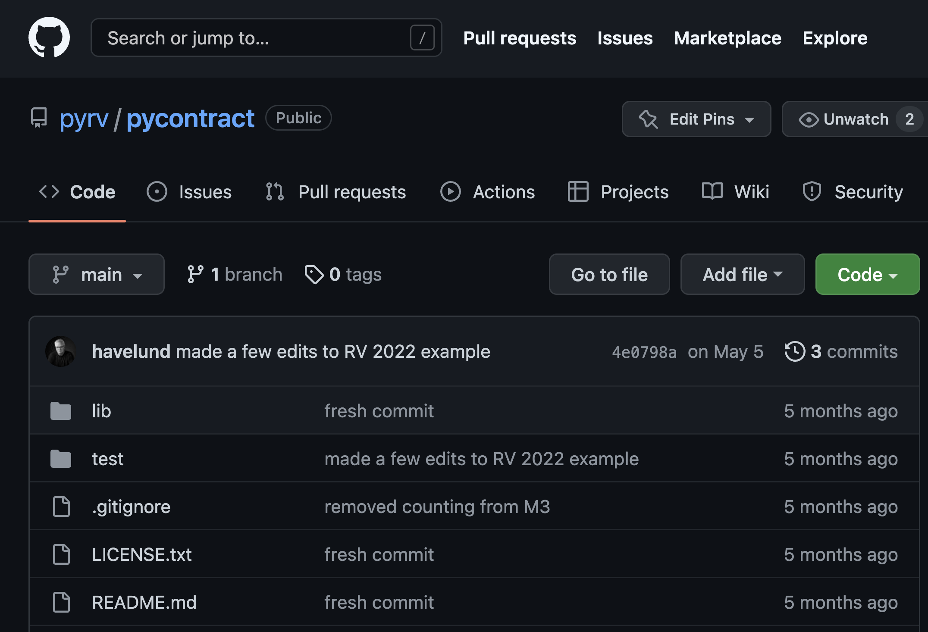
https://github.com/pyrv/pycontract

Slide 3
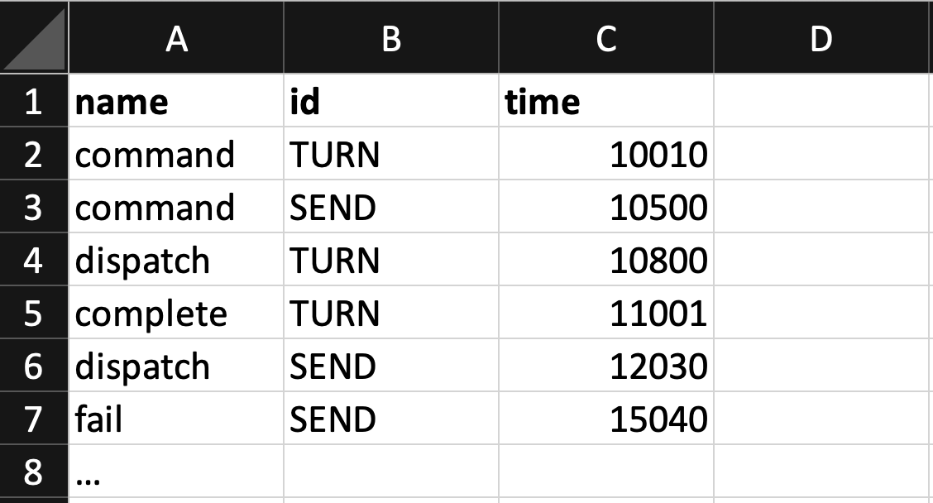
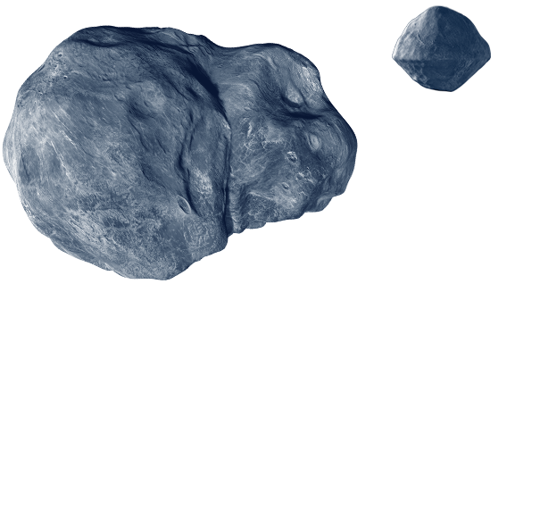
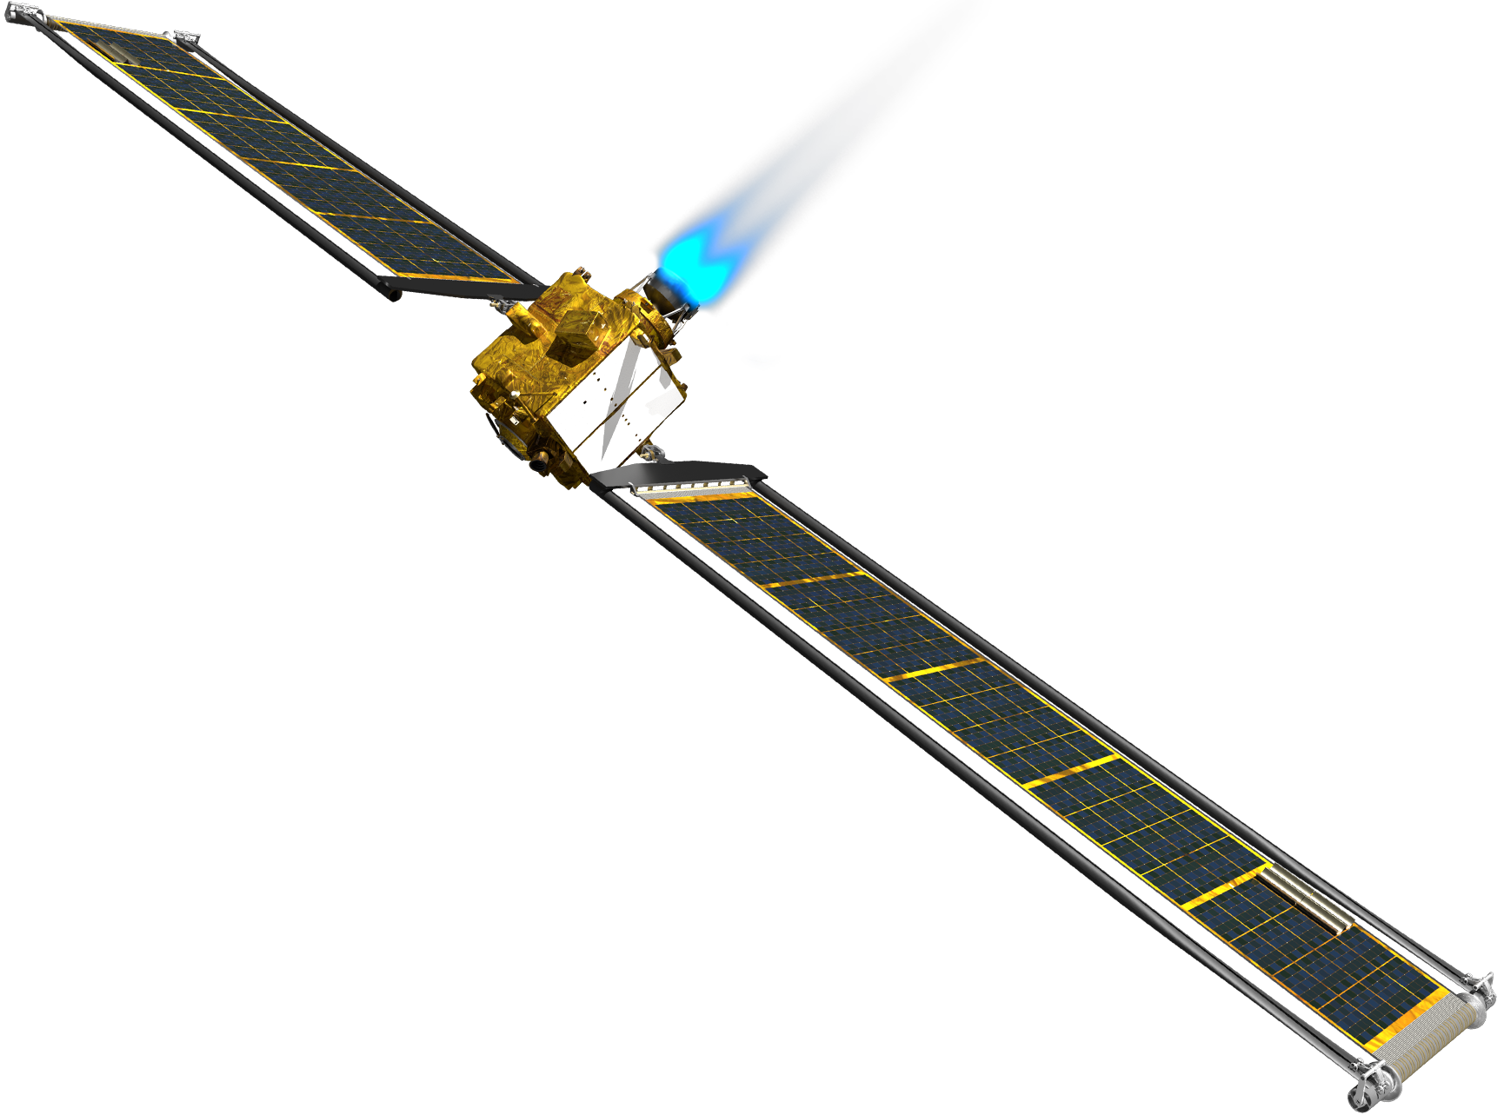
The objective: analysis of log files
events

Slide 4



Classical dimensions to consider = E³
Efficiency
Expressiveness
Elegance

Slide 5
External versus internal DSLs
the specification language
DSL
parser
DSL
API/library
programming
language
programming
language
Shallow internal DSLs
Host language is
part of DSL
Deep internal DSL
Host language is
used to build AST
external DSL
internal DSL

Slide 6
External vs. internal DSLs
External DSL advantages
Internal DSL advantages
Notation can be optimized for writability and readability
Specifications can be analyzed and visualized easily
It may make optimization easier
Expressive
User does not have to learn a new language
Popularity of programming language helps with infusion
Can benefit from existing IDEs, debuggers, etc
Can make DSL development faster
Can make maintenance easier

Slide 7
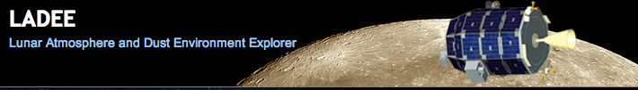

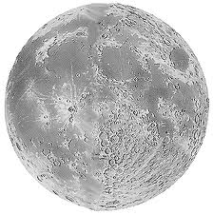
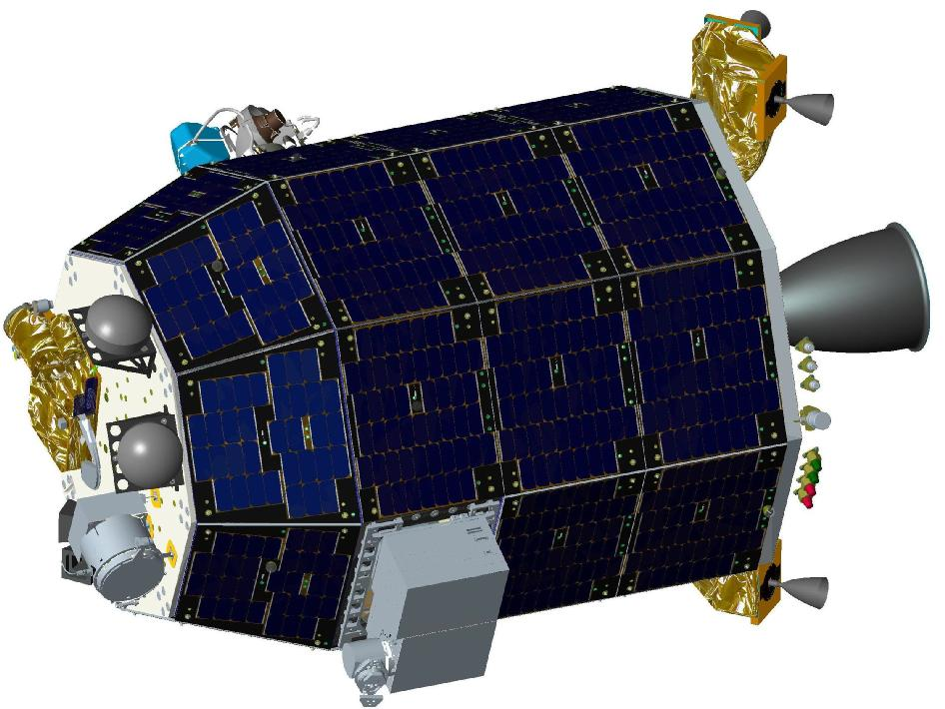

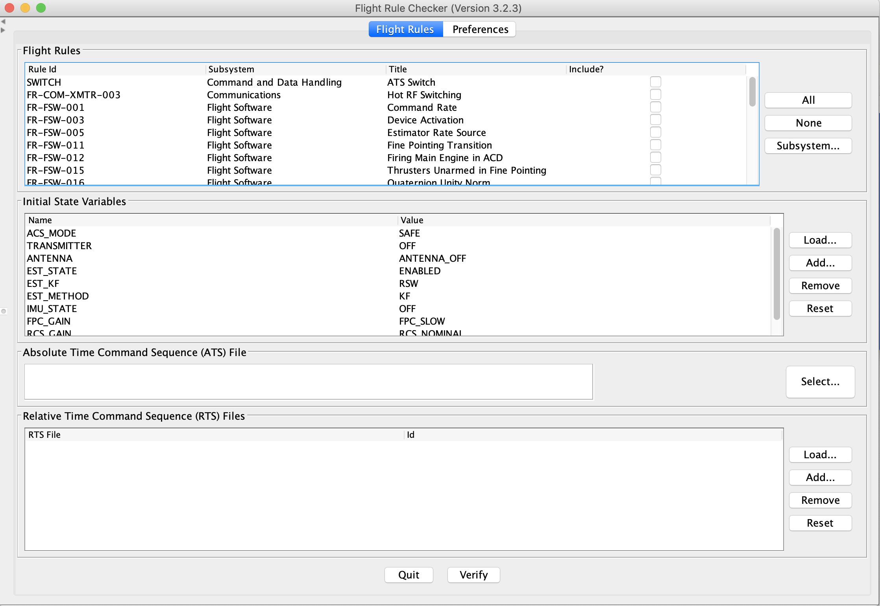
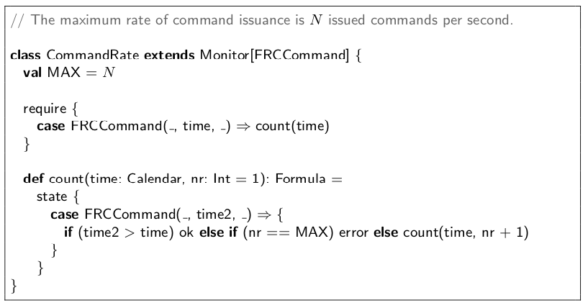


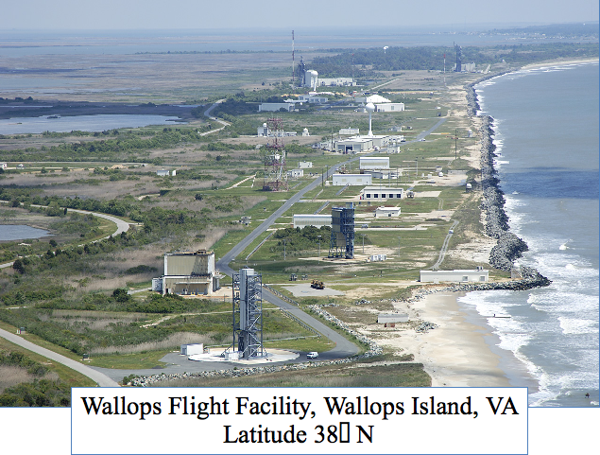
Evidence of value of
internal DSL
verified
command
sequence
command
sequence
TraceContract
Internal DSL
Developed at JPL
Elif Kurklu at NASA Ames Research Center

Slide 8
CommaSuite – an External DSL
Evidence of problems with
external DSL
“The development of the external CommaSuite DSL has involved regularly occurring user requests for more ‘richness’ in the language such as dictionaries (hash maps) as an additional data type and a notation for namespaces”.

Slide 9

Approach inspired by rule based programming
Monitor memory is a set of facts (states)
Rule (transition):
event
F₁(x₁),…, ¬F_{n}(x_{n}) → F_{i}(e_{i}) , ¬F_{j}(e_{j})
check
check
add
delete
Rule Systems for Run-Time Monitoring: from Eagle to RuleR H. Barringer, D. Rydeheard and K. Havelund, RV 2007
Data Automata in Scala,
K. Havelund, TASE 2015
with an automaton look and feel

Slide 10
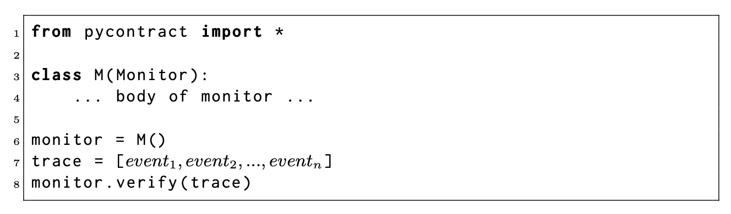
Using the API

Slide 11
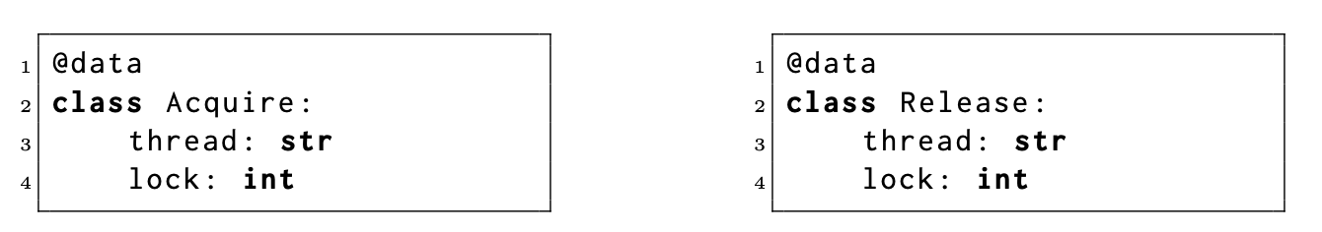

Definition of events
Requirement

Slide 12
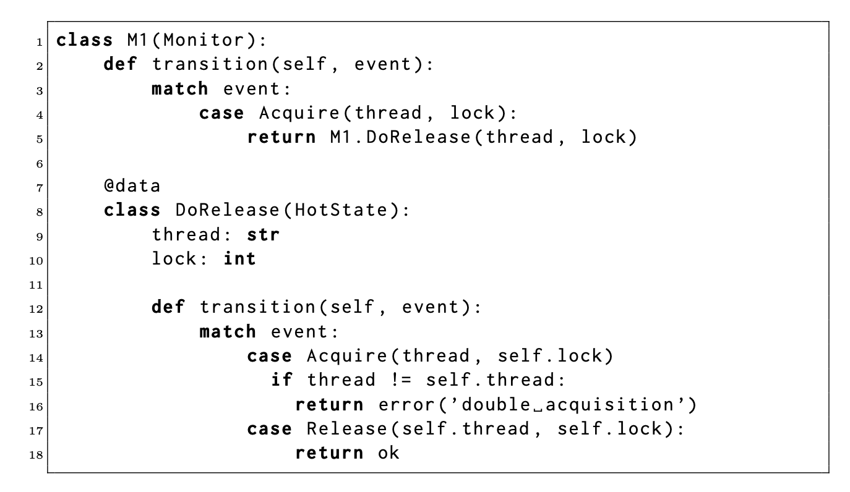
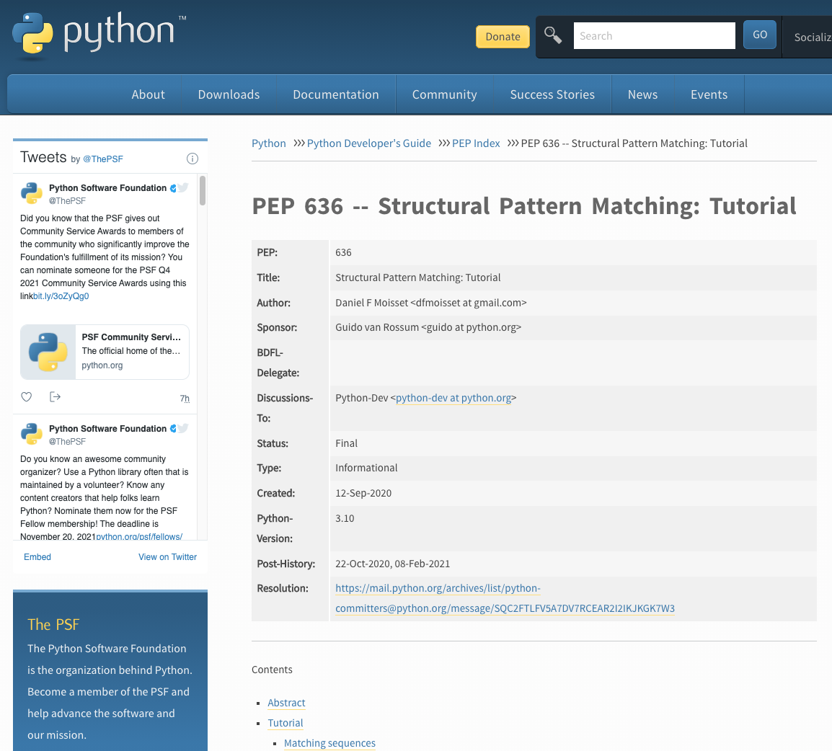
Monitor
transitions
at outermost
level are
always enabled

Slide 13
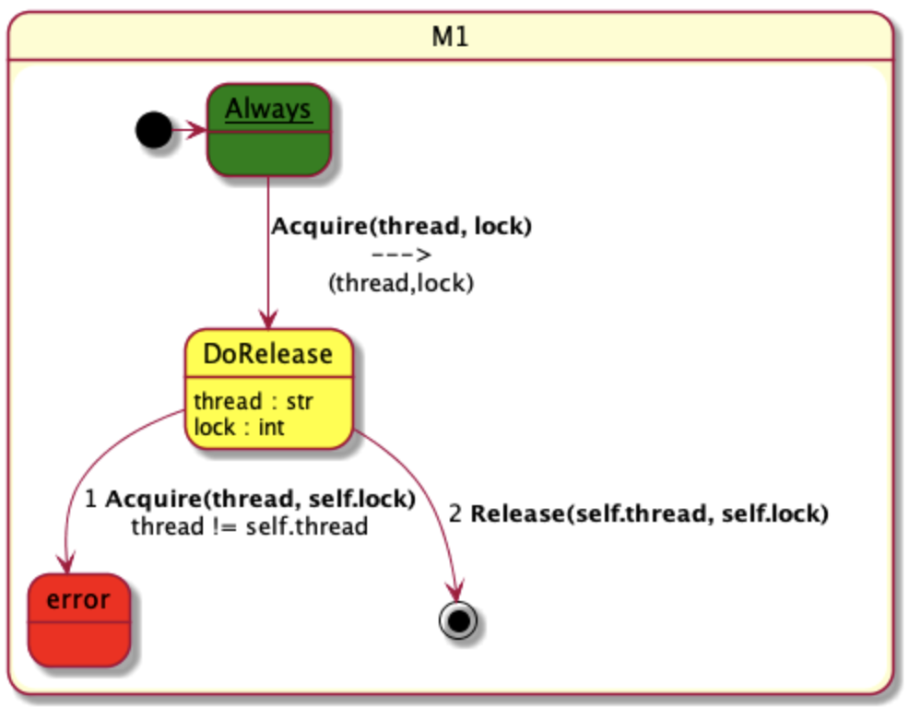
Visualization

Slide 14
Visualization using PlantUML
Meta
programming
PlantUML
@startuml state M1{ [*] -> __Always__ state __Always__ #green state DoRelease #yellow : thread : str\nlock : int __Always__ --> DoRelease : **Acquire(thread, lock)**\n--->\n(thread,lock) state error #red DoRelease --> error : 1 **Acquire(thread, self.lock)**\nthread != self.thread DoRelease --> [*] : 2 **Release(self.thread, self.lock)** } @enduml

Slide 15
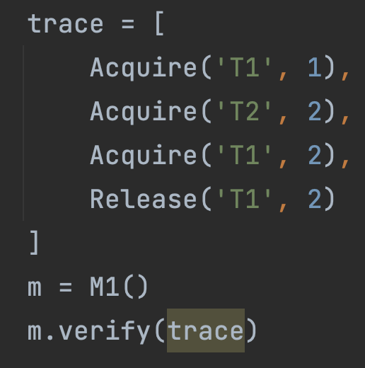
Applying the monitor
============
Analysis result:
============
2 reports!
*** error transition in M1:
state DoRelease('T2', 2)
event 3 Acquire(thread='T1', lock=2)
double acquisition
*** error at end in M1:
terminates in hot state DoRelease('T1', 1)

Slide 16
Debug mode
Event 1 Acquire(thread='T1', lock=1)
----------
DoRelease('T1', 1)
Event 2 Acquire(thread='T2', lock=2)
----------
DoRelease('T1', 1)
DoRelease('T2', 2)
Event 3 Acquire(thread='T1', lock=2)
*** error transition in M1: …
----------
DoRelease('T1', 1)
DoRelease('T1', 2)
Event 4 Release(thread='T1', lock=2)
----------
DoRelease('T1', 1)
Terminating monitoring!
*** error at end in M1: …

Slide 17
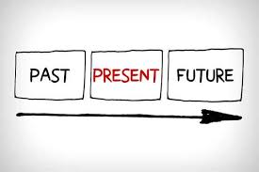
Referring to the past
Does there exists a state
satisfying a predicate P?
States in memory represent things that happened
in the past.
We want to be able to ask whether a certain
state exists, with constraints on data

Slide 18
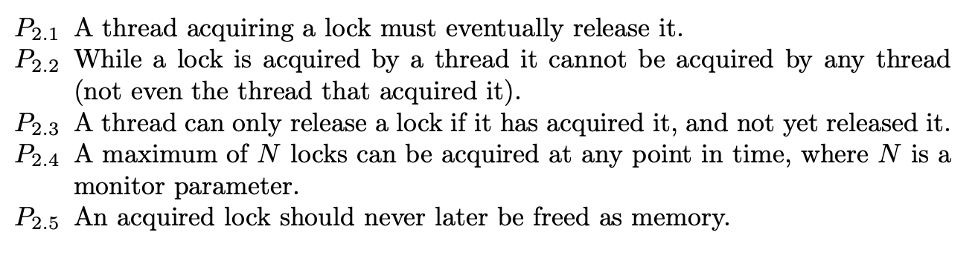
Requirement
past time property

Slide 19
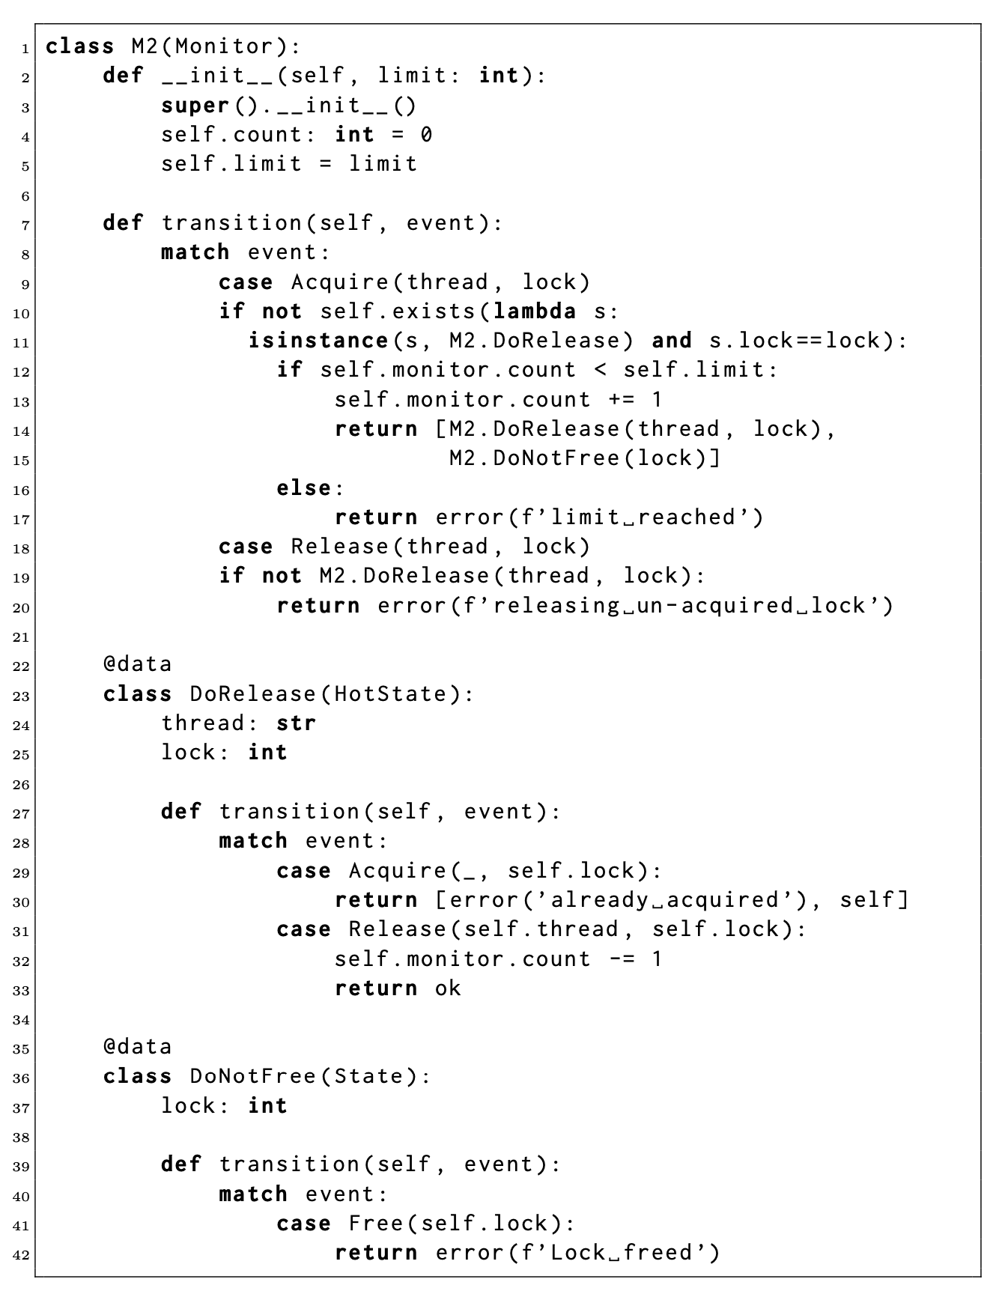
Monitor
Parameter
Monitor local variable
Searching set of states
Checking count
Counting
Returning a list of states
Searching set of states
Returning a list of states
Acceptance state

Slide 20
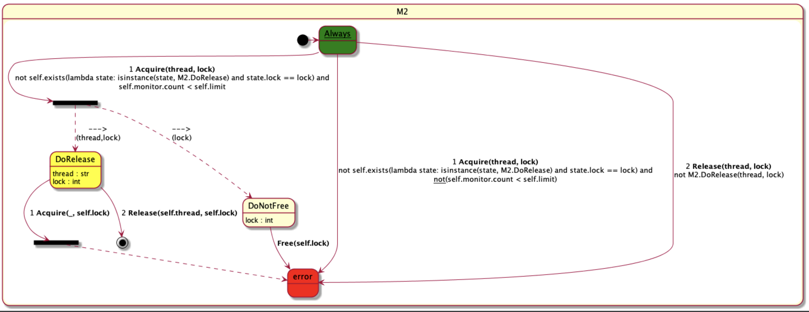

Slide 21
Additional Features
Different types of states:
State, HotState, NextState, HotNextState, AlwaysState
Differ in how they react when:
an event matches a transition
an event does not match any transition
the end of the trace is reached (if reached)
User defined indexing (slicing) for optimizing lookup of states
Monitors can be combined, forming a hierarchy of monitors, useful for conceptual modularization of requirements

Slide 22
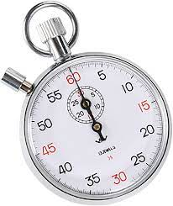
Evaluation
Comparing to:
The internal shallow Scala DSL Daut (which inspired PyContract)
The internal deep Java DSL QEA (one of thee fastest RV systems around)
The external DSL CommaSuite from Philips (inspired by the RuleR system)

Slide 23
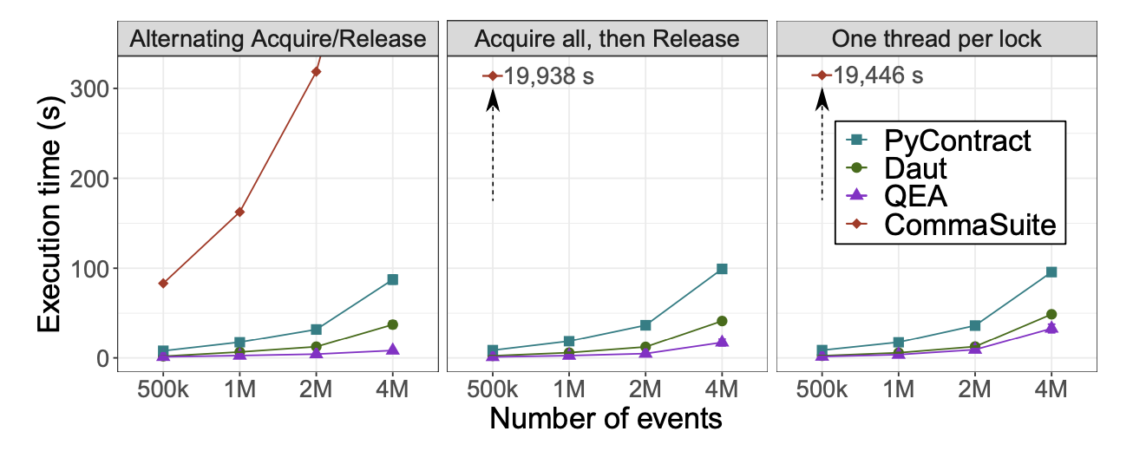

Slide 24
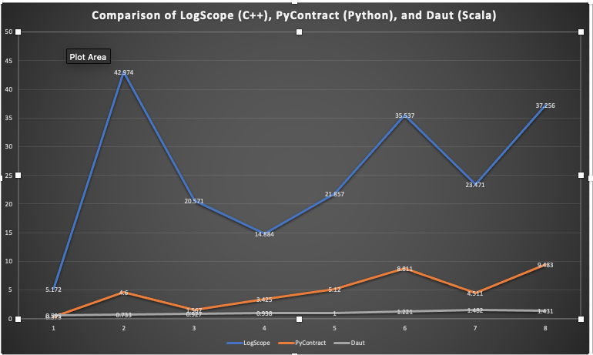
Comparison with external DSL translated to C++
ISoLA 2022 paper:
“Specification-based Monitoring in C++”,
K. Havelund
PyContract (in Python) performs better than external DSL translated to C++ since pattern matching is directly
supported in Python but had to be implemented in C++.

Slide 25
Conclusions
A shallow internal DSL in a popular programming language has advantages: expressiveness, ease of infusion, taking advantage of development tools, taking advantage of other libraries (e.g. such as Pandas for data analysis), fast development, reduced maintenance.
PyContract performs reasonably well.
PyContract is being applied within JPL to mission logs of the Europa Clipper mission.
Future work:
Combine RV with data analysis (ISoLA 2022 paper: “Runtime Verification as Documentation” – D. Dams, K. Havelund, and S. Kauffman)
Explore other library concepts (alternatives and extensions)

Slide 26


Slide 27
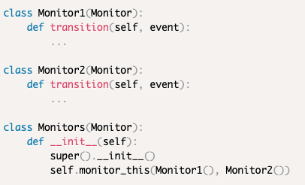
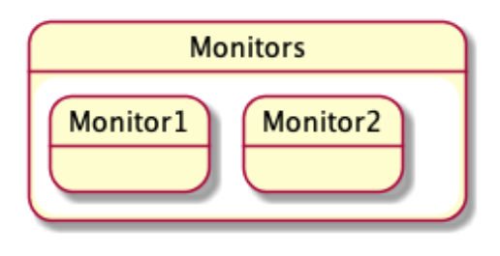
Combining monitors

Slide 28
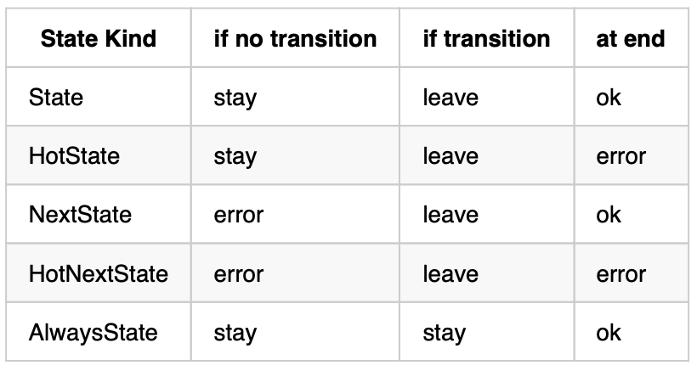
Five kinds of states

Slide 29
The set of states: we have to search for each event
?
Acquire(‘T1’, 1)

Slide 30
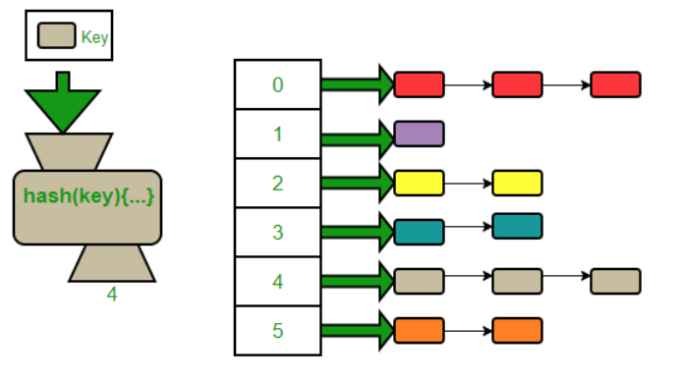
Indexing

Slide 31
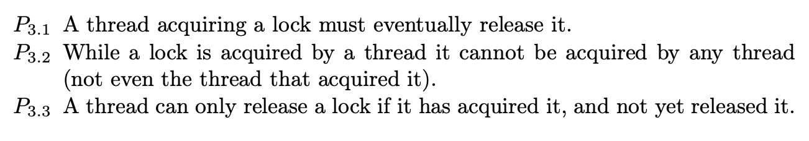
NextState and HotNextState
Requirement

Slide 32
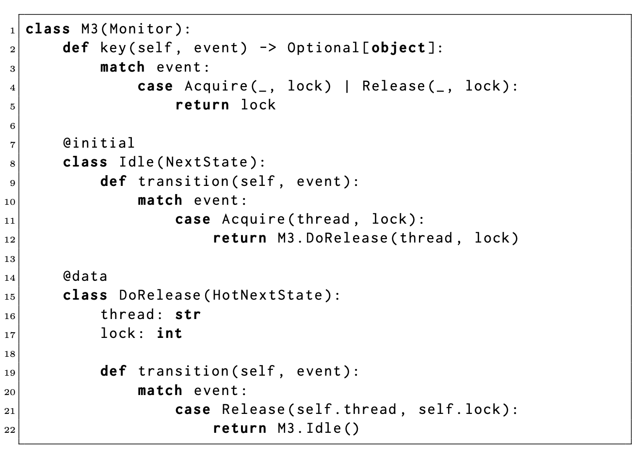

Slide 33
Event 1 Acquire(thread='T1', lock=1)
----------
DoRelease('T1', 1)
Event 2 Acquire(thread='T2', lock=2)
----------
DoRelease('T1', 1)
DoRelease('T2', 2)
Event 3 Acquire(thread='T1', lock=2)
*** error transition in M1: …
----------
DoRelease('T1', 1)
DoRelease('T1', 2)
Event 4 Release(thread='T1', lock=2)
----------
DoRelease('T1', 1)
Terminating monitoring!
*** error at end in M1: …
Previous debugging run with no indexing
With indexing
Event 1 Acquire(thread='T1', lock=1)
----------
index 1:
DoRelease('T1', 1)
Event 2 Acquire(thread='T2', lock=2)
----------
index 1:
DoRelease('T1', 1)
index 2:
DoRelease('T2', 2)
----------
…

Slide 34
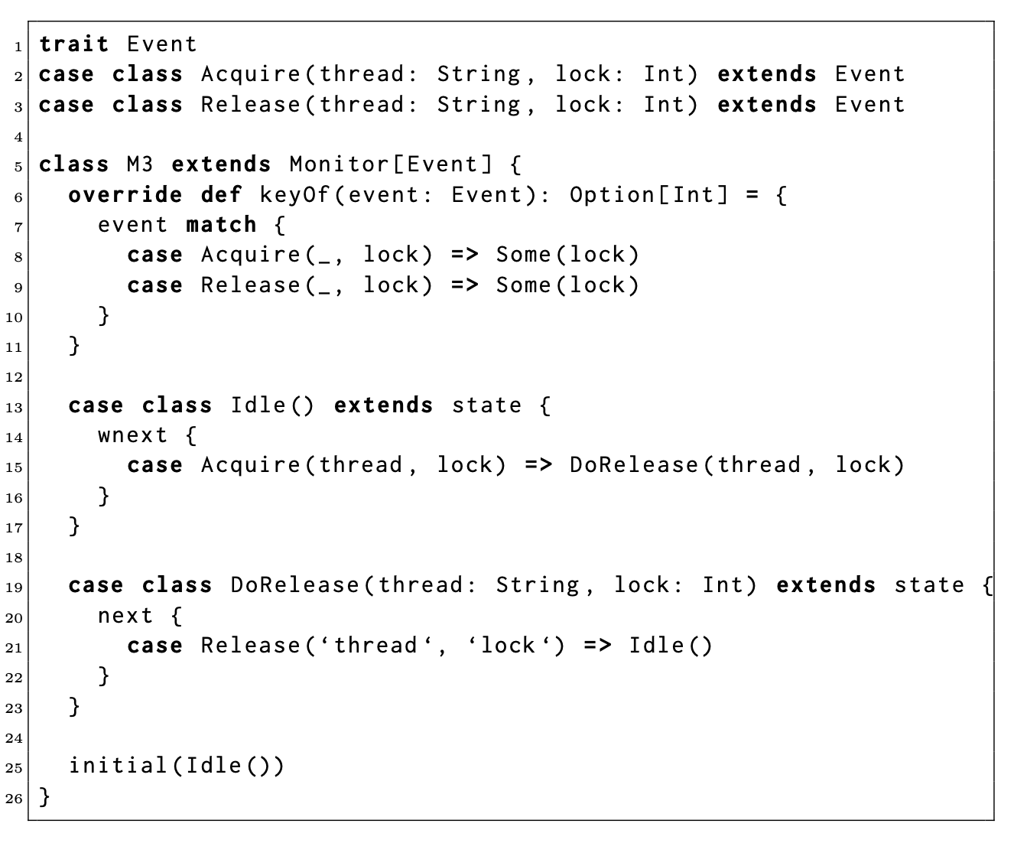
Daut

Slide 35
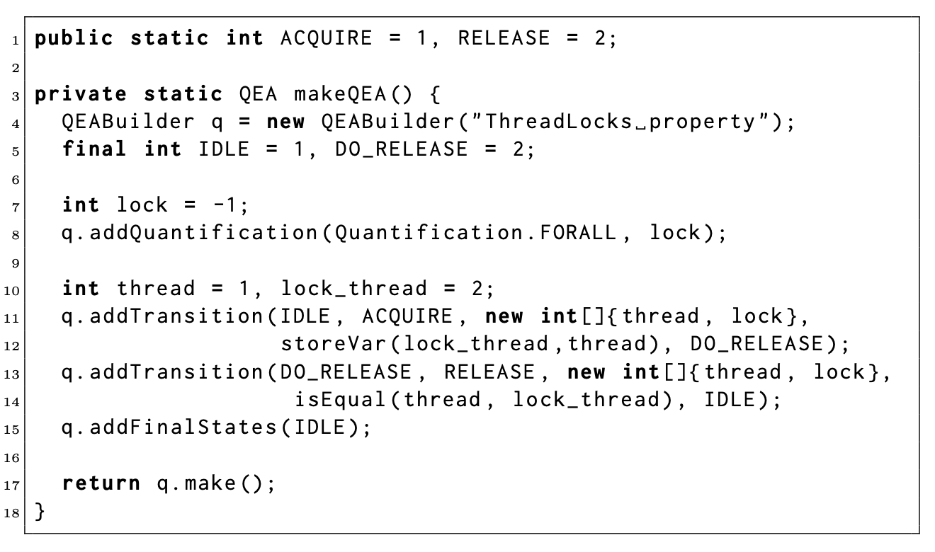
QEA

Slide 36
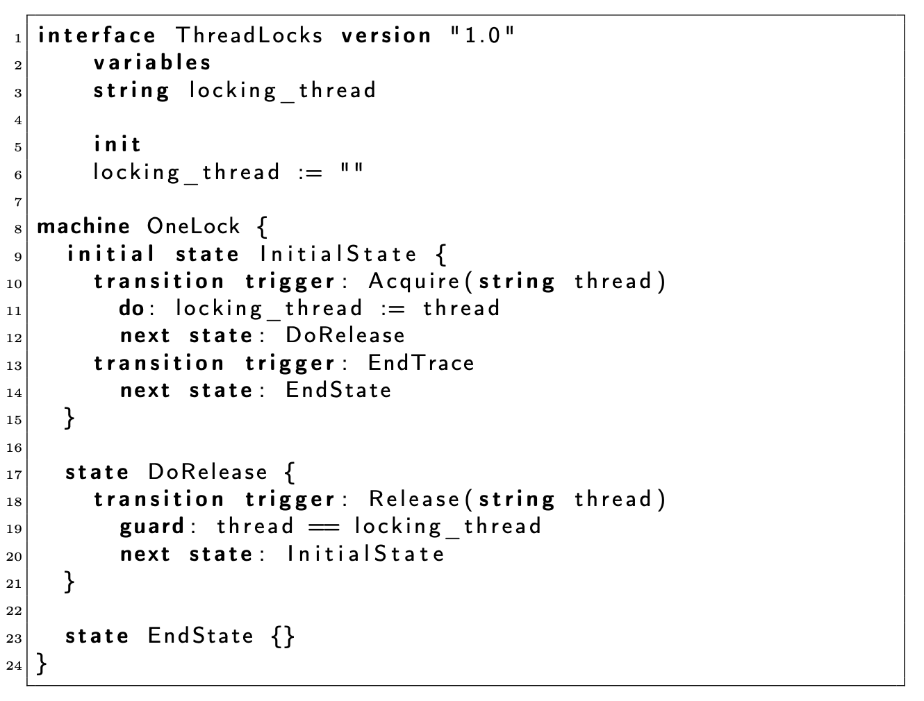
CommaSuite

