Slide 1
Average handling time
Minutes / ticket
Before
Time saving with TypeGenie
After

Slide 2
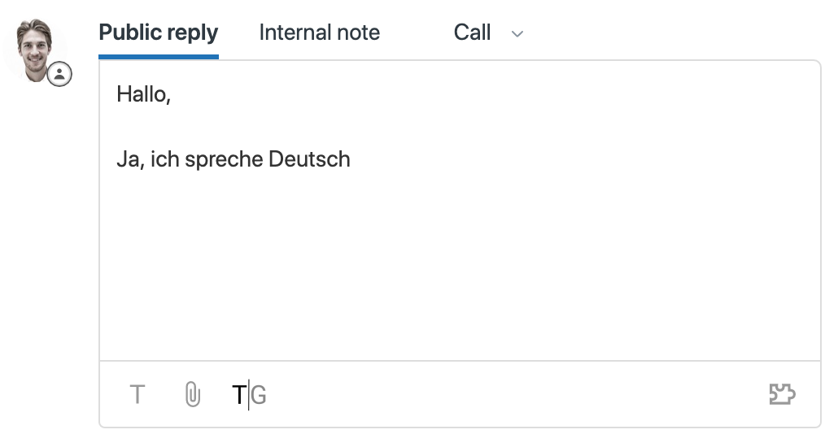
Hallo,
ja, ich spreche auch fließend Deutsch

Slide 3

Our opening hours are now 7am – 9pm
The opening hours are now 7am – 9pm
New opening hours are now 7am – 9pm

