Slide 1


Available Warehouse Properties
Strategic Logistics Locations
Notes:
VALUE
Thank you for giving us the opportunity to show how we can bring value to your organization

Slide 2



WAREHOUSE FACILITIES PROPOSAL FOR
FLASH EXPRESS LOGISTICS
PREPARED BY:
PREPARED FOR:
Cedtrix Rena
Sr. Leasing Advisor
PRIME Philippines
Valued Client
Logistics & Supply Chain Management
Flash Express Logistics
Notes:
VALUE
Thank you for giving us the opportunity to show how we can bring value to your organization

Slide 3

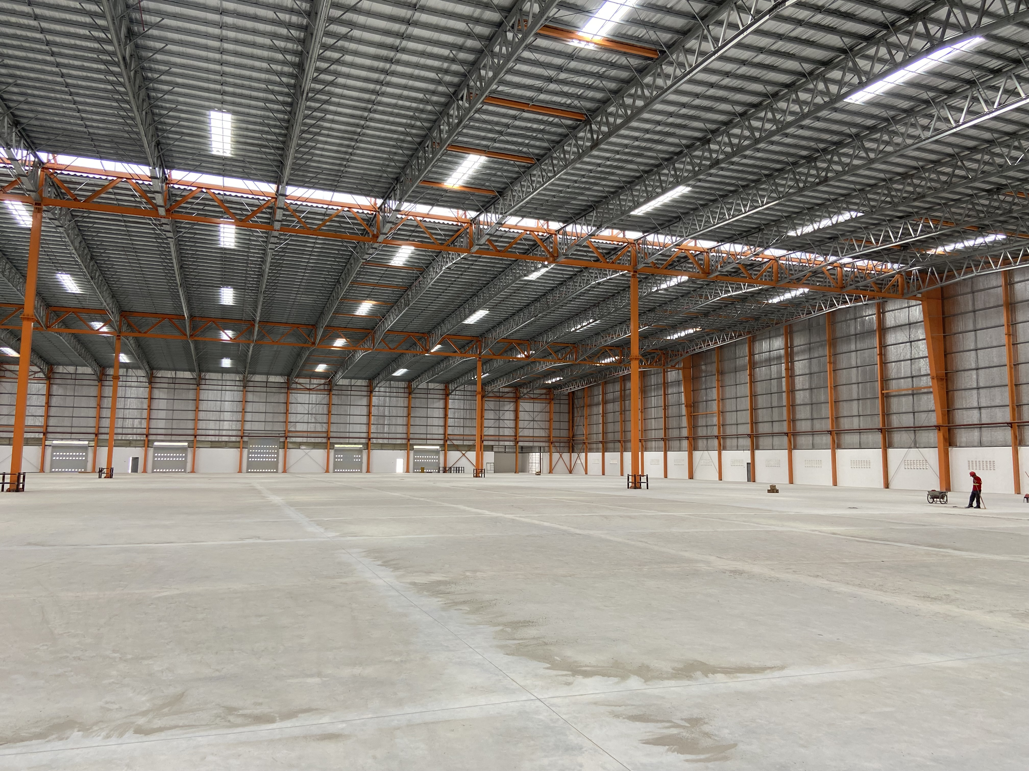
comparison proposal for their South Luzon hub expansion.
Laguna, Philippines
AVAILABLE UNITS FOR LEASE​
Area​ | Size​
Covered Area | 5,000 sqm
Open Yard | 1,000 sqm
TOTAL LEASABLE AREA | 5,000 sqm
LEASE TERMS AND CONDITION​​
Rental Rate (Covered) | Php 350.00/sqm + VAT
Rental Escalation | 5% Yearly
Min. Lease Term | 3 Years
Advance Rent | 3 Months
Security Deposit | 3 Months
Advance Rent ​ | Three (3) months​ + PDCs
Security Deposit​ | Three (3) months
Notes:
Today, we will look at 4 cities

Slide 4

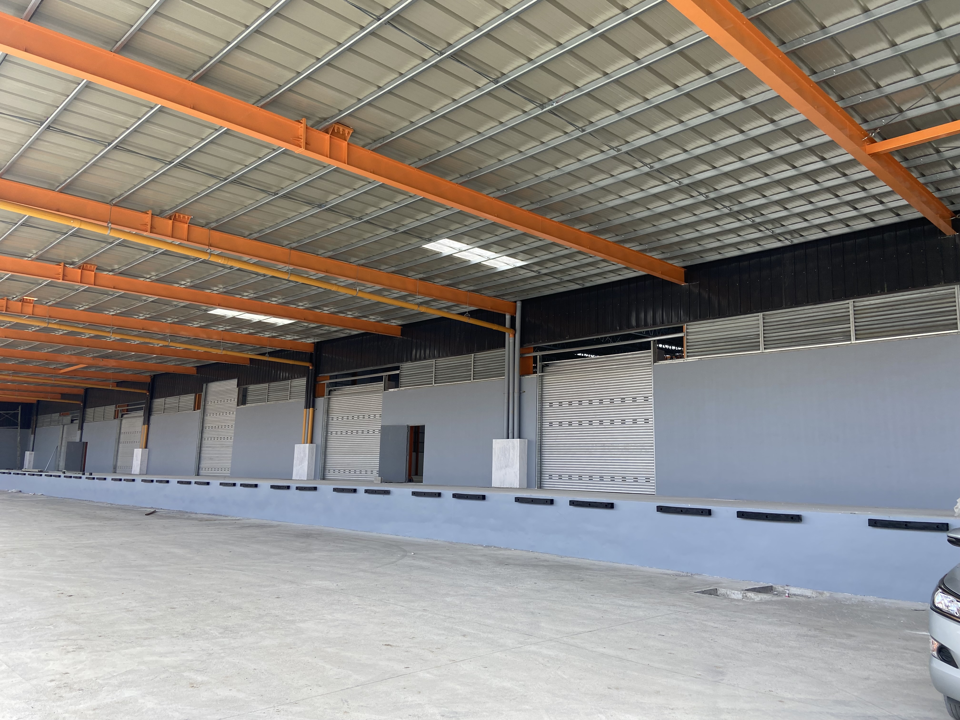
Property Details
SPECIFICATIONS
Loading Area | Elevated loading bays
APEX Height | 12-14 meters
Vehicle Capacity | Up to 40 ft. trucks
Electrical Load | Three Phase Ready
Ideal Use | Storage / Logistics / Distribution
Gated | Yes
Electrical Load | Three Phase Ready
Ideal Use | Storage / Distribution Centers / Manufacturing
Others | FDAS & Sprinklers / Sewage Treatment Plant / Cistern Tank / Backup Genset
ACCESSIBILITY
Distance from:
National Highway | 1.0 km
Expressway Exit | 3.5 km
Manila Port | 45 km
Notes:
Today, we will look at 4 cities

Slide 5
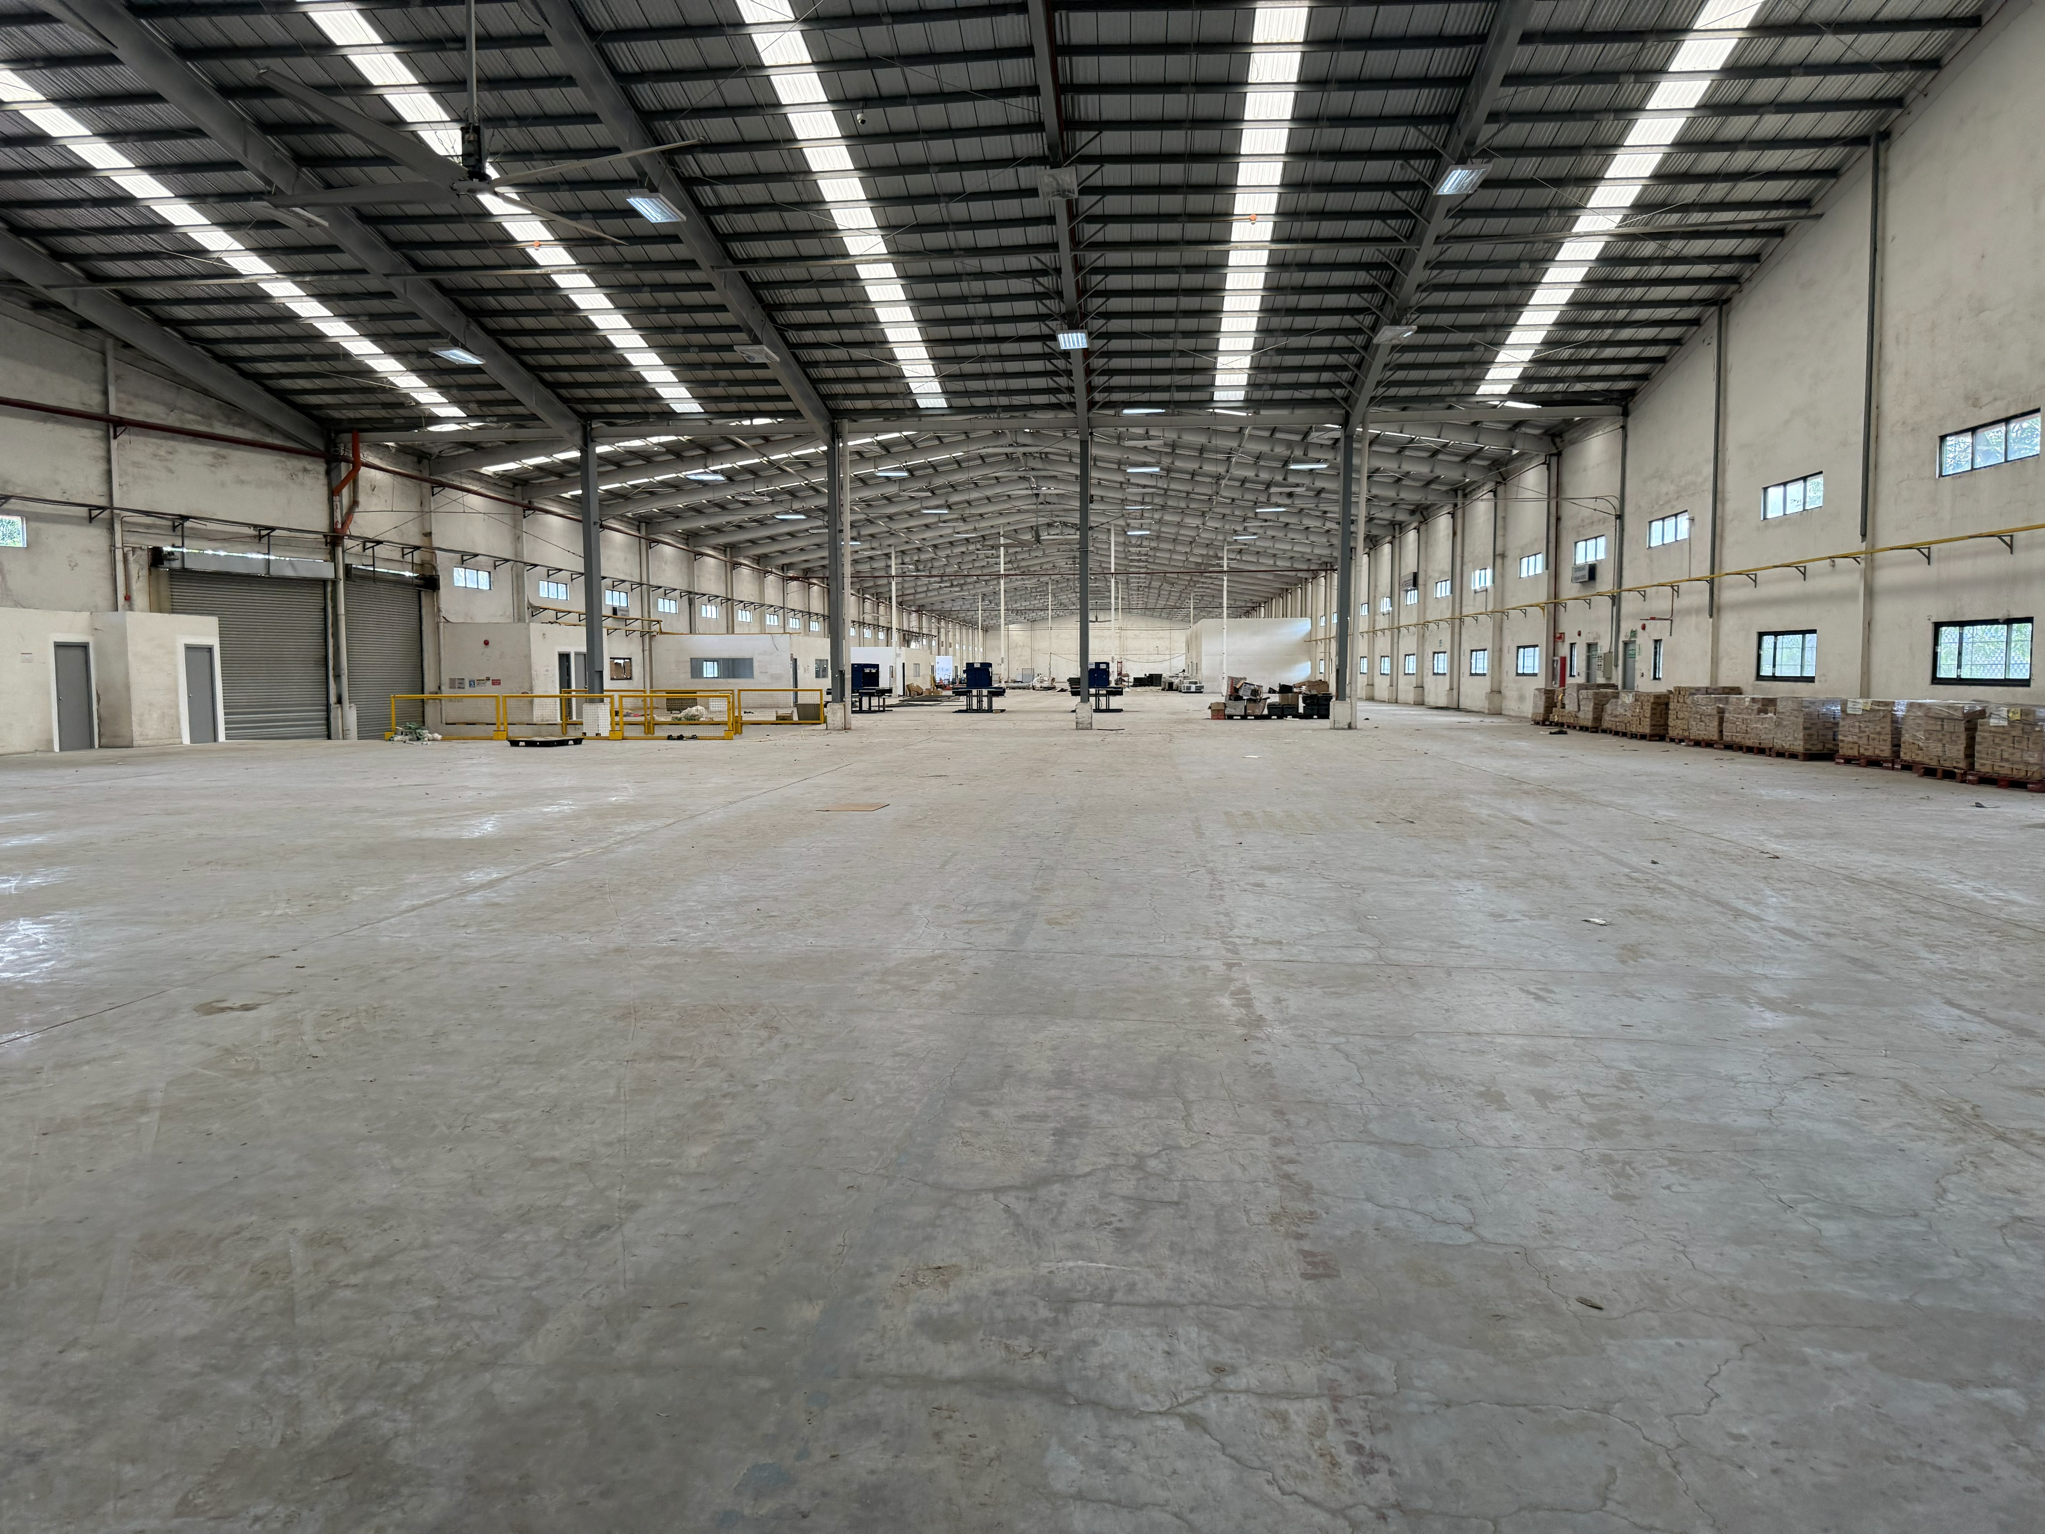
1:
Cabuyao, Laguna
AVAILABLE UNITS FOR LEASE​
Area​ | Size​
Covered Area | is 8,200 sqm, plus 1,500 sqm concrete open yard for truck staging. Total is 9,700 sqm.
Open Yard | 1,000 sqm
TOTAL LEASABLE AREA | is 8,200 sqm, plus 1,500 sqm concrete open yard for truck staging. Total is 9,700 sqm.
LEASE TERMS AND CONDITION​​
Rental Rate (Covered) | 375/sqm for covered, 100/sqm for open yard. Plus VAT.
Rental Escalation | 5% Yearly
Min. Lease Term | 3 Years
Advance Rent | 3 Months
Security Deposit | 3 Months
Advance Rent ​ | Three (3) months​ + PDCs
Security Deposit​ | Three (3) months
Notes:
Today, we will look at 4 cities

Slide 6
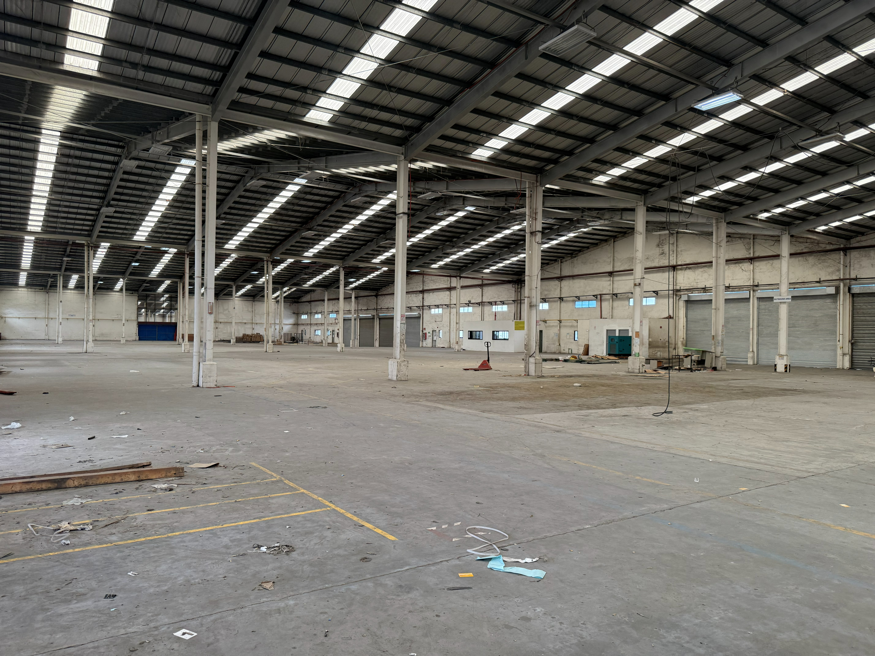
Property Details
SPECIFICATIONS
Loading Area | Elevated loading bays
APEX Height | 12-14 meters
Vehicle Capacity | Up to 40 ft. trucks
Electrical Load | Three Phase Ready
Ideal Use | Storage / Logistics / Distribution
Gated | Yes
Electrical Load | Single Phase Ready
Ideal Use | Storage / Distribution Centers / Manufacturing
ACCESSIBILITY
Distance from:
National Highway | 1.0 km
Expressway Exit | 3.5 km
Manila Port | 45 km
Notes:
Today, we will look at 4 cities

Slide 7
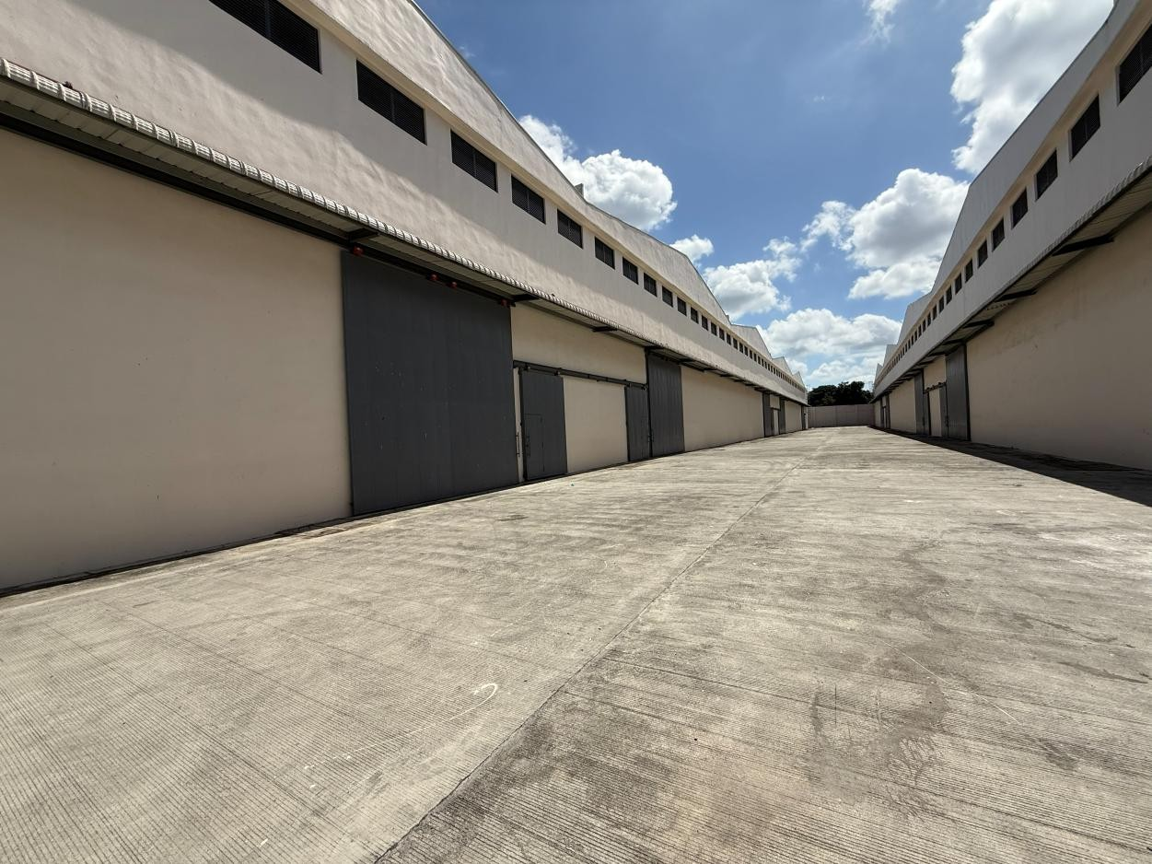

2:
Dasmarinas, Cavite
AVAILABLE UNITS FOR LEASE​
Unit | Size | Unit​ | Size
Covered Area | 6,400 sqm. Open area is 800 sqm. Total leasable: 7,200 sqm. | Warehouse 6 | 1,089.41 sqm
Open Yard | 1,000 sqm | Warehouse 7 | 1,175.35 sqm
TOTAL LEASABLE AREA | 6,400 sqm. Open area is 800 sqm. Total leasable: 7,200 sqm. | Warehouse 8 | 1,547.87 sqm
Warehouse 4 | 1,881.09 sqm | Warehouse 9 | 2,222.83 sqm
Warehouse 5 | 1,846.33 sqm | Warehouse 10 | 1,489.74 sqm
LEASE TERMS AND CONDITION​​
Rental Rate (Covered) | is 350/sqm + VAT. Escalation 5% yearly. 3 years lease, 3 mos adv, 3 mos dep.
Rental Escalation | 5% Yearly
Min. Lease Term | 3 Years
Advance Rent | 3 Months
Security Deposit | 3 Months
Advance Rent ​ | Three (3) months​ + PDCs
Security Deposit​ | Three (3) months
Notes:
Today, we will look at 4 cities

Slide 8
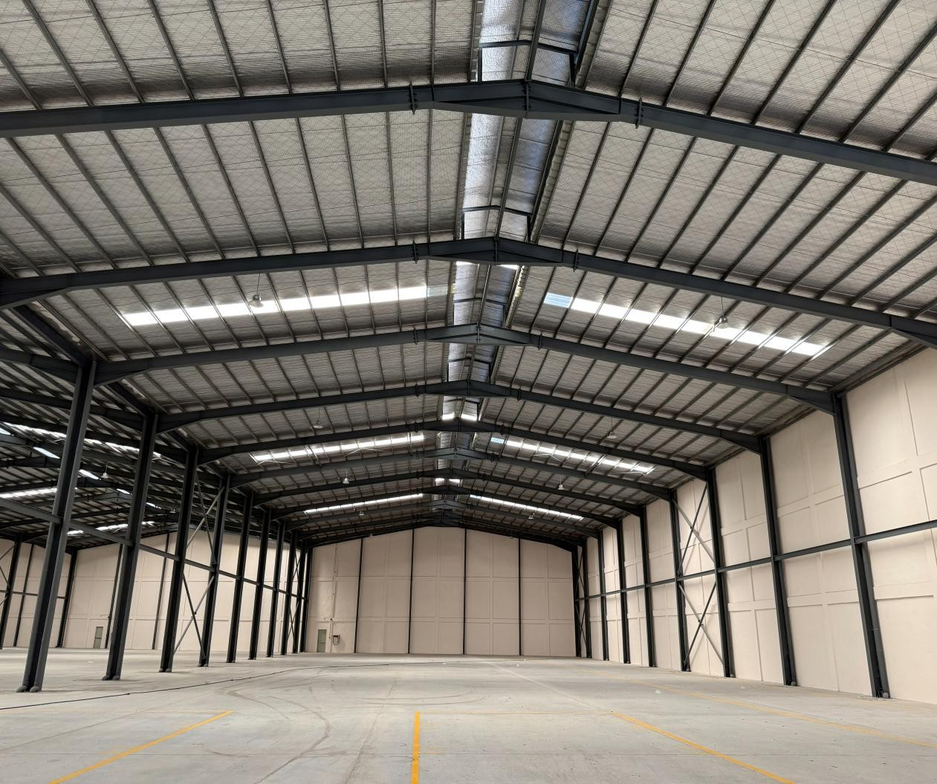

Property Details
SPECIFICATIONS
Loading Area | Elevated loading bays
APEX Height | 12-14 meters
Vehicle Capacity | Up to 40 ft. trucks
Electrical Load | Three Phase Ready
Ideal Use | Storage / Logistics / Distribution
Gated | Yes
Electrical Load | Single Phase Ready
Ideal Use | Storage / Distribution Centers / Manufacturing
ACCESSIBILITY
Distance from:
National Highway | 1.0 km
Expressway Exit | 3.5 km
Manila Port | 45 km
Notes:
Today, we will look at 4 cities

Slide 9


Thank you
For more information and to schedule a viewing, feel free to contact us at:
Cedtrix Rena
Sr. Leasing Advisor – Retail and Industrial Markets
+63 917 625 3353
cedtrix.rena@primephilippines.com
Sondi Tuazon
Sr. Head – Retail and Industrial Markets
+63 917 843 6128
sondituazon.primecorp@gmail.com
Notes:
VALUE
Thank you for giving us the opportunity to show how we can bring value to your organization

Slide 10






