Slide 1


Available Warehouse Properties
Cavite & Laguna Logistics Corridor
Notes:
VALUE
Thank you for giving us the opportunity to show how we can bring value to your organization

Slide 2



LOGISTICS & WAREHOUSE PROPOSAL FOR
GLOBAL FREIGHT LOGISTICS PHILIPPINES INC.
PREPARED BY:
PREPARED FOR:
Cedtrix Rena
Sr. Leasing Advisor
PRIME Philippines
Marcus Vance
Supply Chain Director
Global Freight Logistics Philippines Inc.
Notes:
VALUE
Thank you for giving us the opportunity to show how we can bring value to your organization

Slide 3

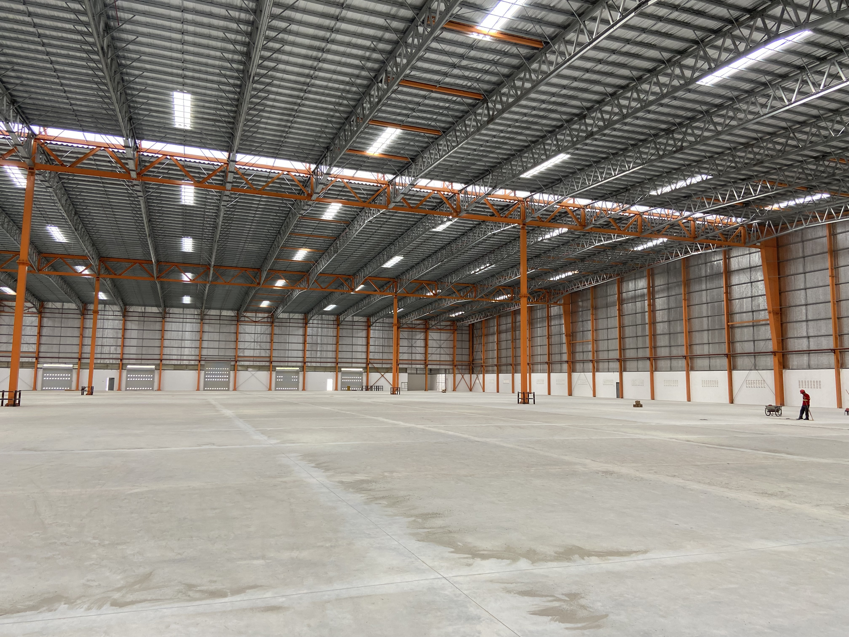
Apex Logistics Center
Carmona, Cavite
AVAILABLE UNITS FOR LEASE​
Area​ | Size​
Covered Area | 10,500 sqm
Open Yard / Parking | 2,200 sqm
TOTAL LEASABLE AREA | 12,700 sqm
LEASE TERMS AND CONDITION​​
Rental Rate (Covered) | Php 380.00/sqm + VAT
Rental Rate (Yard) | Php 120.00/sqm
CUSA | Php 35.00/sqm
Rental Escalation | 5% Annually
Min. Lease Term | 5 Years
Advance Rent | 3 Months
Security Deposit | 3 Months
Notes:
Today, we will look at 4 cities

Slide 4

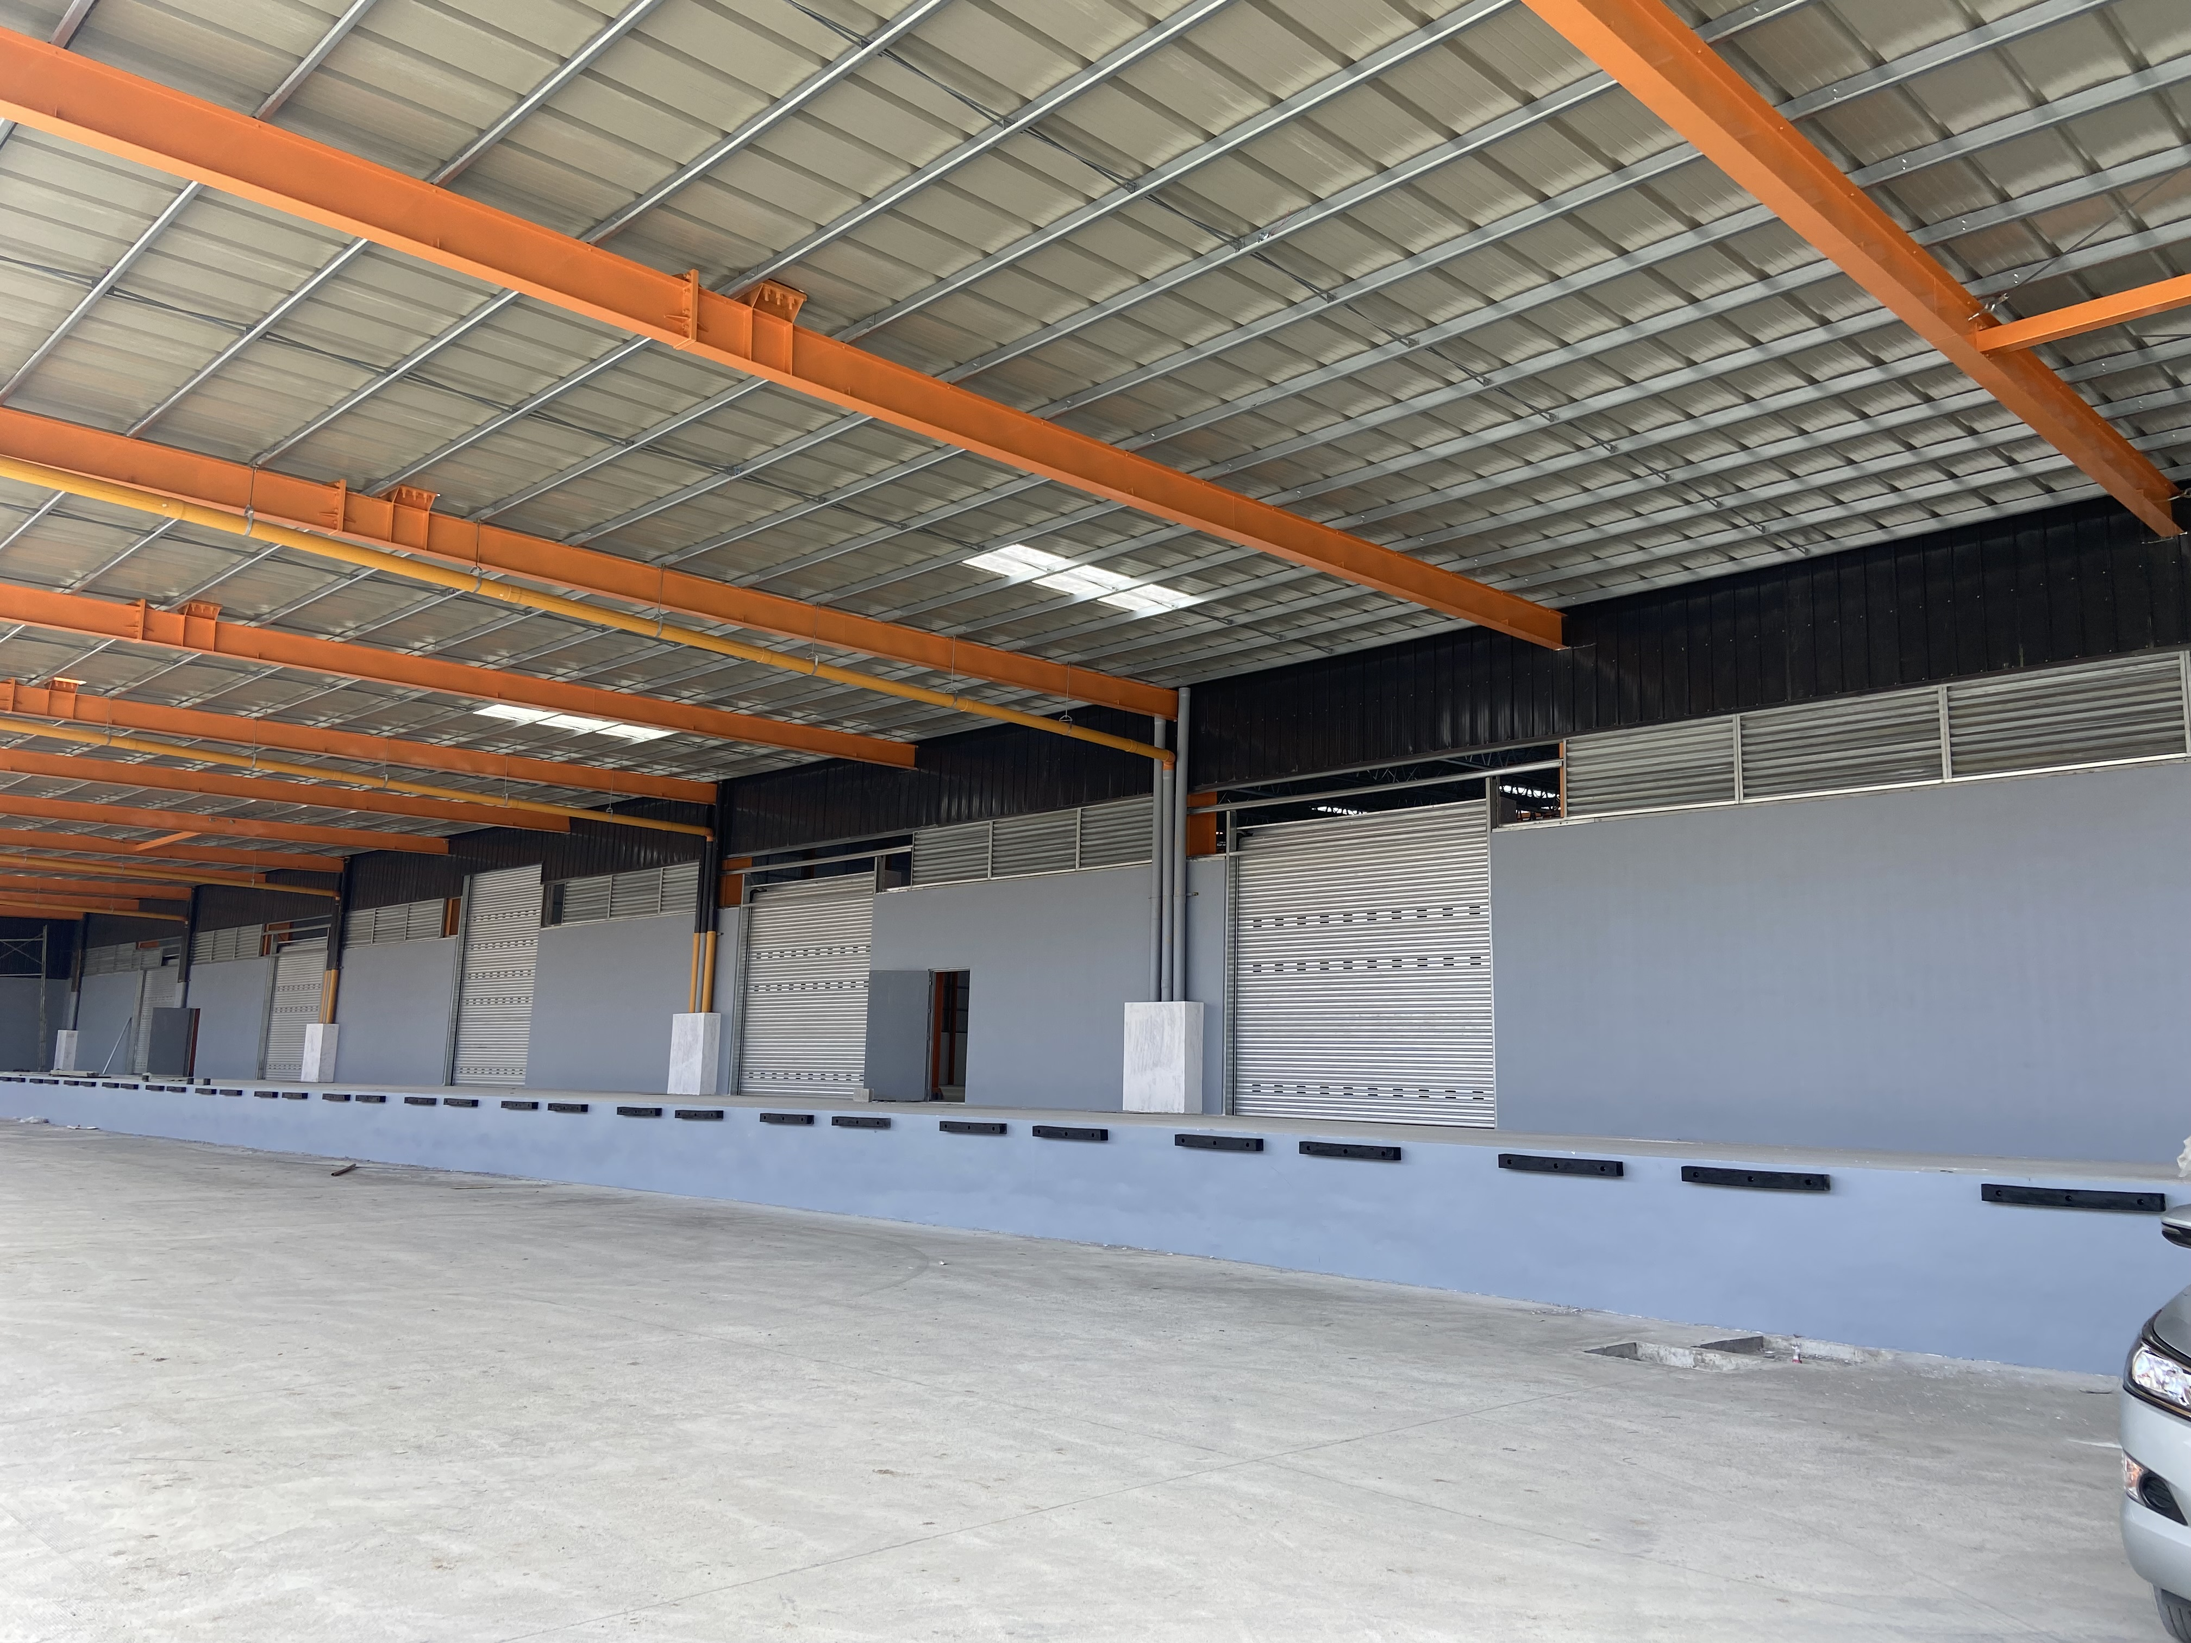
Property Details
SPECIFICATIONS
Loading Area | 12 Elevated Docks with Dock Levelers
APEX Height | 14.5 meters
Shoulder Height | 12.0 meters
Vehicle Capacity | 40-ft and 45-ft Container Trucks
Floor Load Capacity | 5 tons/sqm
Electrical Load | Three-Phase 400 KVA Dedicated Transformer
Fire Protection | ESFR Sprinklers & Central FDAS
Ideal Use | FMCG Distribution, 3PL Logistics, Cold Chain Conversion
Others | FDAS & Sprinklers / Sewage Treatment Plant / Cistern Tank / Backup Genset
ACCESSIBILITY
Distance from:
National Highway | 400 meters
SLEX – Carmona Exit | 1.8 km
CALAX Interchange | 3.2 km
Notes:
Today, we will look at 4 cities

Slide 5
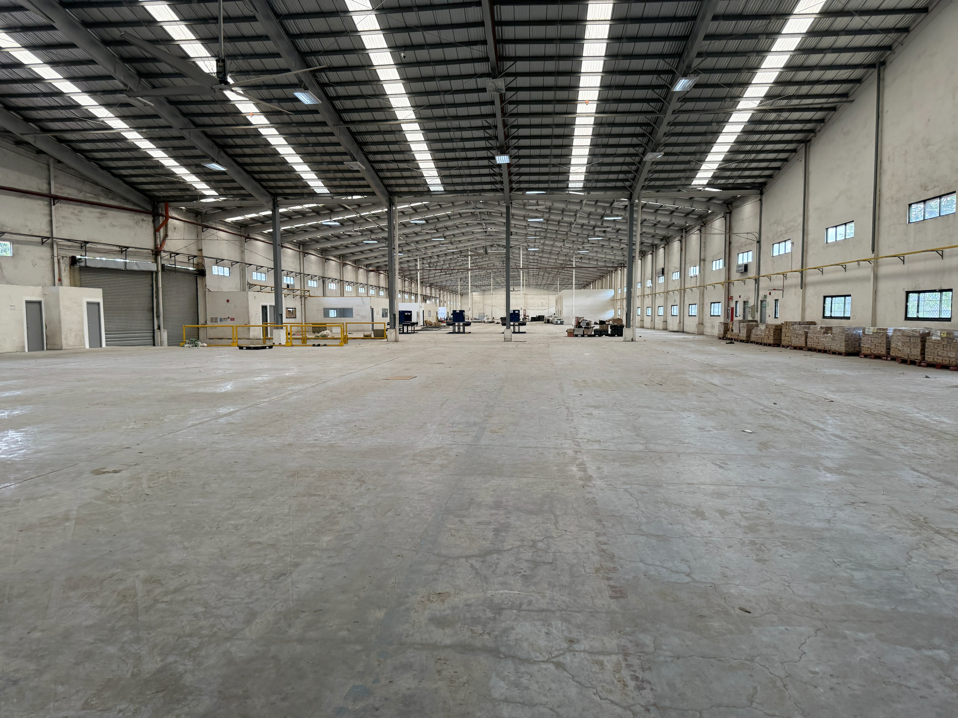
Metro South Industrial Park
Santa Rosa, Laguna
AVAILABLE UNITS FOR LEASE​
Area​ | Size​
Warehouse Bay 1 | 4,800 sqm
Warehouse Bay 2 | 5,200 sqm
Mezzanine Office | 650 sqm
LEASE TERMS AND CONDITION​​
Rental Rate (Covered) | Php 360.00/sqm + VAT
CUSA | Php 30.00/sqm
Rental Escalation | 5% Yearly
Min. Lease | 3 Years
Advance Rent | 3 Months
Security Deposit | 3 Months
Security Deposit​ | Three (3) months
Notes:
Today, we will look at 4 cities

Slide 6
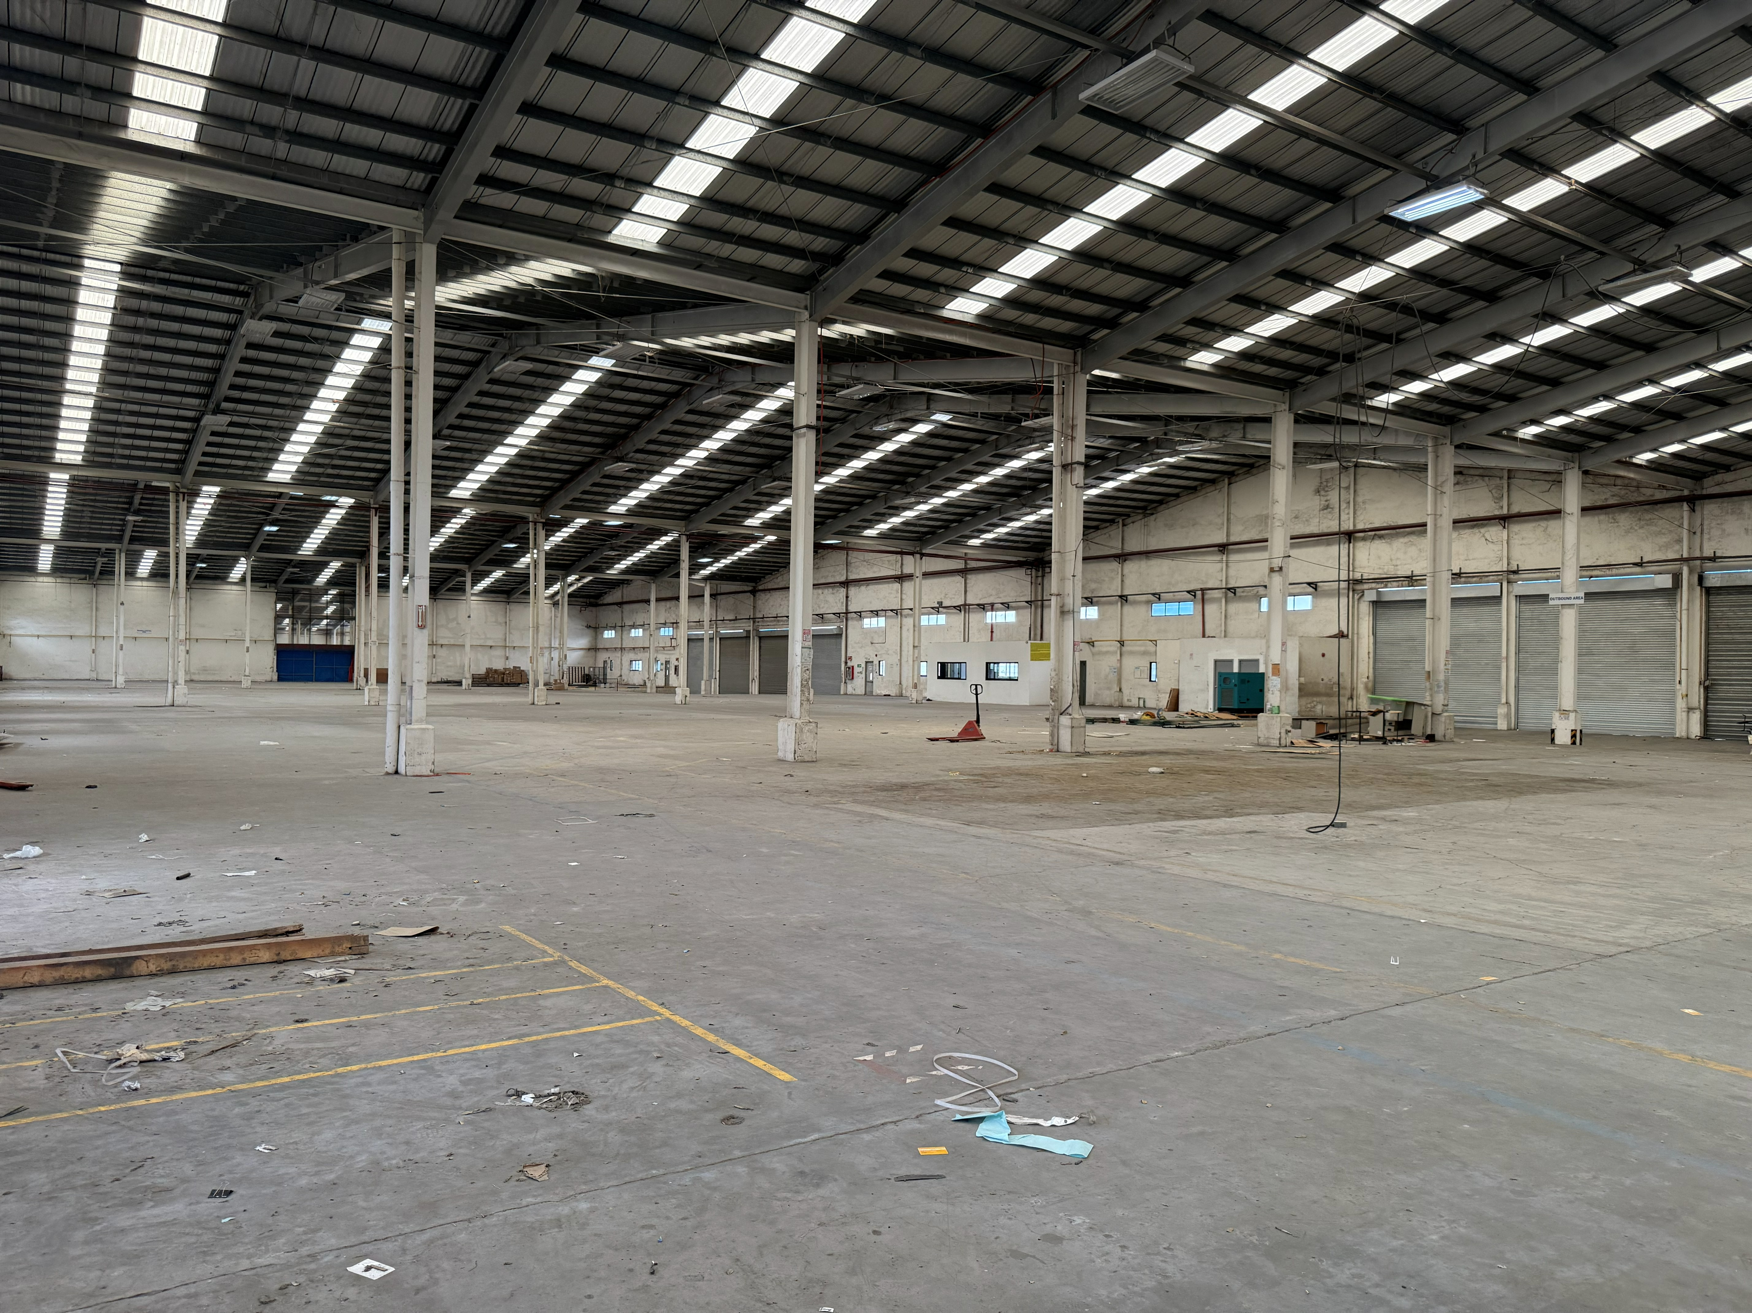
Property Details
SPECIFICATIONS
Loading Area | 8 Cross-Dock Bays with Canopy
APEX Height | 13.0 meters
Shoulder Height | 10.5 meters
Vehicle Capacity | Up to 40 ft. Container Chassis
Security | 24/7 Guarded Gated Industrial Complex
Electrical Load | High-Voltage Three Phase Ready
Ideal Use | E-Commerce Fulfillment, Electronics Assembly, Warehousing
Ideal Use | Storage / Distribution Centers / Manufacturing
ACCESSIBILITY
Distance from:
Sta. Rosa - Tagaytay Road | 600 m
SLEX – Santa Rosa Exit | 2.5 km
SLEX – Eton Exit | 4.1 km
Notes:
Today, we will look at 4 cities

Slide 7

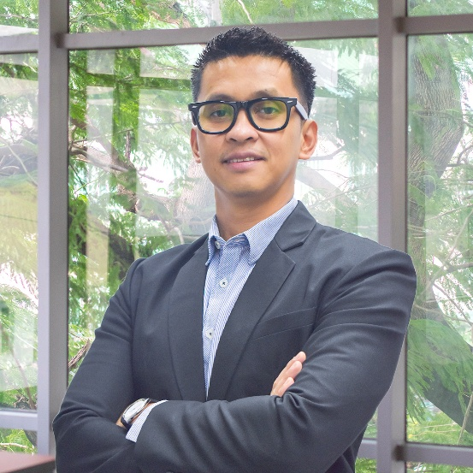
Thank you
For more information and to schedule a viewing, feel free to contact us at:
Cedtrix Rena
Sr. Leasing Advisor – Retail and Industrial Markets
+63 917 625 3353
cedtrix.rena@primephilippines.com
Sondi Tuazon
Sr. Head – Retail and Industrial Markets
+63 917 843 6128
sondituazon.primecorp@gmail.com
Notes:
VALUE
Thank you for giving us the opportunity to show how we can bring value to your organization

Slide 8






