Slide 1
Cell Structure
The cell membrane controls what enters and leaves the cell.
The nucleus contains the genetic material DNA and is surrounded by a double membrane.
Ribosomes build proteins and can be free in the cytoplasm or attached to the endoplasmic reticulum.

Slide 2
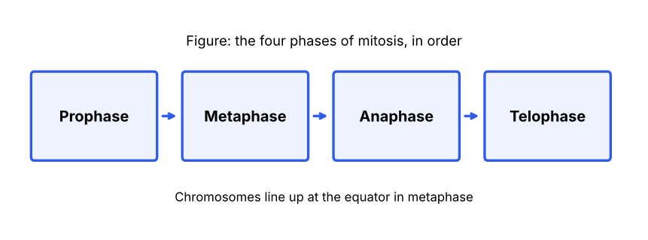
Mitosis
Mitosis produces two genetically identical daughter cells from one parent cell.
Mitosis has four main phases: prophase, metaphase, anaphase, and telophase.
Chromosomes line up at the cell equator during metaphase.

Slide 3
Meiosis
Meiosis produces four haploid gametes, each with half the chromosome number of the parent cell.
Crossing over during prophase I shuffles genetic material and increases genetic variation.

