Slide 1




Big data analysis
PythoNinjas
Guillaume JOLIVALT
Pierre BÉNOT Clément FABIEN Elmurodjon ABDULLAJONOV

Slide 2



Detailed Overview
These are the three main topics we chose to focus on, by searching for datasets and finding statistics about them.
01
Online Education
02
Ecology
03
Online Shopping

Slide 3

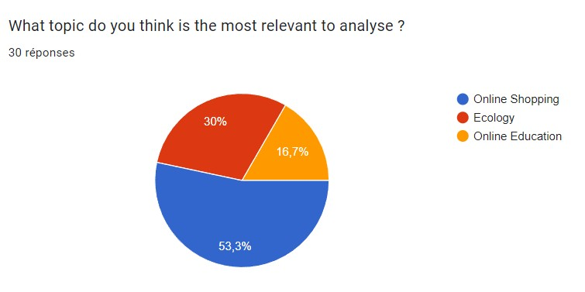
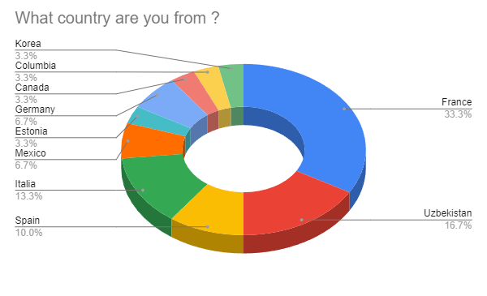


Online Shopping
We created a survey and asked 30 people around the world from different ethnics, age and educational level groups to complete it

Slide 4
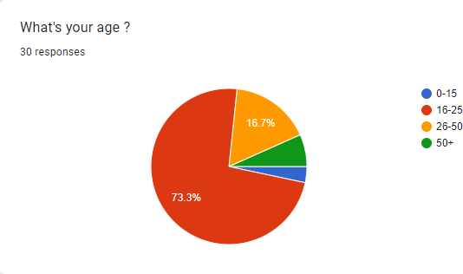
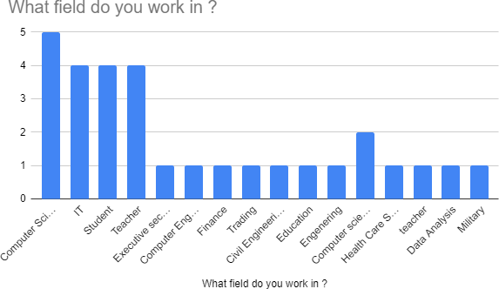
Survey results based on participant's age and the field they work in

Slide 5
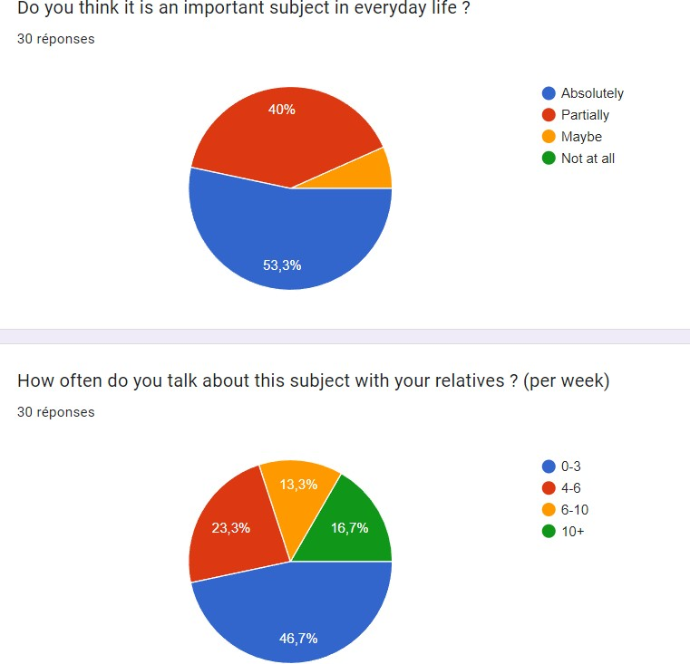
Importance of this subject to people

Slide 6



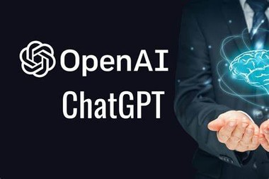
Datasets and tools
Using kaggle we managed to find over 200 datasets about online shopping
To analyze those datasets, we will use tools such as panda, matplotlib, python and GPT models like Chat- GPT

Slide 7
Action Plan
Find Subjects
Create the survey
Collect answers
Choose the subject
Find useful data
Use tools to analyse
Find Datasets
Conclude

Slide 8

THANK
YOU

