Slide 1




Big Data Analysis
PythoNinjas
Online Shopping
Guillaume JOLIVALT
Pierre BÉNOT Clément FABIEN
Elmurodjon ABDULLAJONOV

Slide 2




Summary
Plan
The Dataset
Analysis of the Dataset Conclution

Slide 3


Plan
Since our topic was quite large, we had to narrow it down to a more specific part of the subject for our project
01
Searching for topics
02
Creating the survey
03
Choosing the subject
04
Choosing a dataset
05
06
Analysing it
Concluding

Slide 4

The Dataset
The dataset we used was a dataset that lists all the online sales that occurred in the USA for a year, from October 2020 to September 2021.

Slide 5
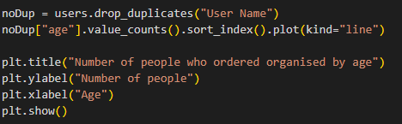
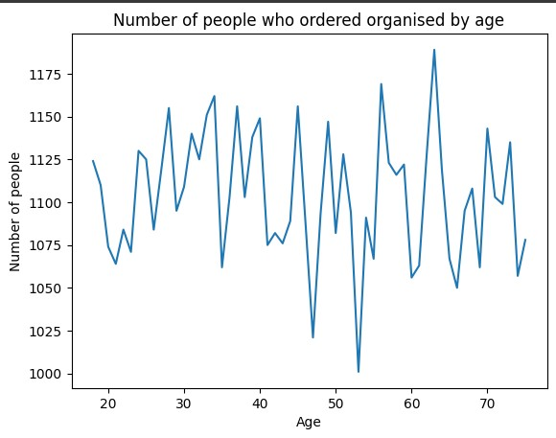


How to analyze it
Loading the file
Getting the info we need
Using graphs to visualize the data

Slide 6
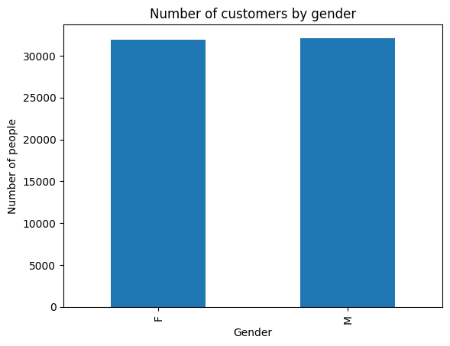

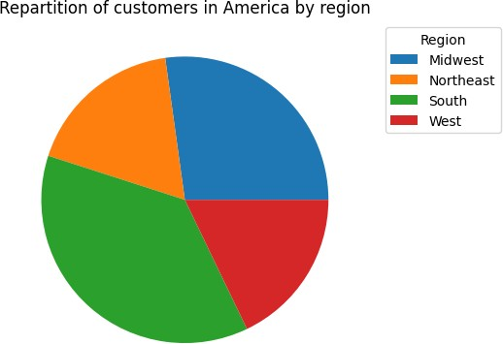
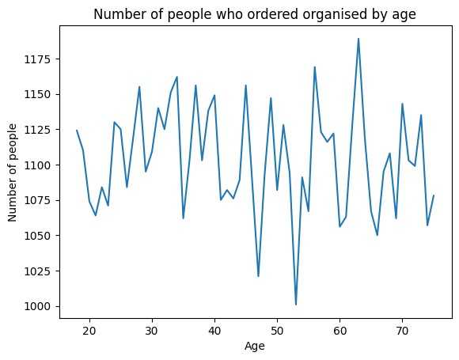
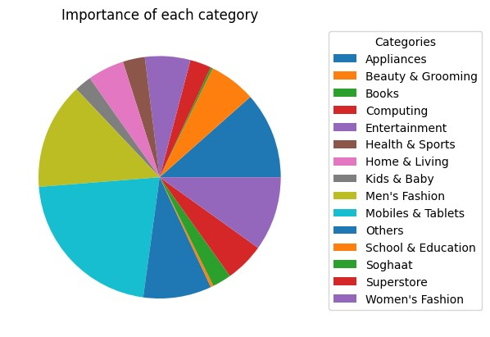
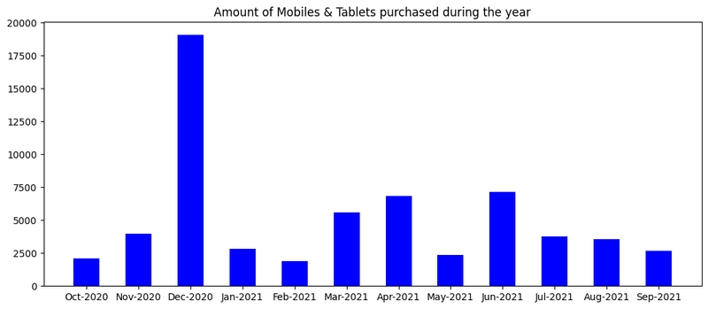

The Graphs
In total we created 5 graphs with the help of pandas and matplotlib

Slide 7
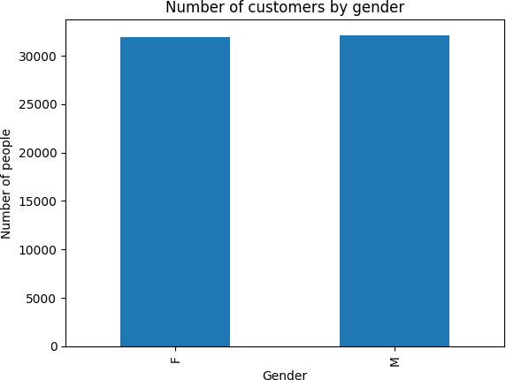
Diverse origins,
genders, and ages

Slide 8
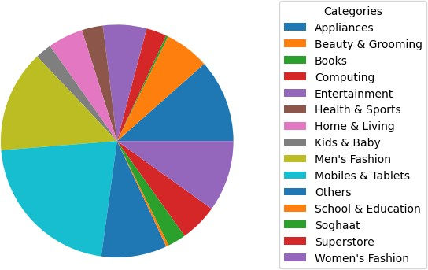
The importance
of each
category with a pie chart

Slide 9
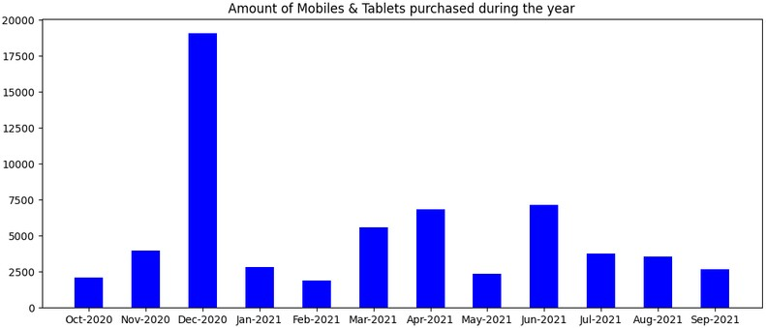
The amount of Mobiles and Tablets purchased during the year

Slide 10


Conclusion
Mobiles and tablets on dataset
Over consumption
Subject
Tools Ideas
Needs to be changed

Slide 11

THANK
YOU
Write a topic or a highlight of the presentation here.

