Slide 1
Facial Landmark Detection
Detecting landmarks in facial heightmaps

Slide 2
Motivation
Currently, processor uses pre-trained PFLD (A Practical Facial Landmark Detector) model with onnxruntime.
It depends on tricky camera position and lighting conditions with rendering 2D image from skin volume
Detection in heightmaps can make feature detection process more efficient and easier.

Slide 3
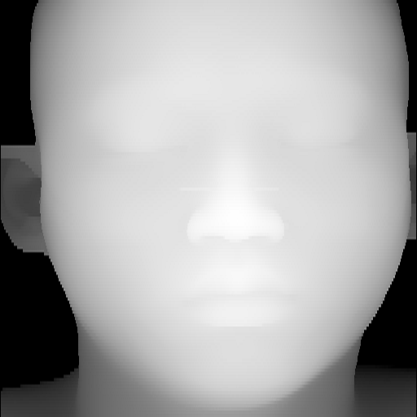
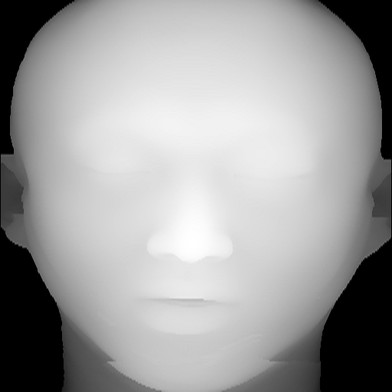
Data (heightmaps)

Slide 4
Approach
According top Mr. Na, our current PFLD model is not providing good detection
It can be tricky to detect since there is no textural or color information
First approach I opted for is MediaPipe Face Mesh model

Slide 5
MediaPipe Face Mesh
MediaPipe Face Mesh is a face geometry solution that estimates 468 3D face landmarks in real-time even on mobile devices.
Developed by Google Research team
According to their paper, these use straightforward residual neural network architecture.
In addition to the Face Landmark Model, they also provide another model that applies attention to semantically meaningful face regions, and therefore predicting landmarks more accurately around lips, eyes and irises, at the expense of more compute.

Slide 6
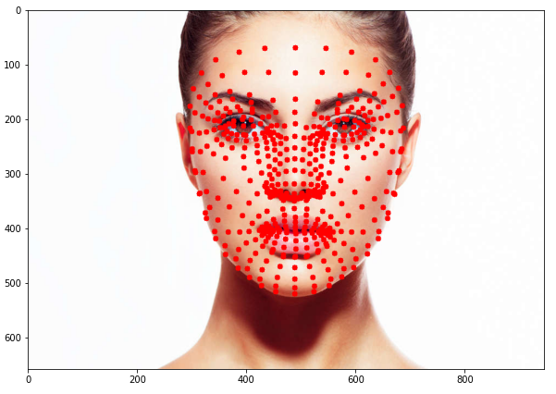
MediaPipe Face Mesh

Slide 7
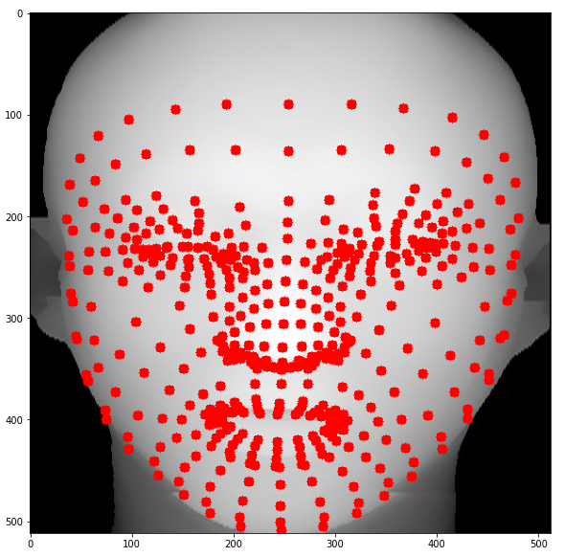
MediaPipe Face Mesh
468 landmarks detected
478 with attention base refinement

Slide 8
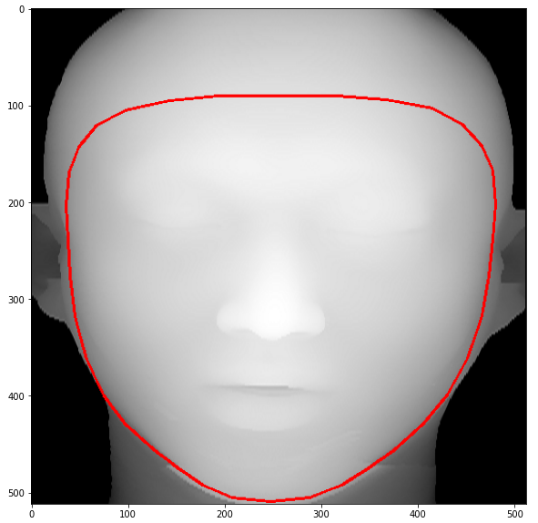
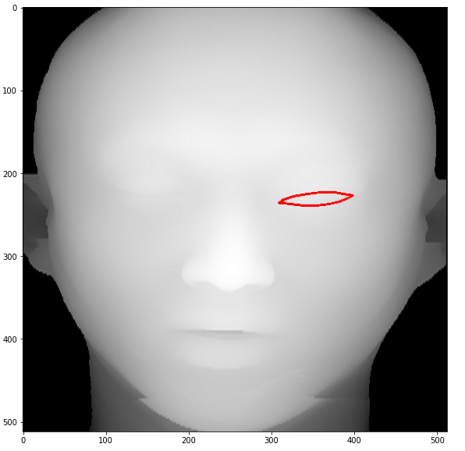
MediaPipe Face Mesh
Can also highlight only the specific regions
e.g. left eye, face oval

Slide 9
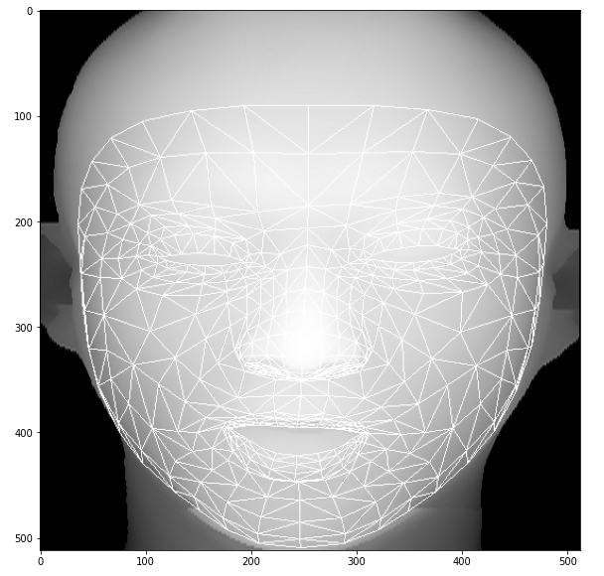
MediaPipe Face Mesh
Face mesh

Slide 10
Conclusion
The model provides good facial landmark detection
However, in our data, there are some cases where model does not detect landmarks.
I am not sure about the reason yet
Looking into it. It can be poor image resolution or quality I think.
These are still early results
Testing on more examples today to be sure

