Slide 1
Facial Landmark Detection
Detecting landmarks in facial height maps

Slide 2
Motivation
Currently, processor uses pre-trained PFLD (A Practical Facial Landmark Detector) model with onnxruntime.
It depends on tricky camera position and lighting conditions with rendering 2D image from skin volume
Detection in heightmaps can make feature detection process more efficient and easier.

Slide 3
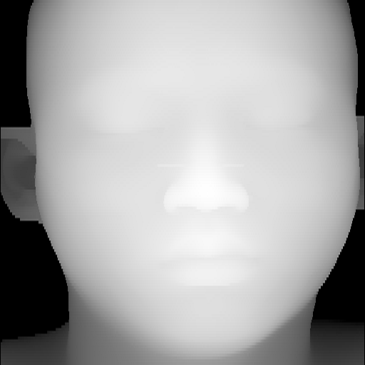
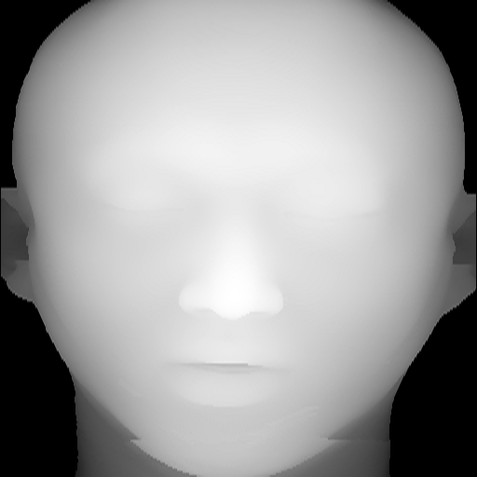
Data (heightmaps)

Slide 4
Approach
According top Mr. Na, our current PFLD model is not providing good detection
It can be tricky to detect since there is no textural or color information
First approach I opted for is MediaPipe Face Mesh model

Slide 5
MediaPipe Face Mesh
MediaPipe Face Mesh is a face geometry solution that estimates 468 3D face landmarks in real-time even on mobile devices.
Developed by Google Research team
According to their paper, these use straightforward residual neural network architecture.
In addition to the Face Landmark Model, they also provide another model that applies attention to semantically meaningful face regions, and therefore predicting landmarks more accurately around lips, eyes and irises, at the expense of more compute.

Slide 6
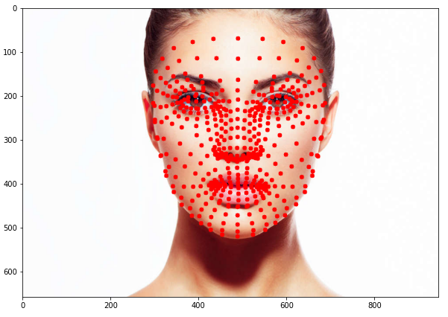
MediaPipe Face Mesh

Slide 7
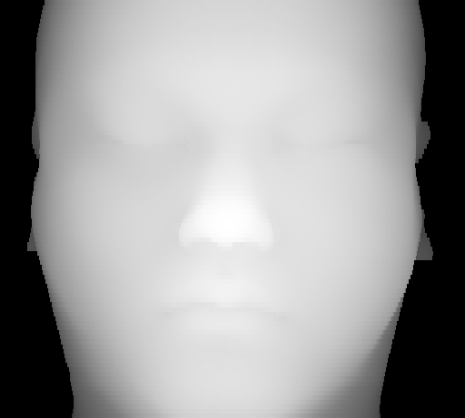
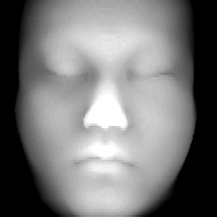
Preprocessing
Gamma Adjustment
+
cv2.detailEnhance

Slide 8
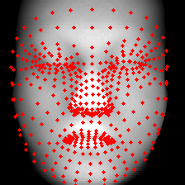
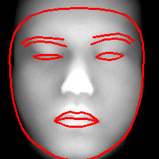
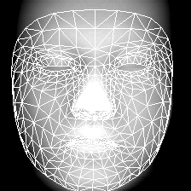
MediaPipe Face Mesh
landmarks
contours
Facemesh_tesselation

Slide 9
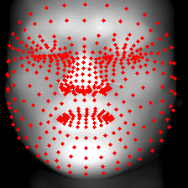
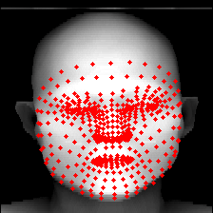
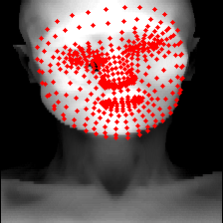
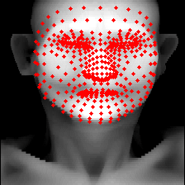
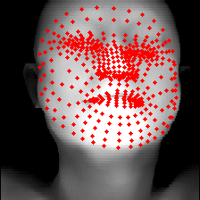
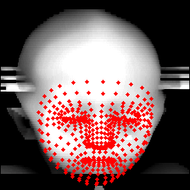
Results
The model performs well even if the face is deformed or is not oriented well.

Slide 10
Some Notes
Model correctly predicts on all 248 input images
Input size
Model performance varies with input size
Good performance for 224x224
Original paper used 128x128 or 256x256
There are some failed cases for higher input size (e.g. 512x512)
Preprocessing
Important due to poor image quality

