Slide 1
Facial Landmark Detection
Detecting landmarks in facial height maps

Slide 2
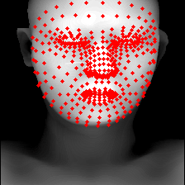
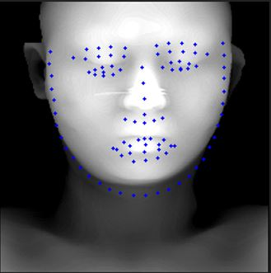
MediaPipe vs PFLD

Slide 3
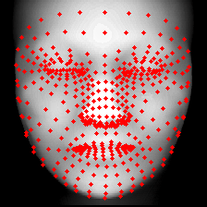
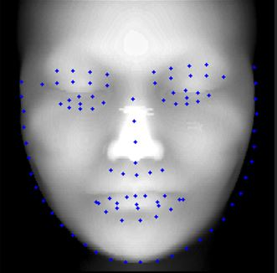
MediaPipe vs PFLD
MediaPipe provides more accurate results

Slide 4
Ongoing
Converted MediaPipe model to Onnx
Model is converted but some operation are not supported
Testing in Unity
Issue due to previous step
Posted on their github issues

