Slide 1
def add(x: int, y: int) -> str:
return x + y
alpha = 5
beta = "6"
gamma = 1
# A
print(alpha + gamma)
# B
print(alpha + beta)
# C
print(alpha * beta)
# D
print(alpha in beta)
alpha = 5
if alpha > 5:
alpha = 2
elif alpha > 3:
alpha = 4
else:
alpha = 1
def sum_and_count(a: int, b: int, c: int) -> int:
"""
Return the total of the three numbers added
together, and the number of numbers that were
passed in (3).
"""
return a + b + c
return 3
print(sum_and_count(1, 1, 2))

Slide 2
from dataclasses import dataclass
class Dog:
name: str
age: int
fuzzy: bool
ada = Dog("Ada Bart", 4, True)

Slide 3




Secret word:
“Dog”
Draw a circle at the top of the page.
The Programmer gets the secret word.
The Programmer gives drawing instructions to The Computers.
Only triangles, circles, and squares are allowed; no other shapes are okay.
The blue circle should be below the red rectangle.
It’s a dog!
Very good!
You are allowed to words related to position, size, rotation, color, and other similar descriptors.
When the instructions are done, The Computers show off their creations.
The Computers take turns guessing what the original secret word was.

Slide 4
grades = [99, 56, 83, 95, 44]
for grade in grades:
print(grade)
0
1
2
3
4
5
6
def double(num: int) -> int:
return num * 2
def add1(num: int) -> int:
return num + 1
print(double(add(5)))

Slide 5
alpha = ["1", "2", "3"]
gamma = True
for beta in alpha:
gamma = gamma and beta == "2"
def double_numbers(numbers: list[int]) -> list[int]:
result = []
for item in numbers:
result = result.append(item * 2)
return
math = "6 + 3 + 2"
# Loop A
for part in math:
print(part)
# Loop B
for part in math.split():
print(part)
# Loop C
for part in math.split("+"):
print(part)

Slide 6
2
2
2
3
3
3
4
4
4
5
5
5
6
6
6
7
7
7
A
14
A
8
8
8
9
9
9
X
10
X
J
11
J
Q
12
Q
K
13
K

Slide 7
Features
5
5
5
5
5
5
5
5
5
4
4
4
5
5
5
6
6
6
3
3
3
4
4
4
4
4
4
>
>
“Three of a Kind”
“Straight”
“Pair”

Slide 8
Player
Hand
Dealer
Hand
Winner?
“Three of a Kind”
“Three of a Kind”
5
6
Dealer wins
(higher value feature)
5
5
6
6
“Three of a Kind”
“Straight”
2
K
Player wins
(better feature)
2
2
Q
A
“No features”
“No features”
Dealer wins
(highest value card)
6
7
9
2
K
3

Slide 9
from dataclasses import dataclass
@dataclass
class Course:
name: str
credits: int
professor: str
def most_credits(courses: list[Course]) -> str:
if not courses:
return None
most = courses[0]
for course in courses:
if course.credits > most.credits:
most = course
return most.name

Slide 10
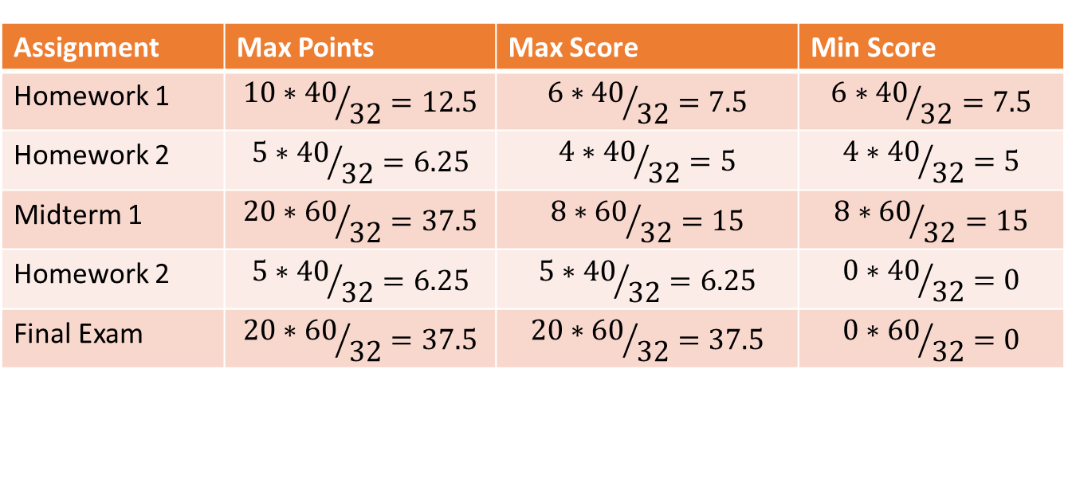
Assignment | Score | Points Possible | Group | Weight
Homework 1 | 6 | 10 | Homework | 40
Homework 2 | 4 | 5 | Homework | 40
Midterm 1 | 8 | 20 | Exam | 60
Homework 2 | ? | 5 | Homework | 40
Final Exam | ? | 20 | Exam | 60
$$Total weighted points= \frac{10∗40+5∗40+20∗60+5∗40+20∗60}{100}=\frac{3200}{100}=32$$
Assignment | Max Points | Max Score | Min Score
Homework 1 | $${10∗40}/{32}=12.5$$ | $${6∗40}/{32}=7.5$$ | $${6∗40}/{32}=7.5$$
Homework 2 | $${5∗40}/{32}=6.25$$ | $${4∗40}/{32}=5$$ | $${4∗40}/{32}=5$$
Midterm 1 | $${20∗60}/{32}=37.5$$ | $${8∗60}/{32}=15$$ | $${8∗60}/{32}=15$$
Homework 2 | $${5∗40}/{32}=6.25$$ | $${5∗40}/{32}=6.25$$ | $${0∗40}/{32}=0$$
Final Exam | $${20∗60}/{32}=37.5$$ | $${20∗60}/{32}=37.5$$ | $${0∗60}/{32}=0$$

