Slide 1



Image to Text Captcha Solver Using Google Lens

Slide 2
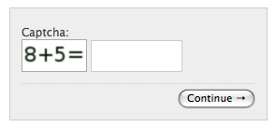
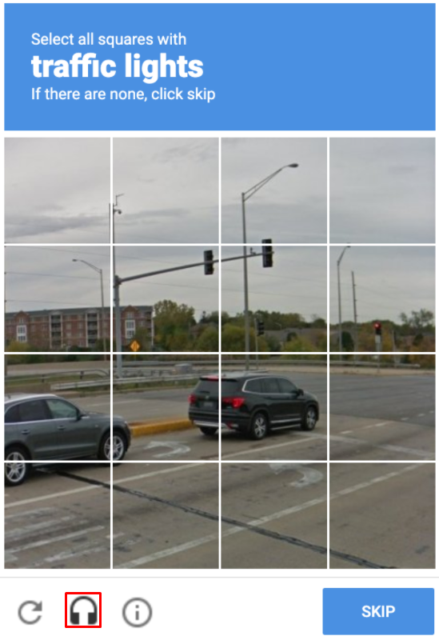
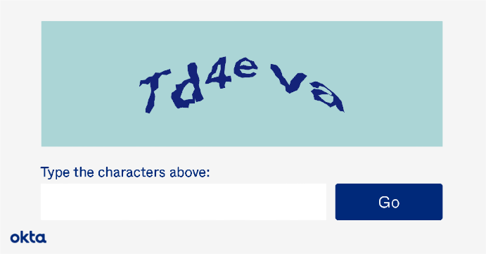
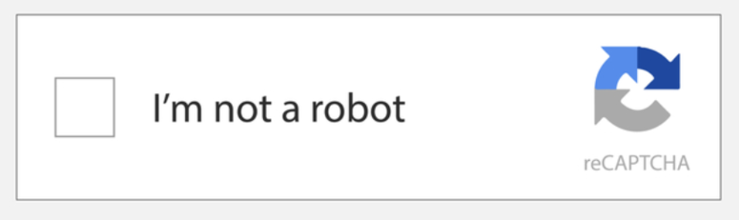
TYPES OF CAPTCHA

Slide 3


TYPES OF CAPTCHA
Solved
Thinking

Slide 4


EXISTING MARKET SOLUTIONS
Solution / Idea | Free | Adaptive (Wide variety coverage) | Easy to Use
Python Libraries- Anti-captcha, Captcha-solver
Writing your own custom OCR module using Tesseract etc.

Slide 5





OUR SOLUTION
Open the URL with Captcha in Chrome Browser using Selenium
Screenshot the Captcha Image from the website and dump it as an image locally
Open Google Lens using Selenium and upload the Captcha Image using Python Script
Extract Text from Image using Google Lens and pasting the result in the answer box in URL Chrome Tab
Keep repeating the steps (automation) until Captcha is solved

Slide 6
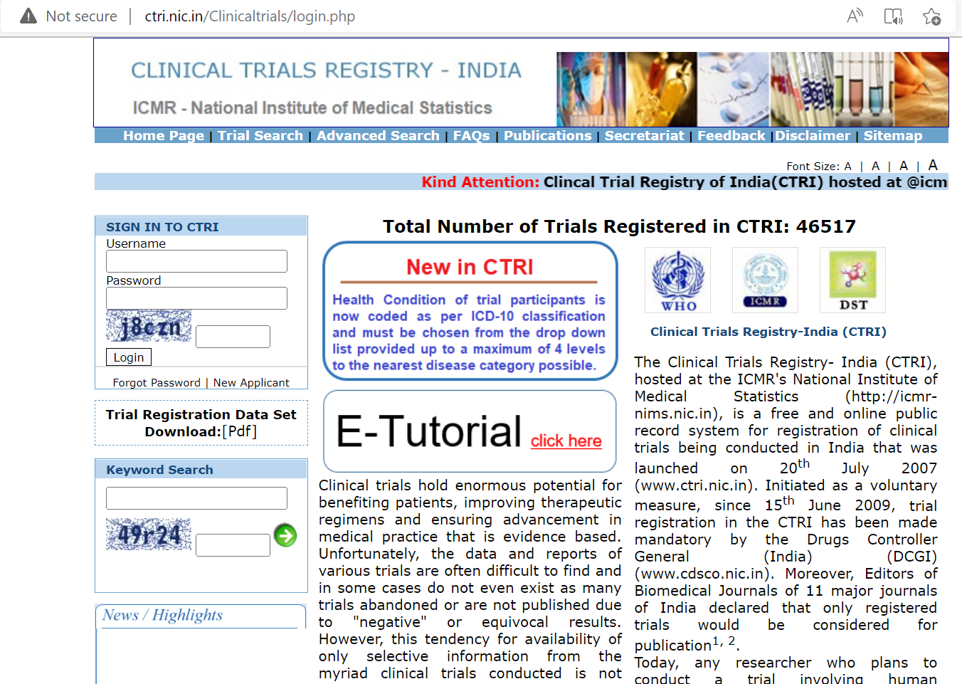
REAL USED CASE EXAMPLE
To extract data from Clinical Registry like this was not possible since it requires Captcha.
Hence, it was not possible to write an Automation Script to extract the data.
But now it would be possible to use the developed module and auto insert the captcha and start scraping data.
http://ctri.nic.in/Clinicaltrials/login.php
INDIAN CLINICAL TRIAL REGISTRY – PHARMA TEAM

Slide 7
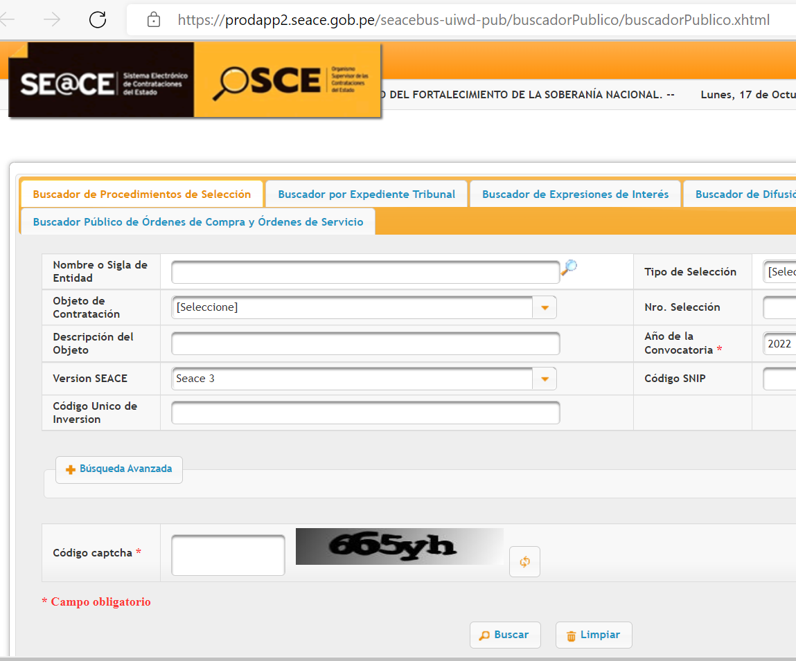
REAL USED CASE EXAMPLE
https://prodapp2.seace.gob.pe/seacebus-uiwd-pub/buscadorPublico/buscadorPublico.xhtml
SPANISH TENDERS WEBSITE – TENDERS TEAM

Slide 8
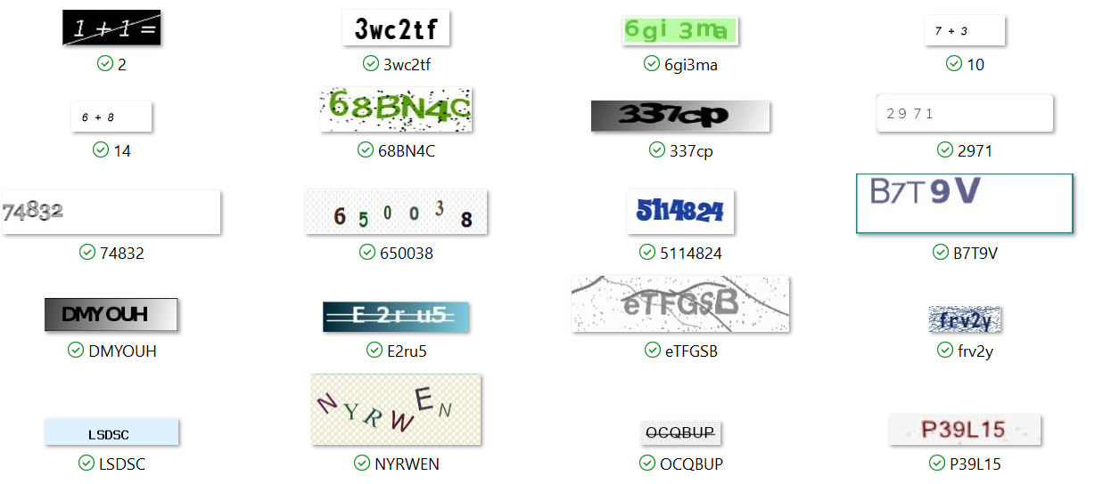
WIDE VARIETY OF CAPTCHA COVERED
Free | Adaptive (Wide variety coverage) | Easy to Use

Slide 9
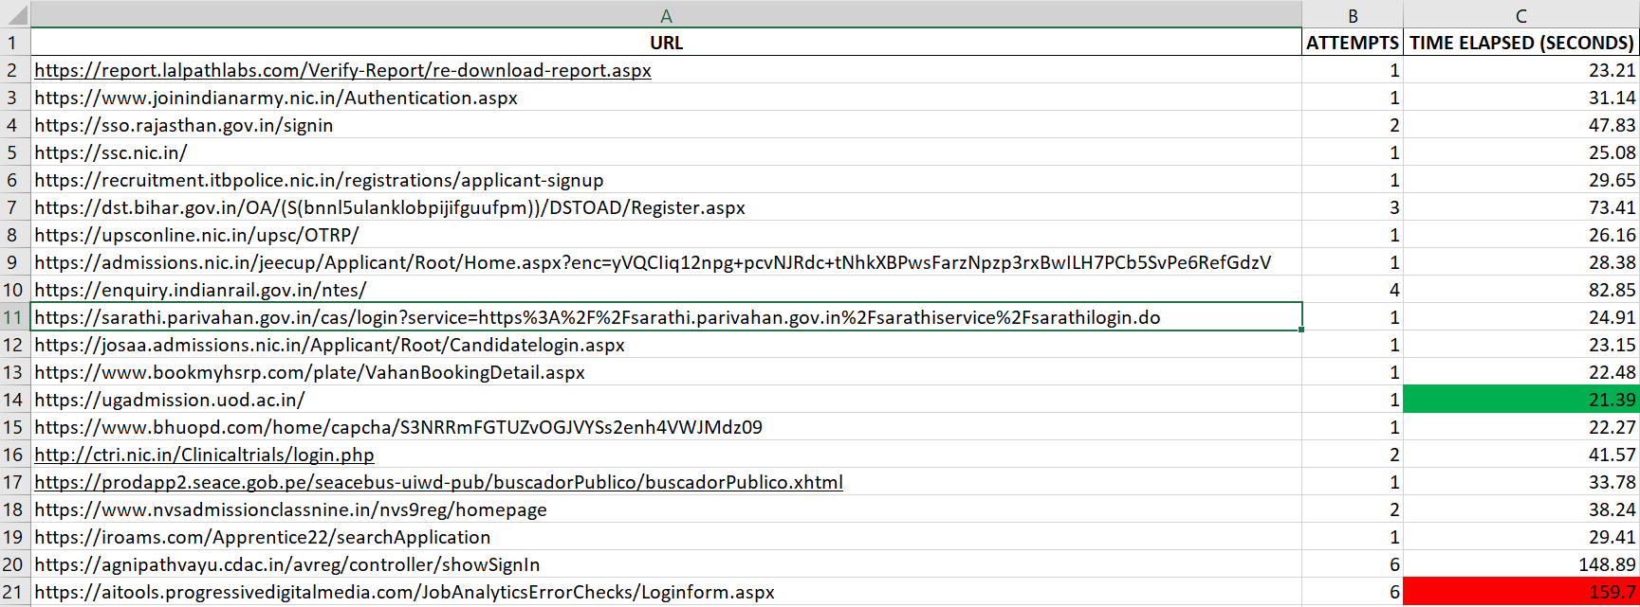
TESTED ON RANGE OF WEBSITES

Slide 10
Thank You
Rupesh Ranjan
rupesh.ranjan@globaldata.com

