Slide 1
Machine Learning in the Cloud with Python
Mercè Martín
BigML

Slide 2



Word association test
I say IRIS and you think...

Slide 3
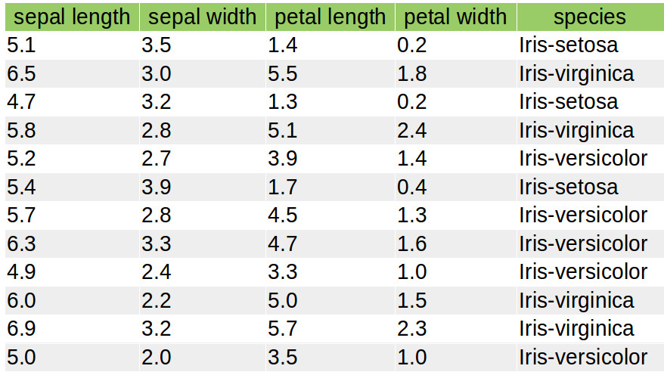
The iris problem
Problem: can you tell the species that a newly observed iris flower belongs to?
Inputs: sepal and petal dimensions
Model
Expected output: species
How do you build the model?
Explicit rules
(human rules)
Difficult to find
re-train and scale
Implicit rules
(data rules)
Programmable, easy
to re-train and scale

Slide 4
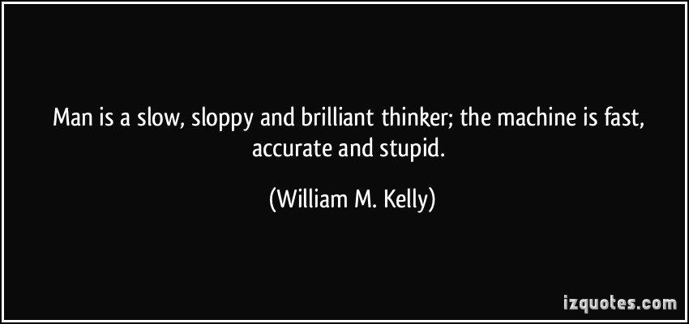
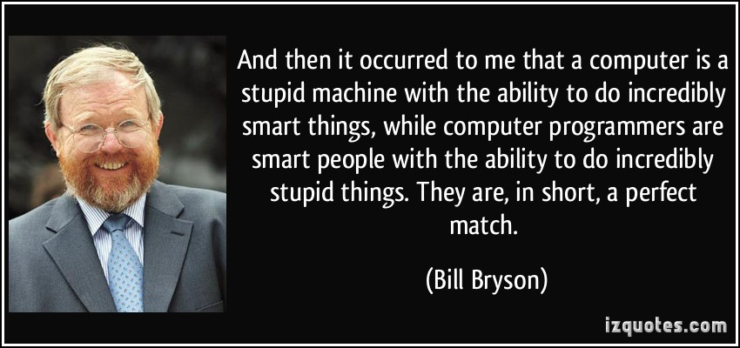
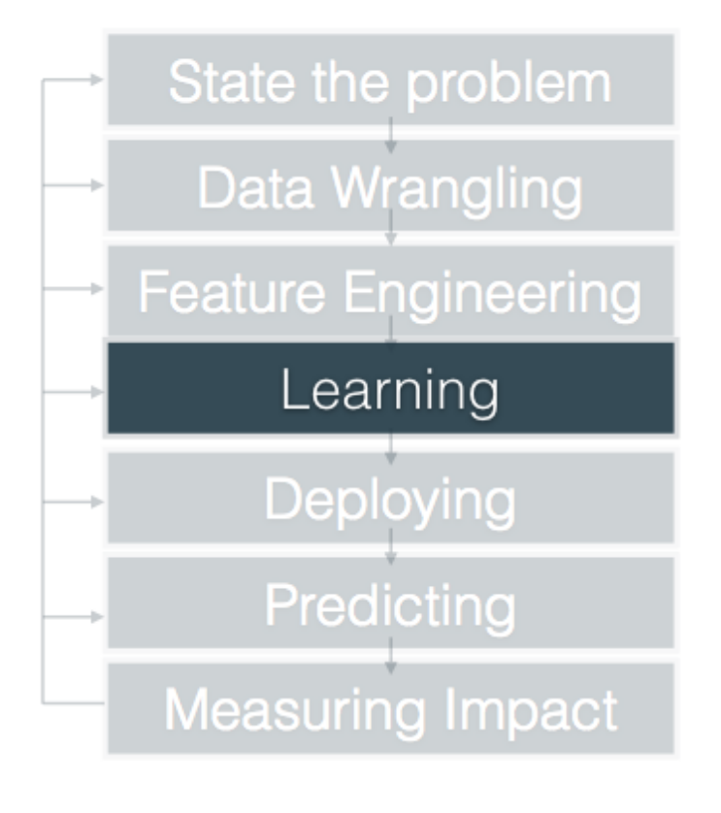
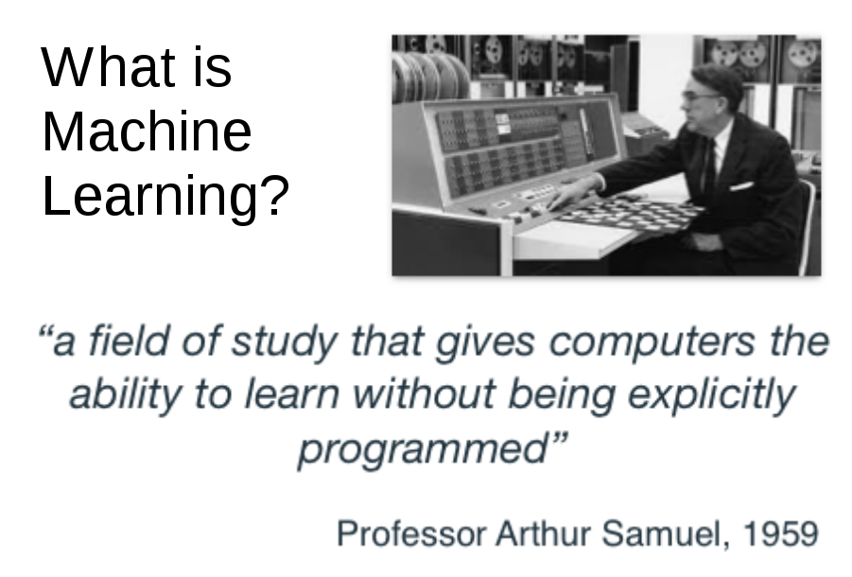
The general ML problem
Teaching the computers to learn

Slide 5
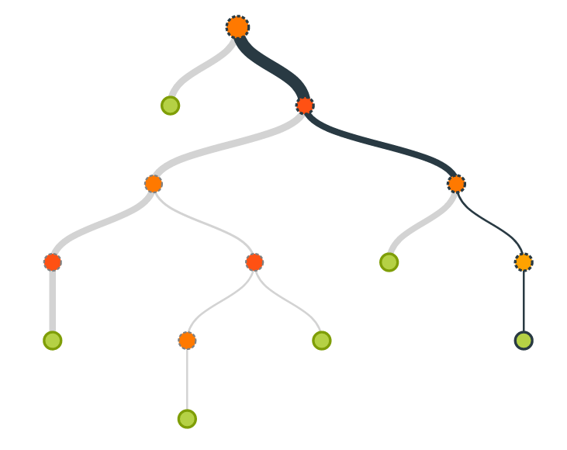
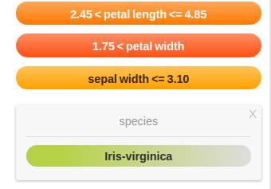
The classification problem
Known data
MODEL
TRAINING
Rules
PREDICTING
New flower

Slide 6
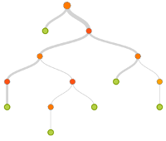

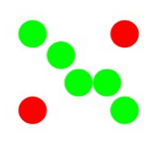
Types of ML problems
  Supervised Learning: the objective field is in our training dataset
    Classification: churn, loans and risk analysis, medical diagnoses
    Regression: price modelling, sales estimation
    Multi-label classification: languages in documents, profiles in jobs
  Unsupervised Learning:
    Clusters: searching for similar instances:
      Similar tastes (Item Discovery)
      Similar users (Customer Segmentation)
      Similar disease diagnoses (Active Learning)
    Anomaly Detectors: searching for dissimilar instances:
      Fraud detection
      Security
      Quality Control
  Semi-supervised Learning:
    Using inference from partially labelled data

Slide 7

The Cloud
Technological advances
Computational
power
Storage
low prices, big data
Predictive APIs
APIs
Combination and
accessibility
Machine Learning as a Service (MLAAS)
AmazonML, AzureML, BigML, Google Prediction API...

Slide 8
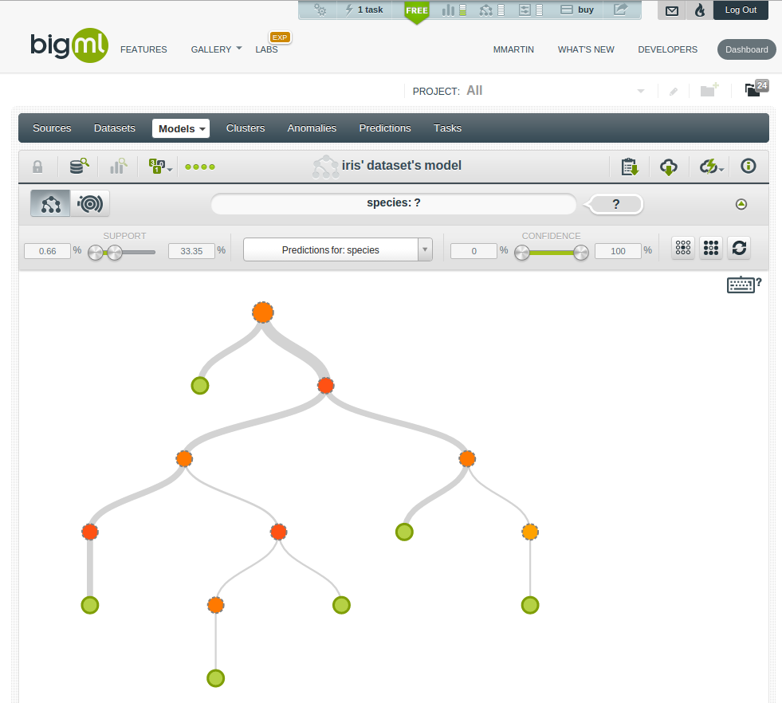
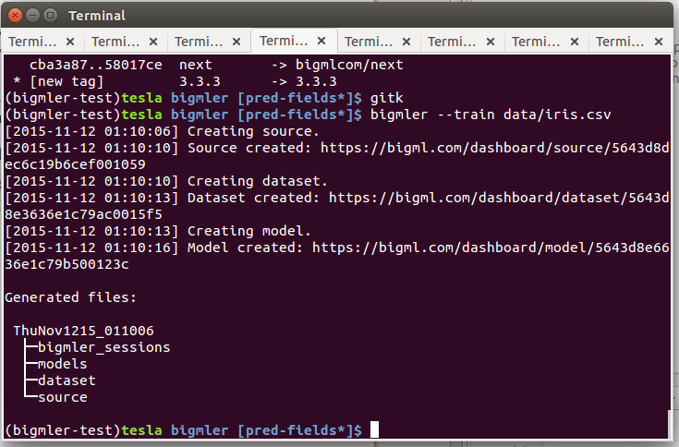
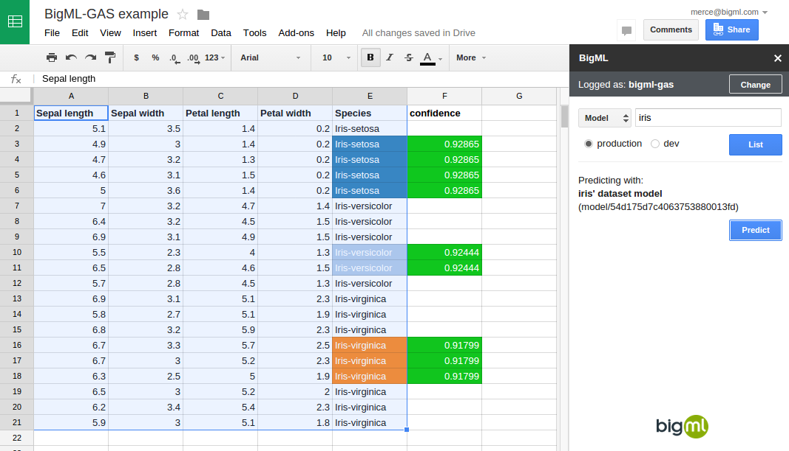
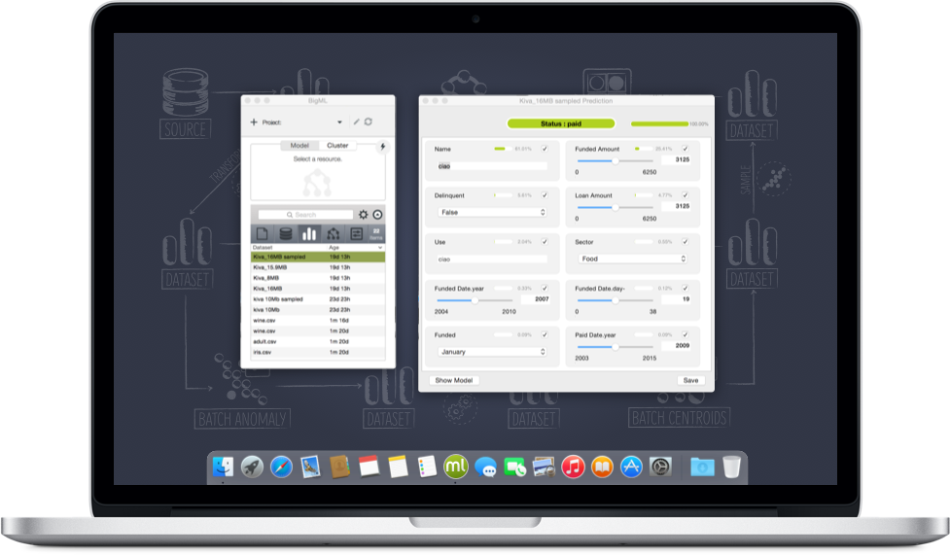
The BigML approach
Machine Learning REST API-first platform:
one API to rule them all
https://bigml.io/andromeda
domain
version

Slide 9
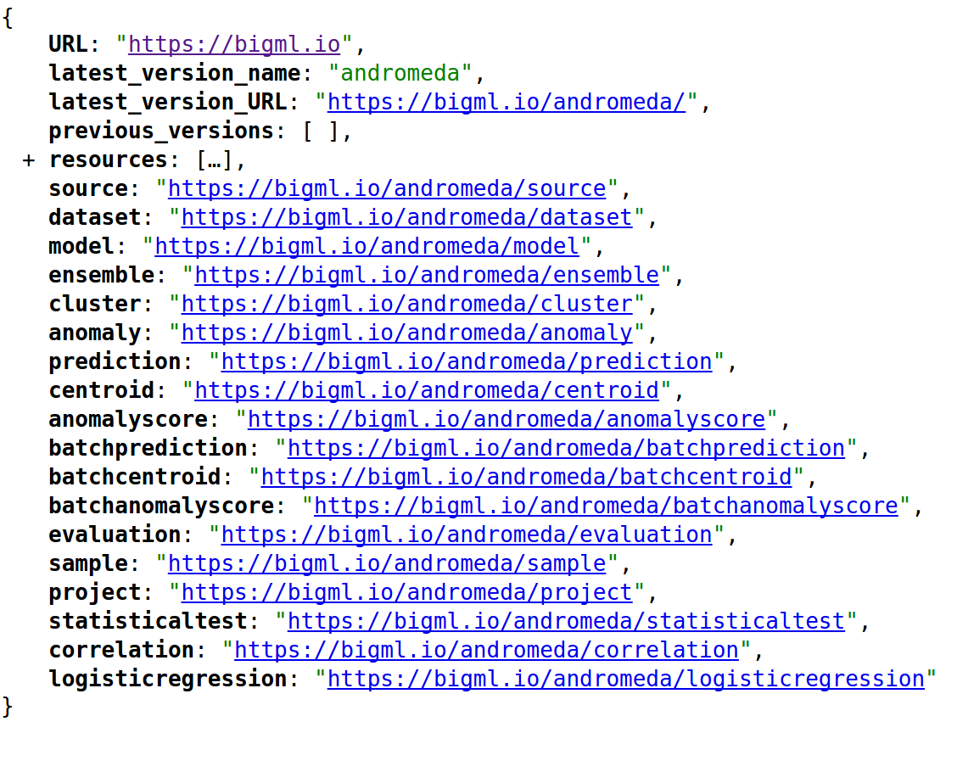
Entry points in the API
The response body is always JSON

Slide 10




Prediction workflow
REST API calls are asynchronous, so we must periodically retrieve the created objects and check whether their status is FINISHED or FAULTY
source
The source stores the raw data once parsed. Separators and field types are inferred.
dataset
The dataset summarizes the data in each field. Histograms and distributions are added. Statistics are added for numeric fields, categorical fields show the list of categories and for text fields
the tag cloud is included.
model
The model object includes the rules that you need to predict the value of the objective field for any input data.
Input data
prediction
The prediction resource stores the user given input data, the prediction result and the confidence associated to this prediction.

Slide 11
Typical REST API calls
WATCH OUT! We are asynchronous
CREATE
curl "https://bigml.io/source?$BIGML_AUTH" \
-X POST \
-H 'content-type: application/json' \
-d '{"remote": "https://static.bigml.com/csv/iris.csv"}'
GET
curl "https://bigml.io/source/4f603fe203ce89bb2d000000?$BIGML_AUTH"
UPDATE
curl "https://bigml.io/source/4f603fe203ce89bb2d000000?$BIGML_AUTH" \
-X PUT \
-H 'content-type: application/json' \
-d '{"name": "a new name", "source_parser": {"locale": "es-ES"}}'
DELETE
curl "https://bigml.io/source/4f603fe203ce89bb2d000000?$BIGML_AUTH" \
-X DELETE
Using previously set credentials:
export BIGML_USERNAME=pycones
export BIGML_API_KEY=340e1de54daf2450022a5abb4e16acd146af3ca1
export BIGML_AUTH="username=$BIGML_USERNAME;api_key=$BIGML_API_KEY"

Slide 12
Mapping REST API calls to bindings functions
from bigml.api import BigML
api = BigML() # username and api_key from BIGML_USERNAME, BIGML_API_KEY
Then, every API REST method and type of resource is mapped to the corresponding method in the BigML object:
CREATE (POST) + source
GET (GET) + dataset
UPDATE (PUT) + model
DELETE (DELETE) + prediction
LIST (GET) + sources
api.create_source
api.get_dataset
api.update_model
api.delete_prediction
api.list_sources
API object - inherits from each resource handler its own create, get, update and delete methods: class BigML
The BigML class inherits from a connection object (class BigMLConnection) that handles the domain and credentials information. It also implements the generic methods for the REST API calls: _create, _get, _update and _delete. Both share the same constructor kwargs:
def __init__(self, username=None, api_key=None, dev_mode=False,
debug=False, set_locale=False, storage=None, domain=None):
When credentials are not explicitly set, the connection object tries to get them from environment variables.

Slide 13
Talking is cheap, show me the code!
Python bindings
Low level control of API calls, plus local prediction objects. You can create any workflow.
BigMLer command line tool
High level control of workflows, both local and remote. Some workflows are predefined, you just need to configure settings.

Slide 14

Python Bindings and BigMLer
Both projects are open-source
https://github.com/bigmlcom/python
https://github.com/bigmlcom/bigmler
Why Python?
Becoming more popular in ML.
General purpose language, so you can reuse code easily (Web app in Django).
Large number of libraries (requests, numpy, scipy, pandas)
Testing framework: nosetests
Docs: readthedocs.org
http://bigml.readthedocs.org/
http://bigmler.readthedocs.org/

