Slide 1

Getting Started with
Joseph Riddle

Slide 2
What to expect
Monthly or bi-monthly meetups
Presentation(s) with code samples
Involvement from Spokane Python community
Guest presenters welcome
Lightning talks

Slide 3
Follow along
$ git clone https://github.com/IntelliTect-Samples/SpokanePythonUserGroup.git
$ cd ./SpokanePythonUserGroup/2021.05.18-FastAPI/
$ code .
Notes:
git clone https://github.com/IntelliTect-Samples/SpokanePythonUserGroup.git
cd ./SpokanePythonUserGroup/2021.05.18-FastAPI/

Slide 4
Please interrupt me with questions

Slide 5
Intro – Definitions
WSGI
What you See is what you Get… I
Python Web Server Gateway Interface
“standard interface between web servers and Python web applications or frameworks, to promote web application portability across a variety of web servers”
https://www.python.org/dev/peps/pep-3333/
ASGI
Asynchronous Server Gateway Interface
Successor to WSGI, being developed by Django core team members
https://asgi.readthedocs.io/en/latest/
No PEP (Python Enhancement Proposal)

Slide 6
FastAPI – what is it?
“FastAPI framework, high performance, easy to learn, fast to code, ready for production”
https://fastapi.tiangolo.com/history-design-future/

Slide 7
FastAPI – Cont.
Batteries included
Modern (3.6+)
Type hinting
async/await
Decorators
Model validation (Pydantic)
Built on
Pydantic
Starlette

Slide 8
FastAPI vs. ?
Flask
2nd most popular
Micro framework
Django
Most popular
Generates HTML
Django REST Framework
Django but for APIs
https://fastapi.tiangolo.com/alternatives/

Slide 9
Hello World
from fastapi import FastAPI
app = FastAPI()
@app.get('/')
def hello_world():
return 'Hello Spokane Python User Group! 🐍'
Notes:
Example 1

Slide 10
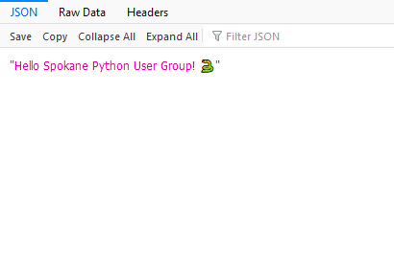
Hello World – Cont.
Wow!
Notes:
Example 1

Slide 11
Models
# Let's create a pydantic vehicle model
class Vehicle(BaseModel):
vehicle_id: int
year: int
make: str
model: str
Notes:
Example 2

Slide 12
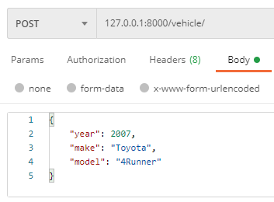
Models – Cont.
{
"detail": [
{
"loc": [
"body",
"vehicle_id"
],
"msg": "field required",
"type": "value_error.missing"
}
]
}
Uh oh 😮
Notes:
Example 2

Slide 13
Validating Models
@validator('make')
def validate_make(cls, value):
if value not in ALL_VEHICLE_MAKES:
return ValueError('Please use a _real_ vehicle make.')
return value
Notes:
Example 3

Slide 14
Dependency Injection
@app.get('/vehicles/', response_model=list[Vehicle])
def list_vehicles(vehicle_service = Depends(VehicleService)):
vehicles = vehicle_service.vehicles
return vehicles
Notes:
Example 4
Dependency Injection
App testing – main_test.py

Slide 15
Docker / docker-compose
FROM tiangolo/uvicorn-gunicorn-fastapi:python3.8
COPY ./app /app
version: "3.9"
services:
api:
build: .
ports:
- "8000:80"

Slide 16
Docker – Hot Reload 🔥
version: "3.9"
services:
api:
image: tiangolo/uvicorn-gunicorn-fastapi
command: /start-reload.sh
environment:
- MAX_WORKERS=1
volumes:
- ./app:/app
ports:
- "8000:80"

Slide 17
Docker DIY
FROM python:3.9
ADD ../requirements.txt /tmp/requirements.txt
RUN pip3 install -r /tmp/requirements.txt
ENTRYPOINT [ "uvicorn" ]
CMD [ "--host", "0.0.0.0", "app:app", \
"--reload", "--reload-dir", "/app" ]

Slide 18
Security – OAuth
from fastapi.security import OAuth2PasswordBearer
oauth2_scheme = OAuth2PasswordBearer(tokenUrl='token')
@app.get('/vehicles/', response_model=list[Vehicle])
def get(token: str = Depends(oauth2_scheme)):
return vehicles

Slide 19
Cars
Let’s bring it all together now

Slide 20
Background Tasks
Built-in
https://fastapi.tiangolo.com/tutorial/background-tasks/
Celery
https://docs.celeryproject.org/en/stable/getting-started/introduction.html

Slide 21
Debugging 🐛
https://fastapi.tiangolo.com/tutorial/debugging/
https://pypi.org/project/web-pdb/

Slide 22
Next Steps
Getting Started
https://fastapi.tiangolo.com/project-generation/
Contribute
https://fastapi.tiangolo.com/help-fastapi/

