Slide 1

Python concurrency for mere mortals
Nathaniel J. Smith

Slide 2
Concurrency, noun: walking and chewing gum at the same time

Slide 3
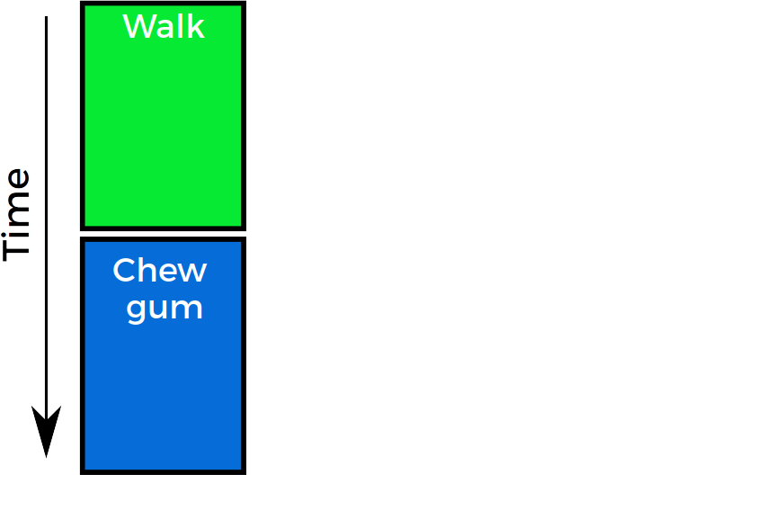
Sequential code
def walk_and_chew_gum():
walk()
chew_gum()

Slide 4
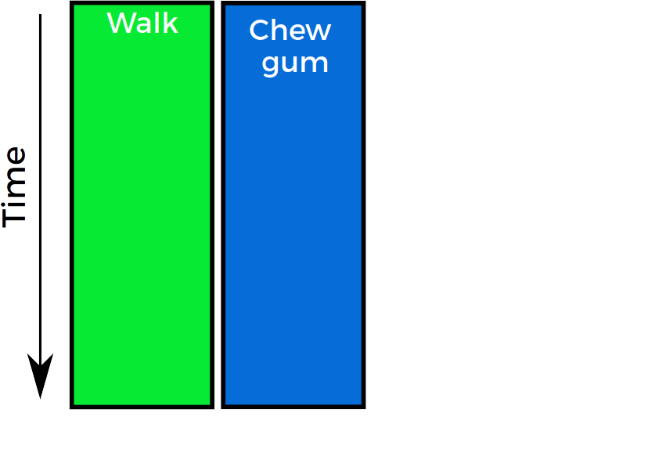
Concurrent code
def walk_and_chew_gum():
???

Slide 5
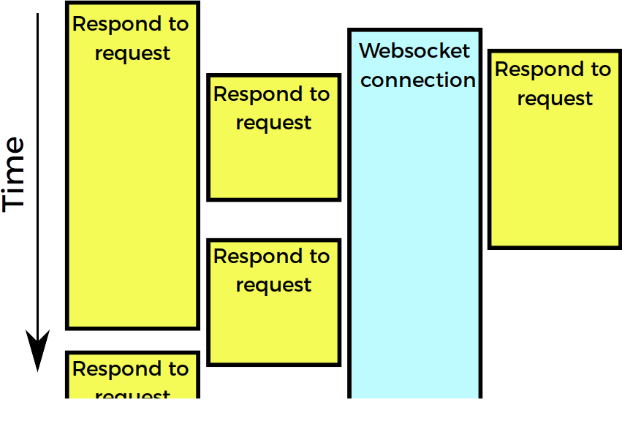
Web server

Slide 6
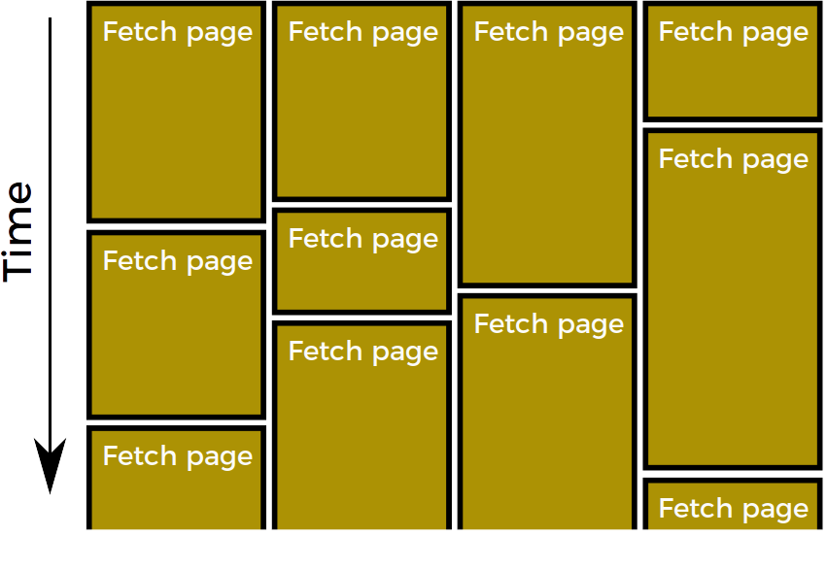
Web spider

Slide 7
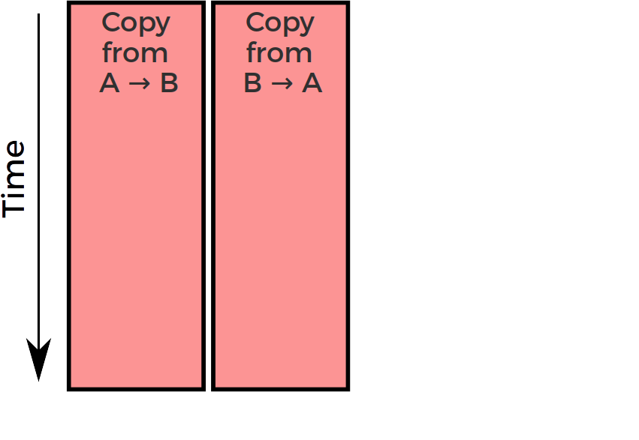
Simple bidirectional proxy

Slide 8
Concurrency is super useful.
But… there’s a problem.

Slide 9
This is about expressivity
Python still has a GIL. I haven’t fixed that.
But even if we can only use 1 core, many programs make more sense when expressed in the language of concurrency:
  Web servers talking to multiple clients
  Experiment software simultaneously monitoring multiple sensors and managing stimulus display
  Two-way proxy: copy data from A → B while copying data from B → A
  “Happy eyeballs”

Slide 10


Slide 11
Example

Slide 12
(getaddrinfo demo)

Slide 13
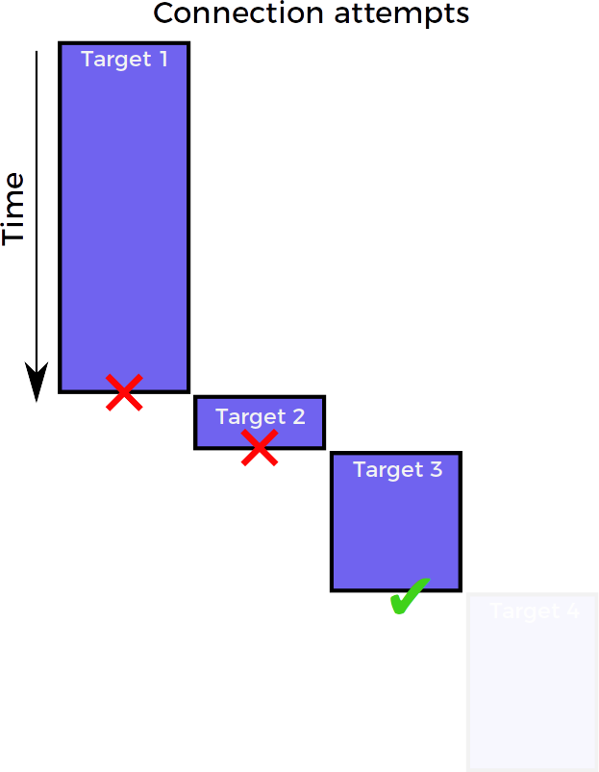
Connection strategy: sequential

Slide 14
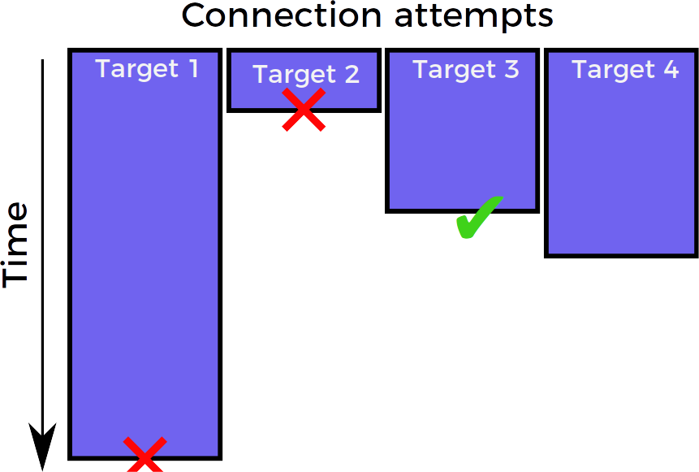
Connection strategy: race

Slide 15

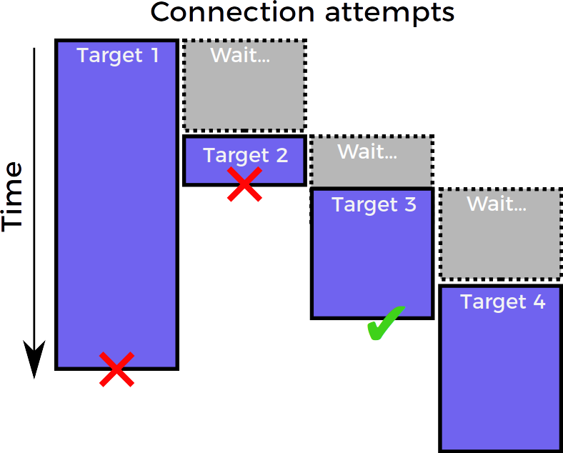
Connection strategy: “happy eyeballs”
Goldilocks solution:
almost as efficient as sequential
& almost as fast as race

Slide 16
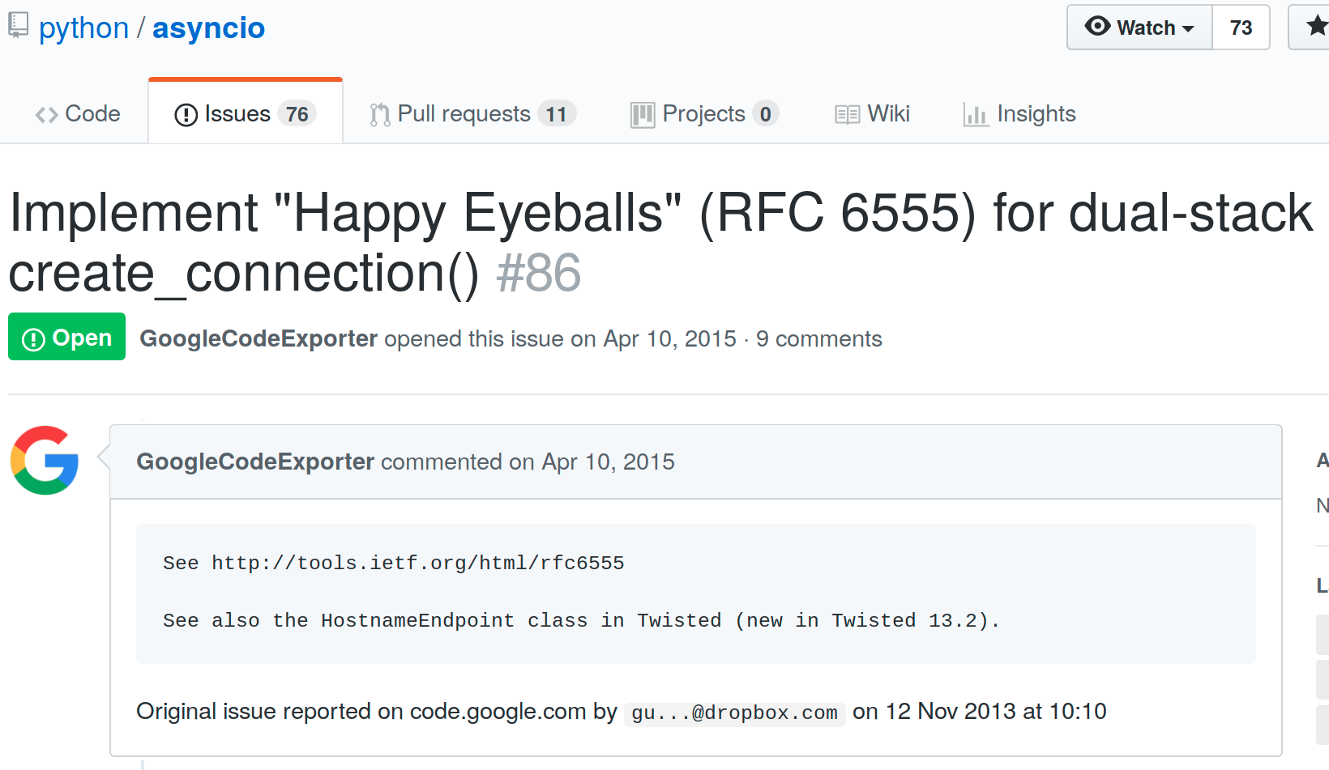
Happy eyeballs in asyncio

Slide 17
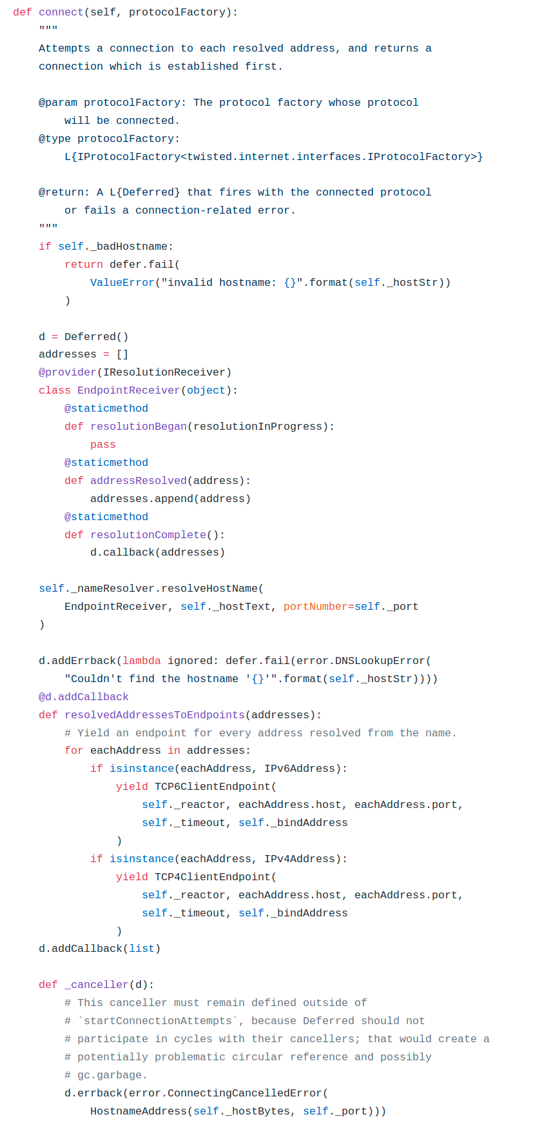
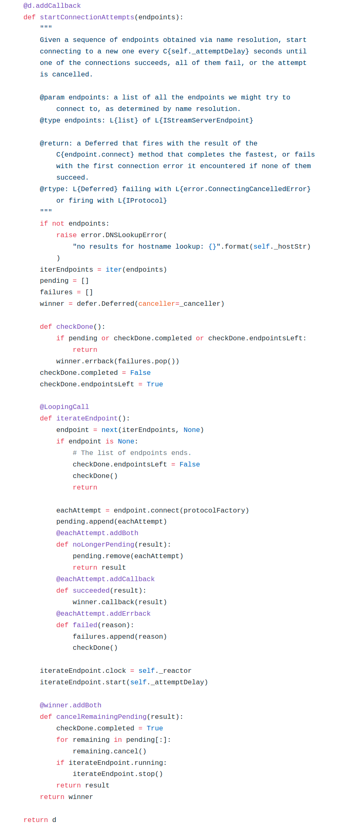

Happy eyeballs in twisted
Ashwini Oruganti
Photo: from https://youtu.be/XsLFLzx4Nq4

Slide 18
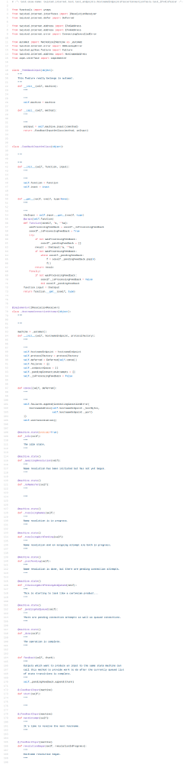
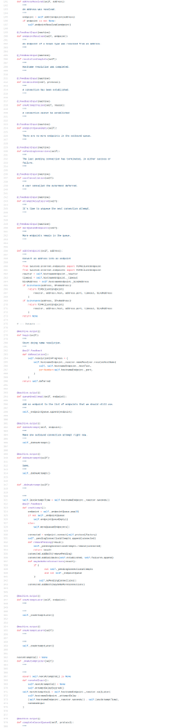
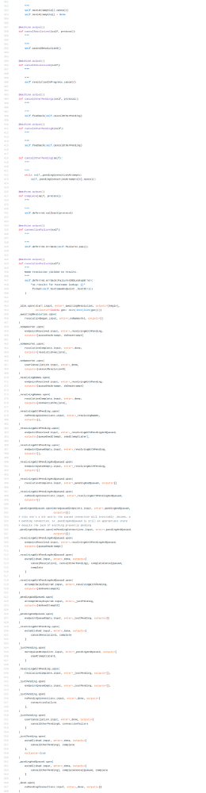

Happy eyeballs in twisted v2
Glyph Lefkowitz
Photo: Kushal Das, CC-BY-NC-SA 2.0 https://www.flickr.com/photos/kushaldas/8608040013

Slide 19
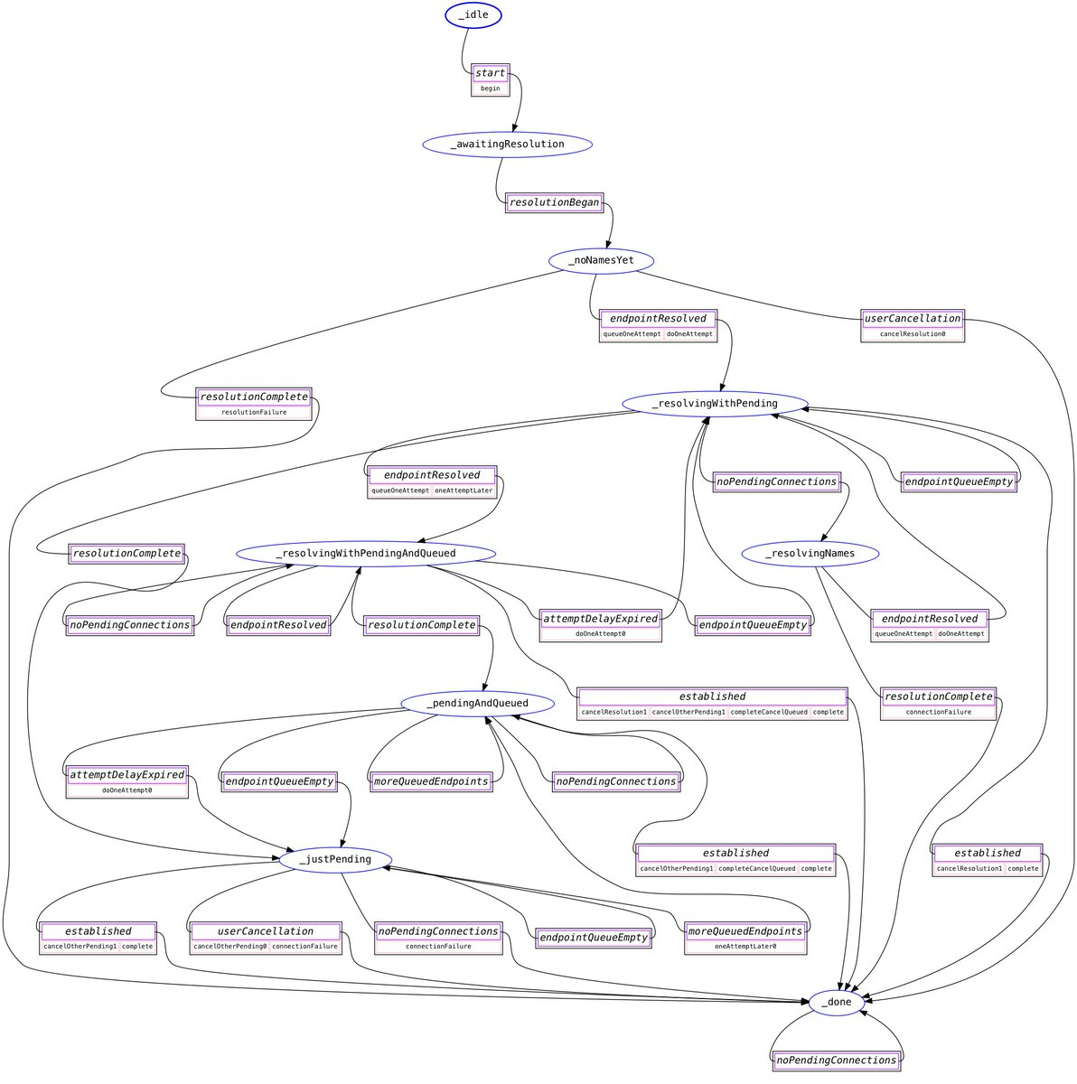
Happy eyeballs in twisted v2
Glyph Lefkowitz
Photo: Kushal Das, CC-BY-NC-SA 2.0 https://www.flickr.com/photos/kushaldas/8608040013

Slide 20
Connection strategy: “happy eyeballs”

Slide 21
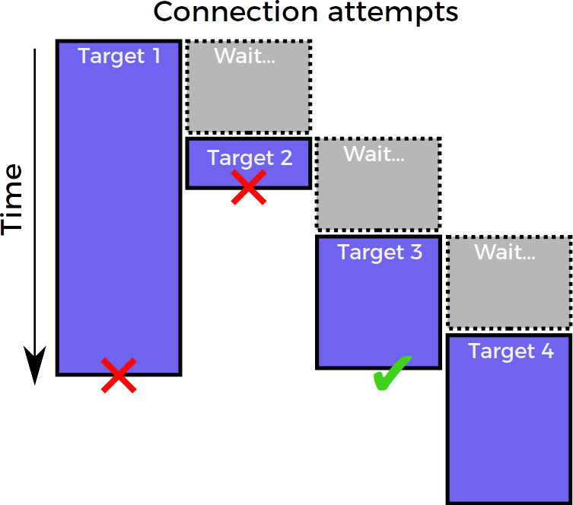
Connection strategy: “happy eyeballs”
Twisted bug #9345

Slide 23
Not a heroic coder
Heroic coders
me

Slide 24


Slide 25
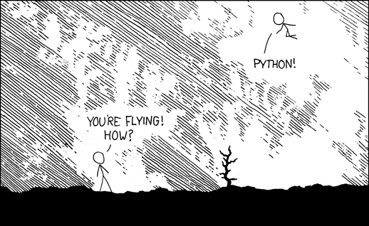
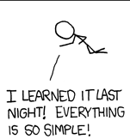
https://xkcd.com/353/ by Randall Munroe, CC-BY-NC 2.0

Slide 26

A new, from-scratch, permissively-licensed concurrency library for Python 3.5+, supporting all major platforms
Install: pip install trio
Use: import trio

Slide 27
Trio will
Solve all your concurrency problems
Make you 10x more productive than Glyph
Whiten your teeth
Walk your dog*
  *Enterprise version only, call for quote
Everything on this slide is a lie

Slide 28

Goal: be the Python of concurrency libraries

Slide 29
Plan today
1. Work through a simple example to see how Trio works
2. Implement happy eyeballs.

Slide 30
Example: simple proxy

Slide 31
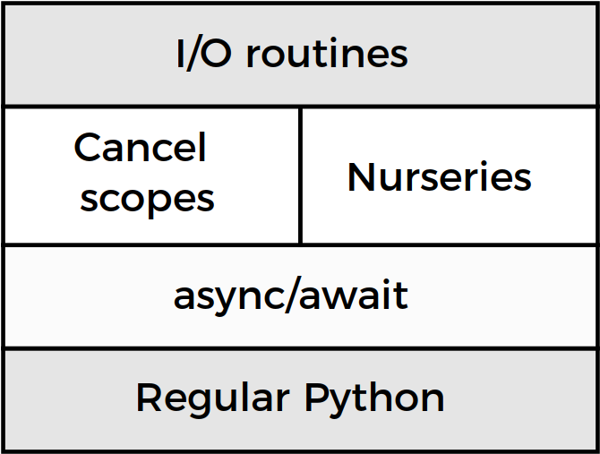
Trio architecture

Slide 32
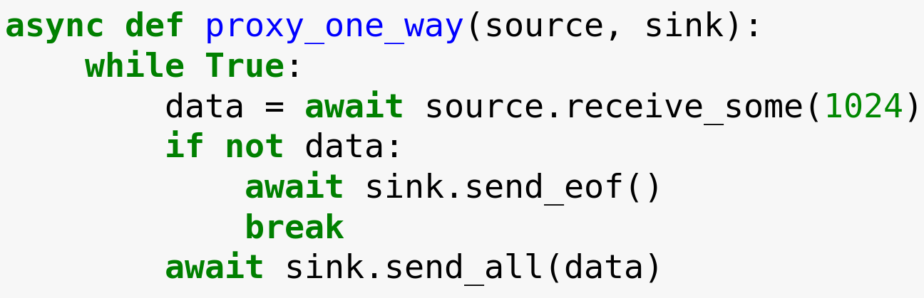

Slide 33
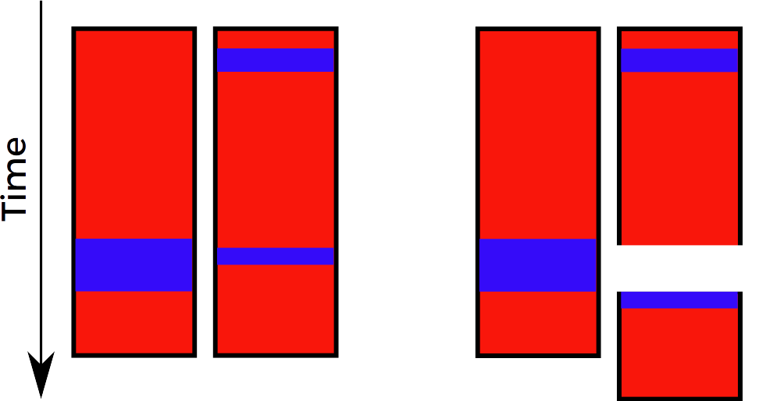
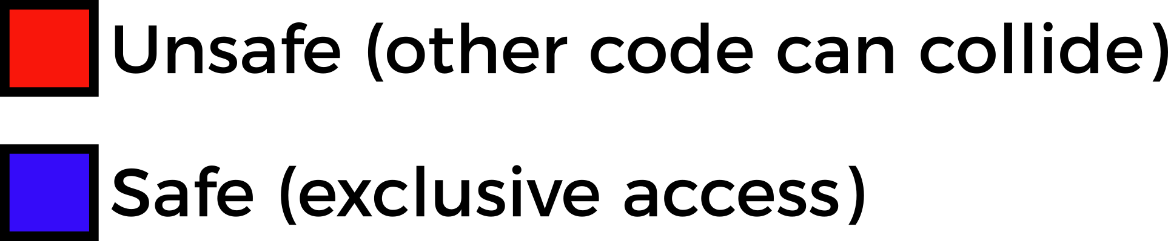
Preemptive concurrency
Your code
How it executes

Slide 34
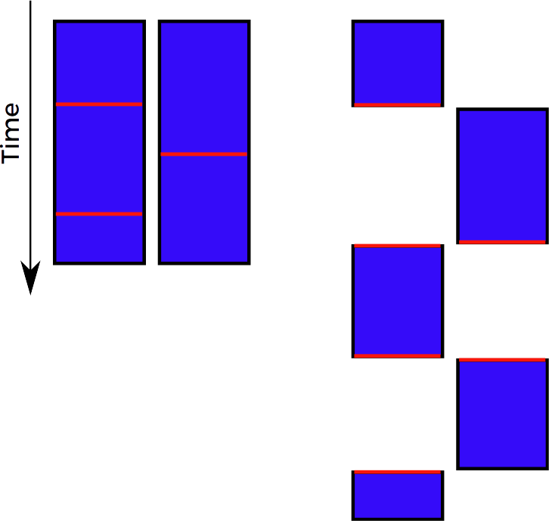
Cooperative (async) concurrency
Your code
How it executes

Slide 35
What is “async concurrency”?
Pre-emptive
multitasking
Async (cooperative)
multitasking
Time
Safe
Unsafe
“The GIL is one honking great idea – let’s do more of those!”

Slide 36
Preemptive
concurrency
Cooperative (async) concurrency
Your code
How it executes
Your code
How it executes
Faster…
...except we have the GIL
Easier to use

Slide 37

THE GIL
By Becker1999 from Grove City, OH (Democracy Spring rally at U.S. Capitol) [CC BY 2.0 (http://creativecommons.org/licenses/by/2.0)], via Wikimedia Commons

Slide 38
Preemptive
concurrency
Cooperative (async) concurrency
Your code
How it executes
Your code
How it executes
Faster…
...except we have the GIL
Easier to use

Slide 40
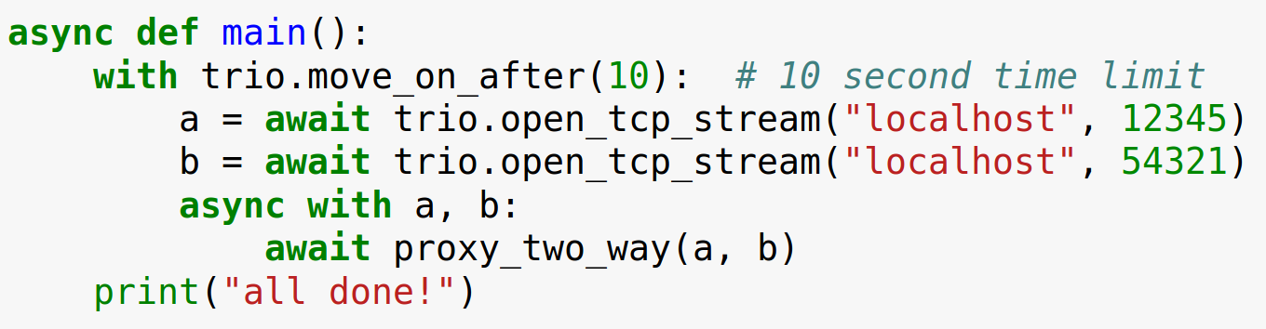

Slide 41
Trio architecture

Slide 42
Trio architecture

Slide 43
(cancel scope demo)

Slide 44
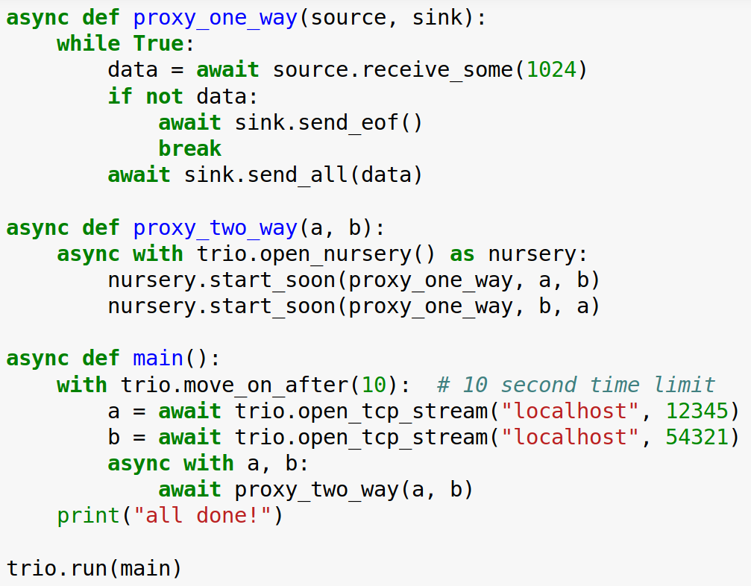
Raises trio.Cancelled
Caught here

Slide 45
Cancel scopes enable timeouts and cancellation
Every time you make an HTTP request, network call, RPC, … there are three possible outcomes:
  Success
  Failure
  It gets wedged forever
Terminology:
  Timeout: give up after X seconds
  Cancellation: give up in response to arbitrary event

Slide 46
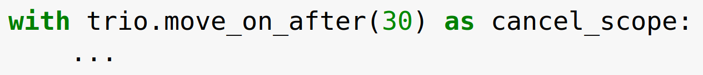
Cancel scopes, continued
cancel_scope.deadline:
read or change timeout
cancel_scope.cancel():
cancel now, without waiting for timeout
+ introspection tools, etc., see docs for details.
Also available: fail_after, move_on_at, ...

Slide 47
Trio architecture

Slide 48
Trio architecture

Slide 49
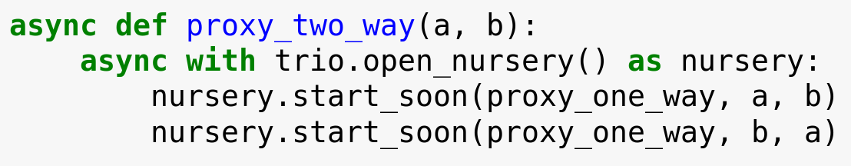
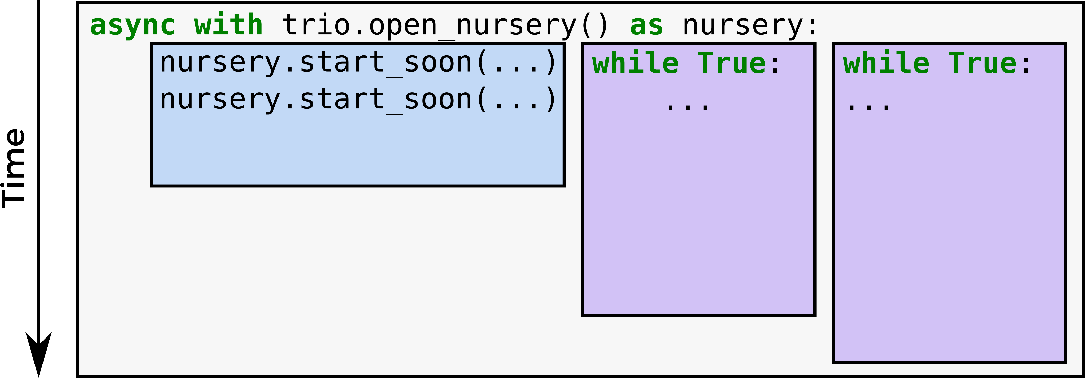
What you see:
How it works:

Slide 51
Exceptions in nurseries
CANCELLED
CANCELLED

Slide 52
Raises trio.Cancelled
Caught here

Slide 53
Nurseries enable concurrency
async with trio.open_nursery() as nursery:
  ...
Child tasks always live in a nursery
Nursery is always attached to a with block in the parent task
Parent always waits for children to finish (no runaway child tasks; with blocks work)
  If you really want child to outlive parent, pass nursery object
Unhandled exceptions bubble up from child into parent (no lost exceptions)
(two-way proxy demo)

Slide 54
Trio architecture

Slide 55
Trio architecture

Slide 56
Other things Trio gives you
...that’s about it right now
Standard stuff for I/O like networking, sleep(), files, signals, …
APIs for inter-task coordination (trio.Event, trio.Queue, …) (demo)
Awesome testing helpers (trio.testing) + pytest plugin
Control-C works
APIs for introspection and monitoring
Sphinx plugin
Prototype asyncio compatibility layer

Slide 57
Not quite there yet...
Young project
HTTP client/server libraries
Managing subprocesses, multiprocessing-equivalent
Working on it...

Slide 61
There should be one – and preferably only one – obvious way to do it.

Slide 62
Thanks
Guido van Rossum, Glyph, Yury Selivanov, Dave Beazley, Ben Darnell, ...
  And everyone else who’s contributed to Python concurrency libraries over the last ~20 years...
The awesome Trio community
You for listening!

Slide 63
Tutorial + reference manual: trio.readthedocs.io
Chat: gitter.im/python-trio/general
Code + issues + slides: github.com/python-trio/trio github.com/python-trio/trio-talks
Come and join us!

Slide 65
main()
│
├─ f1()
│
└─ f2()
│
├─ f2a()
│
└─ f2b()

Slide 66
main()
│
├─ f1() → KeyError
│
└─ f2()
│
├─ f2a() → ValueError
│
└─ f2b() → RuntimeError

Slide 67
main()
│
├─ f1() → KeyError
│
└─ f2()
│
├─ f2a() → ValueError
│
└─ f2b() → RuntimeError
MultiError([
KeyError,
MultiError([
ValueError,
RuntimeError,
]),
])

Slide 68
Traceback (most recent call last):
File "multierror.py", line 22, in <module>
trio.run(main)
File "multierror.py", line 6, in main
nursery.spawn(f2)
trio.MultiError: KeyError(), <MultiError: RuntimeError(), ValueError()>
Details of embedded exception 1:
Traceback (most recent call last):
File "multierror.py", line 9, in f1
raise KeyError
KeyError
Details of embedded exception 2:
Traceback (most recent call last):
File "multierror.py", line 14, in f2
nursery.spawn(f2b)
trio.MultiError: RuntimeError(), ValueError()
Details of embedded exception 1:
Traceback (most recent call last):
File "multierror.py", line 17, in f2a
raise ValueError
ValueError
Details of embedded exception 2:
Traceback (most recent call last):
File "multierror.py", line 20, in f2b
raise RuntimeError
RuntimeError
main()
│
├─ f1() → KeyError
│
└─ f2()
│
├─ f2a() → ValueError
│
└─ f2b() → RuntimeError
MultiError([
KeyError,
MultiError([
ValueError,
RuntimeError,
]),
])

Slide 69
Catching single exceptions
def catch_block(exc):
if isinstance(exc, (RuntimeError, KeyError)):
return None
else:
return exc
with trio.MultiError.catch(catch_block):
...
Traceback (most recent call last):
File "multierror-catch.py", line 28, in <module>
trio.run(main)
File "multierror-catch.py", line 12, in main
nursery.spawn(f2)
File "multierror-catch.py", line 20, in f2
nursery.spawn(f2b)
File "multierror-catch.py", line 23, in f2a
raise ValueError
ValueError

