Slide 1

Python concurrency for mere mortals
Nathaniel J. Smith

Slide 2

Who am I?
Research scientist at BIDS
Work on NumPy and other things
This is a side-project – looking for scientific users

Slide 3
What is Trio?
A library for Python 3.5+
A new approach to concurrent programming in Python
Install: pip install trio
Use: import trio

Slide 4
What do I mean by “concurrent programming”?

Slide 5

Photo “Walking and Talking” copyright Pedro Ribeiro Simões (https://www.flickr.com/photos/pedrosimoes7/24308652606/). Used under CC-BY 2.0 license (https://creativecommons.org/licenses/by/2.0/).

Slide 6
def walk_then_talk():
walk()
talk()
def walk_while_talking():
???

Slide 7
This is about expressivity
Python still has a GIL. I haven’t fixed that.
But even if we can only use 1 core, many programs make more sense when expressed in the language of concurrency:
  Web servers talking to multiple clients
  Experiment software simultaneously monitoring multiple sensors and managing stimulus display
  Two-way proxy: copy data from A → B while copying data from B → A
  “Happy eyeballs”

Slide 8


Slide 9
What the heck is a happy eyeball?

Slide 10
(getaddrinfo demo)

Slide 11
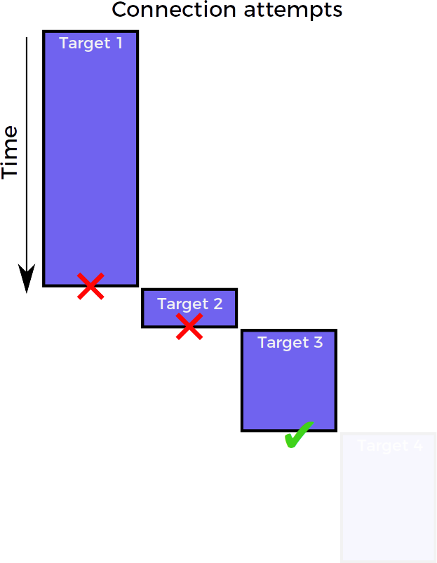
Connection strategy: sequential

Slide 12
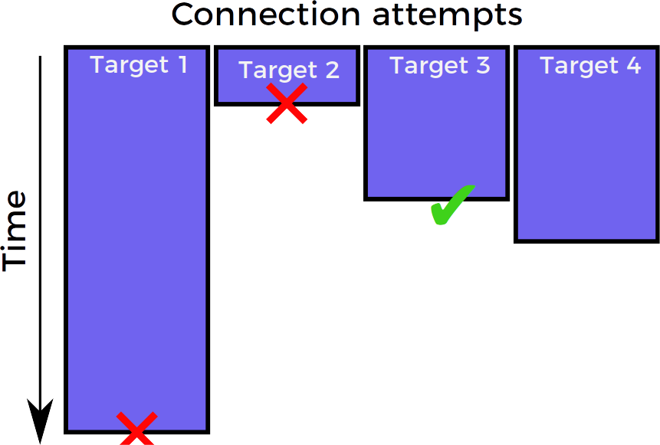
Connection strategy: race

Slide 13
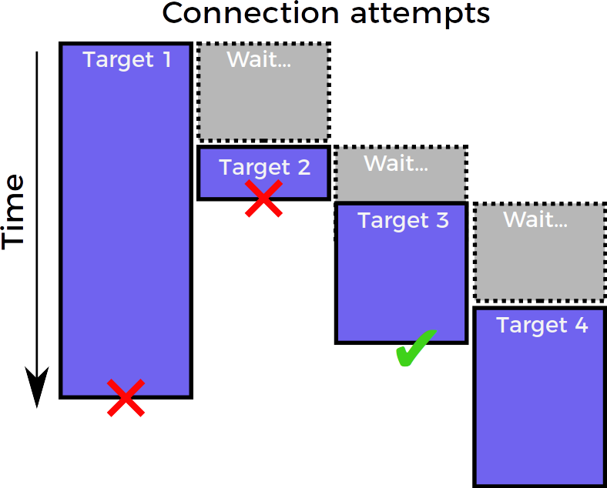
Connection strategy: “happy eyeballs”
Goldilocks solution: almost as fast as race
& almost as efficient as sequential

Slide 14
Why does Python need yet another concurrency library?

Slide 15


Slide 16
Python has lots of mature concurrency options
threading
concurrent.futures
twisted
tornado
asyncio
…

Slide 17
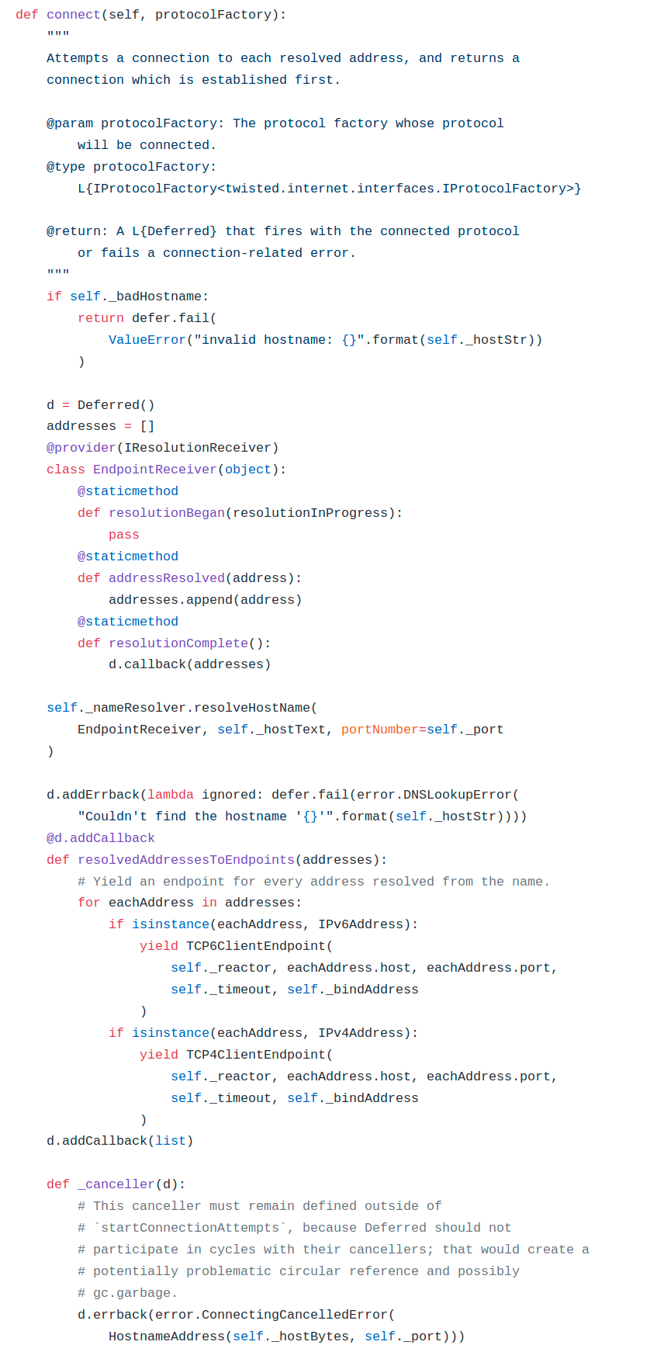
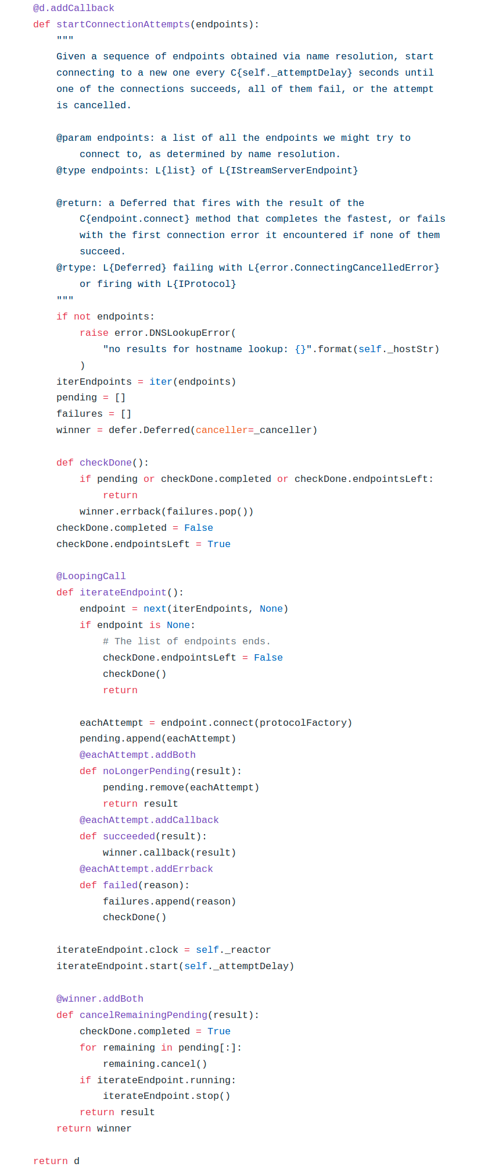
Happy eyeballs in twisted
(current)

Slide 18
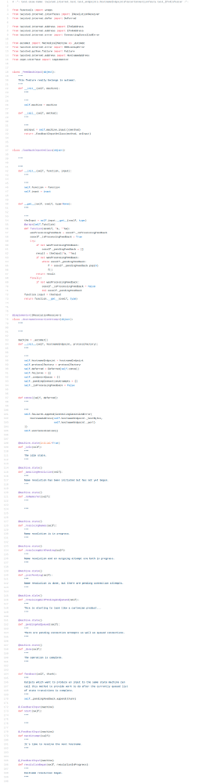
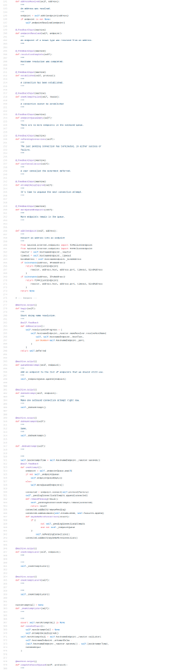
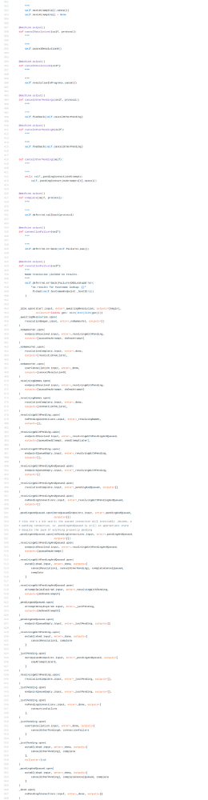
Happy eyeballs in twisted
(future)

Slide 19
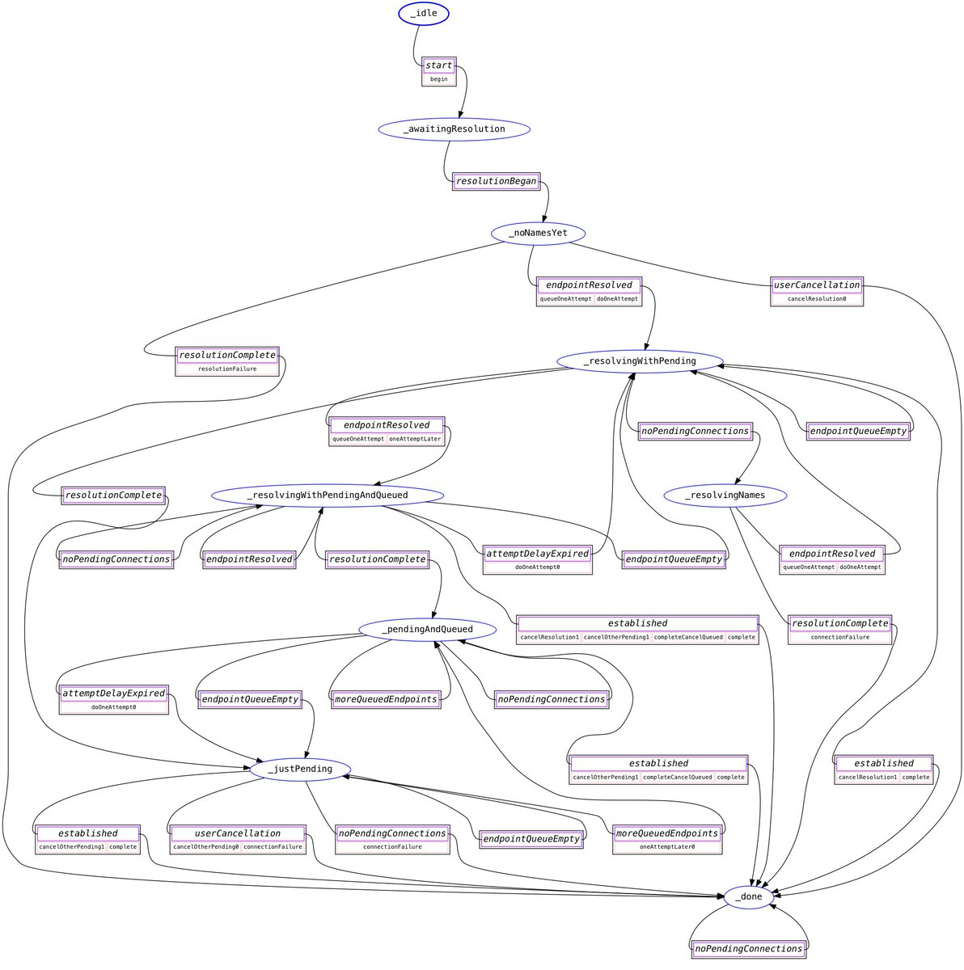
Happy eyeballs in twisted
(future)

Slide 20
Connection strategy: “happy eyeballs”

Slide 21
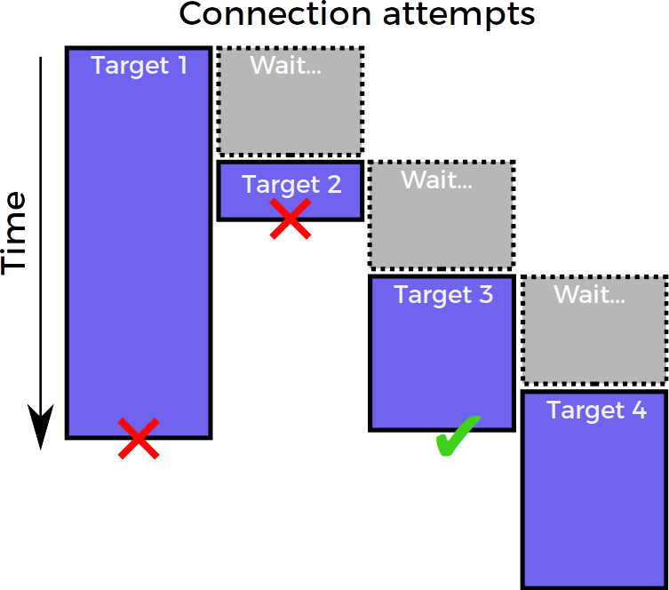
Connection strategy: “happy eyeballs”
Twisted bug #9345

Slide 22
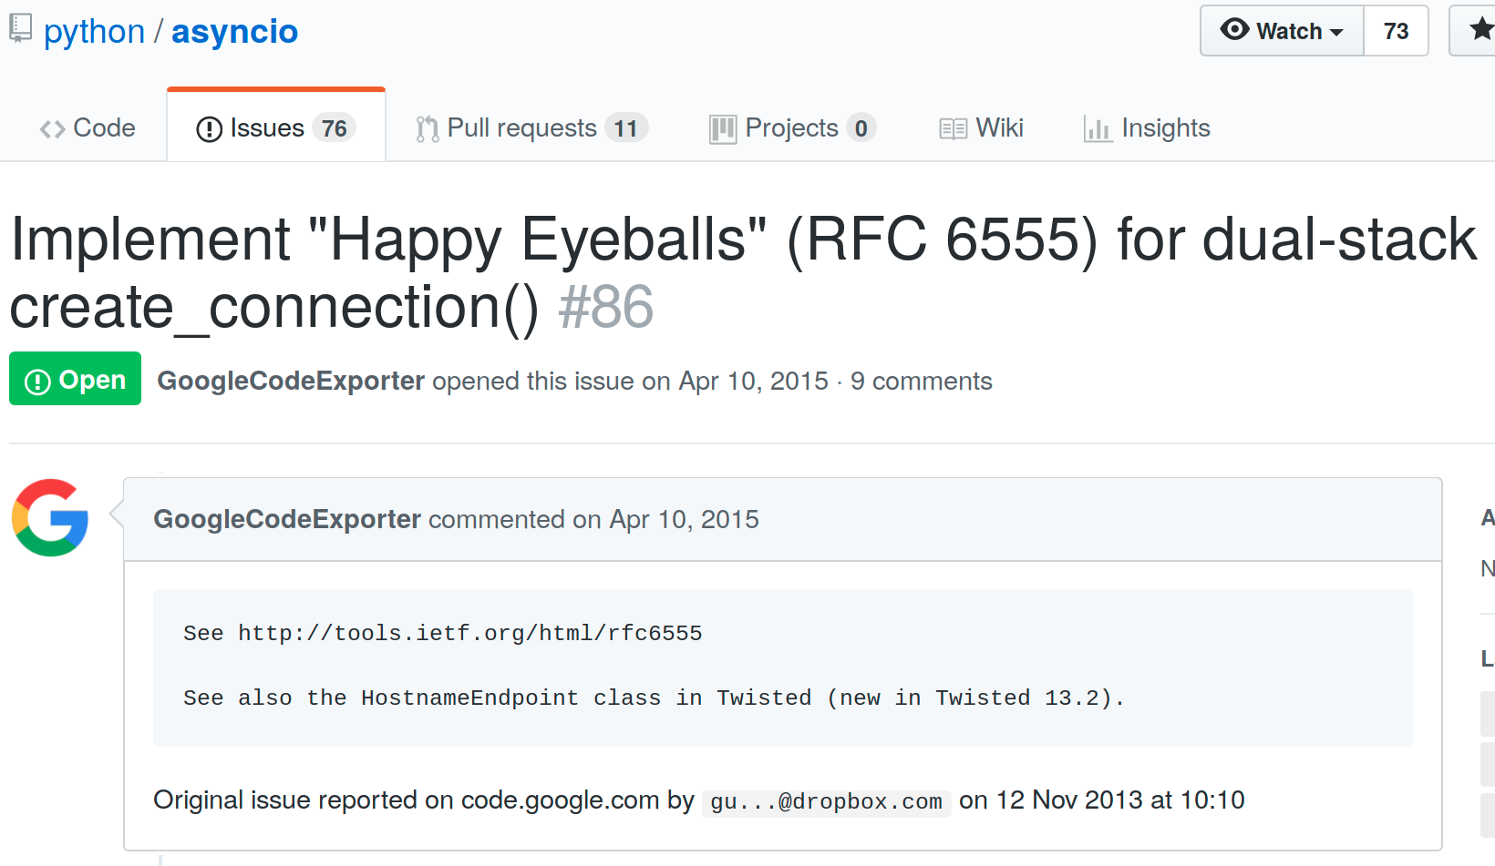
Happy eyeballs in asyncio

Slide 24


Slide 25
Beautiful is better than ugly.

Slide 26
Simple is better than complex.

Slide 27
Readability counts.

Slide 28
Errors should never pass silently.

Slide 29
There should be one – and preferably only one – obvious way to do it.

Slide 30


There should be one – and preferably only one – obvious way to do it.

Slide 31
The Plan
Learn Trio
Use what we’ve learned to implement happy eyeballs

Slide 32
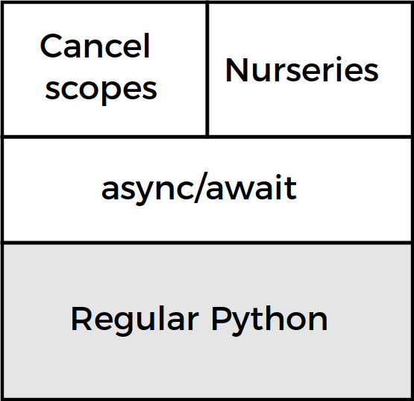
Trio architecture

Slide 33
What is “async concurrency”?
Pre-emptive
multitasking
Async (cooperative)
multitasking
Time
Safe
Unsafe
“The GIL is one honking great idea – let’s do more of those!”

Slide 34

THE GIL
By Becker1999 from Grove City, OH (Democracy Spring rally at U.S. Capitol) [CC BY 2.0 (http://creativecommons.org/licenses/by/2.0)], via Wikimedia Commons

Slide 35
What is “async concurrency”?
Pre-emptive
multitasking
Async (cooperative)
multitasking
Time
Safe
Unsafe
“The GIL is one honking great idea – let’s do more of those!”

Slide 36
(async/await demo)

Slide 37

The async sandwich

Slide 38
The async sandwich
trio.run
async def ...
async def ...
trio.sleep

Slide 39
One last thing...
with whatever:
…
async with whatever:
...
whatever.__enter__()
try
…
finally:
whatever.__exit__()
await whatever.__aenter__()
try:
…
finally:
await whatever.__exit__()
+ for / async for work the same way

Slide 40
Trio architecture

Slide 41
Trio architecture

Slide 42
Cancel scopes enable timeouts and cancellation
Every time you make an HTTP request, network call, RPC, … there are three possible outcomes:
  Success
  Failure
  It gets wedged forever
Terminology:
  Timeout: give up after X seconds
  Cancellation: give up in response to arbitrary event

Slide 43
(cancel scope demo)

Slide 44
The async sandwich
trio.run
move_on_after
async def ...
trio.sleep

Slide 45
Trio architecture

Slide 46
Trio architecture

Slide 47
Nurseries enable concurrency
(nursery demo)

Slide 48
Nurseries enable concurrency
async with trio.open_nursery() as nursery:
  ...
Child tasks always live in a nursery
Nursery is always attached to a with block in the parent task
Parent always waits for children to finish (no runaway child tasks; with blocks work)
  If you really want child to outlive parent, pass nursery object
Unhandled exceptions bubble up from child into parent (no lost exceptions)
(two-way proxy demo)

Slide 49
Trio architecture

Slide 50
Trio architecture

Slide 51
Other things Trio gives you
Boring (standard) APIs like sleep(), networking, file I/O, …
APIs for inter-task coordination (trio.Event, trio.Queue, ...)
Awesome testing helpers (trio.testing)
Control-C works
APIs for introspection and monitoring
Sphinx plugin to document async functions
Prototype asyncio compatibility layer

Slide 52
Not quite there yet...
Young project
HTTP client/server libraries
Managing subprocesses, multiprocessing-equivalent
Working on it...

Slide 53
That’s boring. Let’s implement happy eyeballs!

Slide 56
There should be one – and preferably only one – obvious way to do it.

Slide 57
Thanks
Glyph, Guido van Rossum, Yury Selivanov, Dave Beazley
  And everyone else who’s contributed to Python concurrency libraries over the last ~20 years...
My immune system for forcing me to take an unpaid 6 month vacation to work on Trio
You for listening!

Slide 58
Questions?
Applications?

Slide 60
main()
│
├─ f1()
│
└─ f2()
│
├─ f2a()
│
└─ f2b()

Slide 61
main()
│
├─ f1() → KeyError
│
└─ f2()
│
├─ f2a() → ValueError
│
└─ f2b() → RuntimeError

Slide 62
main()
│
├─ f1() → KeyError
│
└─ f2()
│
├─ f2a() → ValueError
│
└─ f2b() → RuntimeError
MultiError([
KeyError,
MultiError([
ValueError,
RuntimeError,
]),
])

Slide 63
Traceback (most recent call last):
File "multierror.py", line 22, in <module>
trio.run(main)
File "multierror.py", line 6, in main
nursery.spawn(f2)
trio.MultiError: KeyError(), <MultiError: RuntimeError(), ValueError()>
Details of embedded exception 1:
Traceback (most recent call last):
File "multierror.py", line 9, in f1
raise KeyError
KeyError
Details of embedded exception 2:
Traceback (most recent call last):
File "multierror.py", line 14, in f2
nursery.spawn(f2b)
trio.MultiError: RuntimeError(), ValueError()
Details of embedded exception 1:
Traceback (most recent call last):
File "multierror.py", line 17, in f2a
raise ValueError
ValueError
Details of embedded exception 2:
Traceback (most recent call last):
File "multierror.py", line 20, in f2b
raise RuntimeError
RuntimeError
main()
│
├─ f1() → KeyError
│
└─ f2()
│
├─ f2a() → ValueError
│
└─ f2b() → RuntimeError
MultiError([
KeyError,
MultiError([
ValueError,
RuntimeError,
]),
])

Slide 64
Catching single exceptions
def catch_block(exc):
if isinstance(exc, (RuntimeError, KeyError)):
return None
else:
return exc
with trio.MultiError.catch(catch_block):
...
Traceback (most recent call last):
File "multierror-catch.py", line 28, in <module>
trio.run(main)
File "multierror-catch.py", line 12, in main
nursery.spawn(f2)
File "multierror-catch.py", line 20, in f2
nursery.spawn(f2b)
File "multierror-catch.py", line 23, in f2a
raise ValueError
ValueError

