Slide 1

Python concurrency for mere mortals
Nathaniel J. Smith

Slide 2
Thanks
Guido van Rossum, Glyph, Yury Selivanov, Dave Beazley, Ben Darnell, ...
  And everyone else who’s contributed to Python concurrency libraries over the last ~20 years...
The awesome Trio community

Slide 3

Concurrency, noun: walking and chewing gum at the same time
Photo: Keith Allison CC BY-SA 2.0
https://commons.wikimedia.org/wiki/File:Jim_Thome_bubble_gum.jpg

Slide 4
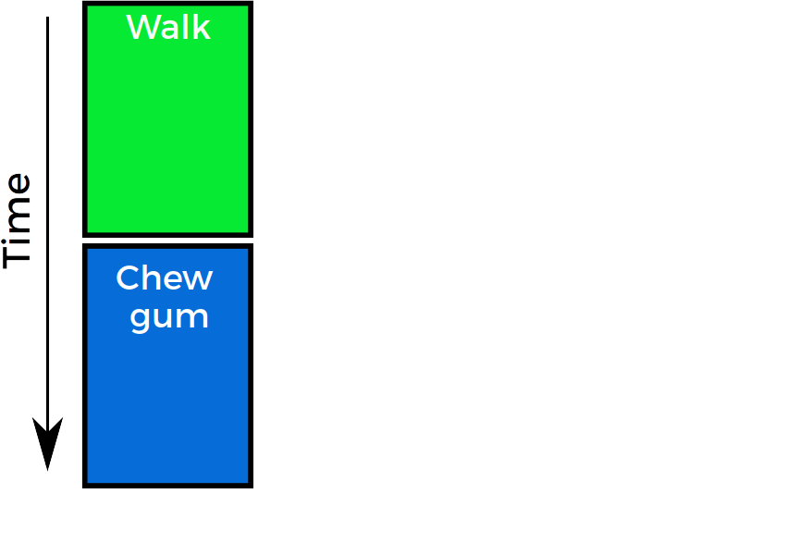


Sequential code
def walk_then_chew_gum():
walk()
chew_gum()

Slide 5
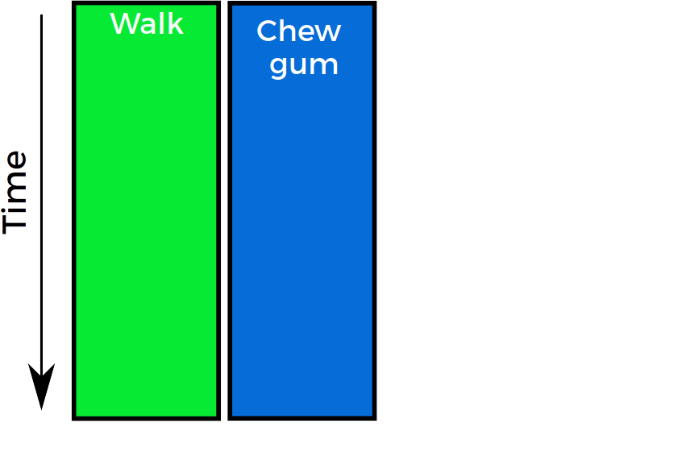
Concurrent code
def walk_and_chew_gum():
???

Slide 6
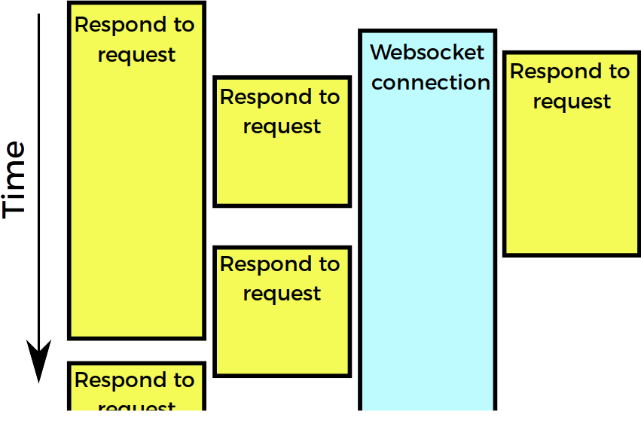
Web server

Slide 7
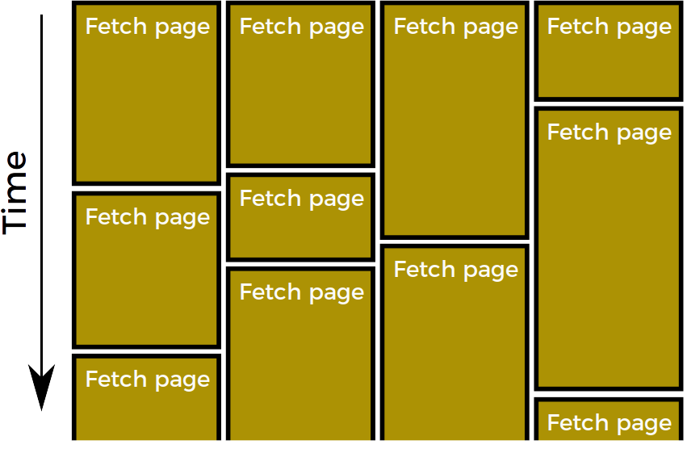
Web spider

Slide 8
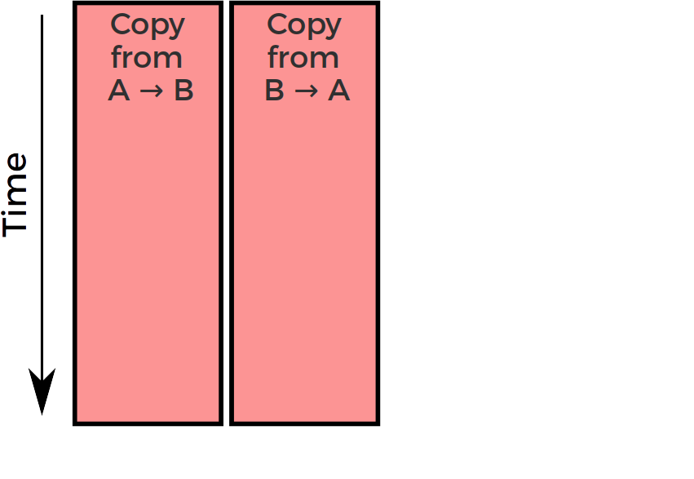
Simple bidirectional proxy

Slide 9
Concurrency is super useful.
But… there’s a problem.

Slide 10
This is about expressivity
Python still has a GIL. I haven’t fixed that.
But even if we can only use 1 core, many programs make more sense when expressed in the language of concurrency:
  Web servers talking to multiple clients
  Experiment software simultaneously monitoring multiple sensors and managing stimulus display
  Two-way proxy: copy data from A → B while copying data from B → A
  “Happy eyeballs”

Slide 11


Slide 12
Example

Slide 13
(getaddrinfo demo)

Slide 14
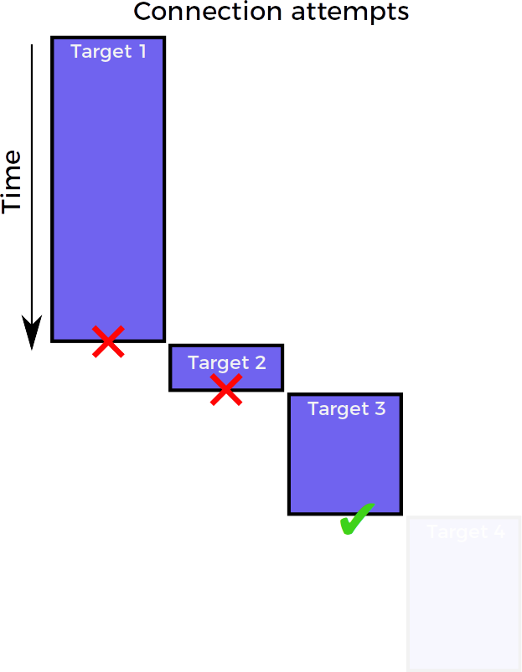
Connection strategy: sequential

Slide 15
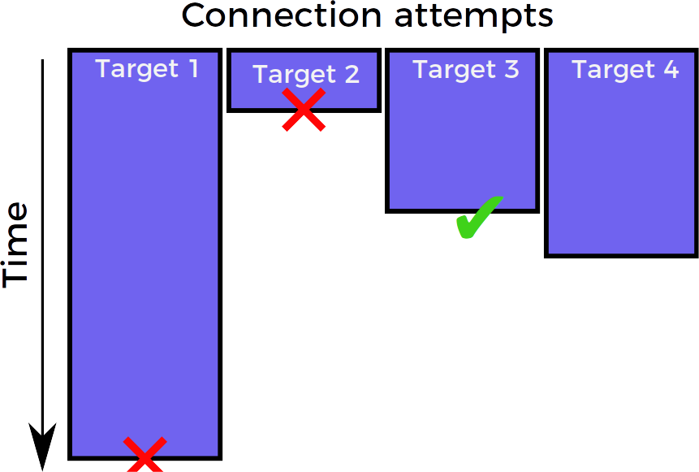
Connection strategy: race

Slide 16

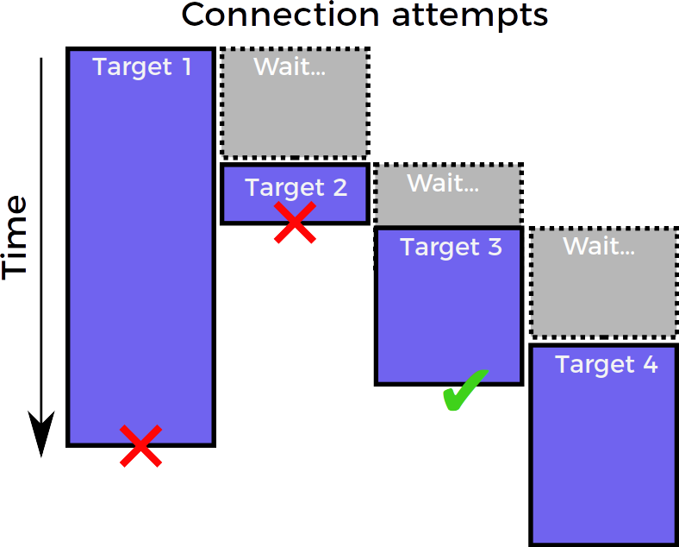
Connection strategy:
“happy eyeballs” (RFC 8305)
Best of both worlds:
almost as efficient as sequential
& almost as fast as race

Slide 17
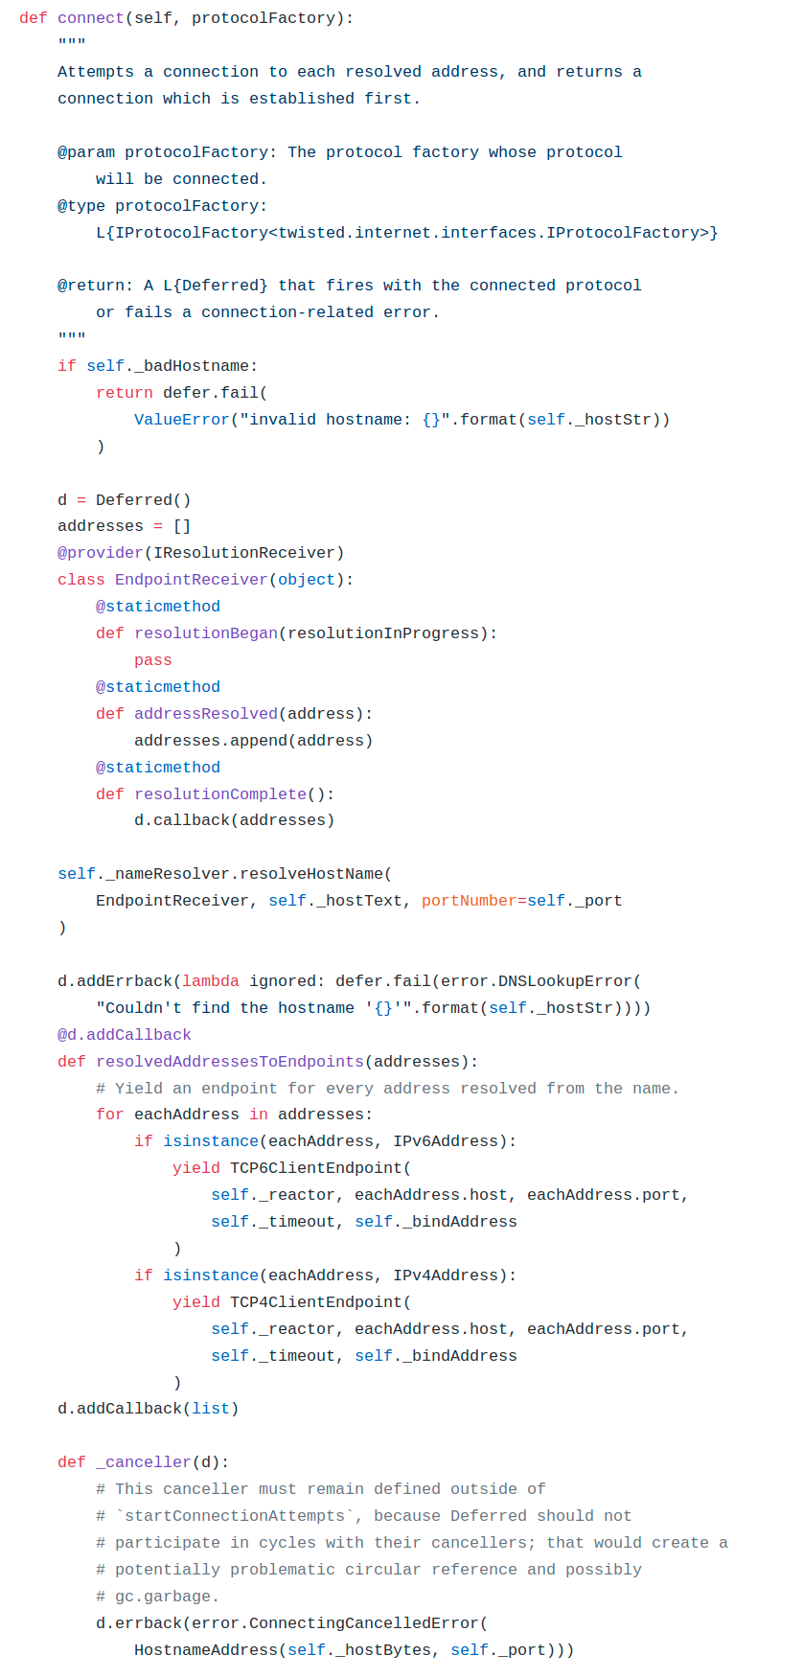
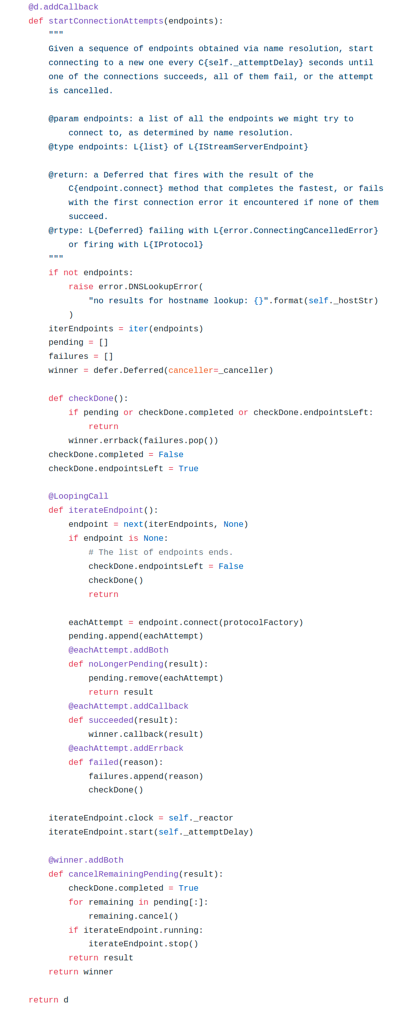
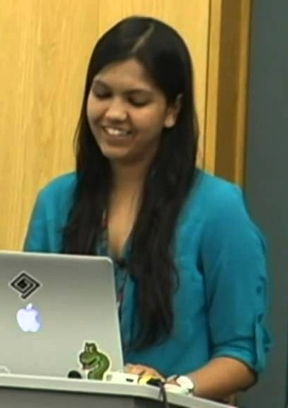
Happy eyeballs in twisted
Ashwini Oruganti
Photo: from https://youtu.be/XsLFLzx4Nq4

Slide 18
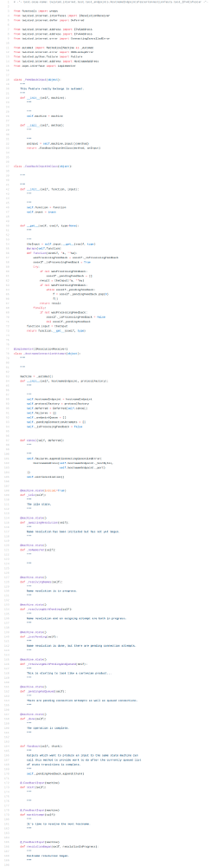
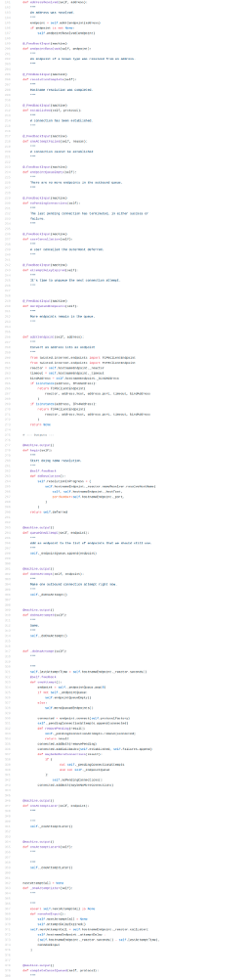
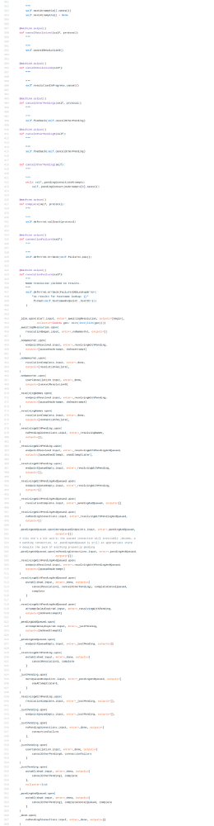
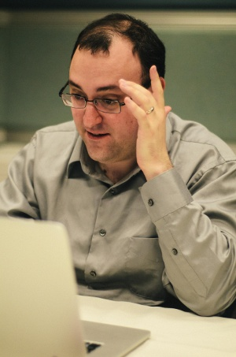
Happy eyeballs in twisted v2
Glyph Lefkowitz
Photo: Kushal Das, CC-BY-NC-SA 2.0 https://www.flickr.com/photos/kushaldas/8608040013

Slide 19
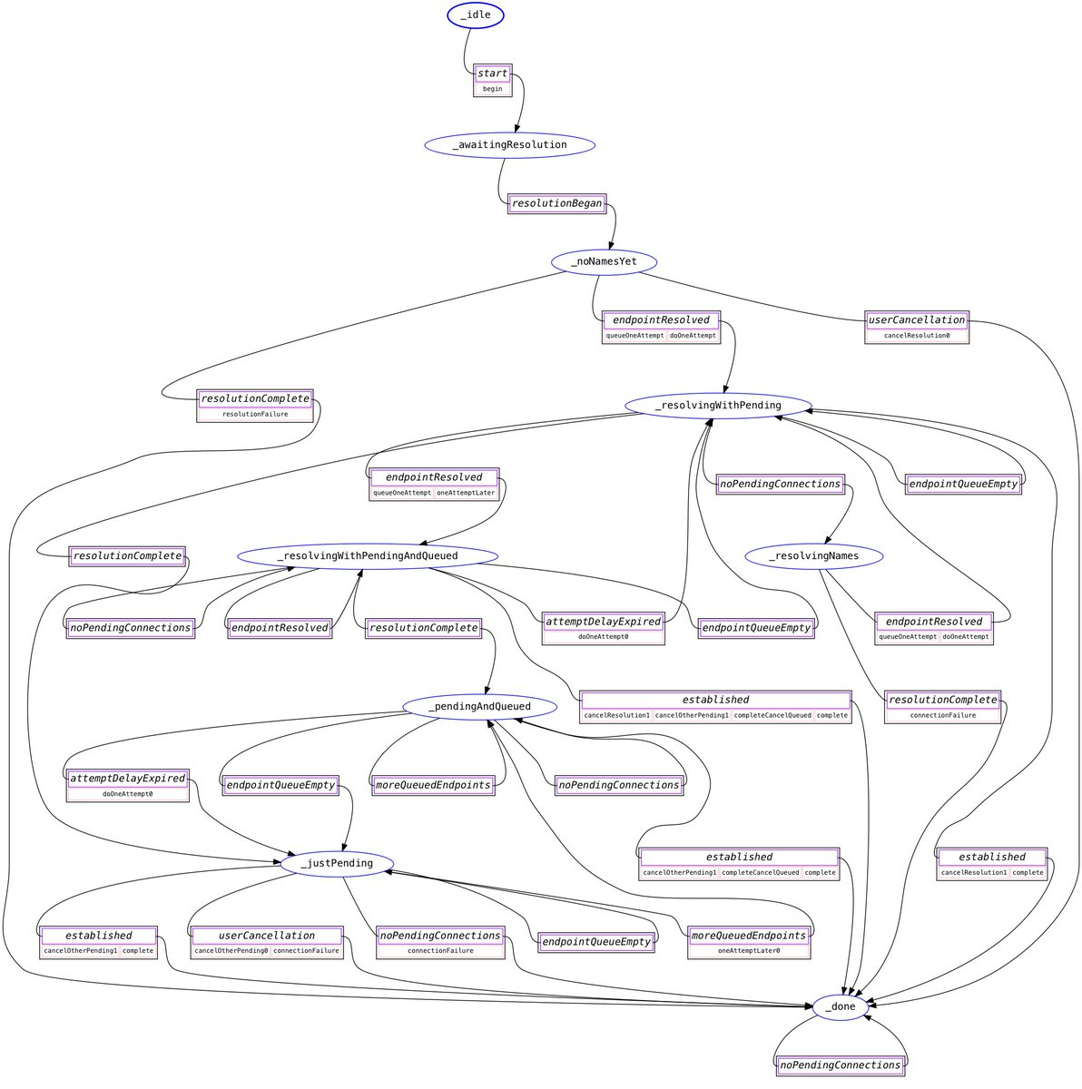
Happy eyeballs in twisted v2
Glyph Lefkowitz
Photo: Kushal Das, CC-BY-NC-SA 2.0 https://www.flickr.com/photos/kushaldas/8608040013

Slide 20
Connection strategy: “happy eyeballs”

Slide 21
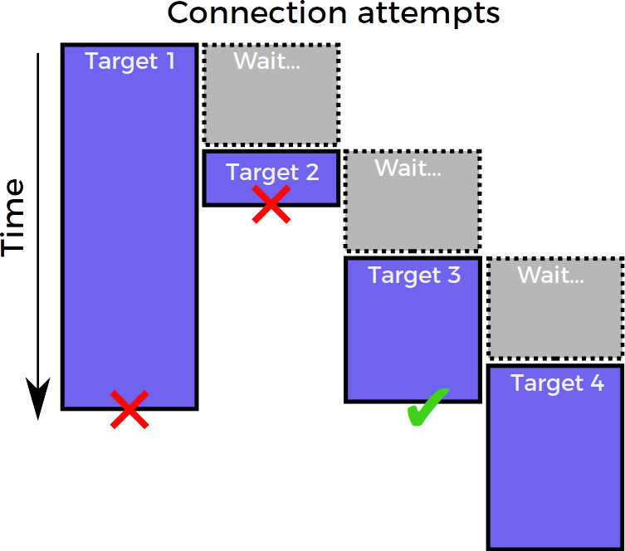
Connection strategy: “happy eyeballs”
Twisted bug #9345

Slide 22
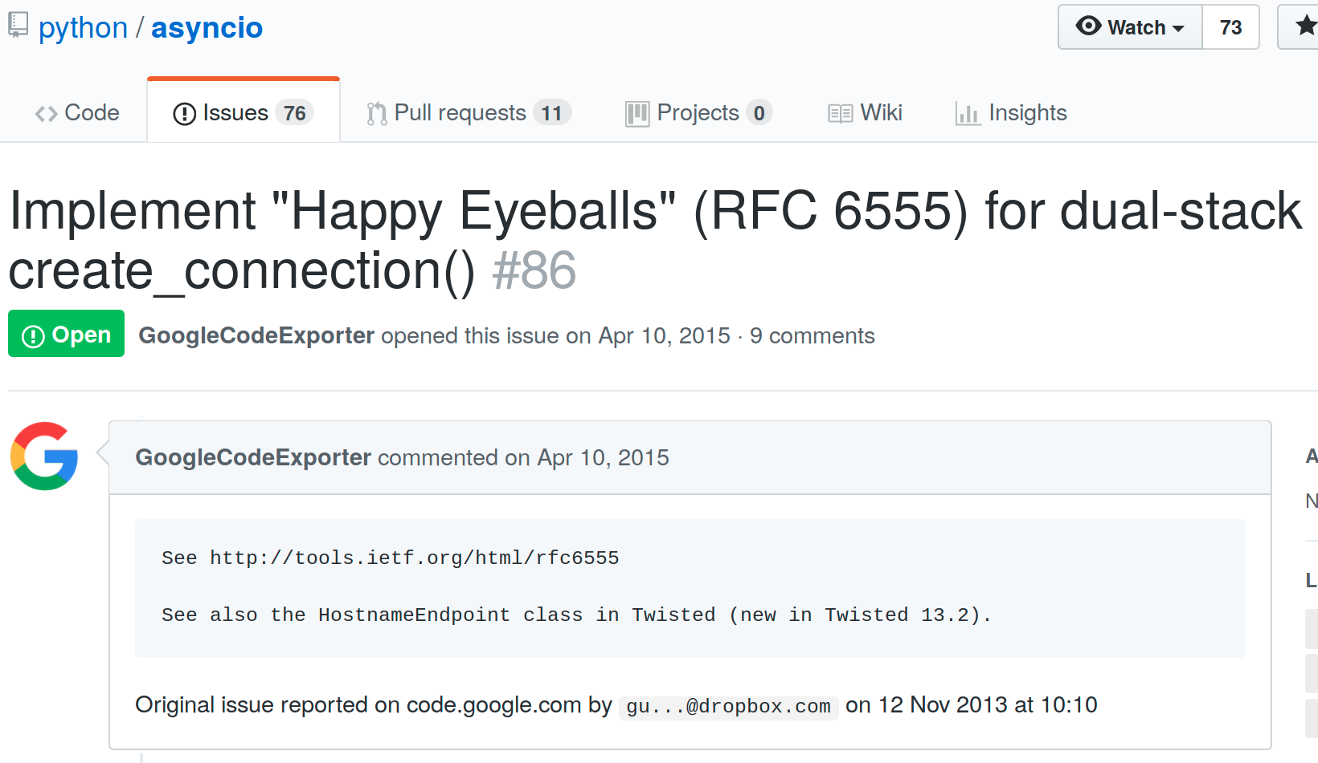
Happy eyeballs in asyncio

Slide 24
Heroic developers

Slide 25
But… why do we need heroes?

Slide 27


Slide 28
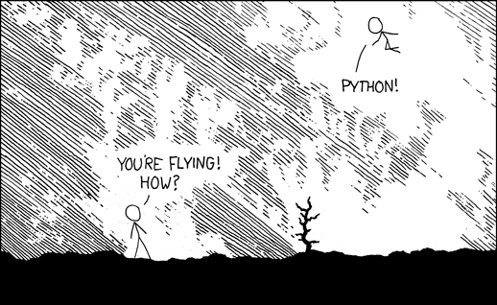
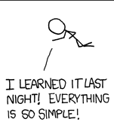
https://xkcd.com/353/ by Randall Munroe, CC-BY-NC 2.0

Slide 29

A new, from-scratch, permissively-licensed concurrency library for Python 3.5+, supporting all major platforms
Install: pip install trio
Use: import trio

Slide 30
Trio will
Solve all your concurrency problems
Make you 10x more productive than Glyph
Whiten your teeth
Walk your dog*
  *Enterprise version only, call for quote
Everything on this slide is a lie

Slide 31

Goal: be the Python of concurrency libraries

Slide 32
Plan today
1. Work through a simple example to see how Trio works
2. Implement happy eyeballs.

Slide 33
Example: simple proxy

Slide 34
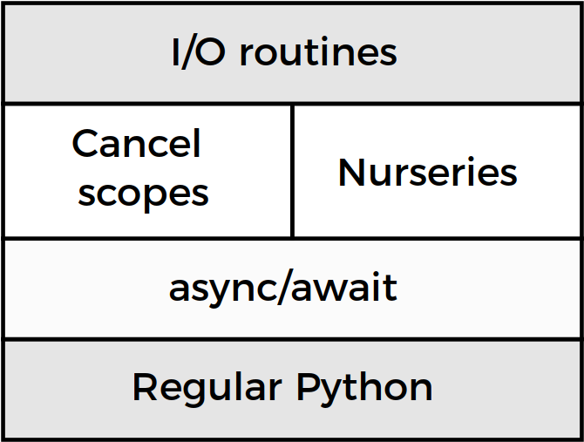
Trio architecture

Slide 35
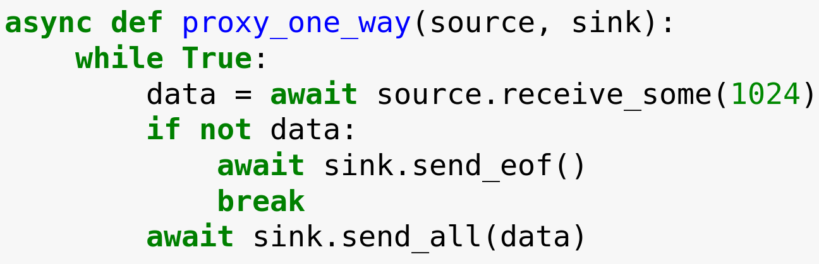

Slide 36
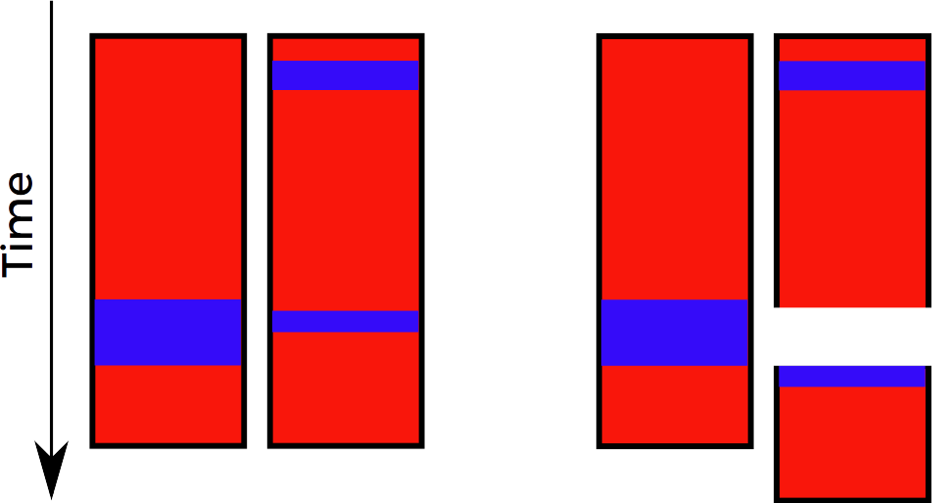
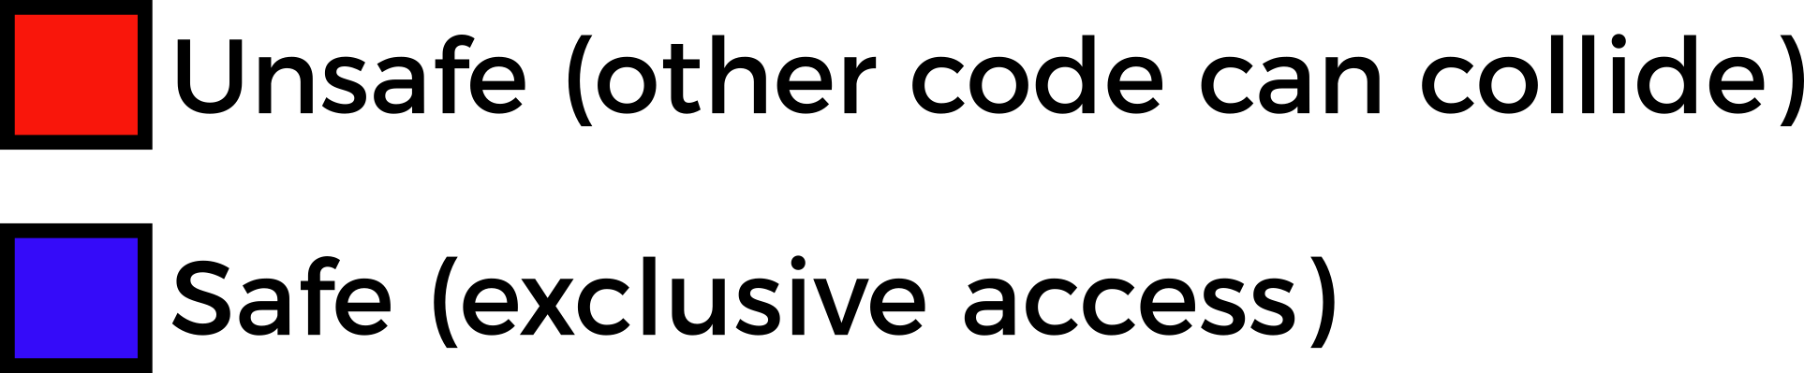
Preemptive concurrency
Your code
How it executes

Slide 37
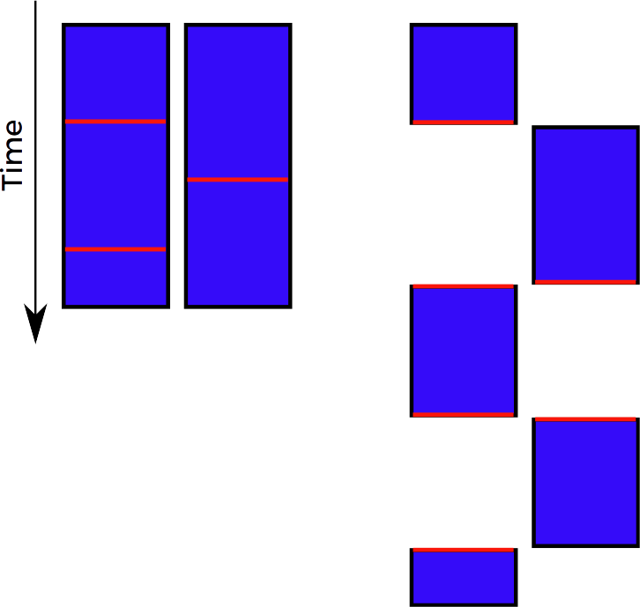
Cooperative (async) concurrency
Your code
How it executes

Slide 38
What is “async concurrency”?
Pre-emptive
multitasking
Async (cooperative)
multitasking
Time
Safe
Unsafe
“The GIL is one honking great idea – let’s do more of those!”

Slide 39
Preemptive
concurrency
Cooperative (async) concurrency
Your code
How it executes
Your code
How it executes
Faster…
...except we have the GIL
Easier to use

Slide 40

THE GIL
By Becker1999 from Grove City, OH (Democracy Spring rally at U.S. Capitol) [CC BY 2.0 (http://creativecommons.org/licenses/by/2.0)], via Wikimedia Commons

Slide 41
Preemptive
concurrency
Cooperative (async) concurrency
Your code
How it executes
Your code
How it executes
Faster…
...except we have the GIL
Easier to use

Slide 43
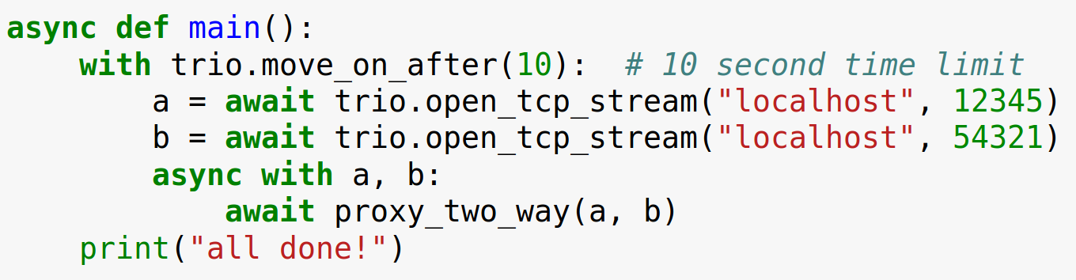

Slide 44
Trio architecture

Slide 45
Trio architecture

Slide 46
Timeouts are important

Slide 47

Timeouts are important
Futurama S04E07

Slide 48

Timeouts are important
Futurama S04E07

Slide 49

Timeouts are important
Futurama S04E07

Slide 50

Timeouts are important
Futurama S04E07

Slide 51

Timeouts are important
Futurama S04E07

Slide 52

Timeouts are important
Futurama S04E07

Slide 53

Timeouts are important
Futurama S04E07

Slide 54
(cancel scope demo)

Slide 55
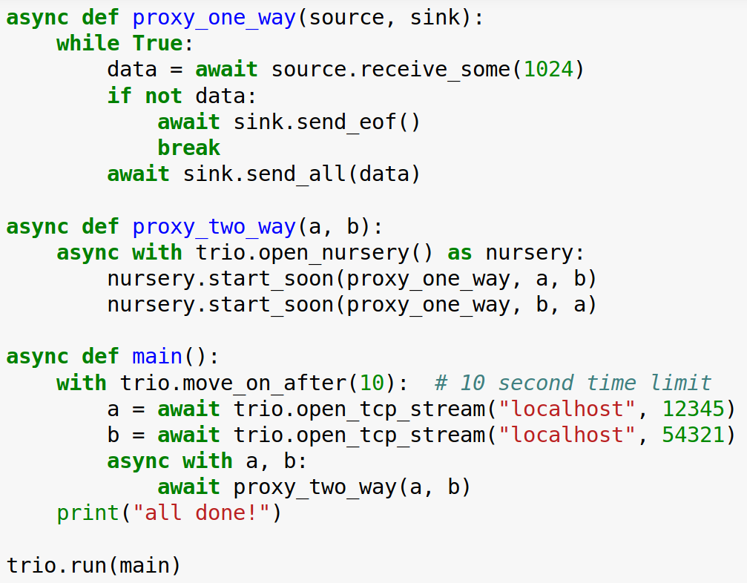
Raises trio.Cancelled
Caught here

Slide 56
Cancel scopes enable timeouts and cancellation
Every time you make an HTTP request, network call, RPC, … there are three possible outcomes:
  Success
  Failure
  It gets wedged forever
Terminology:
  Timeout: give up after X seconds
  Cancellation: give up in response to arbitrary event

Slide 57
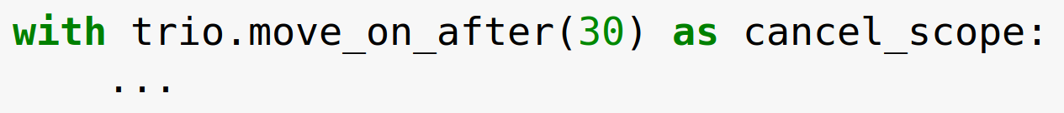
Cancel scopes, continued
cancel_scope.deadline:
read or change timeout
cancel_scope.cancel():
cancel now, without waiting for timeout
+ introspection tools, etc., see docs for details.
Also available: fail_after, move_on_at, ...

Slide 58
Trio architecture

Slide 59
Trio architecture

Slide 60
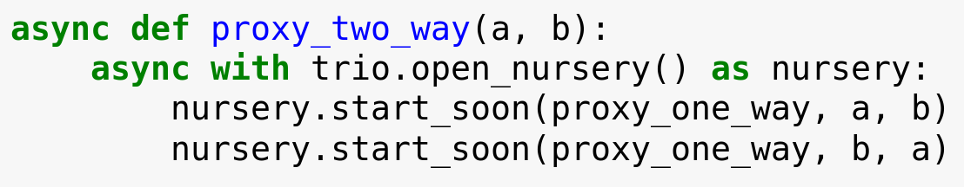
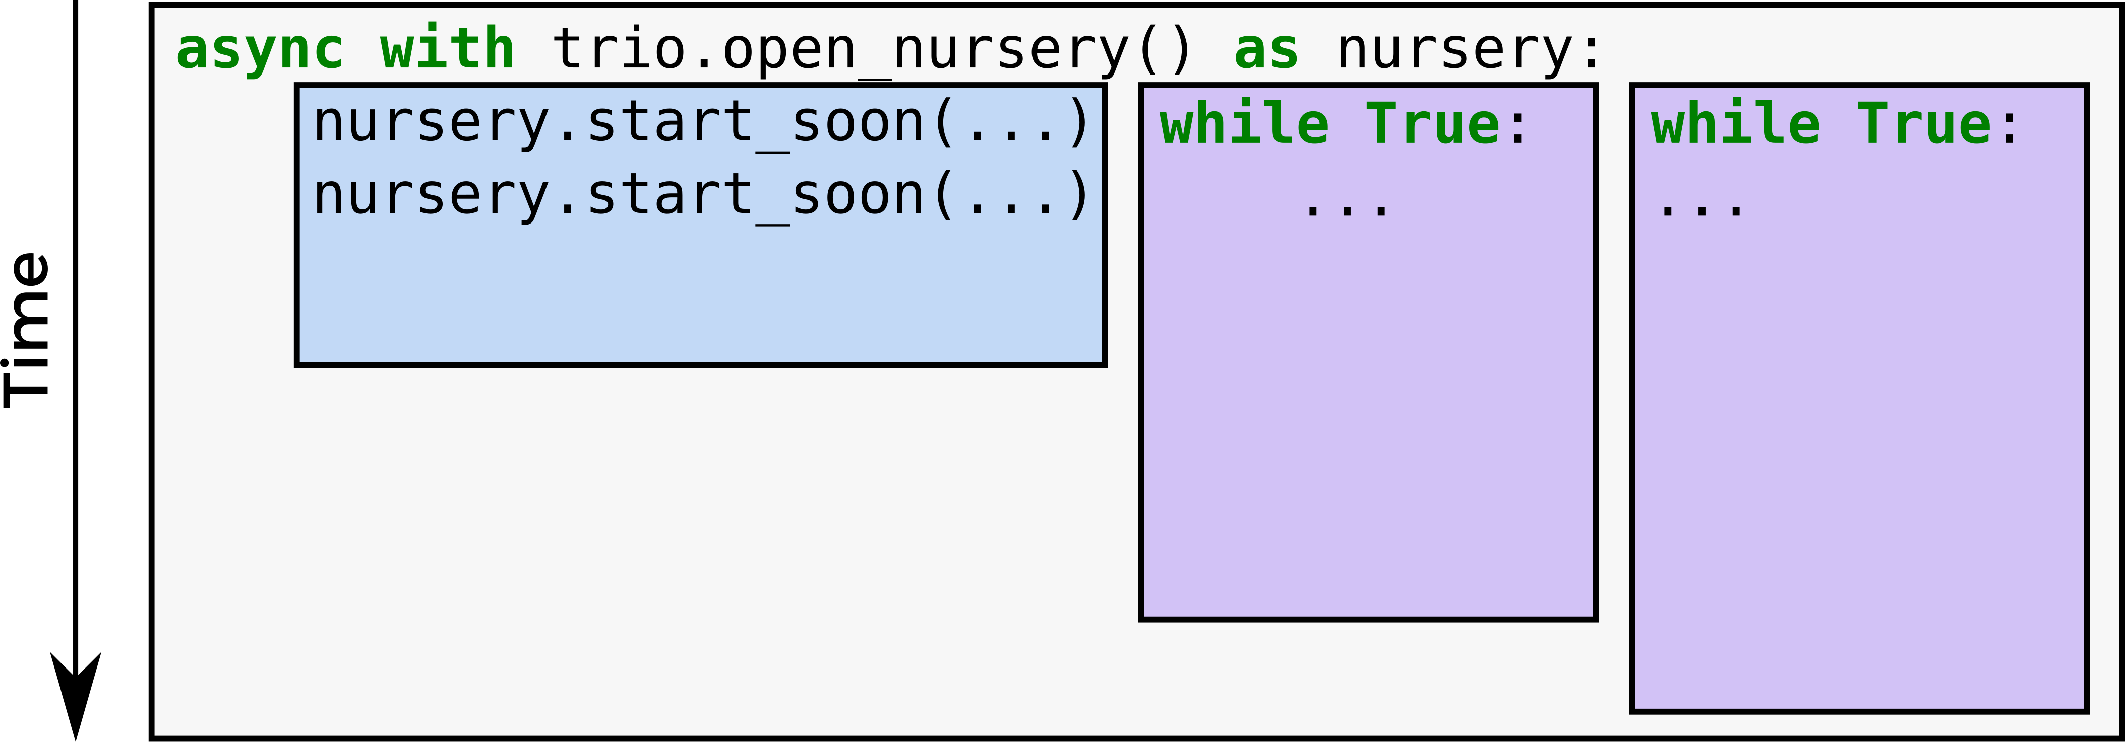
What you see:
How it works:

Slide 61
Exceptions in nurseries
CANCELLED
CANCELLED

Slide 63
Nurseries enable concurrency
async with trio.open_nursery() as nursery:
  ...
Child tasks always live in a nursery
Nursery is always attached to a with block in the parent task
Parent always waits for children to finish (no runaway child tasks; with blocks work)
  If you really want child to outlive parent, pass nursery object
Unhandled exceptions bubble up from child into parent (no lost exceptions)
(two-way proxy demo)

Slide 64
Why do nurseries matter?

Slide 65
Let’s go back in time… way back.

Slide 67
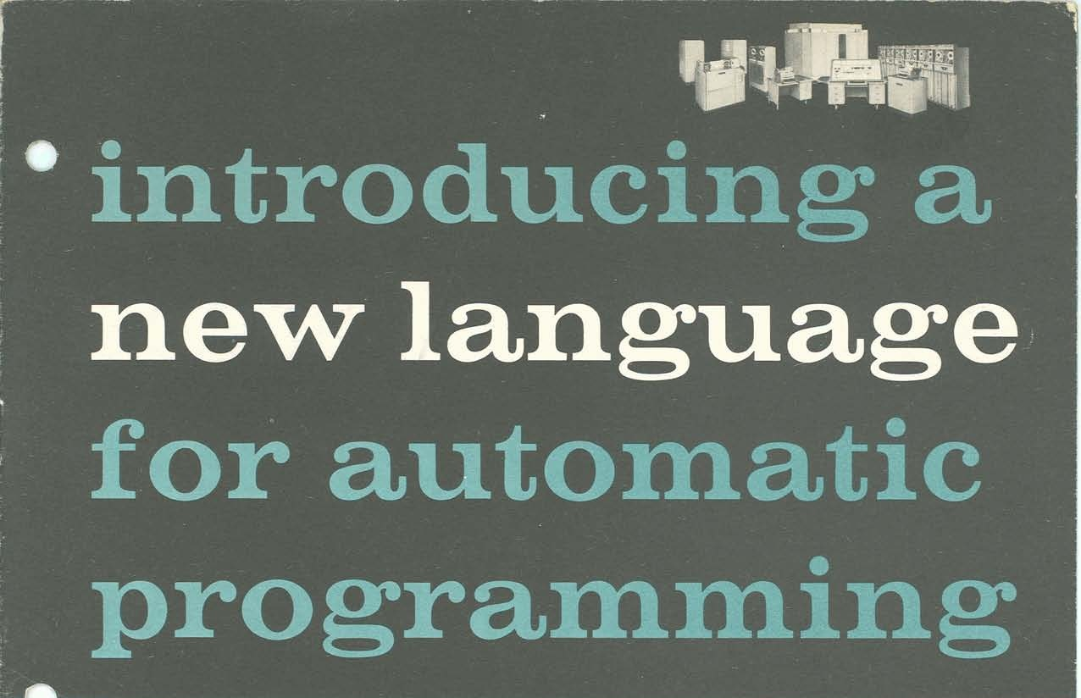

Slide 68

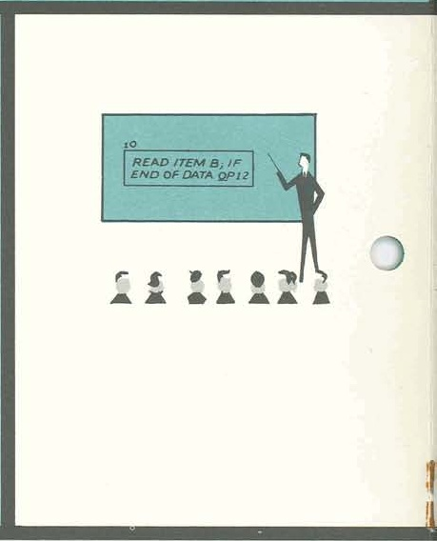
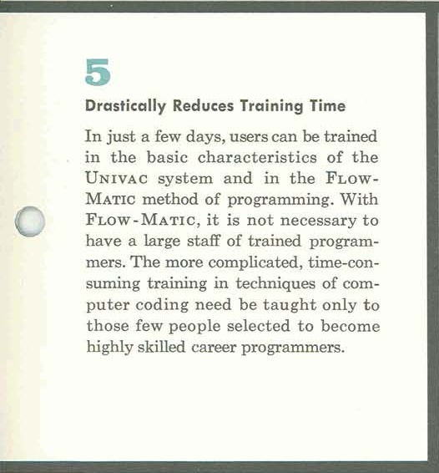
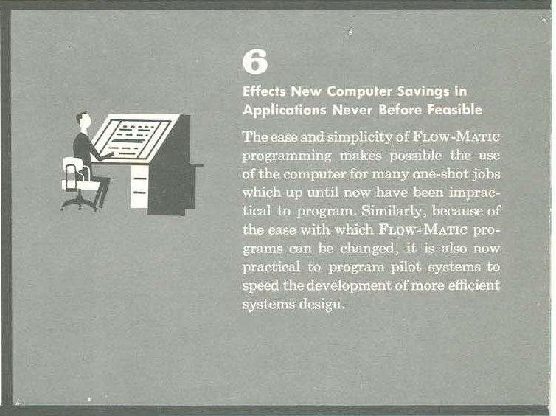

Slide 69
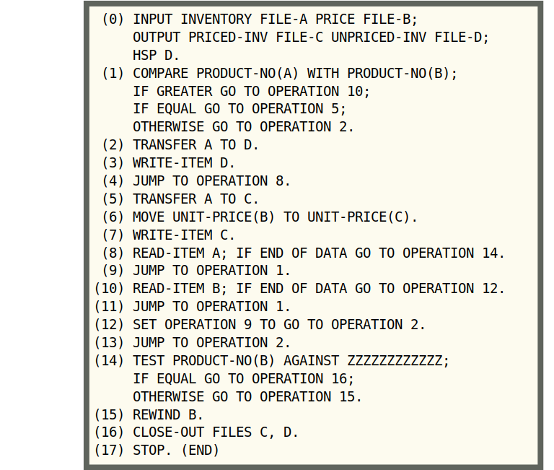
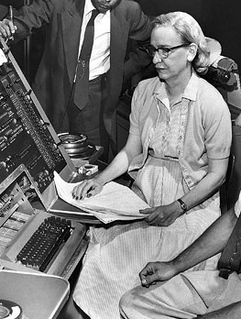
FLOW-MATIC:
1958’s Python
Grace Hopper
Photo: Smithsonian, CC-BY 2.0 https://commons.wikimedia.org/wiki/File:Grace_Hopper_and_UNIVAC.jpg

Slide 70
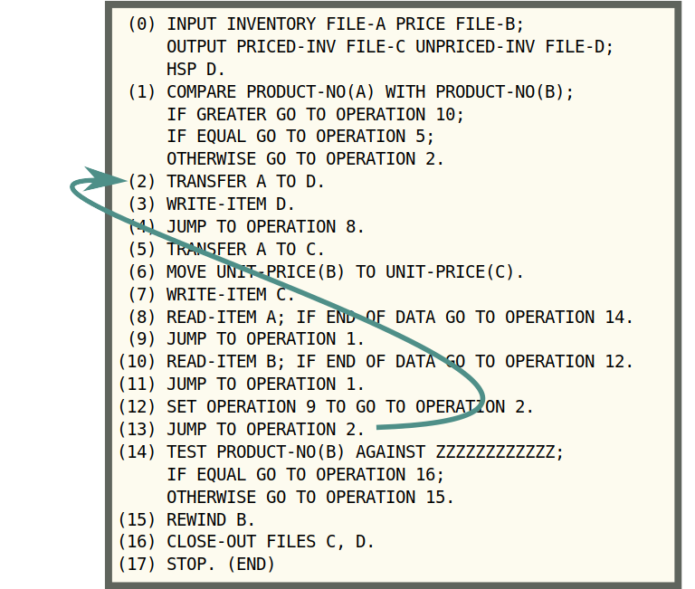
FLOW-MATIC:
1958’s Python
Grace Hopper
Photo: Smithsonian, CC-BY 2.0 https://commons.wikimedia.org/wiki/File:Grace_Hopper_and_UNIVAC.jpg

Slide 71
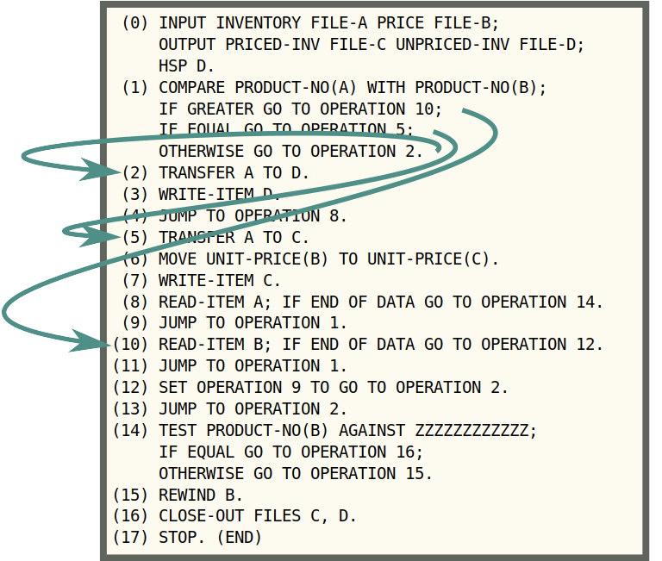
FLOW-MATIC:
1958’s Python
Grace Hopper
Photo: Smithsonian, CC-BY 2.0 https://commons.wikimedia.org/wiki/File:Grace_Hopper_and_UNIVAC.jpg

Slide 72
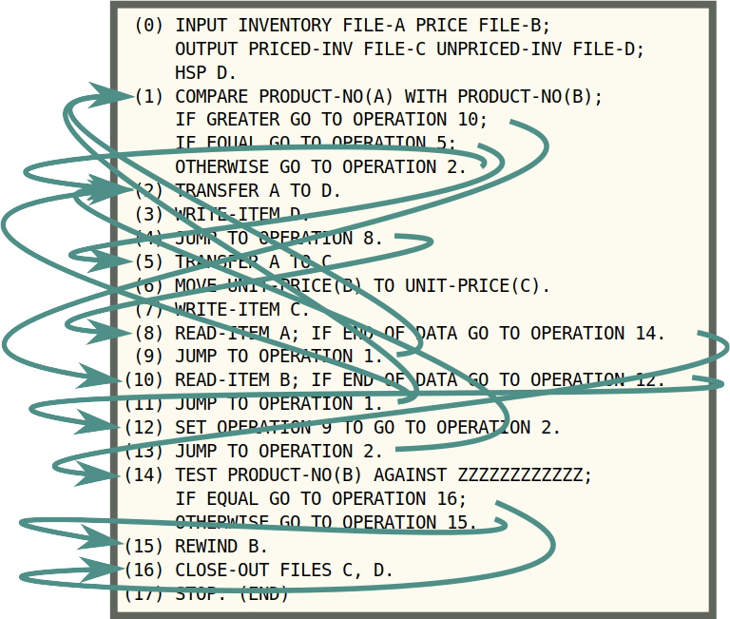
FLOW-MATIC:
1958’s Python
Grace Hopper
Photo: Smithsonian, CC-BY 2.0 https://commons.wikimedia.org/wiki/File:Grace_Hopper_and_UNIVAC.jpg

Slide 73
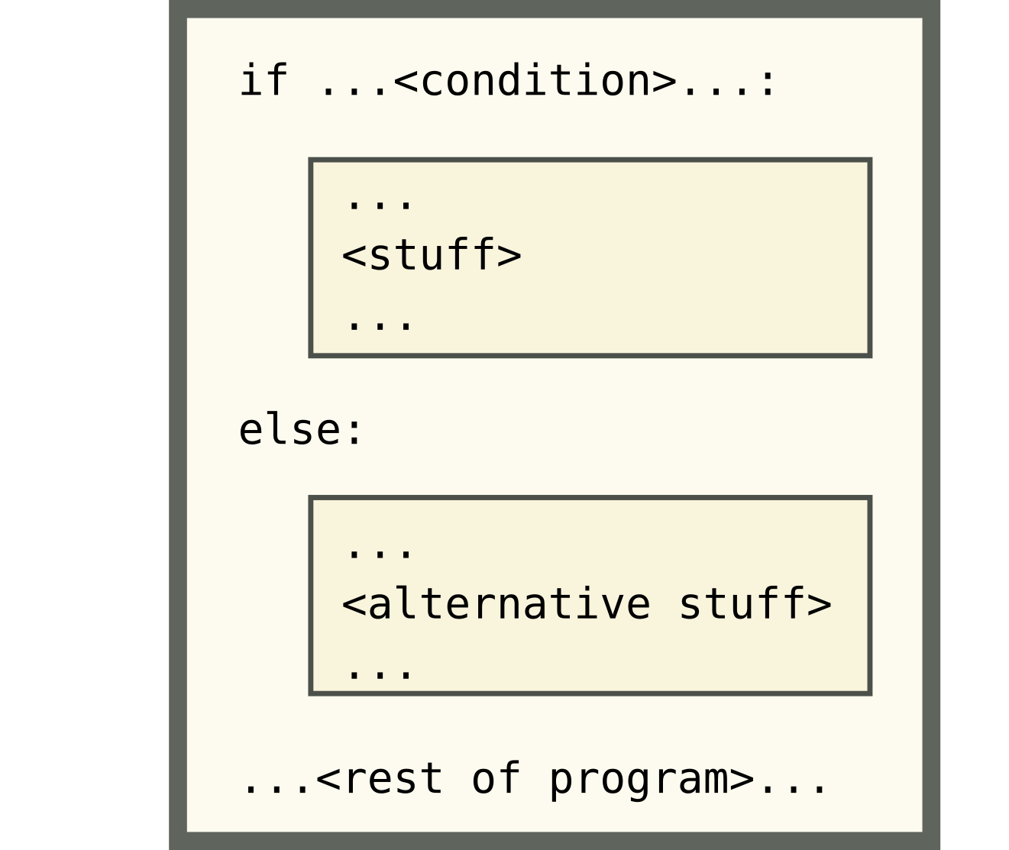

Slide 74
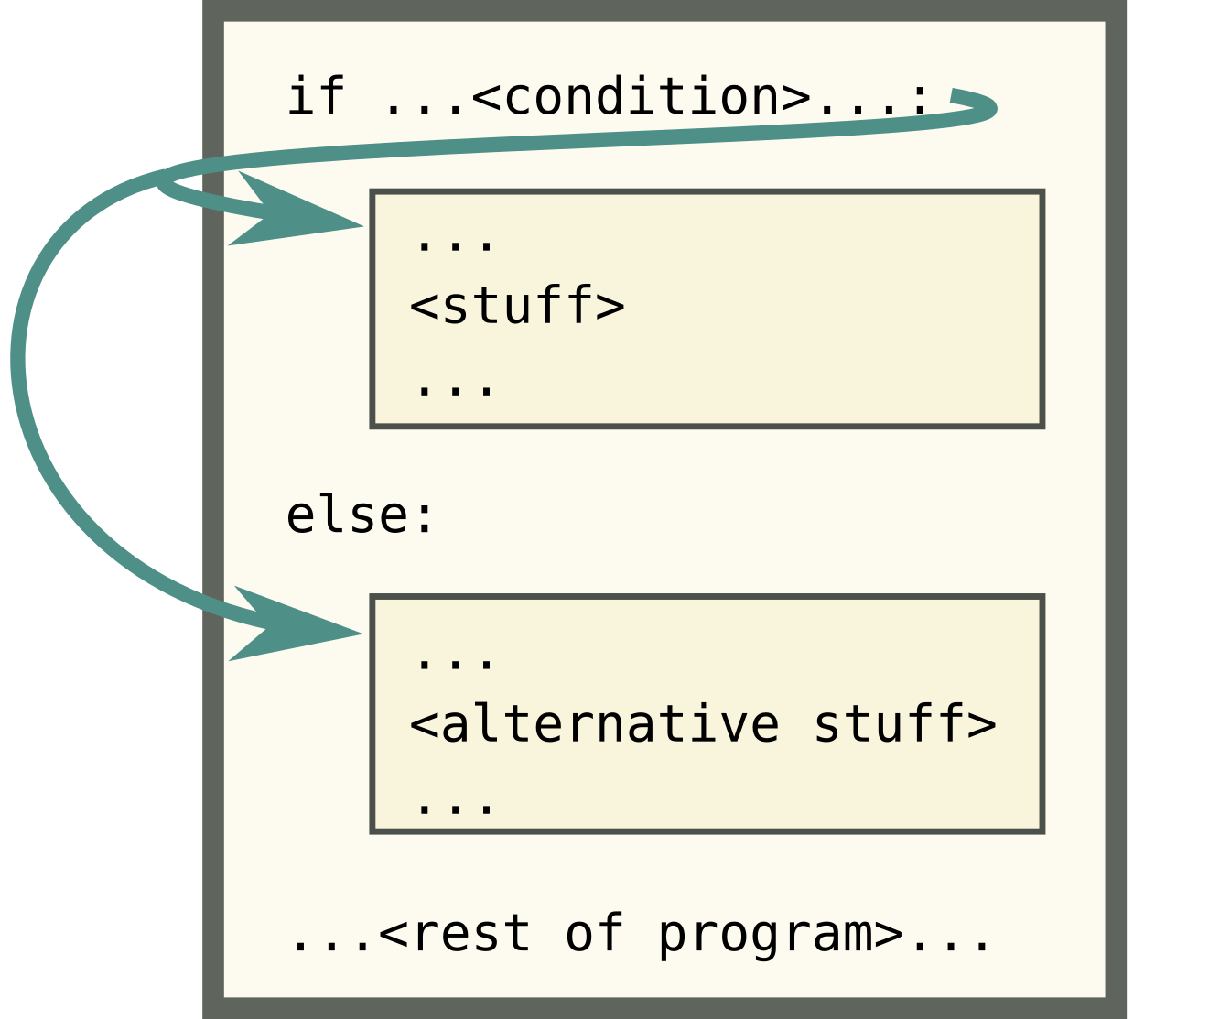

Slide 75
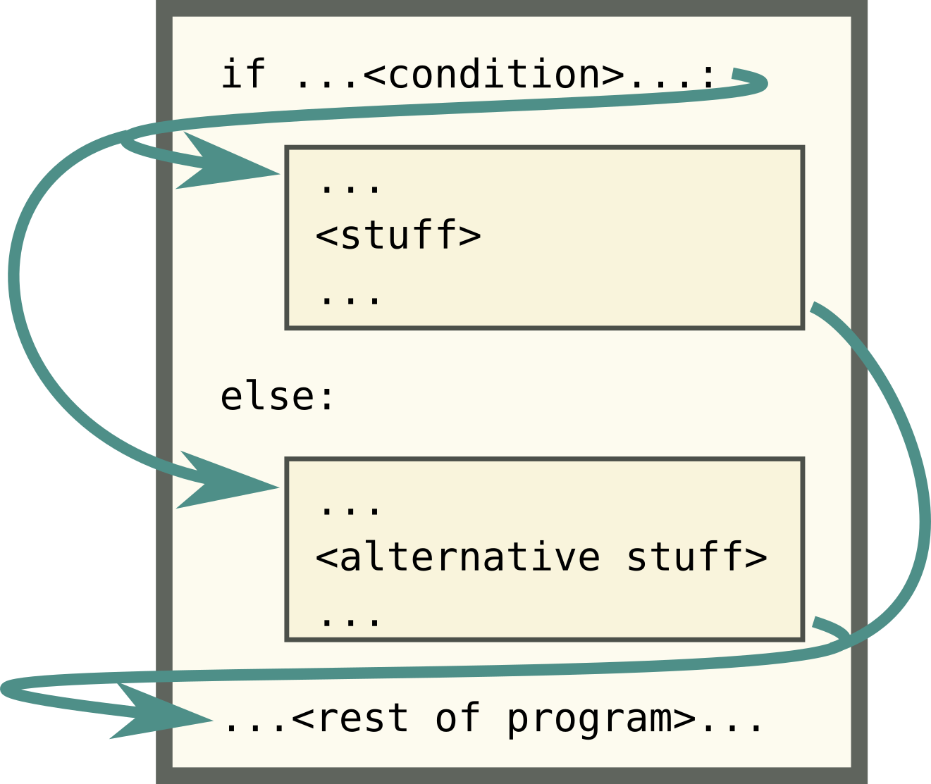

Slide 76
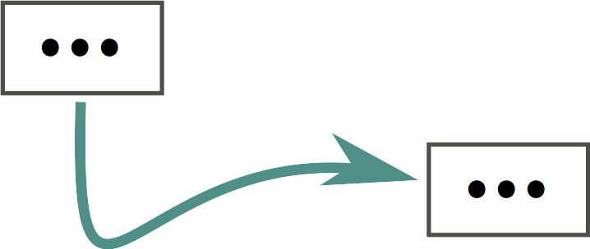
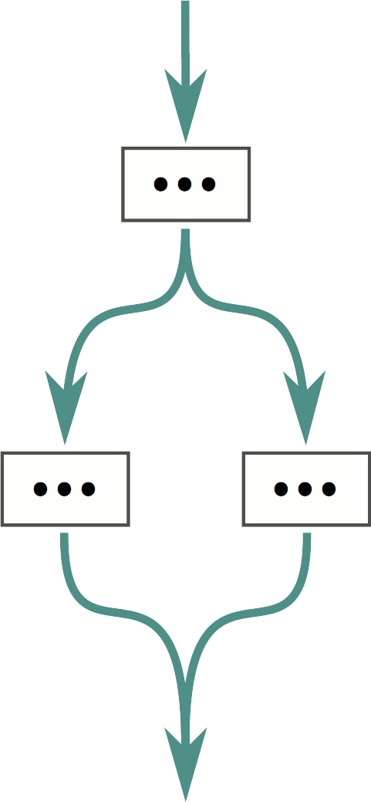
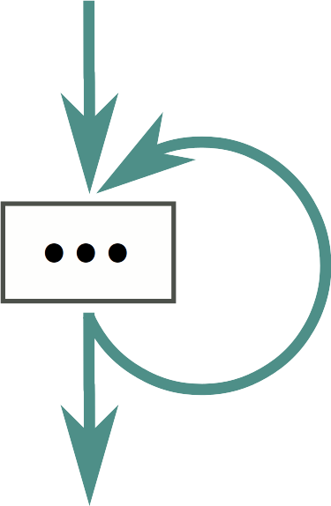
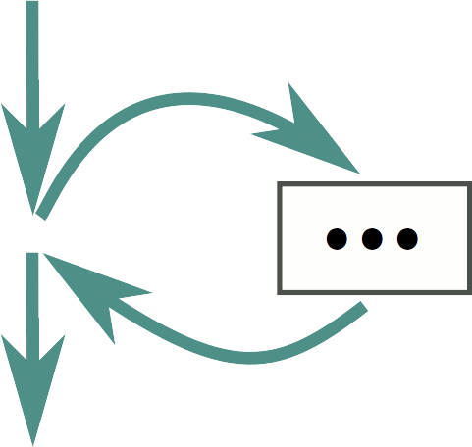
go to
if/else
loop
function call

Slide 77
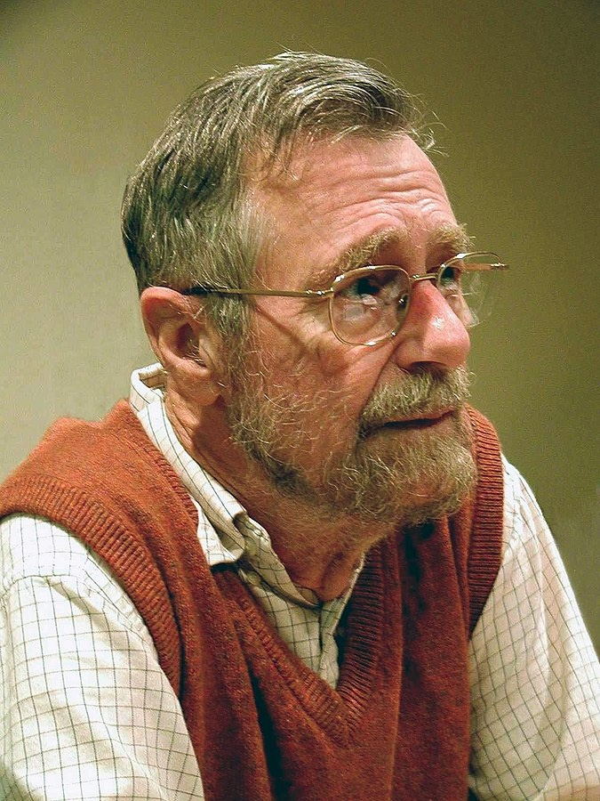
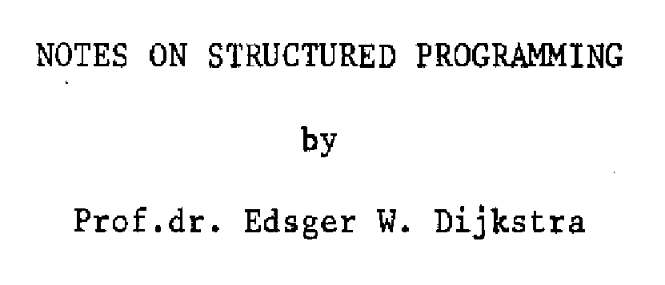
1969
Edsgar W. Dijkstra
Photo: Hamilton Richards, https://commons.wikimedia.org/wiki/File:Edsger_Wybe_Dijkstra.jpg

Slide 78

go to
if/else
loop
function call

Slide 79
What’s so bad about “go to”?
Leads to spaghetti code
Breaks abstractions
Breaks higher-level constructs like exceptions, with statements

Slide 80
OK… back to concurrency

Slide 81
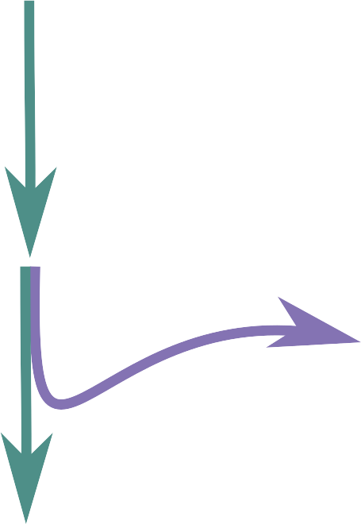
The basic concurrency primitive in most libraries/languages

Slide 82
Examples
classic Python:
Thread.start()
asyncio:
Future.add_done_callback(...)
ensure_future(…)
transport.write(…)
...
C:
pthread_create(...)
Go:
go some_fn()
And so on...

Slide 83
Go To statement = Go statement
Twisted, Tornado, asyncio, ...
2018
FLOW-MATIC
1958

Slide 84
go to
if/else
loop
function call

Slide 85
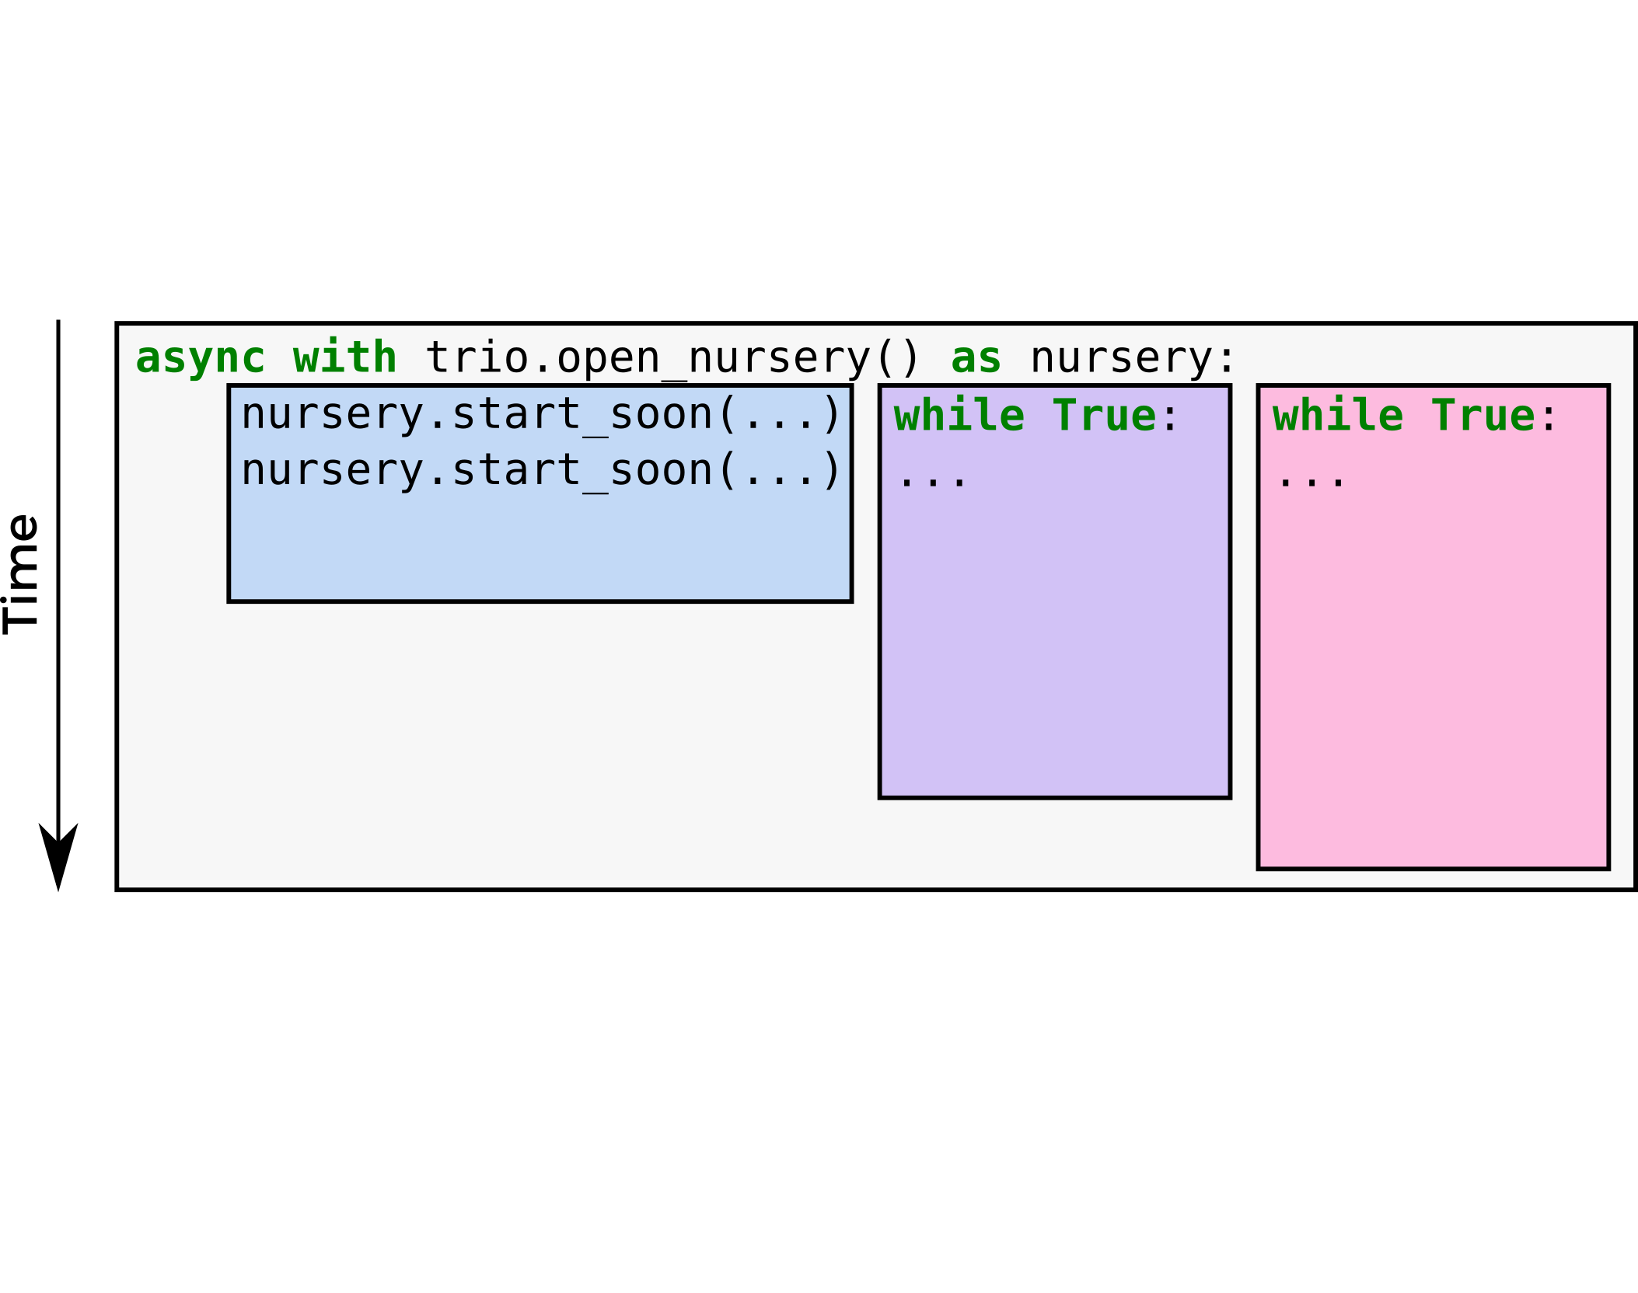

Slide 86


Slide 87
Raises trio.Cancelled
Caught here

Slide 88
Trio architecture

Slide 89
Trio architecture

Slide 90
Other things Trio gives you
...that’s about it right now
Standard stuff for I/O like networking, sleep(), files, signals, …
APIs for inter-task coordination (trio.Event, trio.Queue, …) (demo)
Awesome testing helpers (trio.testing) + pytest plugin
Control-C works
APIs for introspection and monitoring
Sphinx plugin
Compatibility layer to use asyncio libraries on trio

Slide 91
Not quite there yet...
Young project
HTTP client/server libraries
Managing subprocesses, multiprocessing-equivalent
Working on it...

Slide 95

Essential complexity
versus
Accidental complexity
Fred Brooks

Slide 96
There should be one – and preferably only one – obvious way to do it.

Slide 97
Tutorial + reference manual: trio.readthedocs.io
Chat: gitter.im/python-trio/general
Code + issues + slides: github.com/python-trio/trio github.com/python-trio/trio-talks
Come and join us!

Slide 99
main()
│
├─ f1()
│
└─ f2()
│
├─ f2a()
│
└─ f2b()

Slide 100
main()
│
├─ f1() → KeyError
│
└─ f2()
│
├─ f2a() → ValueError
│
└─ f2b() → RuntimeError

Slide 101
main()
│
├─ f1() → KeyError
│
└─ f2()
│
├─ f2a() → ValueError
│
└─ f2b() → RuntimeError
MultiError([
KeyError,
MultiError([
ValueError,
RuntimeError,
]),
])

Slide 102
Traceback (most recent call last):
File "multierror.py", line 22, in <module>
trio.run(main)
File "multierror.py", line 6, in main
nursery.spawn(f2)
trio.MultiError: KeyError(), <MultiError: RuntimeError(), ValueError()>
Details of embedded exception 1:
Traceback (most recent call last):
File "multierror.py", line 9, in f1
raise KeyError
KeyError
Details of embedded exception 2:
Traceback (most recent call last):
File "multierror.py", line 14, in f2
nursery.spawn(f2b)
trio.MultiError: RuntimeError(), ValueError()
Details of embedded exception 1:
Traceback (most recent call last):
File "multierror.py", line 17, in f2a
raise ValueError
ValueError
Details of embedded exception 2:
Traceback (most recent call last):
File "multierror.py", line 20, in f2b
raise RuntimeError
RuntimeError
main()
│
├─ f1() → KeyError
│
└─ f2()
│
├─ f2a() → ValueError
│
└─ f2b() → RuntimeError
MultiError([
KeyError,
MultiError([
ValueError,
RuntimeError,
]),
])

Slide 103
Catching single exceptions
def catch_block(exc):
if isinstance(exc, (RuntimeError, KeyError)):
return None
else:
return exc
with trio.MultiError.catch(catch_block):
...
Traceback (most recent call last):
File "multierror-catch.py", line 28, in <module>
trio.run(main)
File "multierror-catch.py", line 12, in main
nursery.spawn(f2)
File "multierror-catch.py", line 20, in f2
nursery.spawn(f2b)
File "multierror-catch.py", line 23, in f2a
raise ValueError
ValueError

