Slide 1

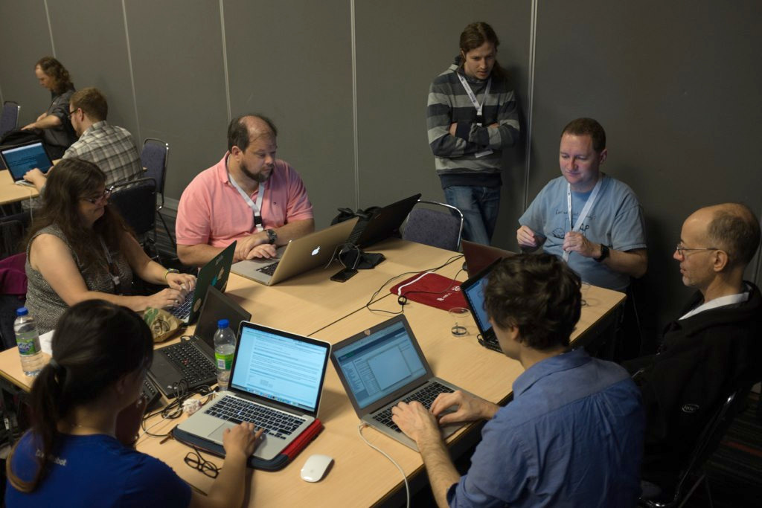
Concurrency made easier
Nathaniel J. Smith
tinyurl.com/trio-pycon
Photo: Kushal Das, CC-BY-NC-SA 2.0 https://www.flickr.com/photos/kushaldas/17104437338

Slide 2
Thanks
Guido van Rossum, Dave Beazley, Glyph, Yury Selivanov, Martin Sústrik, Ben Darnell...
  And everyone who’s contributed to Python concurrency libraries over the last ~20 years…
  And non-Python libraries too for that matter.
All of Trio’s fabulous contributors

Slide 3


Slide 4
tinyurl.com/trio-pycon

Slide 5

Concurrency, noun: walking and chewing gum at the same time
Photo: Keith Allison CC BY-SA 2.0
https://commons.wikimedia.org/wiki/File:Jim_Thome_bubble_gum.jpg

Slide 6
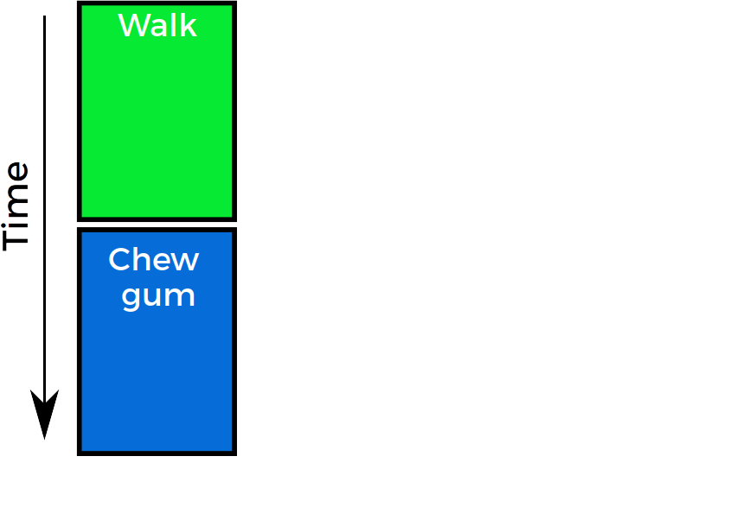


Sequential code
def walk_then_chew_gum():
walk()
chew_gum()

Slide 7
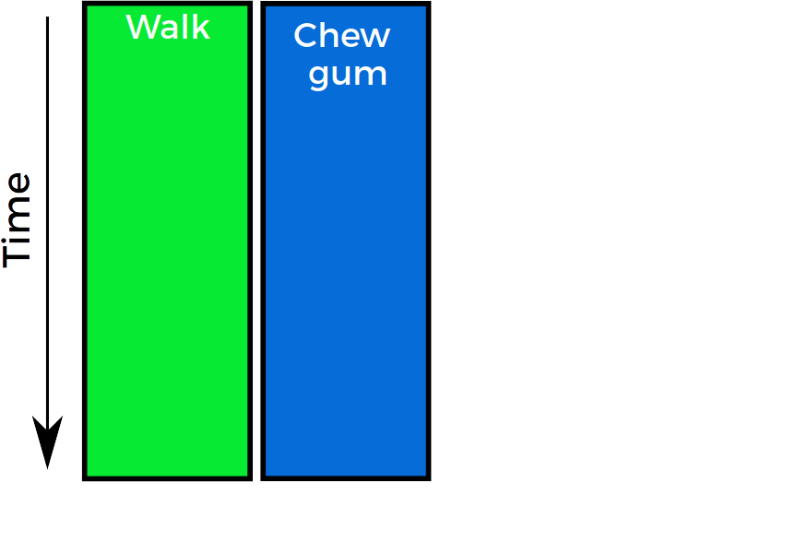
Concurrent code
def walk_and_chew_gum():
???

Slide 8
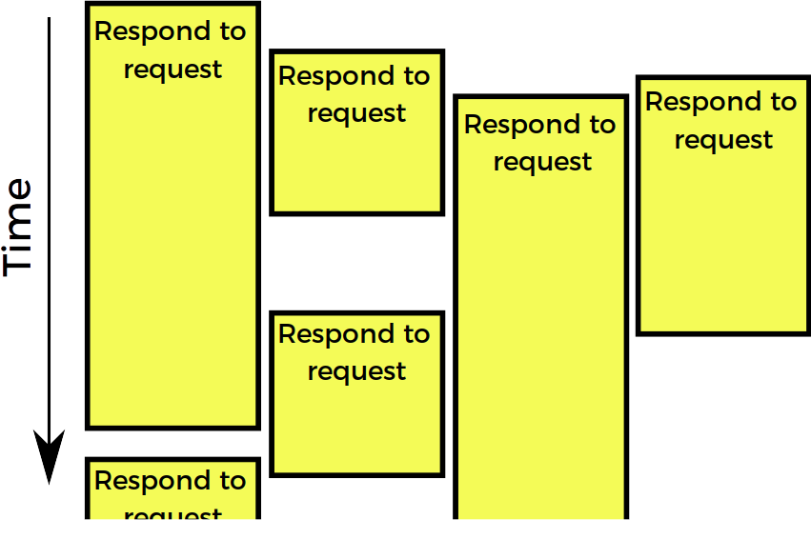
Web server

Slide 9
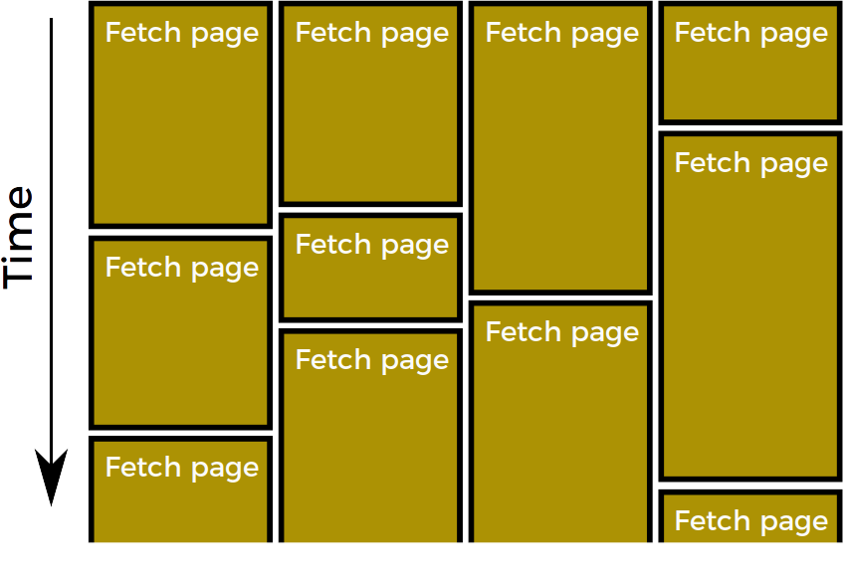
Web spider

Slide 10
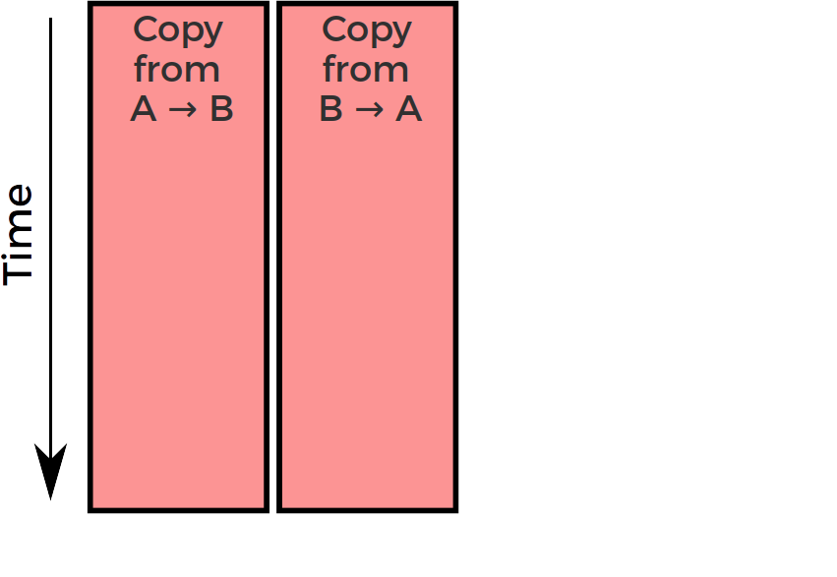
Basic bidirectional proxy

Slide 11
Concurrency is super useful.
But… implementing it is super hard!

Slide 12


Slide 13
How hard?
Let’s see an example.

Slide 14
https://vorpus.org/blog/
(getaddrinfo demo)

Slide 15
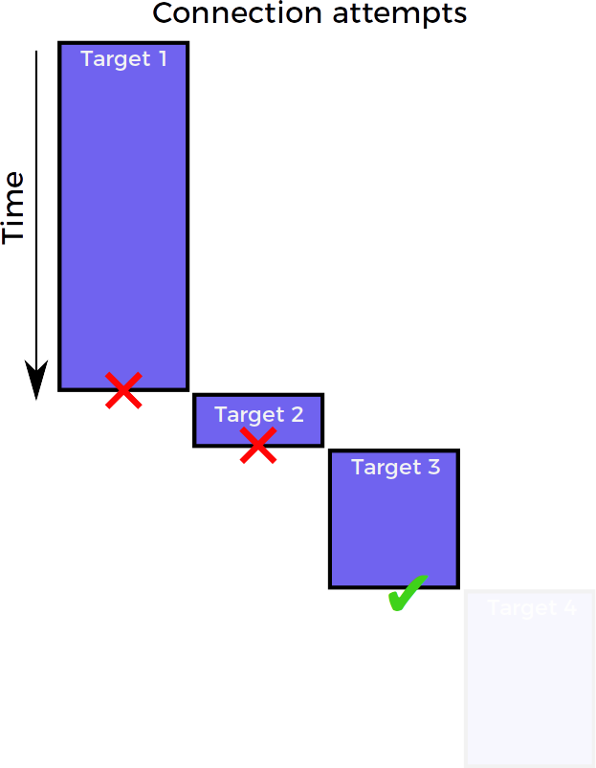
Connection strategy: sequential

Slide 16
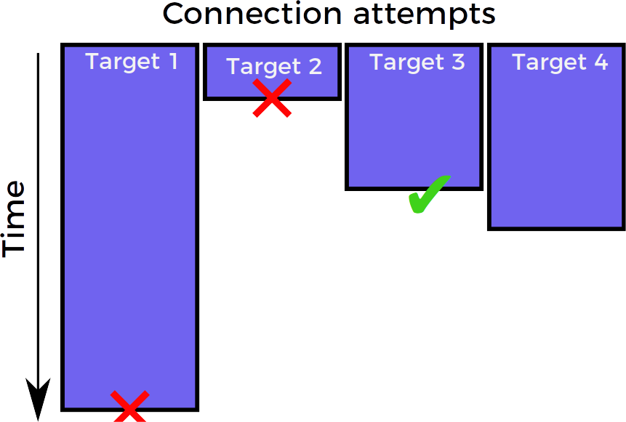
Connection strategy: race

Slide 17

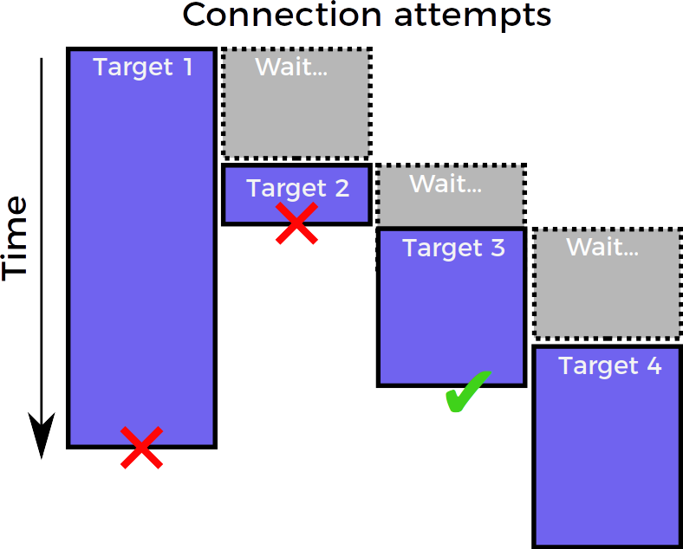
Connection strategy:
“happy eyeballs” (RFC 8305)
Best of both worlds:
nearly as polite as sequential
nearly as fast as race

Slide 18
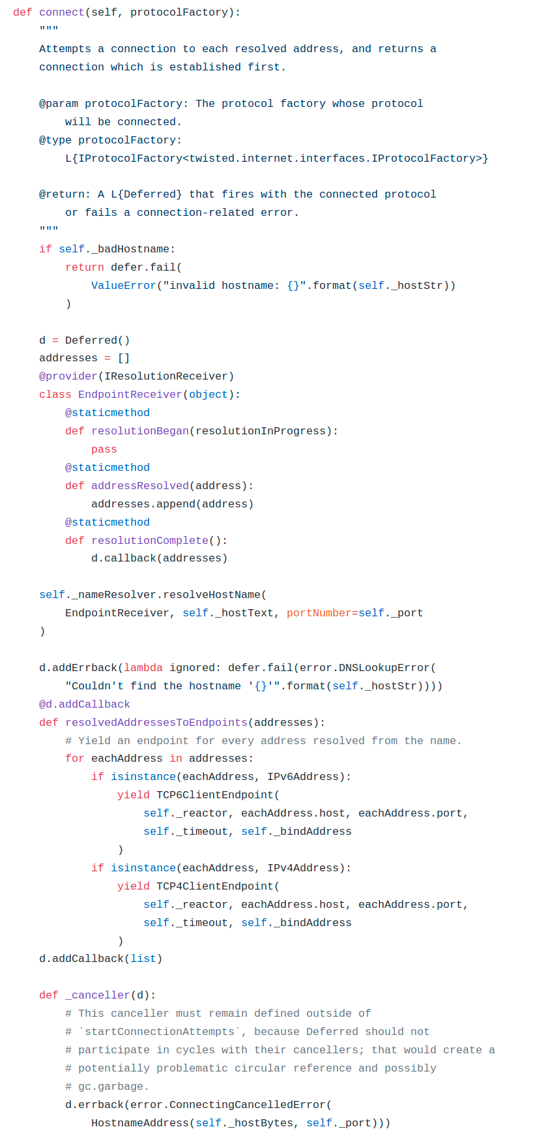
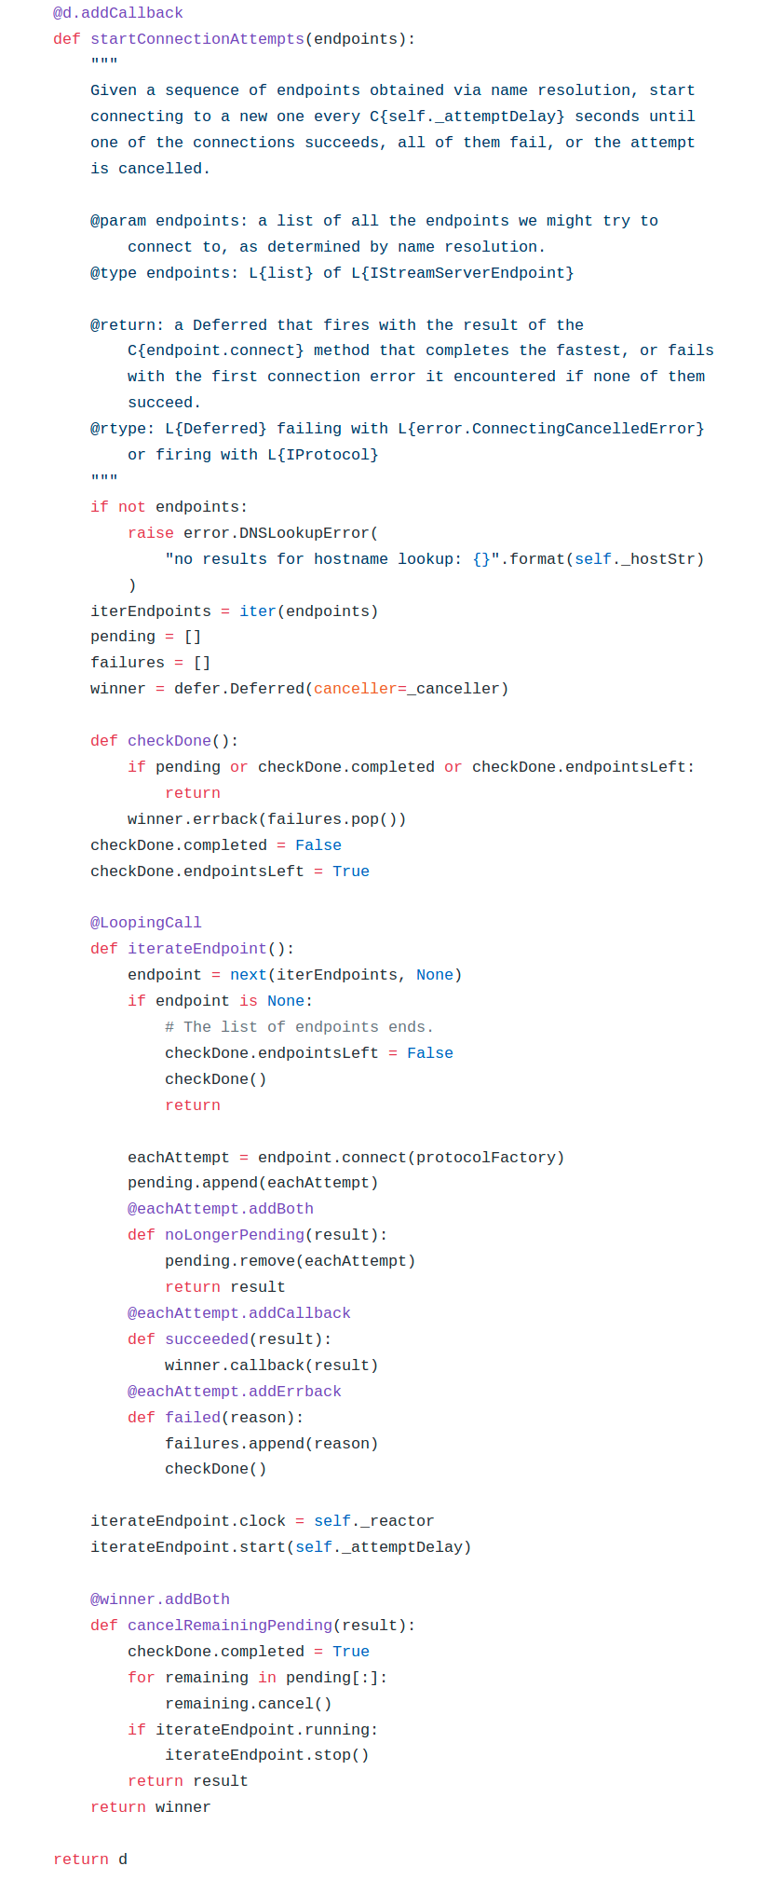
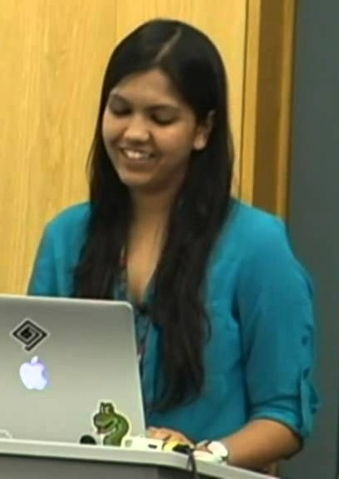
Happy eyeballs in Twisted
Ashwini Oruganti
Photo: from https://youtu.be/XsLFLzx4Nq4

Slide 19
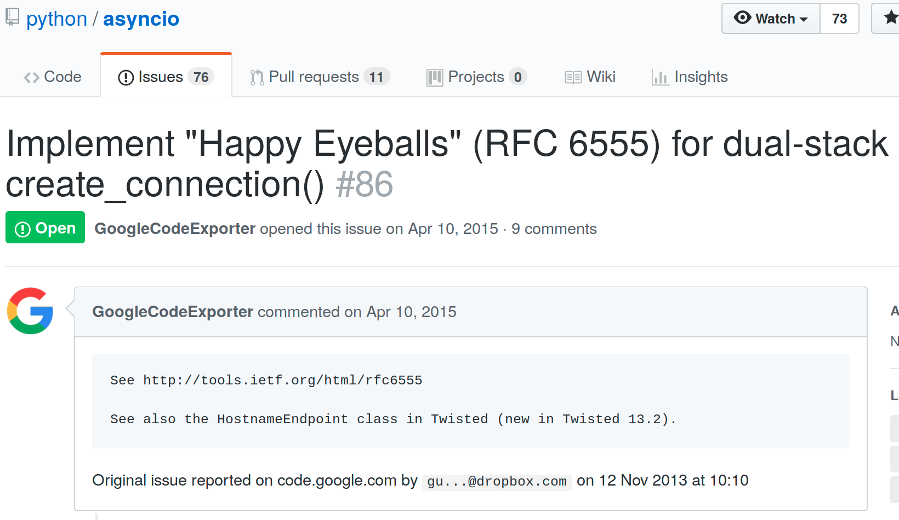
Happy eyeballs in asyncio

Slide 20
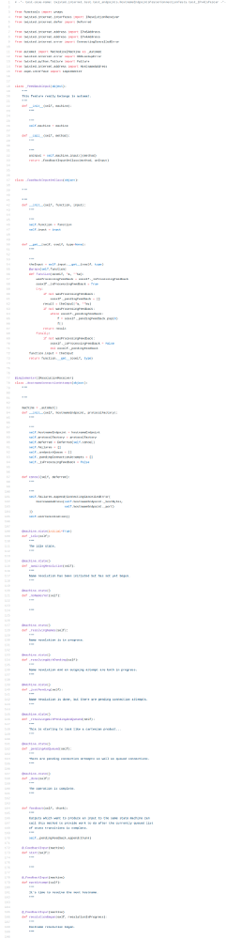
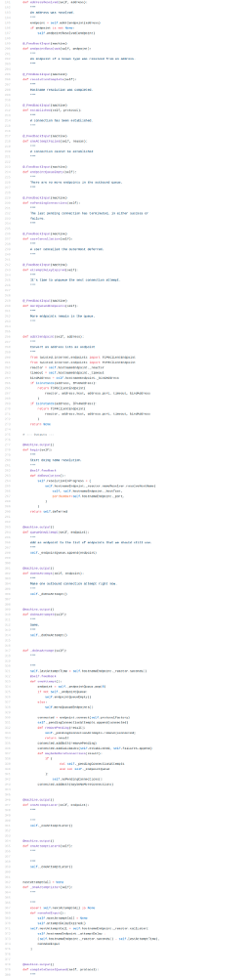
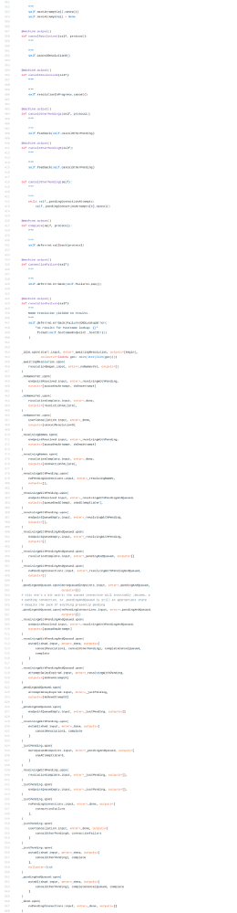

Happy eyeballs in Twisted v2
Glyph Lefkowitz
Photo: Kushal Das, CC-BY-NC-SA 2.0 https://www.flickr.com/photos/kushaldas/8608040013

Slide 21
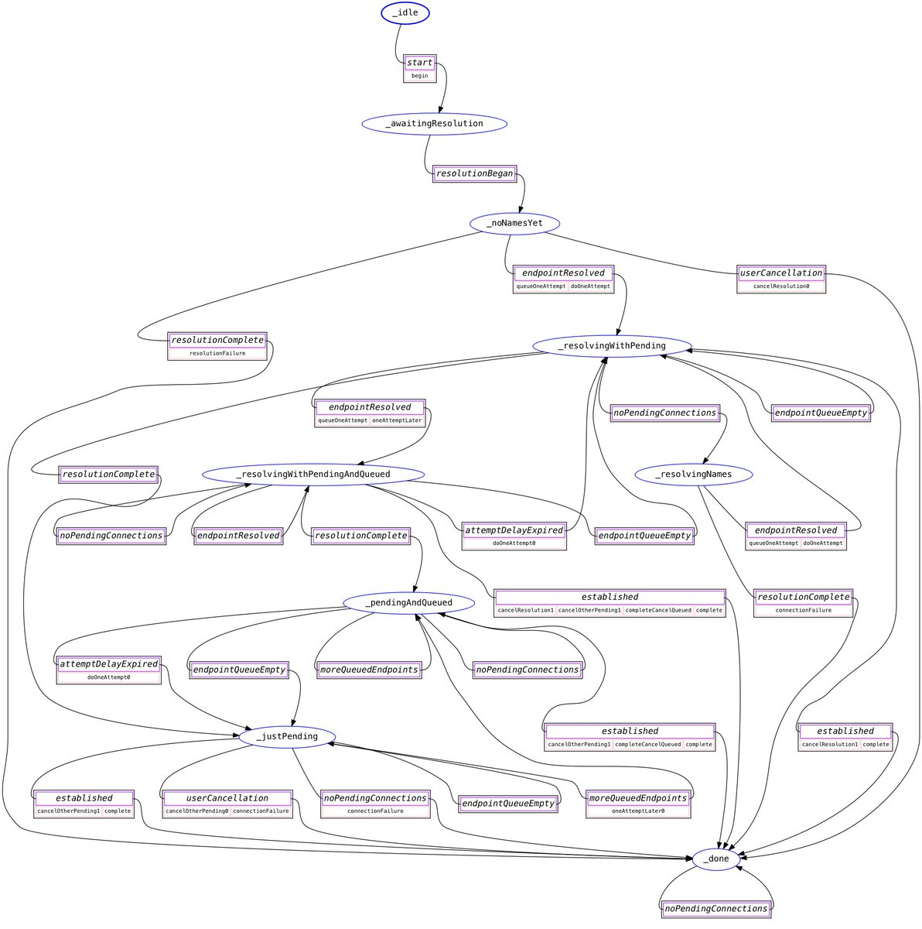
Happy eyeballs in Twisted v2
Hey Glyph, sometimes both versions just… sit and do nothing for a while?
(Twisted bug #9345)
me
“...it's supposed to be simpler to reason about, and my experience of fixing that bug was that it was heinously, fiendishly opaque to follow… So I'm taking that back to the drawing board...”
Glyph Lefkowitz
Photo: Kushal Das, CC-BY-NC-SA 2.0 https://www.flickr.com/photos/kushaldas/8608040013

Slide 22
It’s called “Happy Eyeballs”
But it makes us all sad :-(

Slide 23
A new library for async concurrency in Python
(alternative to asyncio, Twisted, etc.)

Slide 24
Trio example: basic proxy

Slide 25
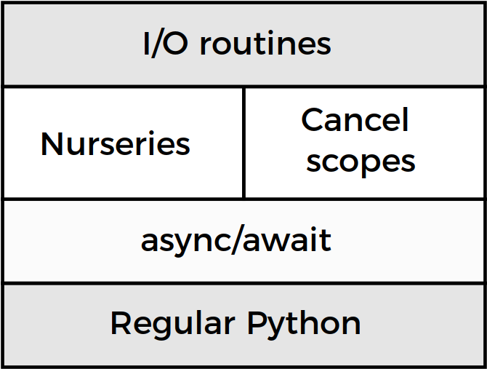
Trio architecture

Slide 26
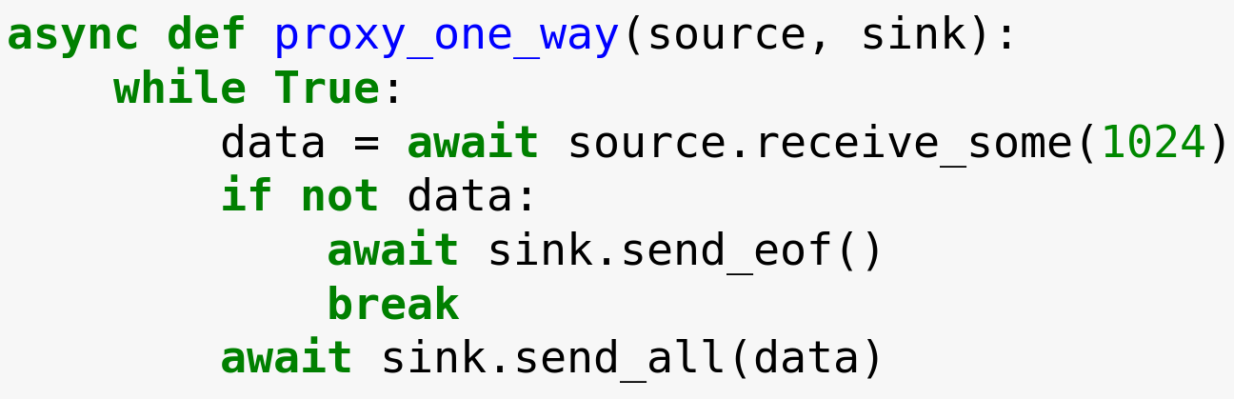

Slide 27
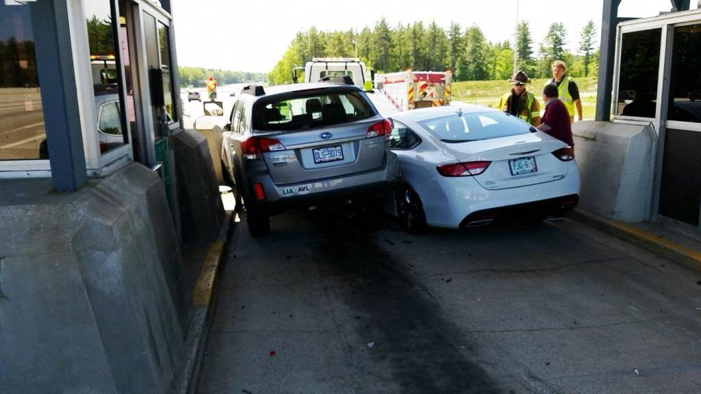
Doing two things at once isn’t always a good idea
https://www.facebook.com/NHDOT/posts/1084905304899744:0

Slide 28
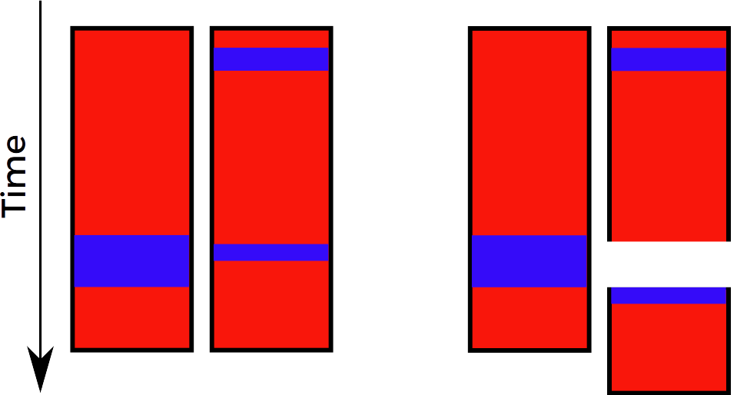
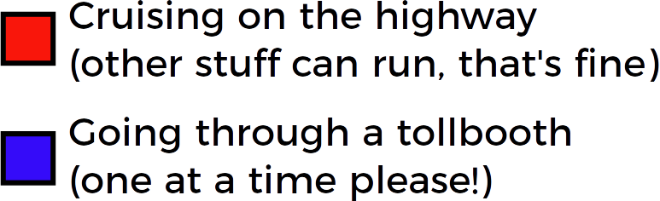
Preemptive concurrency
Your code
How it executes
You mark these spots

Slide 29
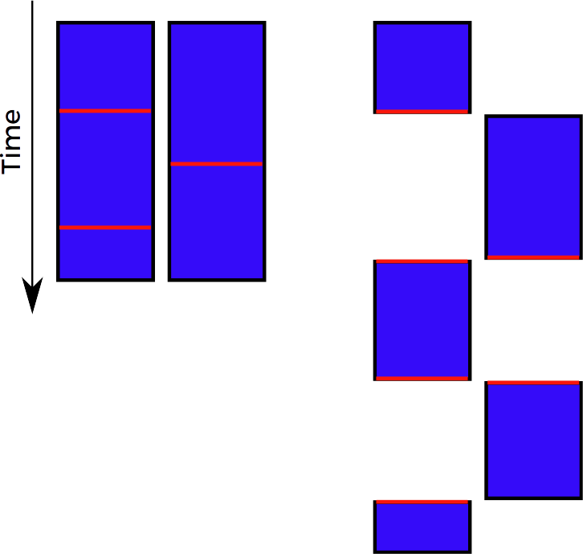
Cooperative (async) concurrency
Your code
How it executes
You mark these spots

Slide 30
Preemptive
concurrency
Cooperative (async) concurrency
Your code
How it executes
Your code
How it executes
Faster…
...except we have the GIL
Easier to use

Slide 32
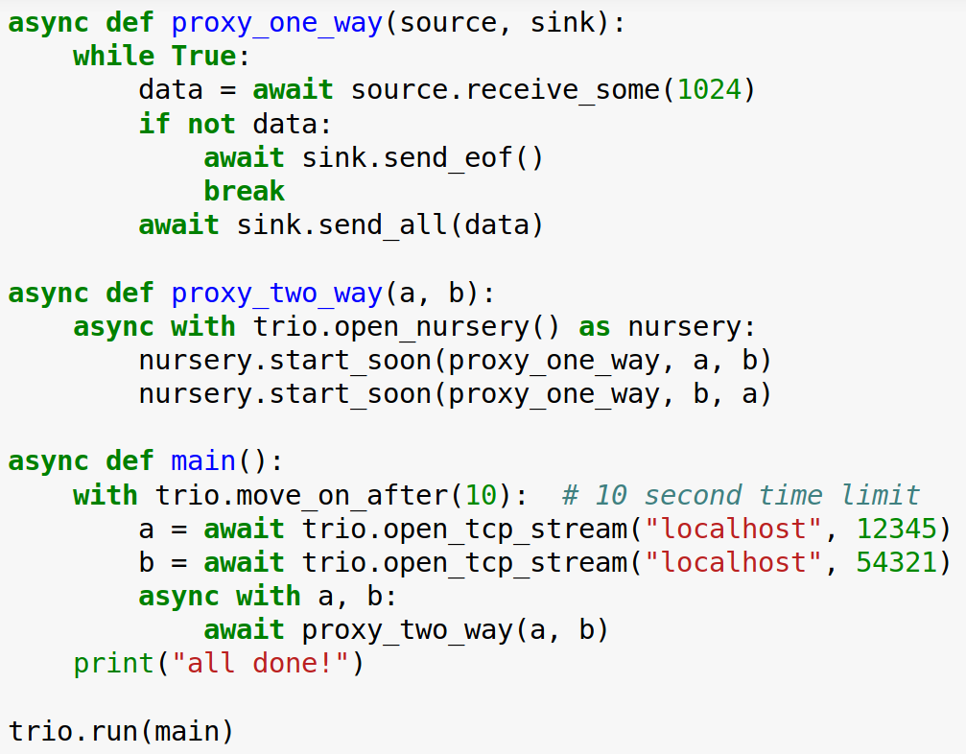

Slide 33
Trio architecture

Slide 34
Trio architecture

Slide 36
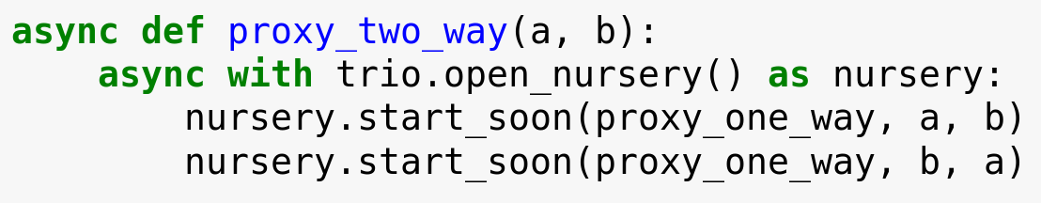
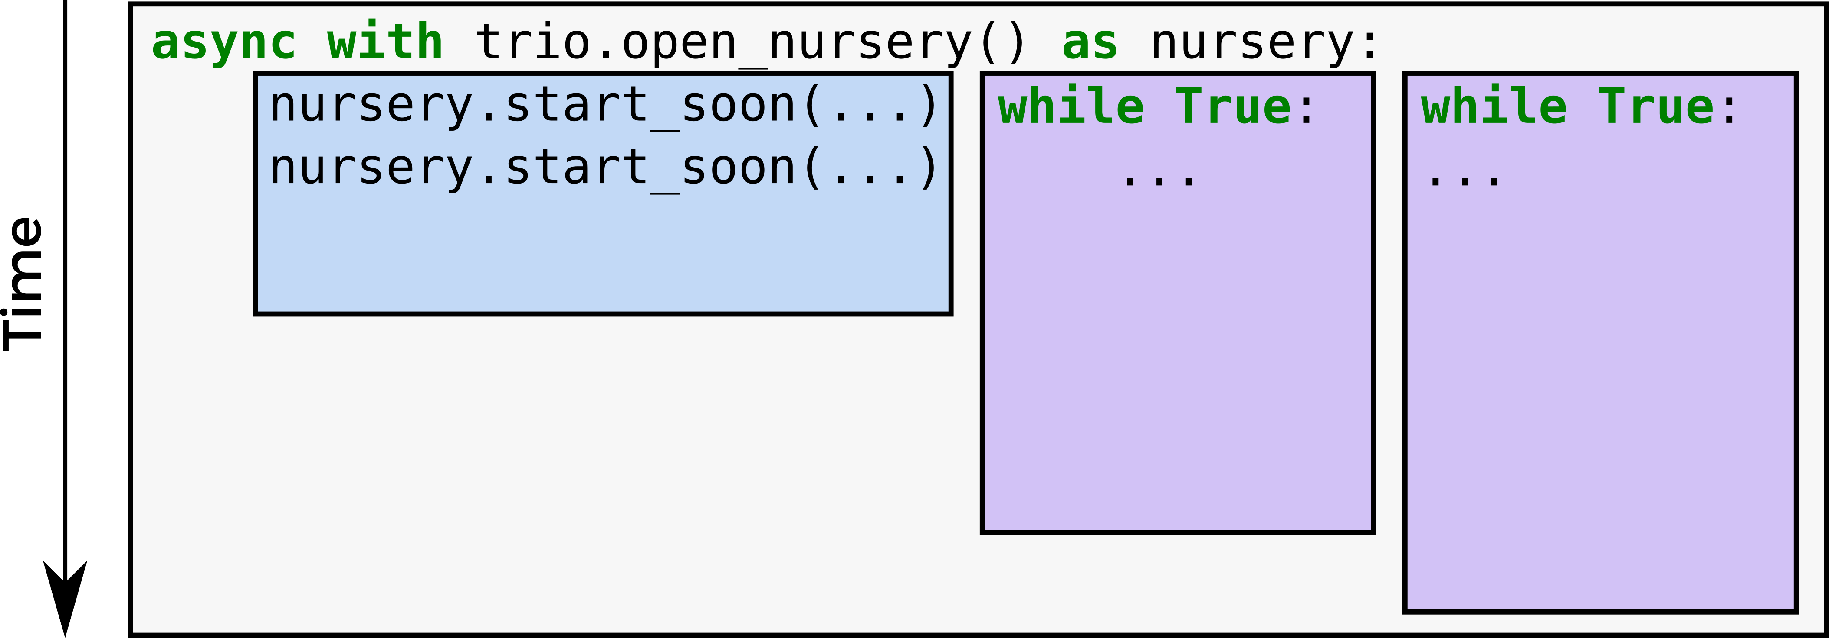
What you see:
How you should imagine it:

Slide 37
Nurseries are weird!
Why does Trio do this?

Slide 38


Slide 40
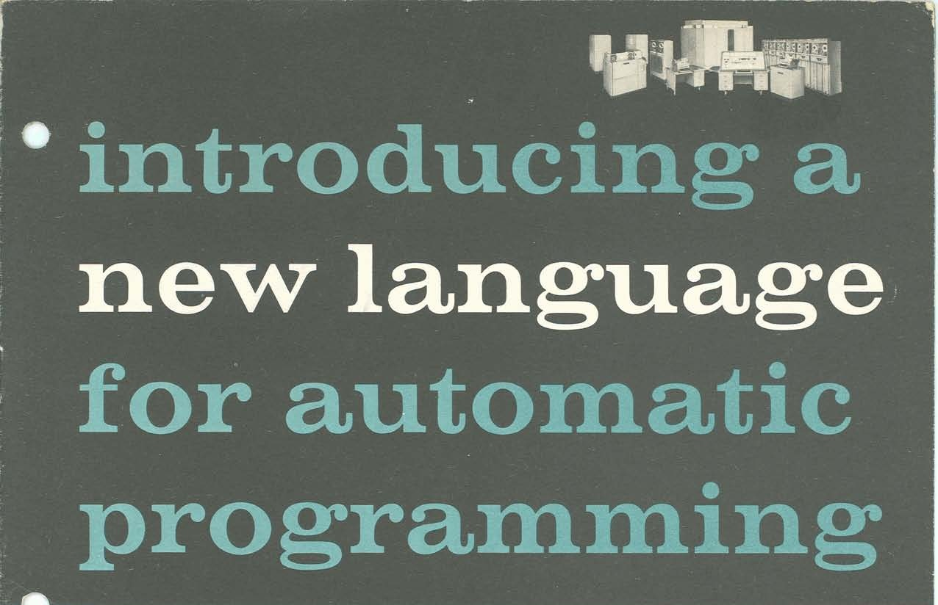

Slide 41


Slide 42
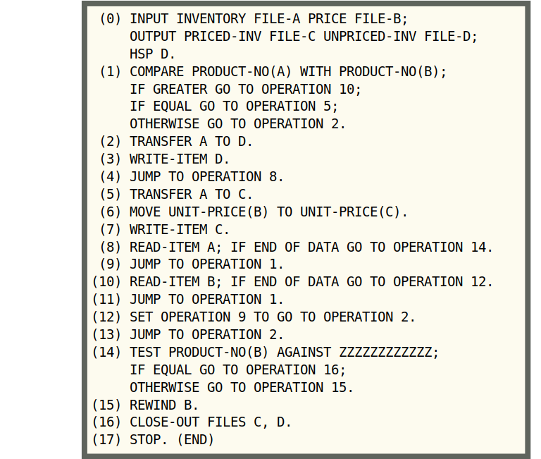
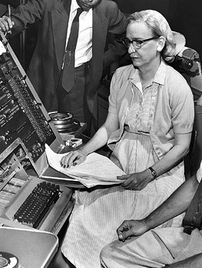
FLOW-MATIC:
Like Python, but for 1958
Grace Hopper
Photo: Smithsonian, CC-BY 2.0, cropped https://commons.wikimedia.org/wiki/File:Grace_Hopper_and_UNIVAC.jpg

Slide 43
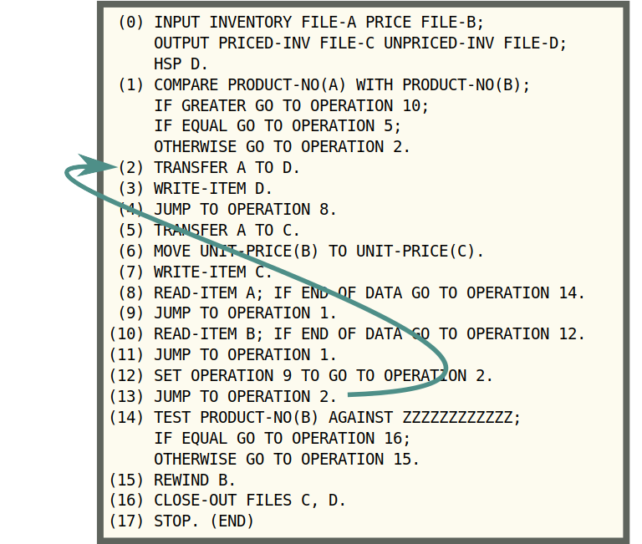
FLOW-MATIC:
Like Python, but for 1958
Grace Hopper
Photo: Smithsonian, CC-BY 2.0, cropped https://commons.wikimedia.org/wiki/File:Grace_Hopper_and_UNIVAC.jpg

Slide 44
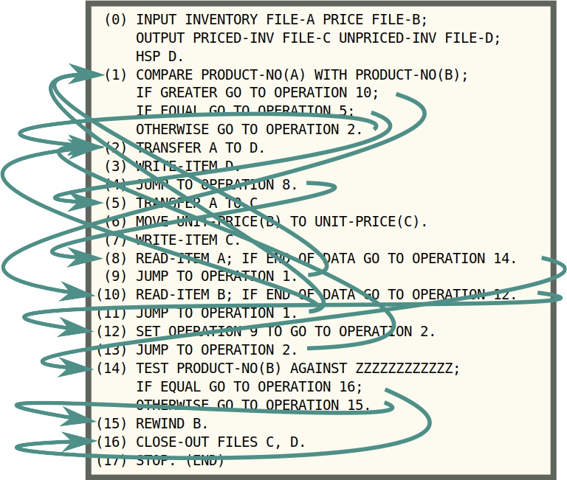
FLOW-MATIC:
Like Python, but for 1958
Grace Hopper
Photo: Smithsonian, CC-BY 2.0, cropped https://commons.wikimedia.org/wiki/File:Grace_Hopper_and_UNIVAC.jpg

Slide 45

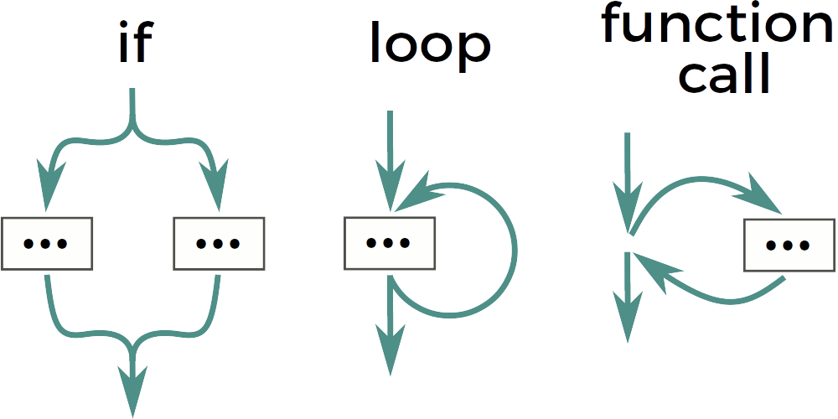
?
?

Slide 46

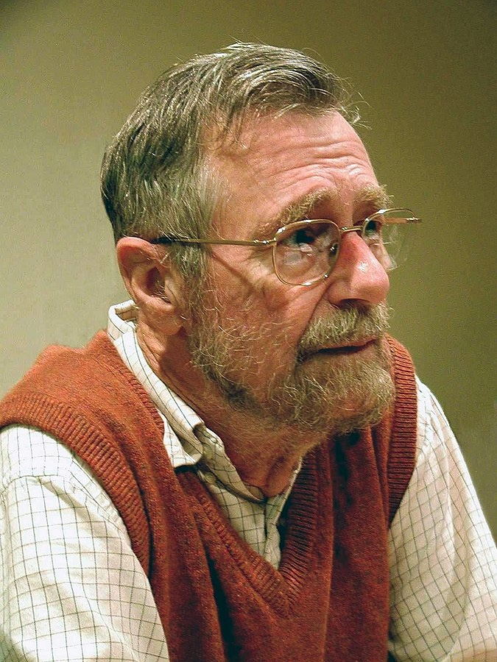
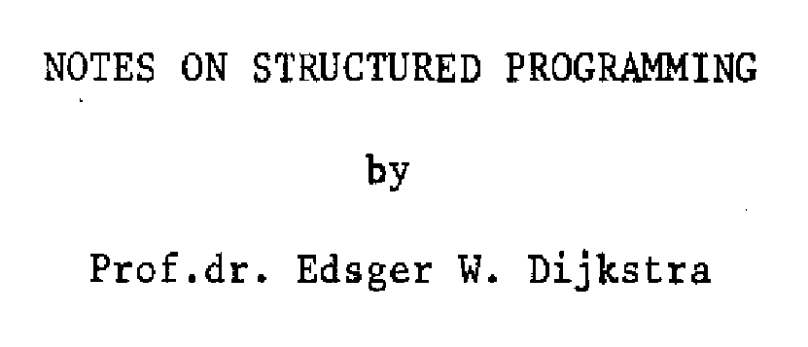
1969
Edsger W. Dijkstra
Photo: Hamilton Richards, https://commons.wikimedia.org/wiki/File:Edsger_Wybe_Dijkstra.jpg

Slide 47


Slide 48

What’s so bad about “goto”?
Breaks abstractions
  any function can be a goto in disguise
Breaks with statements
Breaks exceptions

Slide 49
OK… back to concurrency

Slide 50
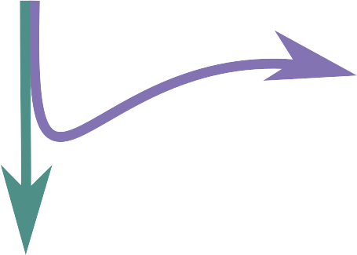
The basic concurrency primitive in most libraries/languages
classic Python:
Thread.start()
asyncio:
fut.add_done_callback(…)
ensure_future(…)
transport.write(…)
loop.add_reader(…)
...
C:
pthread_create(...)
Go:
go some_fn()
And so on...

Slide 51
=
FLOW-MATIC
1958
Twisted, asyncio, Tornado, gevent, threads, ...
2018

Slide 52
What’s so bad about “go”?
Breaks abstractions
  any function can be a go in disguise
Breaks with statements
Breaks exceptions

Slide 53

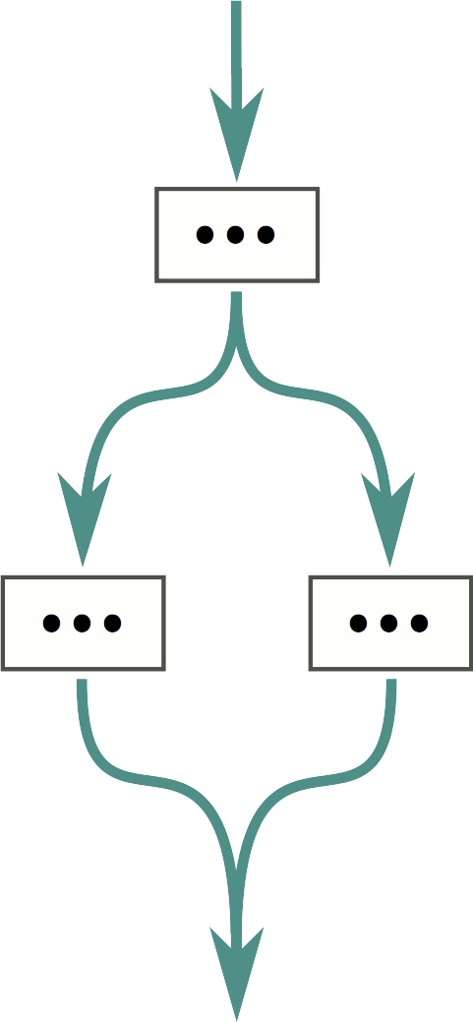
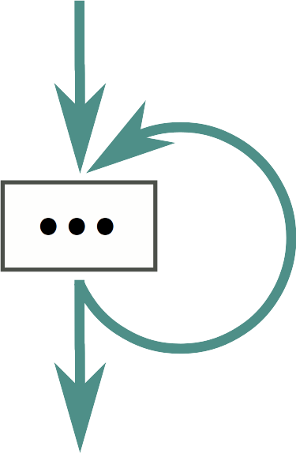
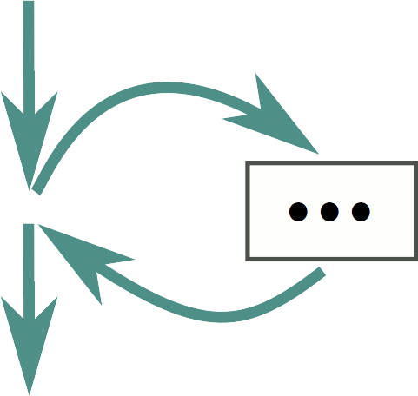
go to
if/else
loop
function call

Slide 54
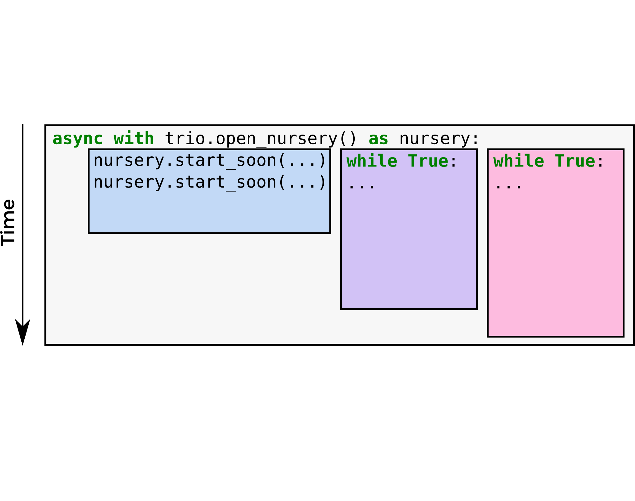

Slide 55
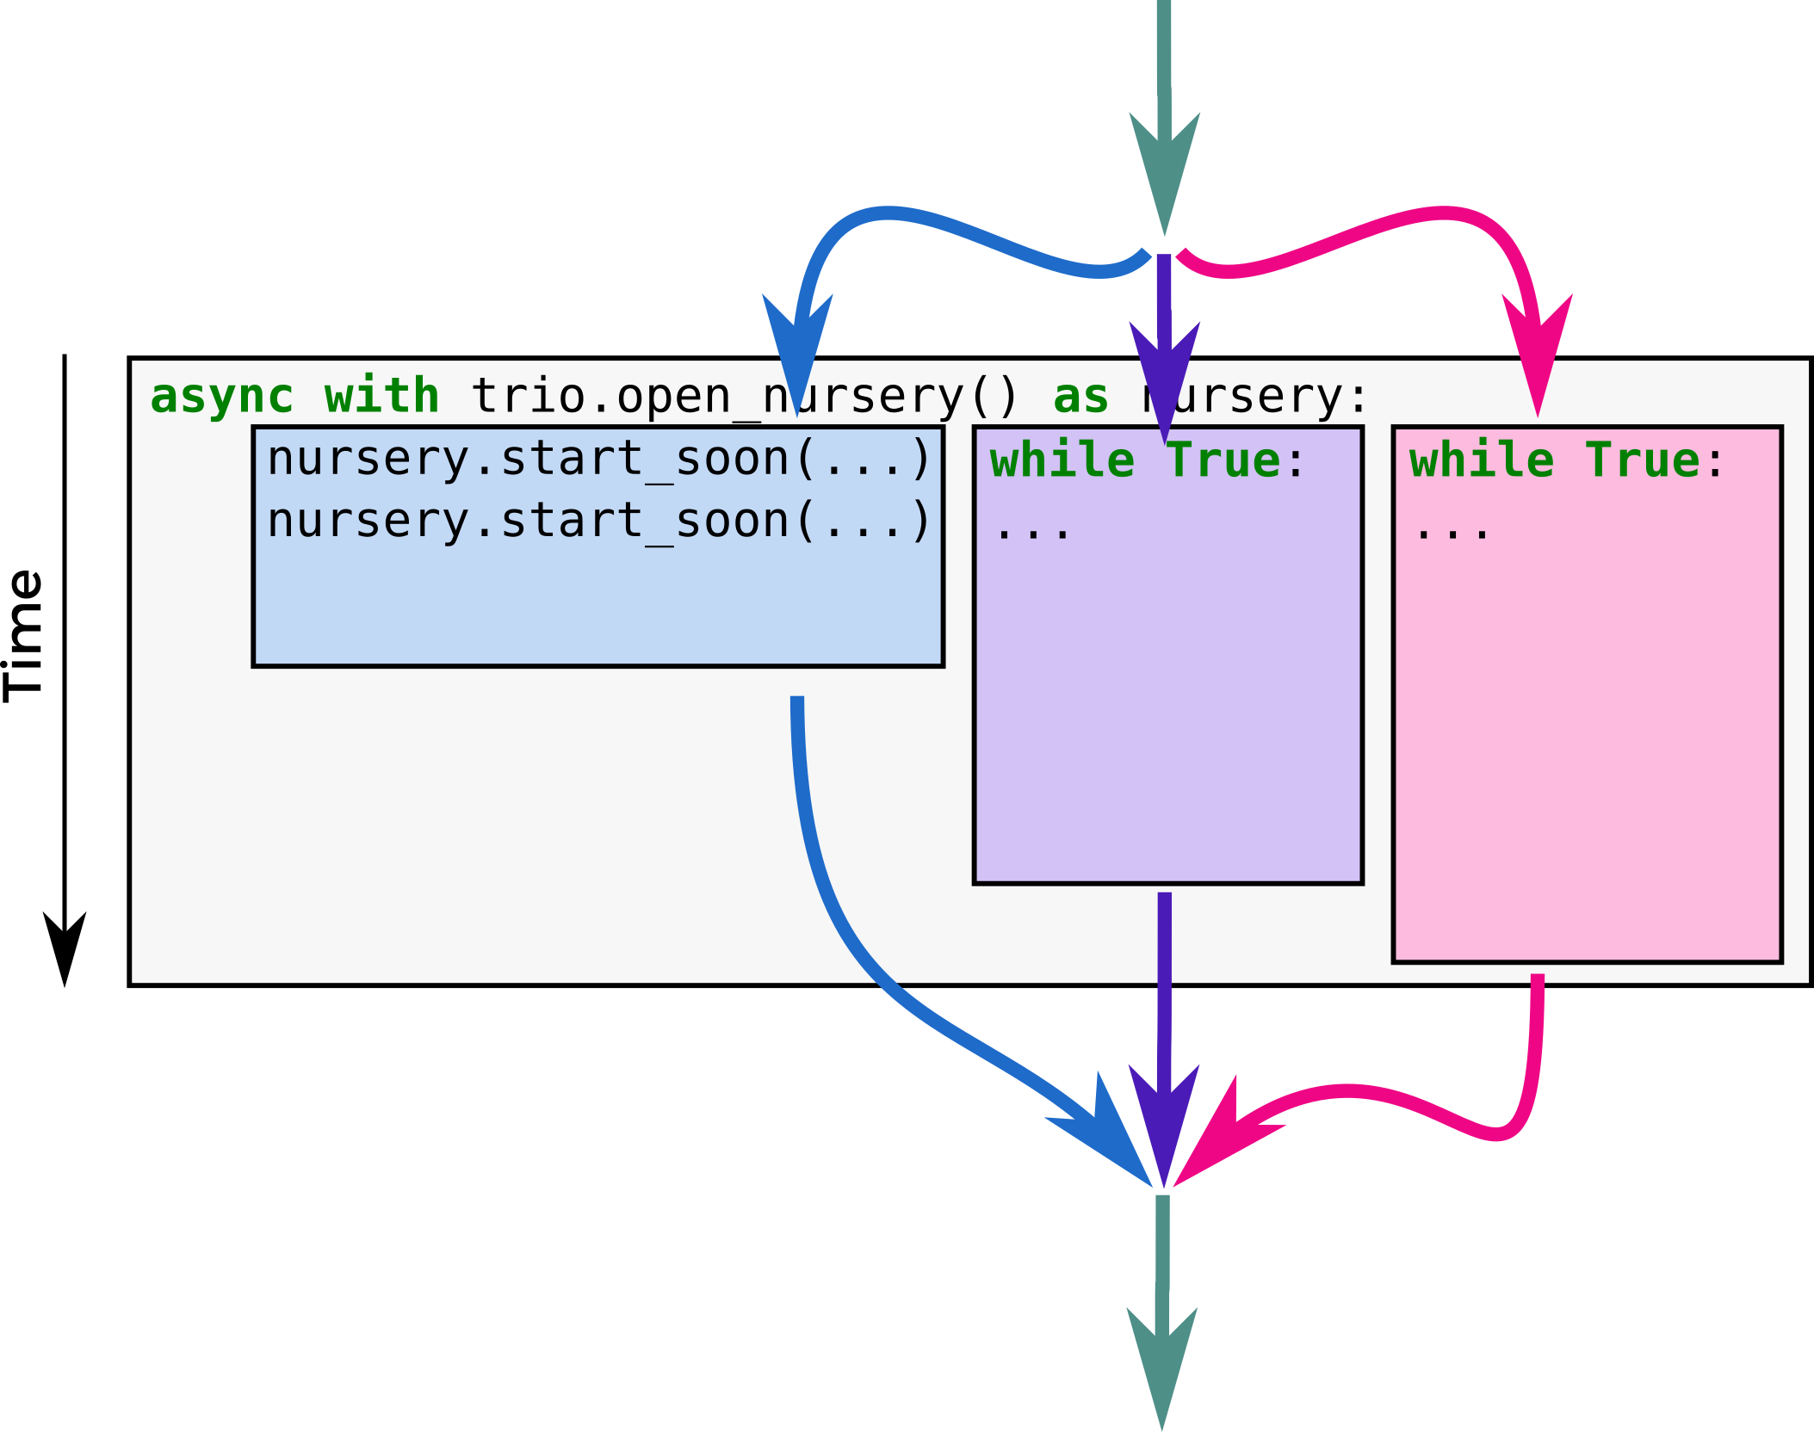

Slide 56
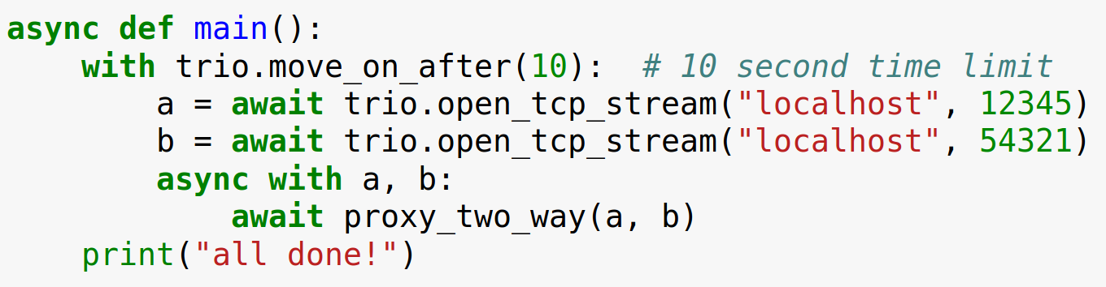
with blocks work

Slide 57
Exceptions don’t get lost

Slide 58
Trio architecture

Slide 59
Trio architecture

Slide 60
Timeouts are important
Whenever you use the network, one of three things will happen:
  Success
  Error
  Neither, it just hangs forever
Therefore, you should always set a timeout!

Slide 61

Timeouts are important
Futurama S04E07

Slide 62

Timeouts are important
Futurama S04E07

Slide 63

Timeouts are important
Futurama S04E07

Slide 64

Timeouts are important
Futurama S04E07

Slide 65

Timeouts are important
Futurama S04E07

Slide 66

Timeouts are important
Futurama S04E07

Slide 67

Timeouts are important
Futurama S04E07

Slide 69
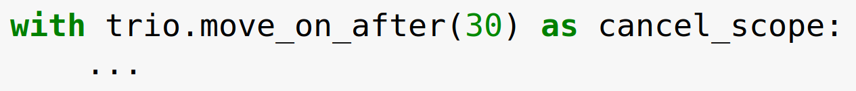
Cancel scopes, continued
cancel_scope.deadline:
read or change timeout
cancel_scope.cancel():
cancel ASAP, without waiting for timeout
Cancel scopes can be safely nested
Also available: fail_after, move_on_at, ...

Slide 70
2. await raises trio.Cancelled
1. Registers the timeout
3. Recognizes & catches the exception

Slide 71
Exceptions in nurseries actually use cancellation
CANCELLED
CANCELLED

Slide 72
Trio architecture

Slide 73
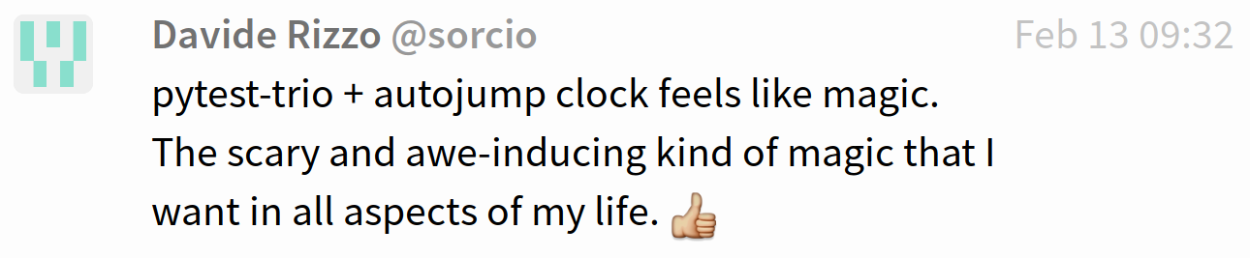
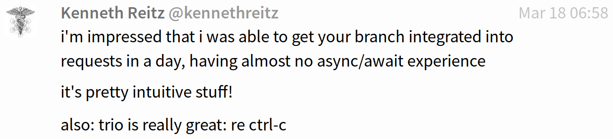

Other things Trio gives you
...that’s about it right now
Standard stuff for I/O like networking, sleep(), filesystem access, signals, …
APIs for inter-task coordination (trio.Event, trio.Queue, …)
Awesome testing helpers
Control-C works the way you’d expect
Compatibility layer to use asyncio libraries on trio (→ incremental migration)

Slide 76


There should be one – and preferably only one – obvious way to do it.

Slide 77

More information tinyurl.com/trio-pycon
Open space
Saturday, 3pm, room 9
Photo: WOCinTech Chat, CC-BY 2.0 https://www.flickr.com/photos/wocintechchat/25392377053/

Slide 79
main()
│
├─ f1()
│
└─ f2()
│
├─ f2a()
│
└─ f2b()

Slide 80
main()
│
├─ f1() → KeyError
│
└─ f2()
│
├─ f2a() → ValueError
│
└─ f2b() → RuntimeError

Slide 81
main()
│
├─ f1() → KeyError
│
└─ f2()
│
├─ f2a() → ValueError
│
└─ f2b() → RuntimeError
MultiError([
KeyError,
MultiError([
ValueError,
RuntimeError,
]),
])

Slide 82
Traceback (most recent call last):
File "multierror.py", line 22, in <module>
trio.run(main)
File "multierror.py", line 6, in main
nursery.spawn(f2)
trio.MultiError: KeyError(), <MultiError: RuntimeError(), ValueError()>
Details of embedded exception 1:
Traceback (most recent call last):
File "multierror.py", line 9, in f1
raise KeyError
KeyError
Details of embedded exception 2:
Traceback (most recent call last):
File "multierror.py", line 14, in f2
nursery.spawn(f2b)
trio.MultiError: RuntimeError(), ValueError()
Details of embedded exception 1:
Traceback (most recent call last):
File "multierror.py", line 17, in f2a
raise ValueError
ValueError
Details of embedded exception 2:
Traceback (most recent call last):
File "multierror.py", line 20, in f2b
raise RuntimeError
RuntimeError
main()
│
├─ f1() → KeyError
│
└─ f2()
│
├─ f2a() → ValueError
│
└─ f2b() → RuntimeError
MultiError([
KeyError,
MultiError([
ValueError,
RuntimeError,
]),
])

Slide 83
Catching single exceptions
def catch_block(exc):
if isinstance(exc, (RuntimeError, KeyError)):
return None
else:
return exc
with trio.MultiError.catch(catch_block):
...
Traceback (most recent call last):
File "multierror-catch.py", line 28, in <module>
trio.run(main)
File "multierror-catch.py", line 12, in main
nursery.spawn(f2)
File "multierror-catch.py", line 20, in f2
nursery.spawn(f2b)
File "multierror-catch.py", line 23, in f2a
raise ValueError
ValueError

