Slide 1
Review of Descriptive Statistics with Applications in Python

Slide 2
Overview
Distinguishing between Statistics and statistics
Descriptive Statistics vs. Inferential Statistics
Descriptive Statistics
Measures of central tendency
Measures of variation
Generating numeric and visual data summaries using numpy, pandas, and seaborn

Slide 3
Statistics
Statistics is a sub-field of applied mathematics and is concerned with analyzing data
More specifically, statistics involves the following tasks
Collecting Data
Organizing Data
Displaying and Presenting Data
Interpreting Data
Statistical methods are used to make descriptions and/or inferences about some population
It’s not surprising then that statistical methods used in data analyses are often sub-divided into two classes
Descriptive statistical methods
Inferential statistical methods

Slide 4
Distinguishing between Statistics and statistics
Before moving forward we need to make a clear distinction between Statistics (big S) and statistics (little s)
Statistics (big S) is a sub-field of applied mathematics and is concerned with analyzing data
statistics (little s) are numerical quantities calculated from a data set that provide important features about the data
In this presentation we define a number of descriptive statistics (little s)
Explain what important features they provide to help us understand our data
Show how they are calculated
Demonstrate how to compute them using Python
The big idea is that descriptive statistics allow us to reduce large data sets down to a few numerical measures - these measures give clues as to how to proceed in an analysis

Slide 5
Descriptive Statistics
Descriptive statistics are numerical measures that help analysts communicate the features of a data set by giving short summaries about the measures of central tendency or the measures of dispersion (variability)
Measures of central tendency describe the location of the center of a distribution or a data set
Some commonly used measures of central tendency are
mean
median
mode

Slide 6
Descriptive Statistics
Measures of variability describe how spread-out the data are
While measures of central tendency help locate the middle of a data set, they don’t provide information about how the data are arranged (aka distributed)
Some commonly used measures of variability include:
standard deviation
variance
minimum and maximum values
range
kurtosis
skewness

Slide 7
Descriptive Statistics vs. Inferential Statistics
It’s rare that a data set contains observe from every member of a population
Most analyses are conducted on a representative sample taken from the population
Analysts make inferences about the population based on observations contained in the sample
Inferential statistics are measures resulting from mathematical computations – help analysts infer trends about a population based upon the study of the sample
Examples of inferential statistics
Methods to compute Confidence intervals that “capture” a population parameter with a specified degree of confidence
Methods to test claims about the population by analyzing a representative samples (hypothesis tests)

Slide 8
Descriptive Statistics using Python
In the following slides we’ll cover several descriptive statistics and show how to compute them using Python
To do this we’ll use the following Python libraries (clicking the links below will take you to the reference pages of each library)
statistics - Functions for calculating mathematical statistics of numeric (Real-valued) data
numpy - Create efficient multi-dimensional data objects for scientific computing
seaborn - High-level interface for drawing attractive and informative statistical graphics
matplotlib - Foundational 2D plotting library for Python
statsmodels - Implement statistical models, statistical tests, and statistical data exploration
scipy - Foundational software for mathematics, science, and engineering
pandas - High-performance, easy-to-use data structures and analysis tools for Python

Slide 9
Importing the Python Libraries
First, we need to import the libraries into our workspace to make them available
If you have Python installed on your machine you can copy/paste the code below
Note that Python allow us to denote a library using a shorthand notation which I’ll use in subsequent slides
import statistics as st import numpy as np import seaborn as sb import matplotlib.pyplot as plt import pandas as pd import scipy as sp
If you don’t have Python installed click this link to interact with Python using Google Colaboratory – Go here to learn more about Google Coloaboratory,

Slide 10
Measures of Central Tendency - mean
The mean() function from the statistics library returns the arithmetic average of a set of numeric values stored in a data object
For the set of values $x_{1},x_{2},…,x_{N}$ the mean is calculated as
$$\overline{x}=\frac{\sum_{i=1}^{N}{x_{i}}}{N}=\frac{x_{1}+x_{2}+⋯+x_{N}}{N}.$$
The sample mean gives an unbiased estimate of the true population mean
When taken on average over all the possible samples, mean() converges on the true mean of the entire population
If the data are the entire population rather than a sample, then mean(data) is equivalent to calculating the true population mean $μ$.

Slide 11
Measures of Central Tendency - mean
In the most simple case, we can create an array of values and find the mean on these values by passing the array to the mean() function.
nums = [-2,-4,1,2,3,5,7,9] st.mean(nums)
## 2.625
Similarly, we can create a dictionary of value:key pairs and the mean() function will compute the mean of the values (assuming all of the the values are numeric).
Dict = {1:"one",2:"two",3:"three"} Dict
## {1: 'one', 2: 'two', 3: 'three'}
st.mean(Dict)
## 2

Slide 12
Measures of Central Tendency - median
The median() function from the statistics library returns the middle value of a set of numeric values stored in a data object
For the set of values $X=x_{1},x_{2},…,x_{N}$ the median is calculated as
$$median(X)=\frac{X_{⌊(N+1)÷2⌋}+X_{⌈(N+1)÷2⌉}}{2}$$
where $X$ is an ordered list of numbers, $N$ denotes the length of $X$, and $⌊.⌋$ and $⌈.⌉$ represent the floor and ceiling functions, respectively.
The median is a preferred measure of central location skewed distributions and data sets, in a later slide we show how the median summarizes differently from the mean

Slide 13
Descriptive statistics - median
As was shown when introducing the mean, we can compute the median of an array of values by passing the array to the median() function.
Note that because the array contains an even number of elements the median is computed as mean of the two number in the middle - in this case 2 and 3
nums = [-2,-4,1,2,3,5,7,9] st.median(nums)
## 2.5
Similarly, the median() function will compute the median of the values in a dictionary containing value:key pairs (assuming all of the the values are numeric)
Dict = {1:"one",2:"two",3:"three"} st.median(Dict)
## 2

Slide 14
Measures of Central Tendency - mode
The mode() function from the statistics library returns the value that is most probable or occurs most often in a set of numeric values stored in a data object
Note that in the array defined below there is not unique mode as each value occurs once - this results in the function throwing a StatisticsError
nums = [-2,-4,1,2,3,5,7,9] st.mode(nums) ## StatisticsError: no unique mode; found 8 equally common values ## ## Detailed traceback: ## File "<string>", line 1, in <module> ## File "C:\Users\Aubur\Anaconda3\lib\statistics.py", line 506, in mode ## 'no unique mode; found %d equally common values' % len(table)

Slide 15
Measures of variation - range
The range of a data set shows the span of the data
For a sample of observations $X=x_{1},x_{2},…,x_{N}$ the range of $X$ may be found from a simple computation
$$\text{range(X)}=\text{max}(X)−\text{min}(X)$$
Note - the value of the range statistic is determined by only two observations from any data set - and is easily influenced by the presence of outliers
In Python the range statistic may be computed using the intrinsic functions max() and min()
max(nums) - min(nums)
## 13

Slide 16
Measures of variation - variance
The variance of a data set measures how far the values are spread out from their average value (or mean)
For a sample of observations $X=x_{1},x_{2},…,x_{N}$ the unbiased sample variance, denoted as $s^{2}$ is computed as
$$s^{2}=\frac{1}{N−1}\sum_{i=1}^{N}{{\left(x_{i}−\overline{x}\right)}^{2}}$$
If the data are the entire population the the population variance, denoted as $σ^{2}$ or $\text{Var}[X]$ is computed
$$σ^{2}=\text{Var}(X)=\frac{1}{N}\sum_{i=1}^{N}{(}x_{i}−μ)^{2}$$

Slide 17
Measures of variation - variance
In Python the variance of an array of numeric values can be computed using the variance function from the statistics library
st.variance(nums)
## 19.125
The variance function can also be used to compute the variance of the values contained within a Dictionary
st.variance(Dict)
## 1

Slide 18
Measures of variation - standard deviation
The standard deviation of a data set, like the variance, is measure of how far the values are spread out relative to the mean
A useful property of the standard deviation is that, unlike the variance, it is expressed in the same units as the data
If the data are a sample the sample standard deviation, denoted by $s$ is the square root of the sample variance
$$s=\sqrt{s^{2}}=\sqrt{\frac{1}{N−1}\sum_{i=1}^{N}{{\left(x_{i}−\overline{x}\right)}^{2}}}$$
If the data are the population the standard deviation, denoted by $σ$ is the square root of the variance
$$σ=\sqrt{σ^{2}}=\sqrt{\text{Var}(X)}=\sqrt{\frac{1}{N}\sum_{i=1}^{N}{(}x_{i}−μ)^{2}}$$

Slide 19
Measures of variability - standard deviation
In Python the standard deviation of an array of numeric values can be computed using the stdev function from the statistics library
st.stdev(nums)
## 4.373213921133975
The stdev function can also be used to compute the standard deviation of the values contained within a Dictionary
st.stdev(Dict)
## 1.0

Slide 20
Generating numeric and visual data summaries
In the next slides we show various ways to summarize data
Visual summaries
Histograms
Boxplots
Scatterplots
Numeric summaries
z-score
covariance
correlation

Slide 21
Generating numeric and visual data summaries
To implement these summaries I create two numpy arrays containing pseudorandom observations generated from two different distributions
For the first array I use numpy’s random.normal() function link to generate 4000 observations from a standard normal distribution $NOR(0,1)$
For the second array I use numpy’s random.lognormal() function link to generate 4000 observations from a lognormal distribution $LOGNOR(1,0.75)$
N_obs = 4000 normal = np.random.normal(loc = 1, scale = 10000, size = N_obs) lognormal = np.random.lognormal(mean = 10, sigma = .75, size = N_obs)

Slide 22
Generating numeric and visual data summaries
Next, I create a dictionary with two keys 'normal' and 'lognormal' and assign the corresponding numpy arrays to these keys
d = {'normal': normal, 'lognormal': lognormal} d
## {'normal': array([ 1314.0900122 , 195.34383563, 25135.95705104, ..., ## -17298.6486693 , 6813.87149383, -16375.90889681]), 'lognormal': array([28551.28177716, 55348.79027248, 44183.99946235, ..., ## 12221.28225576, 7869.89264355, 37439.5384024 ])}
Then I use the DataFrame() function link from pandas to transform the dictionary into a data frame
df = pd.DataFrame(data = d)

Slide 23
Use .head() to view the first 10 rows in the data frame
df.head(10)
## normal lognormal ## 0 1314.090012 28551.281777 ## 1 195.343836 55348.790272 ## 2 25135.957051 44183.999462 ## 3 3255.216938 6384.297271 ## 4 -784.807298 5051.660669 ## 5 6142.461554 63948.783707 ## 6 -7715.000079 20129.411928 ## 7 -2857.794677 45008.321252 ## 8 3644.349437 32198.066925 ## 9 12682.566722 34493.857155

Slide 24
Histogram of normal observations
This code creates a histogram for the normal data showing that mean and median are nearly the same for symmetrically distributed data (i.e. have low skewness values)
# Settings sb.set_style("whitegrid") # Create histogram plot = sb.distplot(df['normal'], kde = False, bins = int(N_obs / 10), axlabel = "x NOR(0,1)") # add vertical line showing the location of the mean, median plot = plt.axvline(df['normal'].mean(), 0,1, color = 'red') plot = plt.axvline(df['normal'].median(), 0,1, color = 'orange') plt.show(plot)

Slide 25
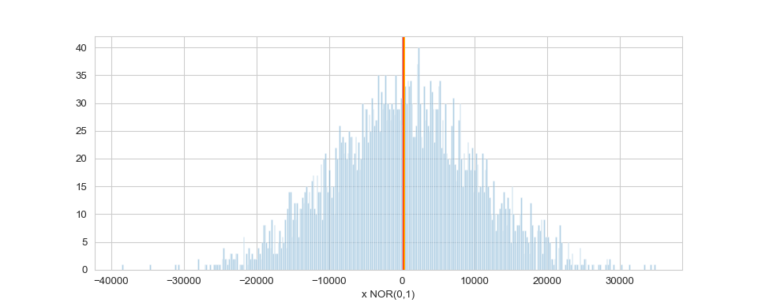
Histogram of pseudorandom observations from a standard normal distribution

Slide 26
Histogram of lognormal observations
This code creates a histogram for the lognormal data and shows how the mean and median separate when the data are not symmetrically distributed (i.e. have larger skewness values)
# Create histogram plot = sb.distplot(df['lognormal'], kde = False, bins = int(N_obs / 10), axlabel = "x LOGNOR(10,0.75)") # add vertical line showing the location of the mean, median plot = plt.axvline(df['lognormal'].mean(), 0,1, color = 'red') plot = plt.axvline(df['lognormal'].median(), 0,1, color = 'orange') plt.show(plot)

Slide 27
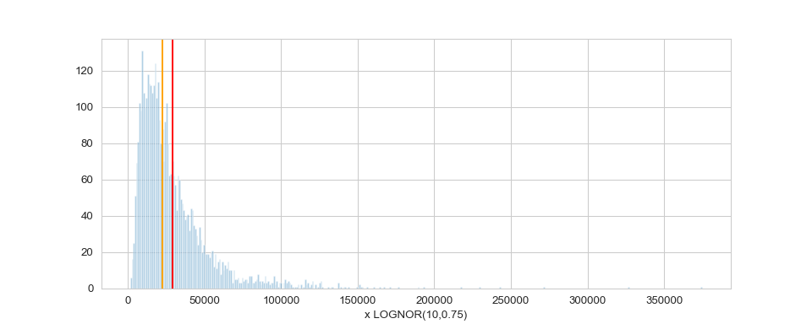
Histogram of pseudorandom observations from a standard normal distribution

Slide 28
Box plots
A box plot (or box-and-whisker plot) shows the distribution of quantitative data in a way that facilitates comparisons between variables or across levels of a categorical variable.
The box shows the quartiles of the dataset while the whiskers extend to show the rest of the distribution, except for points that are determined to be “outliers” using a method that is a function of the inter-quartile range.
The code below generates a seaborn boxplot displaying both columns of the DataFrame
plot = sb.boxplot(data = df) plt.show(plot)

Slide 29
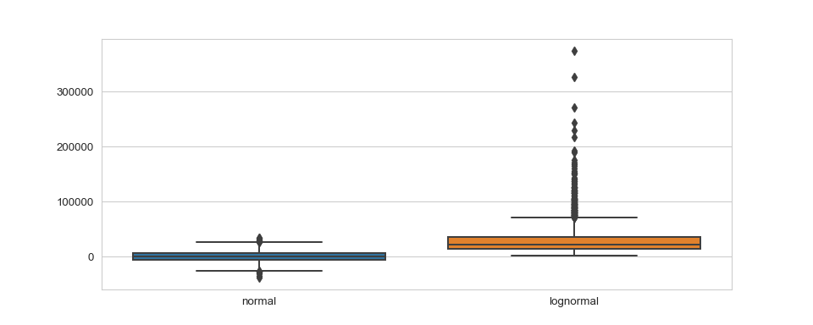
Boxplot comparing the normal and lognormal data

Slide 30
Jointplots
A joint plot combines a histogram with scatter plot
Scatter plots are useful for visualizing the relationship between variables
The scatter chart created by the code below shows no evidence of a linear relationship between the normally distributed observations and the lognormally distributed observations
sb.jointplot("normal","lognormal", data = df)
## <seaborn.axisgrid.JointGrid object at 0x0000000036292A48>
plt.show()

Slide 31
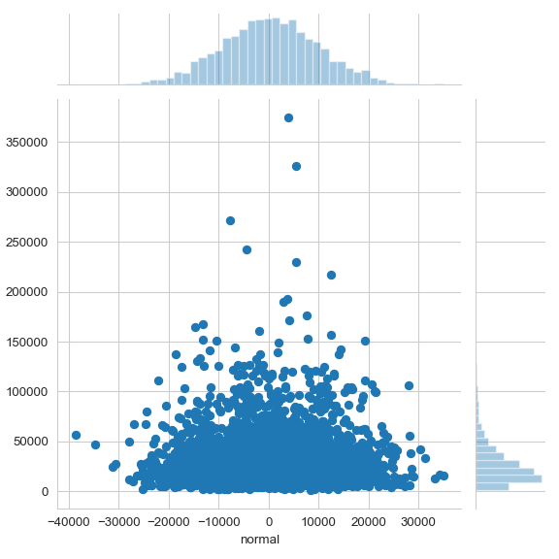
Jointplot showing the relationship between the normal and lognormal observations

Slide 32
Jointplots
But, what if we modified the code to produce a jointplot of the lognormal with itself?
Do so gives the expected result, the plot shows that the lognormal data has a perfect linear relationship with itself
Can we express this numerically?
plot = sb.jointplot("lognormal","lognormal", data = df) plt.show(plot)

Slide 33
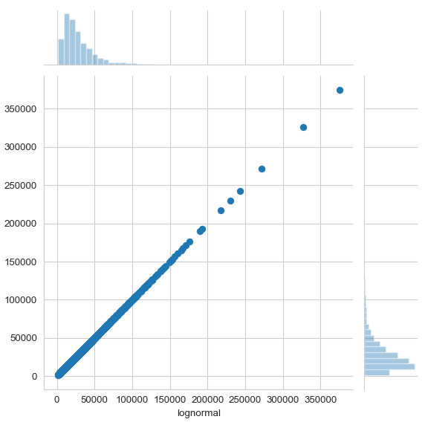
Jointplot showing the relationship between the lognormal observations at itself

Slide 34
Z-Score
The z-score (aka the standard score)
A measure computed for each value in a data set
Returns the number of standard deviations below or above the mean
Usually assumes that the data are normally distributed
The Z-score for a sample is computed as
$$z_{i}=\frac{x_{i}−\overline{x}}{s_{x}}$$

Slide 35
Z-Score
If you’re comparing multiple samples that may contain a different number of elements, the Z-score for each sample is computed as
$$z_{i}=\frac{x_{i}−\overline{x}}{s_{x}/\sqrt{n}}$$
Where the $n$ term is used to account for potentially different sample sizes

Slide 36
z-score
In Python we can compute the z-score for the normally distributed data using the zscore() function from scipy
z1 = sp.stats.zscore(df['normal']) # Print first 10 elements in z1 z1[0:9]
## array([ 0.10782604, -0.00644843, 2.54111351, 0.30610268, -0.10656608, ## 0.60102063, -0.81445146, -0.31831163, 0.34585066])

Slide 37
z-score
Or we can compute it using pandas functions
(df['normal'] - df['normal'].mean()) / df['normal'].std()
## 0 0.107813 ## 1 -0.006448 ## 2 2.540796 ## 3 0.306064 ## 4 -0.106553 ## ... ## 3995 1.730497 ## 3996 -1.282631 ## 3997 -1.793150 ## 3998 0.669518 ## 3999 -1.698909 ## Name: normal, Length: 4000, dtype: float64

Slide 38
Covariance
Covariance is a descriptive statistic used to measure the linear association between two variables
The sample covariance between variables $X$ and $Y$ is computed as
$$S_{XY}=\frac{\sum_{i=1}^{N}{(}x_{i}−\overline{x})(y_{i}−\overline{y})}{N−1}$$
The population covariance is computed as
$$σ_{XY}=\frac{\sum_{i=1}^{N}{(}x_{i}−μ_{x})(y_{i}−μ_{y})}{N−1}$$

Slide 39
Covariance
To compute the covariances for the DataFrame df we created earlier we can use the cov() function from the pandas library
cov1 = df.cov() cov1
## normal lognormal ## normal 9.586793e+07 4.206186e+06 ## lognormal 4.206186e+06 6.203347e+08

Slide 40
Correlation
Correlation is a descriptive statistic used to measure the linear association between two variables
The correlation (or correlation coefficient) is a measure defined between -1 and 1
Is a dimensionless quantity that is not affected by the units of measurement for X and Y
The sample correlation between variables $X$ and $Y$ is computed as
$$r_{​_{XY}}=\frac{S_{​_{XY}}}{s_{​_{X}}s_{​_{Y}}}$$

Slide 41
Correlation
To compute the correlations for the DataFrame df we created earlier we can use the corr() function from the pandas library
df.corr()
## normal lognormal ## normal 1.000000 0.017248 ## lognormal 0.017248 1.000000

Slide 42
Covariance and Correlation
Finally, what if we wanted to compute the covariance ourselves?
The code below computes the covariance as well as the difference between this value and the value found from using the cov() function from pandas
X = df['normal'] Y = df['lognormal'] X_diff = X - st.mean(X) Y_diff = Y - st.mean(Y) prod = X_diff * Y_diff cov2 = sum(prod) / (len(X) - 1) cov1['lognormal'][0] - cov2
## 1.30385160446167e-08

