Slide 1
ENGG2112 Multi-Disciplinary Engineering
Semester 2, 2026
Week 1
Professor T. J. Lim
Professor Mary Lou Maher

Slide 2
Unit Overview
Teaching staff, learning activities, assessments, learning objectives, etc.

Slide 3


Unit Coordinators/Lecturers
Prof. T. J. Lim
tj.lim@sydney.edu.au
J12 Level 5
Prof. Mary Lou Maher
marylou.maher@sydney.edu.au
J12 Level 4

Slide 4
Tutors
Dr Ahsan Rizvi
Dr Elyas Shamsabadi
Ms Clarissa Miranda Pena
Mr Chenyu Xu
Mr Colin Zuhlke
Mr Jasper Wang
Mr Jianheng Lan
Mr Pratul Singh Raghava
Mr Yunfeng Zhu

Slide 5
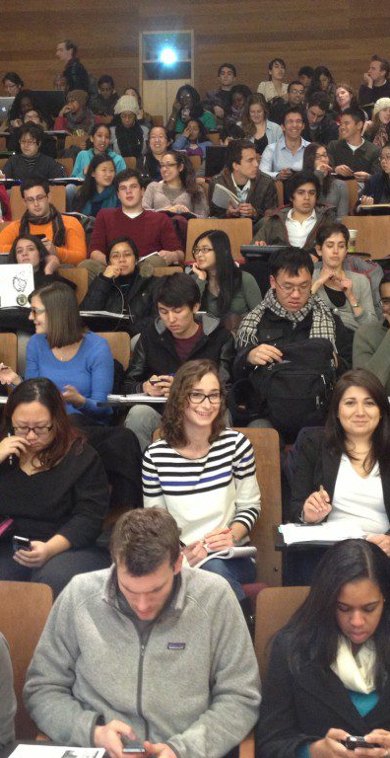
Lectures and Tutorials
Lectures on Mondays, 4.00 to 6.00pm, F11 Chemistry Bldg, LT1
Tutorials in 11 groups:
  Group 1: Wed 9.00 to 11.00am, Merewether 158
  Group 2: Thu 3.00 to 5.00pm, Carslaw 351
  Group 3: Thu 5.00 to 7.00pm, Civil 304
  Group 4: Fri 5.00 to 7.00pm, Law Annex 442
  Group 5: Fri 5.00 to 7.00pm, Law Annex 346
  Group 6: Tue 3.00 to 5.00pm, Mechanical S220
  Group 7: Tue 8.30 to 10.30am, BHB 3190
  Group 8: Wed 9.00 to 11.00am, BHB 2280
  Group 9: Tue 11.00am to 1.00pm, Civil 304
  Group 10: Fri 9.00 to 11.00am, Mechanical S220
  Group 11: Thu 1.00 to 3.00pm, BHB 2240
This Photo by Unknown Author is licensed under CC BY-SA-NC

Slide 6

Tutorials
Starts this week!
Find one other person you want to be grouped with in the first two tutorials.
Submit names to your tutor by end of second tutorial (10 to 14 August).
Two pairs will be put together in a project team with more than one engineering stream.
You will be buddies for the semester, consulting each other not just in your project but in all other class activities.
This Photo by Unknown Author is licensed under CC BY

Slide 7
Shift in Focus
Previous versions of ENGG2112 – learn technical aspects of AI/ML, then use AI/ML in a group project.
New version of ENGG2112 from this semester – learn socio-technical aspects of AI/ML, especially generative AI, then use AI for personalized learning of new material as well as in a group project.
WHY?
We are living through an industrial revolution
The way we live, work and play is changing rapidly
We need to know how to leverage our human abilities in collaboration with AI to improve society
As engineers, you need to develop an intuitive sense of what AI is and is not, based on what we will cover in this semester

Slide 8
What is in ENGG2112
Technical Aspects of AI and ML
Project Management
Social Responsibility and Ethics in AI/ML Use
Group Project on Use of AI/ML in Engineering

Slide 9

Assessments
Individual Tasks – Use AI as a learning and project partner
  Week 3: AI conversation transcript #1 (open) – 5%
  Week 5: AI conversation transcript #2 (open) – 5%
  Week 5: Explain learnt topic to other project members (secure) – 5%
Group Project – Use AI as part of the solution to an engineering problem
  Week 6: Proposal (open) – 10%
  Week 12: Final Report (open) – 15%
  Week 13: Q&A/Oral Exam (secure) – 20%
Final Exam (secure) – 40%
Tutorial Attendance (hurdle) – at least 80% required
Total secure = 65%, Total open = 35%

Slide 10
Attendance
Compulsory attendance in at least 80% of tutorials
  No need for Spec Con if you’re going to miss up to two tutorials.
  If you miss three or more tutorials without SC, it will be an Absent Fail (AF) regardless of the marks accumulated over the semester.
Lecture attendance is not compulsory but strongly encouraged
  If you don’t attend the lecture in-person, at least watch the recording.

Slide 11
Learning Objectives
Understand basics of machine learning and AI, and how they can be used to solve complex problems.
Develop ability to use generative AI to accelerate learning and increase productivity.
Understand safety, ethics and regulatory aspects of AI.
Define an engineering problem and iterate through multiple solutions to the problem.
Manage a team project successfully.
Present updates and results, write reports.

Slide 12
AI and Machine Learning
Tools for Solving Problems

Slide 13
A Toolbox for Solving Complex Problems
New this semester: Teaching you how to use generative AI in productive and safe ways.
  Both AI for learning and AI for engineering
  How should humans interact with AI in the age of AI?
We’re using this unit as an opportunity to introduce you, engineers of the future, to this toolbox of the future.
You will learn through using AI to learn new topics – both seen and unseen in lectures – and then using AI in your project.
The team project requires you to exercise your uniquely human creativity and sense of purpose, connecting technical solutions to real problems.

Slide 14
Issues and Open Questions
AI is bound to replace routine human mental labour but will it replace human ingenuity?
  Where is the labour market headed in the age of AI?
Is AI growth going to deplete natural resources (energy and water) and will the gains arising from AI be worth the environmental costs of mass AI?
  Are the AI pessimists wrongly assuming that energy efficiency will not improve in the future?
As AI gets smarter and is used more routinely, are humans destined to become “dumber”?
  How humans interact with AI matters a lot. We humans have the agency to ensure that AI interactions benefit us as humans!
If AI is used in critical, even life-and-death, scenarios, who is responsible if something goes wrong?
How does society protect vulnerable people from AI outputs generated for nefarious purposes?
How do we draw the line between productive use of AI and unethical or illegal use of AI?
  Is it ever right to claim AI outputs as our own work? What if AI produces a first cut and we carefully review and revise it?

Slide 15
Good Practices When Using AI
Be ready to think and challenge. To do this, you need to have an opinion and a goal.
Plan on having a conversation, not a one-off search query.
Verify information provided by AI – first ask for sources, then read them.
  AI hallucination continues to be a thing.
Give prompts that contain detail, e.g. role playing (“You are a patient advisor and I am seeking your help on study habits”), your own understanding of the problem (“I think that the variable t in signals and systems always refers to continuous time. Am I right?”), precise descriptions (“I need a Python function that replaces all instances of positive values in the attached Excel with +”).
  The more context you can give AI, the better its response
In a long conversation, remember that AI’s context window is limited. Ask it to summarize the earlier conversation so that the context is refreshed.
Open Claude Desktop

Slide 16
Formative Assessments
We will be introducing formative low-weight assessments to encourage you to engage with AI productively.
Assignment 1 asks that you use AI to learn more about the material introduced in our first three lectures.
Assignment 2 asks that you use AI to learn about a topic that you don’t know much about and then explain the topic to your project team.
15% of total marks

Slide 17
Technical Underpinnings of AI
We will discuss these from Week 3
Long and interesting history with technical roots in topics like statistical signal processing, Bayesian inference, stochastic detection and estimation theory, adaptive systems, etc.
Powerful parallel computing hardware has enabled the realisation of computational learning methods based on theory or heuristics.
  Question: how do we make use of them intelligently?
  This is a question we would like you to consider deeply…

Slide 18

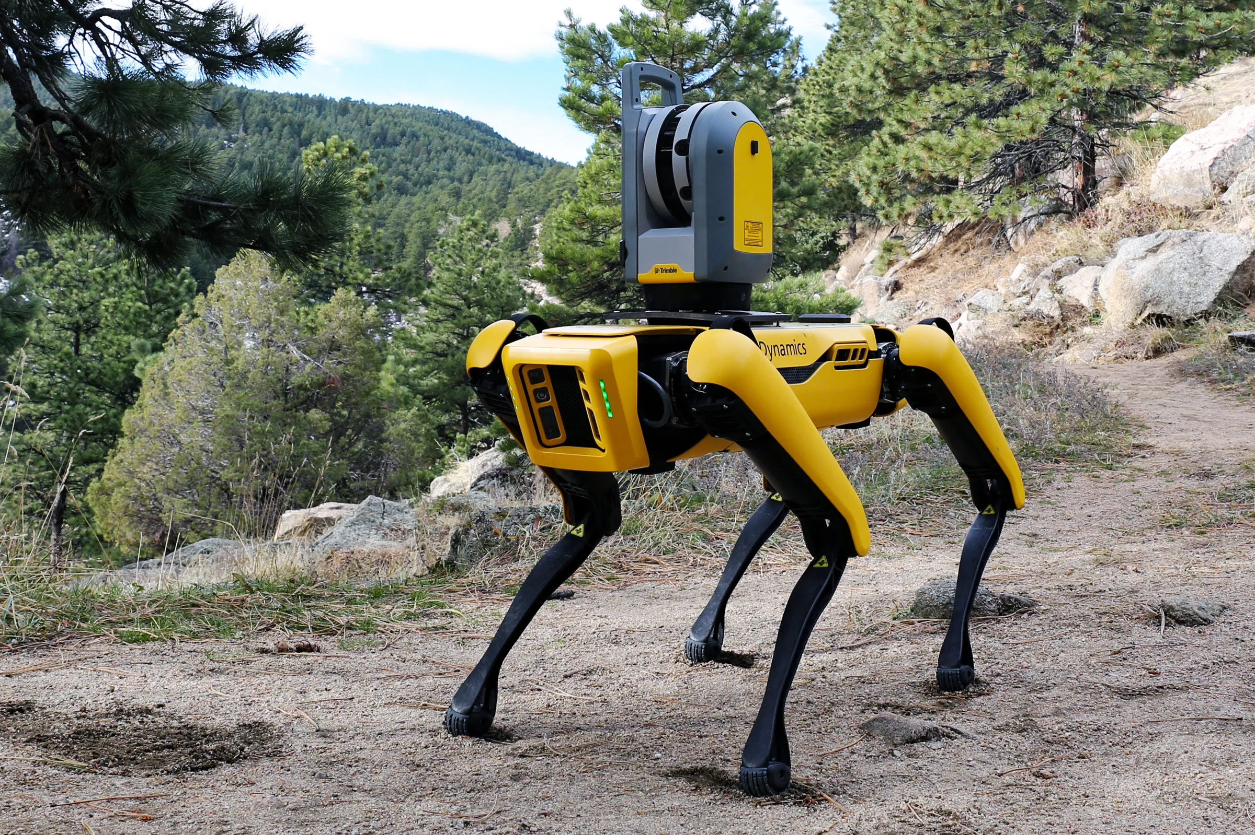
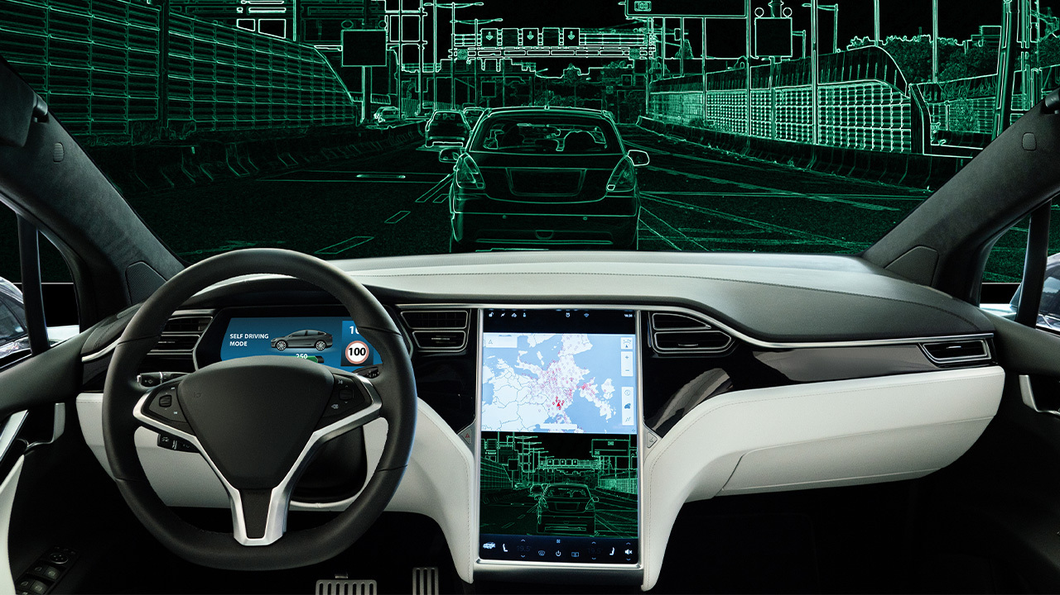
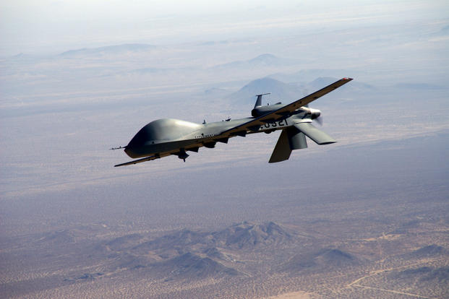

What is AI/ML?

Slide 19
Definition of artificial intelligence (?)
Intelligence = ability to take actions that lead to desirable outcomes with an adequately high probability in an environment that frequently results in a state of nature not previously encountered
This means the following systems are examples of artificial intelligence:
Automatic cruise control in a car – able to regulate speed on any road under any conditions
Noise cancelling headphones – works to some acceptable degree with any noise and any audio signal
Power system – provides required power to an uncertain number of consumers at any time
Google Maps – able to find a route from any place to any place at any time and estimate travel time
Social media recommendations – able to suggest people/places/etc. to check out based on individual data
ChatGPT – able to respond with near-human (or super-human) intelligence to any question on any topic

Slide 20
What Does AI Mean Today?
At its most basic, an AI is nothing more than the implementation of a mapping from a set of inputs to one or more outputs
  Human intelligence is also the same – in response to our sensory inputs, we produce thoughts, words, muscle activations, etc.
AI, therefore, encompasses many of the “old” or “traditional” engineered systems, which can be construed to be making an automated decision, by whatever means.
  But this definition is a bit too broad and AI currently refers only to computational methods for arriving at these decisions.
  Even this narrower definition is quite broad, since it includes all programmed systems such as if/then/elseif rules-based systems.
A lot of what we mean by AI these days is really Machine Learning (ML)
  ML refers to a computational machine that ingests data and learns a model that links input data (features) to output data (labels). This is what we focus on in ENGG2112.

Slide 21


Abstract view of Machine Learning: Model
First, define a model linking inputs to output(s)
This model has a set of parameters denoted $θ$
The critical task of ML is to find the best values for the parameters $θ$ using available data
This is accomplished in the training phase
inputs
Model
$$y=f_{θ}\left(x\right)$$
outputs

Slide 22
Abstract view of Machine Learning: Model
Examples:
Input: Optical signals into C3PO’s eyes. Output: Recognized object (R2D2, Luke, etc.)
Input: Sensors around car. Output: Steering, brake, accelerator signals
Input: Audio signals into Google Home. Output: Recognized command
Input: Sensors on robot. Output: Signals to each leg to control movement.
inputs
Model
$$y=f_{θ}\left(x\right)$$
outputs

Slide 23

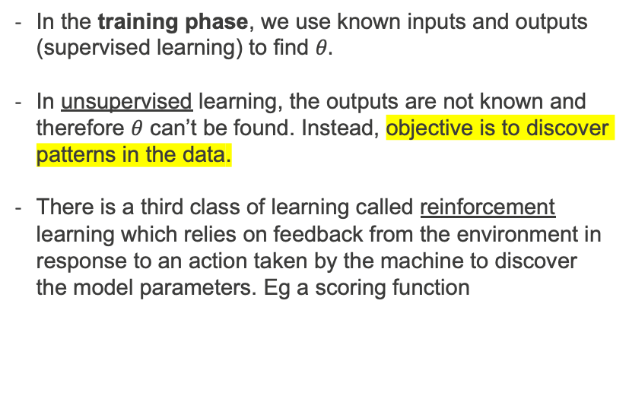

Abstract view of machine learning: Training/learning
In the training phase, we use known inputs and outputs (supervised learning) to find $θ.$
In unsupervised learning, the outputs are not known and therefore $θ$ can’t be found. Instead, objective is to discover patterns in the data.
There is a third class of learning called reinforcement learning which relies on feedback from the environment in response to an action taken by the machine to discover the model parameters. Eg a scoring function
Supervised Learning
(known)
(known)
inputs
Model
$$y=f_{θ}\left(x\right)$$
outputs
Unsupervised Learning
(known)
(unknown)
inputs
Model
$$y=f_{θ}\left(x\right)$$
outputs

Slide 24

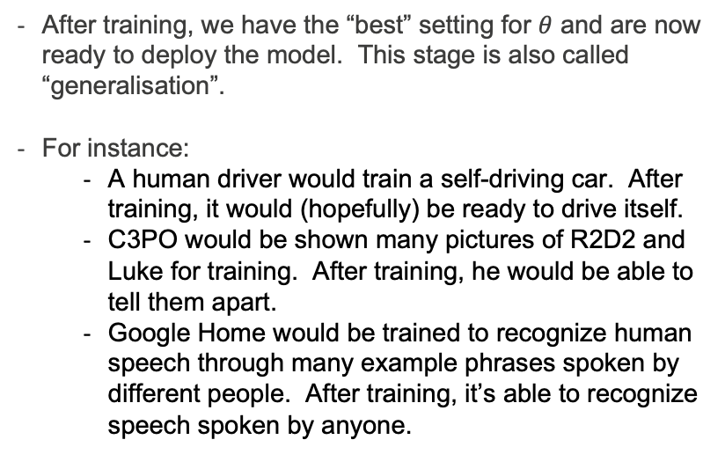
Abstract view of machine learning: Deployment
After training, we have the “best” setting for $θ$ and are now ready to deploy the model. This stage is also called “generalisation”.
For instance:
  A human driver would train a self-driving car. After training, it would (hopefully) be ready to drive itself.
  C3PO would be shown many pictures of R2D2 and Luke for training. After training, he would be able to tell them apart.
  Google Home would be trained to recognize human speech through many example phrases spoken by different people. After training, it’s able to recognize speech spoken by anyone.
(new)
inputs
Model
$$y=f_{θ}\left(x\right)$$
outputs

Slide 25
Keys to the Rapid Development of ML
1. Acceptance That Explanation is Not Always Necessary
Engineers and scientists traditionally sought to understand model functionality.
ML shows that sometimes, we only need to know it works reliably, even without full explanations.
Example: In smartphones, users care only that facial recognition works accurately, not how it does.
2. Advances in Algorithms and Computational Power
In the 1990s, neural networks and deep learning were possible but computationally impractical.
Today, GPUs and TPUs enable massive parallel computing, making complex models trainable in hours. For example, image recognition that once needed supercomputers can now be done on a standard laptop.
3. Explosion of Data Availability
ML models need large datasets to train effectively.
In the 90s, data collection was limited, but today, IoT, smartphones, and online platforms generate vast amounts of data. Example: Self-driving cars—modern ML models continuously improve as they process millions of miles of real-world driving data.

Slide 26
Traditional Methods Still Matter - Shouldn’t Discard Them
1. If a Traditional Model Works, Keep It
Many engineering problems have established analytical models that are efficient and reliable.
ML should not replace these methods unless it offers a clear advantage. For example, in structural engineering, finite element analysis (FEA) is understood and reliable, so ML may not provide significant value.
2. Engineers Must Still Learn Traditional Methods
Many ML models are black boxes, meaning they lack the interpretability of traditional models.
Understanding fundamental engineering principles is crucial for verifying ML outputs.
Example: ML can predict turbulence patterns in fluid mechanics, but engineers still need to understand Navier-Stokes equations to validate results.
3. Hybrid Approaches Are the Future
The best engineering solutions often combine traditional models with ML.
Example: Predictive maintenance in aviation—traditional physics-based failure models combined with ML anomaly detection create more accurate and reliable predictions.

Slide 27
Project Work

Slide 28
Aims of the Group Project
Learn to work in a team of diverse people
  There’s a separate set of slides on project management that you can use as guidance on how to run your project
Learn to identify goals in a project that are ambitious but achievable
Learn the importance of a workplan and regular project updates and meetings
Leverage the project to promote your expertise and achievements on LinkedIn
Learn how to use AI as an additional team member (or two)
Learn how AI can be used to solve interesting engineering problems

Slide 29
Career Preparation and Employability
Your ultimate aim is to land a fulfilling job. How do you maximize your chances of doing that?
Throughout the project, work on discovering your strengths and weaknesses – how do you amplify those strengths and overcome those weaknesses?
  Teamwork and collegiality
  Written and verbal communications
  Empathy and relating to others
  Work attitude
  Attention to detail
  Technical competency
Even if you’re “only” in second year, it’s not too soon to think about life after graduation. Start preparing for it in this unit of study.

Slide 30
Broad Project Objectives
“AI for Good” – we will provide a few tutorial-style papers to get you started.
Technical components of project – use AI/ML to solve a problem chosen by your team.
Non-technical components – understand how your proposed solutions can impact society both positively and negatively.
AI as a learning accelerator – learn to use AI to your advantage.
Multi-disciplinary aspects – appreciate that most engineering projects are not confined to one well-defined domain; and that AI/ML is applicable to/disrupting all fields of engineering.

Slide 31
Examples of Projects

Slide 32
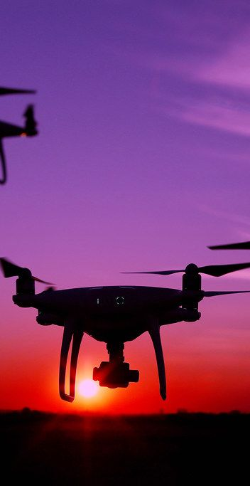
Drones for Surveillance and Tracking
Police and military may need to track vehicles or people on the ground using drones
Technical problem: How can multiple drones be used to improve performance over using just one drone? What are the cost-benefit trade-offs?
Other questions: What are the consequences of identification errors? Are these ethically acceptable? Are there legal implications?
This Photo by Unknown Author is licensed under CC BY

Slide 33

Cybersecurity
Malware and viruses spread from one computer to another and ideally, should be stopped early.
Technical question: Can we use AI operating on network parameters to detect the spread of malware and viruses?
Other questions: Who operates and owns the AI? How would the spread be stopped? What are the costs of stopping the spread?
This Photo by Unknown Author is licensed under CC BY-SA-NC

Slide 34

Detecting Driver Fatigue
Driver fatigue is a major cause of road accidents. Early detection can save lives.
Technical question: Using onboard cameras and other sensors, can AI be used to detect the early onset of driver fatigue?
Other questions: Will this increase cost substantially? Can we quantify the benefits of this technology in terms of lives saved? What level of false alarm and missed detections can we accept?

Slide 35
Negative Examples…
Prediction of stock market index in the future based on past without discussion of how it will be used and the cost of inaccurate predictions, etc.
Classification of water as potable or not, based on chemical readings – do we need ML or AI for this?
Prediction of bushfire at a certain location based on current weather conditions and knowledge of where bushfires are burning – why would AI/ML work better than conventional methods?
Diagnosis of diabetes based on non-invasive measurement of vital signs – accuracy is low relative to simple blood test.

Slide 36

Q&A – what do you want to know?
https://app.sli.do/event/tQrbCkdiYkbtHg2hXoN2ji

Slide 37
What’s Coming Up?
Next Week’s Class

Slide 38
Week 2 Preview

Slide 39

Short Survey

