Slide 1
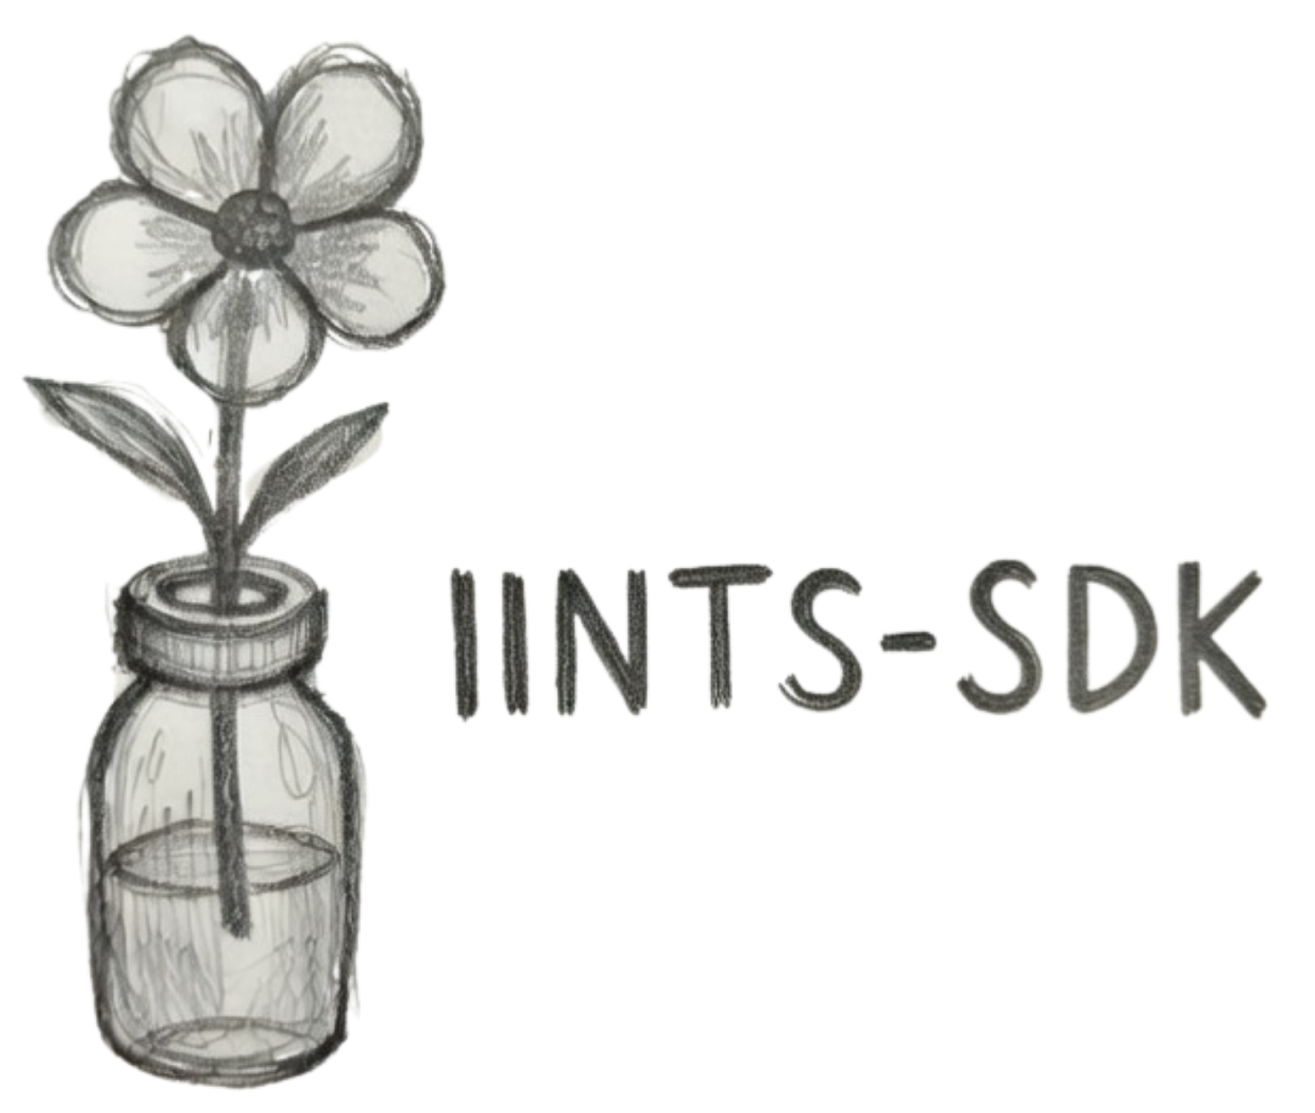
IINTS-AF SDK
A safety-first digital twin laboratory
for diabetes technology research
PHYSIOLOGY
↓
Simulation · physiology · deterministic safety · AI forecasting · reproducible evidence
AI PROPOSAL
↓
SAFETY GATE
UNIVERSITY DISCUSSION
↓
EVIDENCE
Rune Bobbaers | June 2026
Open-source pre-clinical research SDK
Notes:
Open with the one-sentence claim: IINTS-AF is a research laboratory for testing diabetes algorithms before they are anywhere near a real patient. Emphasise that the project combines physiology, software engineering, AI and deterministic safety. State immediately that it is not a medical device.

Slide 2
MOTIVATION
Why build another diabetes simulator?
Because algorithm development needs a place where failure is observable, repeatable and harmless.
“No real patient should be the debugging environment.”
MULTI-SCALE
SAFETY
EVIDENCE
Physiological complexity
Opaque algorithm behaviour
Weak reproducibility
Meals, insulin kinetics, exercise, stress, sensor lag and counter-regulation interact over different time scales.
A low numerical error does not prove that a controller or predictor behaves safely in difficult situations.
A graph without seeds, profiles, data lineage and safety logs is difficult for another researcher to challenge.
THE SDK IS A PRE-CLINICAL RESEARCH TOOL — NOT A DOSING SYSTEM
RESEARCH & EDUCATION ONLY · NOT A MEDICAL DEVICE
02
Notes:
Frame the need, not the feature list. Diabetes is difficult because disturbances and treatments have delayed and overlapping effects. The research problem is therefore not only prediction accuracy; it is whether behaviour remains understandable and testable under stress.

Slide 3
RESEARCH QUESTION
Can risky algorithm behaviour be exposed before clinical use?
Can an open-source, safety-first simulation SDK make unsafe or unrealistic diabetes-algorithm behaviour visible before algorithms are tested near real patients?
1
Simulate
2
Supervise
3
Validate
4
Explain
Virtual patients, scenarios, sensors and device faults.
A deterministic layer checks every proposed action.
Data contracts, realism gates, replay and benchmarks.
Clinical-style reports, XAI events and model cards.
The contribution is the research infrastructure around the algorithm—not only the algorithm itself.
Source: IINTS-AF Paper Technical Dossier; EUCYS Technical Brief.
RESEARCH & EDUCATION ONLY · NOT A MEDICAL DEVICE
03
Notes:
Read the research question slowly. Then explain the four contributions. This is important: the project is not claiming to have solved automated insulin delivery. It provides infrastructure to make candidate behaviour measurable, reviewable and safer to discuss.

Slide 4
SOFTWARE ARCHITECTURE
One pipeline, separated responsibilities
The design keeps data, physiology, algorithm proposals, safety authority and evidence generation distinct.
DATA + SCENARIOS
ORCHESTRATOR
DIGITAL TWIN
ALGORITHM
SAFETY GATE
EVIDENCE
imports
profiles
events
→
fixed seed
time-step loop
→
patient ODEs
sensor model
→
PID · MPC · AI
custom plugin
→
bounds · trend
IOB · dose window
→
CSV
PDF
audit
STATE
DECISION TRACE
glucose · IOB · COB · activity · stress · sensor quality
accepted · reduced · blocked + reason
Key design rule: candidate logic proposes; the safety layer authorises.
Code map: src/iints/data · core · api · safety · analysis · validation.
RESEARCH & EDUCATION ONLY · NOT A MEDICAL DEVICE
04
Notes:
Walk left to right. The digital twin and the candidate algorithm are separate objects. The algorithm never writes directly to the patient state. Its action passes through deterministic supervision, and every step is recorded as evidence.

Slide 5
SIMULATION LOOP
What happens during one time step?
A five-minute research tick turns a scenario event into a new physiological state and an auditable decision.
1
2
3
4
5
6
EVENT
→
PATIENT
→
CGM
→
PROPOSAL
→
VERIFY
→
RECORD
meal
exercise
stress
update ODE
states
lag + noise
+ artifacts
insulin or
glucagon
limits · trend
IOB · contract
next state
+ reason
PROPOSAL ≠ PERMISSION
The distinction is logged at every step—especially when the supervisor changes the action.
Source: src/iints/core/simulator.py and src/iints/core/supervisor.py.
RESEARCH & EDUCATION ONLY · NOT A MEDICAL DEVICE
05
Notes:
Use this slide to make the loop concrete. A scenario changes the virtual patient; the CGM model hides perfect blood glucose; the algorithm proposes; the safety supervisor verifies; the recorder stores both the final action and the reason.

Slide 6
MATHEMATICAL CORE
Two mathematical lenses on the same patient
A fast transparent model supports sweeps; richer ODE models support mechanistic research questions.
BERGMAN-STYLE
HOVORKA-STYLE · 19 STATES
Minimal-model extension
Compartmental physiology
Glucose G · remote insulin action X · plasma insulin I
+ gut, subcutaneous insulin, glucagon and HAAF states
Accessible/non-accessible glucose · insulin depots · three insulin-action channels · meal compartments · stress/exercise · glucagon · HAAF · GLUT4
dG/dt = −(p₁ᵉᶠᶠ + X)G + p₁ᵉᶠᶠGᵦ + Rₐ + Ddawn − Uexercise − FR
dQ₁/dt = −(NIMGU + FR) − x₁Q₁ + k₁₂Q₂ + EGP₀·max(0, 1 − x₃ + xgluc) + UG
Best for: interpretable sensitivity studies and faster scenario sweeps.
Best for: delayed kinetics, stress, exercise and dual-hormone experiments.
Both are research abstractions—not complete human physiology.
Foundations: Bergman et al. 1979; Hovorka et al. 2004.
RESEARCH & EDUCATION ONLY · NOT A MEDICAL DEVICE
06
Notes:
Do not claim that one model is the human body. Explain that each is an explicit approximation with a purpose. Bergman is compact and interpretable. The Hovorka-style model has 19 states and separates delayed physiological pathways.

Slide 7
PHYSIOLOGY + MEASUREMENT
From a dose or meal to the value seen by an algorithm
Delays are modelled explicitly so events do not become impossible vertical glucose jumps.
MEAL ABSORPTION
INSULIN PK/PD
CGM MEASUREMENT
Solid stomach → liquid stomach → gut → rate of appearance
Dose → subcutaneous depots → plasma insulin → slow action states
Blood glucose → interstitial lag → colored noise, drift and dropout
→
→
dD₃/dt = kempt·D₂ − kabs·D₃
UG = kabs·D₃·AG
dS₁/dt = uI − S₁/tmax,I
dI/dt = UI/VI − ke·I
τISF·dISF/dt = BGlagged − ISF
CGM = ISF + bias + drift + noise
What the controller sees is intentionally not perfect latent blood glucose.
Foundations: Dalla Man et al. 2007; Wentholt et al. 2004; insulin PK/PD literature.
RESEARCH & EDUCATION ONLY · NOT A MEDICAL DEVICE
07
Notes:
This is one of the most important realism points. Meals and insulin do not act instantly, and a CGM does not directly measure blood glucose. The SDK makes these delays visible and configurable, including sensor artifacts.

Slide 8
DEEP PHYSIOLOGY
Hypoglycaemia risk has memory
The experimental physiology layer models rescue, repeated-low vulnerability and dual-hormone response.
ENDOGENOUS RESCUE
PHYSIOLOGICAL MEMORY
Counter-regulation
HAAF state
Below 70 mg/dL, endogenous glucose production rises through a rescue term that is weakened by HAAF.
Repeated lows increase a bounded state; slow decay allows prior hypoglycaemia to influence later vulnerability.
Rrescue = 1 + (70 − G)⁺/10 · (1 − HAAF)
dHAAF/dt = kbuild·Δhypo·(1−HAAF) − kdecay·HAAF
DUAL-HORMONE RESEARCH
MASS BALANCE
Exogenous glucagon PK/PD
Smooth renal clearance
Two subcutaneous depots feed plasma glucagon and a delayed hepatic action state.
A differentiable soft threshold avoids an abrupt renal cutoff at high glucose.
dΓ/dt = UΓ/VΓ − ke,G·Γ
FR = 0.003·VG·10·ln(1 + exp((G−162)/10))
EXPERIMENTAL PHYSIOLOGY — REQUIRES CALIBRATION AND EXTERNAL VALIDATION
Foundations: Gerich et al. 1979; Cryer 2013; Lv et al. 2013; Hummel et al. 2018.
RESEARCH & EDUCATION ONLY · NOT A MEDICAL DEVICE
08
Notes:
The key message is that a low glucose event is not isolated. Counter-regulation can rescue glucose, but antecedent lows can blunt later responses. The HAAF state is an experimental abstraction and must never be presented as a clinical diagnosis.

Slide 9
SAFETY ARCHITECTURE
AI proposes. Deterministic logic decides.
The supervisor is deliberately simpler, transparent and independent from the candidate controller.
CANDIDATE
DETERMINISTIC SAFETY SUPERVISOR
APPLIED ACTION
PID
MPC
Neural policy
Custom algorithm
LLM-assisted experiment
hard hypo / severe-low stop
maximum bolus and 60-minute dose
IOB mass-balance clamp
falling-trend and predicted-low guard
sensor validity and dual-hormone caps
ACCEPTED
REDUCED
BLOCKED
→
→
Gmomentum,30 = Gt + 30·vG
≤ severe low ⇒ approved insulin = 0
+ reason, limits and trace
Safety rules reduce risk in simulation; they do not prove clinical safety.
Implementation: src/iints/core/supervisor.py and src/iints/core/safety/.
RESEARCH & EDUCATION ONLY · NOT A MEDICAL DEVICE
09
Notes:
This is the central architectural claim. The safety supervisor does not make the system a medical device and does not prove safety. Its value is that risky proposals become observable, blocked when rules require it, and recorded with a reason.

Slide 10
ARTIFICIAL INTELLIGENCE
Three AI roles—with three different safety boundaries
The SDK does not treat every AI component as the same kind of intelligence.
01 · EXPLAIN
02 · FORECAST
03 · EXPERIMENT
Local language model
Glucose time-series model
Controller / policy
Mistral / Ministral through Ollama or API
LSTM-style multihorizon predictor
MPC, imitation or compact policy
summarise a run
explain anomalies
index evidence
predict trend/value
quantify uncertainty
detect hypo risk
propose insulin
propose glucagon
compare strategies
ADVISORY TEXT ONLY
NO DOSING AUTHORITY
ALWAYS SUPERVISOR-GATED
Language explains · numeric models forecast · deterministic rules retain authority
AI modules: src/iints/ai/ and src/iints/research/.
RESEARCH & EDUCATION ONLY · NOT A MEDICAL DEVICE
10
Notes:
Avoid saying 'the AI controls the patient'. There are three distinct roles. The local language model explains. The numeric model forecasts. An experimental controller may propose actions, but only inside simulation and behind deterministic supervision.

Slide 11
PHYSICS-INFORMED PREDICTION
Forecasting glucose without rewarding impossible behaviour
The objective combines numerical accuracy with explicit physiological penalties.
INPUT HISTORY · 240 MIN
BAND-PINN LOSS
CGM
TREND
IOB
L
S
T
M
L = MSE + λ · Lphys
→
COB
TIME
ACTIVITY
Lphys = bounds + rate-of-change + IOB/COB consistency
penalise predictions outside 20–600 mg/dL
penalise excessive glucose rate-of-change
penalise suspicious IOB / COB trajectories
OUTPUT
24 forecast steps × 5 min = 120-minute horizon
Subject-level train / validation / test splits reduce leakage between people.
Promotion score = MAE + wphys·violations + whypo·missed hypoglycaemia
Model workflow: research/train_predictor.py; src/iints/research/losses.py.
RESEARCH & EDUCATION ONLY · NOT A MEDICAL DEVICE
11
Notes:
Explain why pure MSE is insufficient. A model can improve average error and still produce implausible dynamics. The band-PINN objective adds physiology penalties, and candidate promotion also considers missed hypoglycaemia and violation rates.

Slide 12
CURRENT RESEARCH CHECKPOINT
The predictor is promising—but not deployment-ready
One leakage-aware OhioT1DM evaluation shows improvement over simple baselines and clear remaining limitations.
120-MINUTE FORECAST · MAE (mg/dL, LOWER IS BETTER)
153,055
12
OHIO TRAINING ROWS
SUBJECTS
52.91
48.91
8 / 2 / 2
20,748
TRAIN / VAL / TEST SUBJECTS
EVALUATION WINDOWS
27.24
22.59
SAFE-BAND CHECKPOINT
MAE 22.59 · RMSE 32.58
Within ±20 mg/dL: 59.8%
Missed hypo rate: 2.41%
Any physiology violation: 4.80%
RESEARCH EVALUATION — NOT CLINICAL VALIDATION
Local model comparison created 16 Jun 2026; OhioT1DM data are not redistributed in this deck.
RESEARCH & EDUCATION ONLY · NOT A MEDICAL DEVICE
12
Notes:
Be scientifically honest here. The safe-band model improves MAE over last-value persistence on this evaluation, but 22.6 mg/dL at 120 minutes is not a clinical claim. The metrics also reveal residual physiological violations. The point is that the SDK makes that trade-off visible rather than hiding it.

Slide 13
RESEARCH OPERATIONS
A run is useful only when its evidence survives the demo
The SDK turns experiments into inspectable bundles instead of leaving results inside a notebook.
IMPORT
CERTIFY
SIMULATE
COMPARE
REPORT
EDGE
CareLink · Ohio
Nightscout · CSV
→
contract · provenance
realism · corruption
→
fixed seed · profile
scenario · controller
→
baseline · ablation
replay · golden
→
CSV · JSON · PDF
AGP · poster · XAI
PI
UNO Q
JETSON
FPGA
EVIDENCE BUNDLE
protocol + manifest + hashes + results + safety decisions + limitations
MDMP-style data review and EU AI Pact-oriented documentation support auditability; they do not equal regulatory compliance.
The same CLI connects simulation, data, AI, reports and hardware experiments.
Examples: iints run-study · iints report · iints data certify · iints fpga demo.
RESEARCH & EDUCATION ONLY · NOT A MEDICAL DEVICE
13
Notes:
This slide explains why it is an SDK rather than a set of scripts. The CLI creates a repeatable path from data to evidence. Mention MDMP carefully: it supports data quality and governance-oriented review but is not itself regulatory certification.

Slide 14
SCIENTIFIC POSITION
What the SDK is—and what it is not
The credibility of the project depends on making the boundary explicit.
IT IS
IT IS NOT
a pre-clinical research simulator
a reproducible algorithm test harness
a physiology and AI experimentation platform
an educational digital twin
a medical device or certified controller
a replacement for clinical trials
a source of treatment or dosing advice
proof that every physiology parameter is clinically exact
NEXT VALIDATION STEPS
1
Calibrate
2
Stress-test
3
Quantify
4
Review
Ohio + external CGM
meals · exercise · illness
uncertainty + identifiability
clinicians + engineers
Scientific position aligned with the project dossier and release documentation.
RESEARCH & EDUCATION ONLY · NOT A MEDICAL DEVICE
14
Notes:
This slide is a strength, not an apology. The models are physiologically motivated, but parameter calibration, external validation and uncertainty analysis remain active work. Invite the university to challenge these parts.

Slide 15
FROM PRESENTATION TO LIVE EVIDENCE
What I will demonstrate
A controlled scientific story—not a terminal trick.
1
2
3
4
5
→
→
→
→
Normal day
Meal stress
Risk scenario
Safety gate
Evidence
BASELINE
DISTURBANCE
UNSAFE PROPOSAL
INTERVENTION
REPORT + TRACE
iints demo eucys
iints demo doctor
iints demo booth
iints report --style standard
QUESTIONS FOR COLLABORATION
• Which physiology parameters should be calibrated first?
• Which external validation design would be most defensible?
• How should prediction uncertainty enter safety evaluation?
Thank you
github.com/python35/IINTS-SDK
Notes:
Transition directly into the EUCYS demo. Narrate normal day, meal stress, risky proposal, supervisor intervention and evidence report. End by asking for collaboration on physiology calibration, external validation and uncertainty—not only general feedback.

Slide 16
APPENDIX
Selected scientific foundations
The equations in the SDK are documented as research abstractions linked to primary literature.
Bergman et al. (1979)
Gerich et al. (1979)
Quantitative estimation of insulin sensitivity.
DOI 10.1152/ajpendo.1979.236.6.E667
Hormonal recovery from insulin-induced hypoglycaemia.
DOI 10.1152/ajpendo.1979.236.4.E380
Hovorka et al. (2004)
Cryer (2013)
Nonlinear MPC of glucose in type 1 diabetes.
DOI 10.1088/0967-3334/25/4/010
Mechanisms of hypoglycaemia-associated autonomic failure.
DOI 10.1056/NEJMra1215228
Dalla Man et al. (2007)
Lv, Breton & Farhy (2013)
Meal simulation model of the glucose–insulin system.
DOI 10.1109/TBME.2007.893506
Exogenous glucagon pharmacokinetics in T1D.
DOI 10.1089/dia.2013.0150
Wentholt et al. (2004)
Marling & Bunescu (2020)
CGM measurement and glucose-sensor context.
DOI 10.1089/dia.2004.6.615
OhioT1DM dataset update 2020.
CEUR Workshop Proceedings, Vol. 2675
FULL SOURCE TRAIL: docs/EVIDENCE_BASE.md + docs/SOURCE_LIBRARY.md
Repository snapshot: IINTS-AF SDK v1.5.15 plus current research worktree, June 2026.
RESEARCH & EDUCATION ONLY · NOT A MEDICAL DEVICE
16
Notes:
Use this slide only if asked about scientific provenance. The full repository contains a larger evidence base and source library. Be clear that literature inspiration does not by itself validate the implementation.

