Slide 1
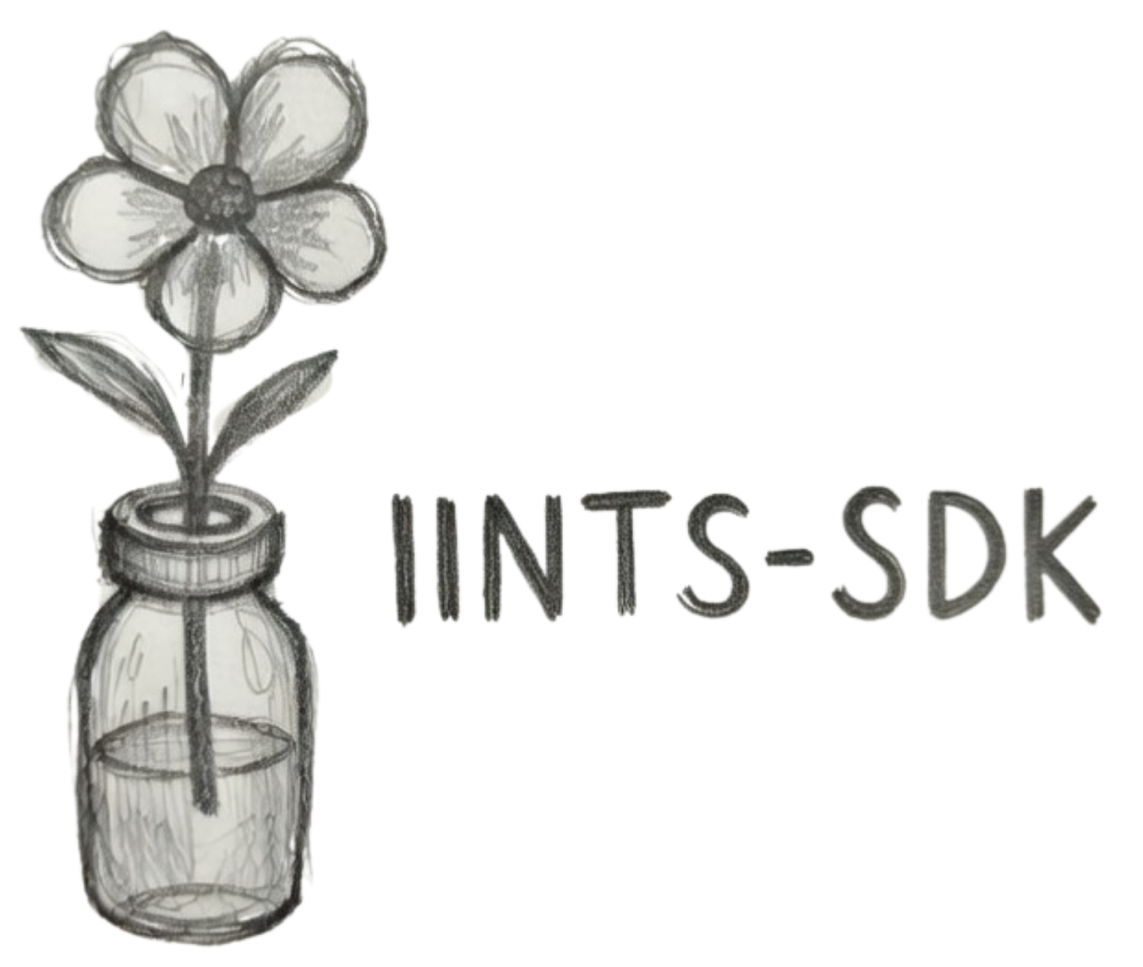
OXFORD RESEARCH DISCUSSION
IINTS-AF
An open-source educational platform for transparent AI and diabetes digital twins
Rune Bobbaers · Belgium · EUCYS 2026
SAFE EDUCATIONAL SANDBOX
Digital twin
AI experiments
Deterministic safety
Bench demonstrator
NOT A MEDICAL DEVICE
iints.org · github.com/python35/IINTS-SDK
Notes:
Thank you very much for taking the time to meet with me. I am Rune Bobbaers, a recently graduated high school student from Belgium. I have type 1 diabetes myself, and that personal experience made me interested in how diabetes technology works behind the scenes. My project, IINTS-AF, is an open-source educational platform that combines a diabetes digital twin, glucose-insulin simulation, AI decision-support experiments, and an embedded bench demonstrator. It is not intended as a clinical medical device. I was selected for EUCYS, and I would especially value your feedback on the digital twin, time-series AI, validation, and scientific presentation.

Slide 2
PERSONAL MOTIVATION
Why I started building IINTS-AF
“I depended on diabetes technology long before I understood what was happening inside it.”
01
02
03
Lived experience
A transparency gap
A maker question
Type 1 diabetes made pumps, sensors and algorithms part of everyday life.
Powerful systems are often closed, complex and difficult for students or patients to inspect.
Could a safe open platform explain the concepts and stress-test algorithms without involving a real patient?
PERSONAL EXPERIENCE → SCIENTIFIC CURIOSITY → OPEN EDUCATIONAL TOOL
EDUCATIONAL / RESEARCH ONLY · NOT A MEDICAL DEVICE
02
Notes:
Keep this personal section short. I depend on diabetes technology myself, but for a long time I did not understand what was happening inside these systems. IINTS-AF began with a transparency question: how can pumps, sensors, physiology and algorithms become understandable without claiming to replace clinical systems?

Slide 3
PLATFORM OVERVIEW
What is IINTS-AF?
A connected research workflow, not a single pump algorithm.
1
2
3
4
5
EVENTS
→
DIGITAL PATIENT
→
AI + ALGORITHMS
→
SAFETY GATE
→
OUTPUTS
meals · insulin
activity · stress
glucose-insulin
dynamics
forecast · explain
stress-test
verify · limit
record reasons
dashboard · reports
bench demonstrator
Goal: make diabetes technology visible, testable and discussable before anyone talks about clinical use.
Architecture: scenarios → simulator → candidate logic → deterministic safety → evidence.
EDUCATIONAL / RESEARCH ONLY · NOT A MEDICAL DEVICE
03
Notes:
This is the most important slide. The platform starts with controlled events, updates a digital patient, runs AI or algorithm experiments, checks the proposed action through deterministic safety logic, and produces understandable outputs. The physical board is only one output interface; it is not the core project.

Slide 4
SCIENTIFIC CORE
The digital patient: useful because it is explicit
The model makes delayed physiology visible—while keeping its limitations visible too.
A SIMPLE RESEARCH VIEW
Meals
Insulin
dG/dt = meal appearance
+ endogenous production
− insulin-mediated uptake
− basal utilisation
− renal loss
multi-compartment absorption
subcutaneous PK/PD delay
Context
CGM
exercise · stress · circadian
ISF lag · noise · drift · dropout
Mechanistic ODEs inspired by Bergman- and Hovorka-style models
EXPERIMENTAL MODEL · PHYSIOLOGICALLY MOTIVATED · NOT CLINICALLY VALIDATED
Foundations documented in Bergman 1979, Hovorka 2004, Dalla Man 2007 and CGM lag literature.
EDUCATIONAL / RESEARCH ONLY · NOT A MEDICAL DEVICE
04
Notes:
Explain one equation, not every equation. The simulator separates meal appearance, endogenous production, insulin-mediated uptake and losses. It also models delayed insulin action and imperfect CGM measurement. At this stage it remains educational and experimental; improving realism and validation is one reason I am seeking expert feedback.

Slide 5
TRUSTWORTHY AI EXPERIMENTS
The goal is not only accuracy—it is understandable behaviour under stress
EXPLAIN
FORECAST
EXPERIMENT
SUPERVISE
Local language model
Time-series predictor
Candidate controller
Deterministic safety
→
→
→
Summarises runs and turns anomalies into reviewable XAI events.
Forecasts future glucose and is checked for error, hypo misses and physiological violations.
PID, MPC or learned policies can propose actions inside simulation.
Independent rules accept, reduce or block proposals and record why.
Normal day · sport · bad carb count · delayed meal · night hypo risk · sensor failure
Safety principle: the candidate proposes; deterministic logic retains authority.
EDUCATIONAL / RESEARCH ONLY · NOT A MEDICAL DEVICE
05
Notes:
My main interest is not just prediction accuracy. I want to know whether an algorithm behaves transparently under difficult scenarios. The SDK separates explanation, forecasting, experimental control and deterministic safety so that each role has a clear boundary.

Slide 6
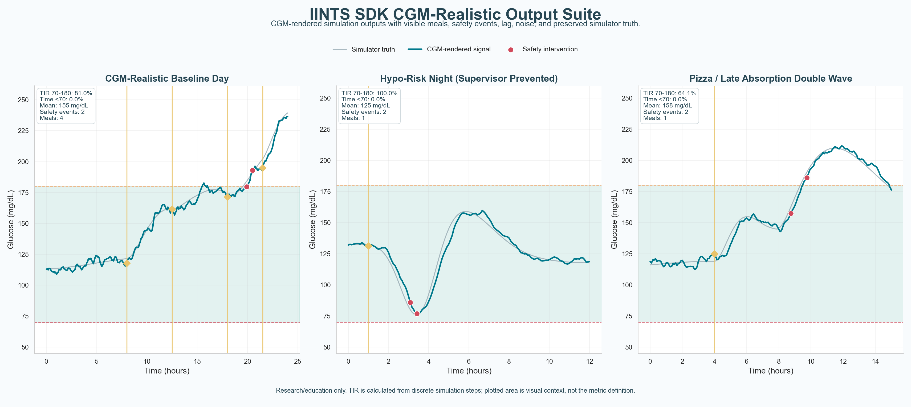
EXAMPLE OUTPUT
One view reveals physiology, sensor realism and safety events
An SDK-generated research poster compares a baseline day, a prevented low-risk night and delayed meal absorption.
CGM VS SIMULATOR TRUTH
MEALS + TARGET RANGE
SAFETY INTERVENTIONS
SCENARIO STRESS TESTS
Actual SDK output: CGM-Realistic Output Suite. Research/education only; visual inspection is not clinical validation.
EDUCATIONAL / RESEARCH ONLY · NOT A MEDICAL DEVICE
06
Notes:
Use the figure as evidence that the SDK makes behaviour inspectable. The grey line is latent simulator truth, the teal line is the CGM-rendered signal, yellow markers are meals and red markers are supervisor interventions. The purpose is to notice delayed, aggressive or unsafe responses—not to claim clinical performance.

Slide 7
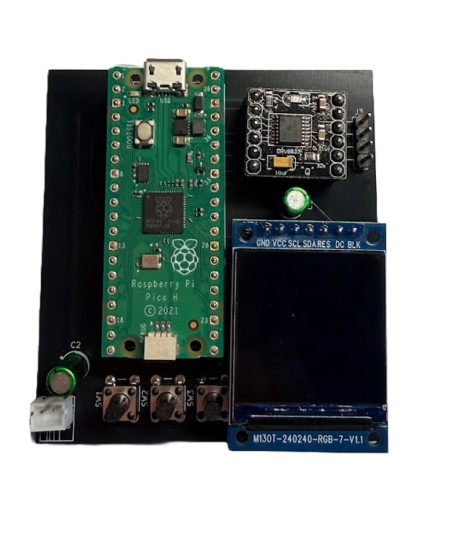
PHYSICAL DEMONSTRATOR
Making abstract safety
logic tangible
A Pico-based bench interface for teaching, serial testing and visible system states.
Raspberry Pi Pico + display + buttons
Locked non-actuating bench firmware
No motor pins and zero delivery authority
DOSE / BOLUS / BASAL / PRIME are rejected
Never connected to a reservoir, person or animal
hardware_actuation_enabled = false
USER-PROVIDED BENCH PROTOTYPE
BENCH-ONLY · ZERO DELIVERY · NOT FOR THERAPY
07
Notes:
Do not call this a real insulin pump. It is an embedded demonstrator that makes a pump-like architecture tangible. The current SDK firmware is deliberately locked: it has no motor pins, hardware actuation is disabled and dose commands are rejected. That safety boundary is part of the engineering story.

Slide 8
DIGITAL HEALTH RELEVANCE
Why transparency matters in medical AI
01
02
03
04
UNDERSTAND
STRESS-TEST
TRACE
TEACH
Show how physiology, sensors and algorithms interact.
Explore failure cases before real-world deployment is discussed.
Keep seeds, data lineage, decisions and reports reviewable.
Make complex technology accessible to students, patients and makers.
The challenge is not only building models. It is making their behaviour understandable, testable and trusted.
EDUCATIONAL / RESEARCH ONLY · NOT A MEDICAL DEVICE
08
Notes:
Connect the project to trustworthy AI and digital health. Simulation creates a safe place to inspect failure modes. Open-source evidence and explicit limits help other people challenge the work. Education is not secondary: it is part of making medical AI understandable.

Slide 9
SCIENTIFIC HONESTY
Current limitations and open questions
Knowing what is missing is part of the research contribution.
WHAT EXISTS NOW
WHAT STILL NEEDS VALIDATION
working open-source SDK and CLI
mechanistic patient and CGM models
AI forecasting and explainability workflow
deterministic safety and evidence reports
physiological parameter calibration
comparison with established simulators and datasets
prediction uncertainty and subgroup robustness
clearer metrics for safety and failure cases
1 CALIBRATE
2 BENCHMARK
3 QUANTIFY
4 REVIEW
The simulator is not clinically validated; expert review is sought before EUCYS presentation claims are finalised.
EDUCATIONAL / RESEARCH ONLY · NOT A MEDICAL DEVICE
09
Notes:
This is deliberately direct. I know the project is not clinically validated. I need stronger calibration, comparison with established models, uncertainty analysis and clearer safety metrics. That is why this conversation matters before EUCYS.

Slide 10
THE PURPOSE OF THIS MEETING
What I would value your feedback on
1
Digital twin realism
2
Time-series validation
Which physiological assumptions or parameters should I improve first?
Which metrics and external benchmarks would be scientifically defensible?
3
Trustworthy AI
4
EUCYS framing
How should I communicate uncertainty, safety and failure cases?
What should I emphasise so the work is strong but understandable?
I am building a safe educational sandbox where diabetes algorithms and digital twins can be understood, visualised and stress-tested before clinical use is discussed.
iints.org · github.com/python35/IINTS-SDK
Thank you
Notes:
I would be very grateful for advice on where the project is scientifically strongest and what I should improve before EUCYS. I am especially interested in digital twin calibration, time-series evaluation, trustworthy-AI evidence and clear scientific framing. Then stop presenting and invite discussion.

