Slide 1
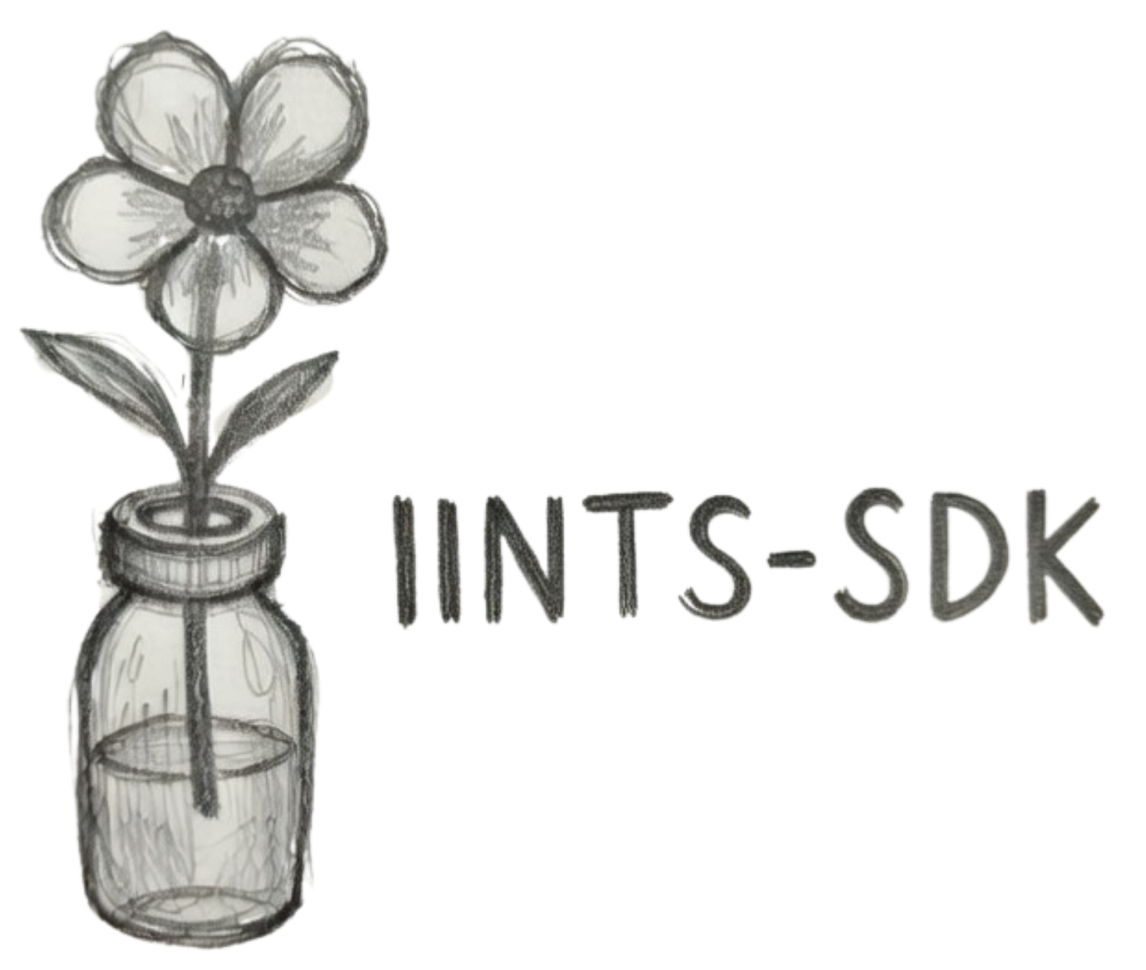
OXFORD RESEARCH DISCUSSION
IINTS-AF
An open-source educational platform for transparent AI and diabetes digital twins
Rune Bobbaers · Belgium · EUCYS 2026
SAFE EDUCATIONAL SANDBOX
SDK software core
Digital patient
AI experiments
Safety checks
NOT A MEDICAL DEVICE
iints.org · github.com/python35/IINTS-SDK
Notes:
Thank you very much for taking the time to meet with me. I am Rune Bobbaers, a recently graduated high school student from Belgium. I have type 1 diabetes myself, and that personal experience made me interested in how diabetes technology works behind the scenes. The main project is the IINTS-SDK: an open-source educational test environment for a diabetes digital twin, CGM-like data, AI experiments, safety checks and evidence reports. The physical board is only an optional bench demonstrator. The SDK is not a clinical medical device. I was selected for EUCYS, and I would especially value your feedback on the digital twin, time-series AI, validation, and scientific presentation.

Slide 2
PERSONAL MOTIVATION
Why I started building IINTS-AF
“I depended on diabetes technology long before I understood what was happening inside it.”
01
02
03
Lived experience
A transparency gap
A maker question
Type 1 diabetes made pumps, sensors and algorithms part of everyday life.
Powerful systems are often closed, complex and difficult for students or patients to inspect.
Could a safe open platform explain the concepts and stress-test algorithms without involving a real patient?
PERSONAL EXPERIENCE → SCIENTIFIC CURIOSITY → OPEN EDUCATIONAL TOOL
EDUCATIONAL / RESEARCH ONLY · NOT A MEDICAL DEVICE
02
Notes:
Keep this personal section short. I depend on diabetes technology myself, but for a long time I did not understand what was happening inside these systems. IINTS-AF began with a transparency question: how can pumps, sensors, physiology and algorithms become understandable without claiming to replace clinical systems?

Slide 3
SOFTWARE ARCHITECTURE
The SDK is the brain of IINTS-AF
It connects scenarios, a virtual patient, CGM-like data, algorithm tests, safety checks and reports.
1
2
3
4
5
SCENARIOS
→
DIGITAL PATIENT
→
CGM SIGNAL
→
ALGORITHMS
→
SAFETY + EVIDENCE
meals · insulin
exercise · sensor issues
glucose-insulin
behaviour over time
delay · noise
imperfect measurements
forecast · detect risk
test decisions
block · explain
plot · report
The SDK runs this complete workflow; the hardware board is only an optional demonstrator.
Core workflow: scenario → digital patient → CGM signal → algorithm → safety check → report.
EDUCATIONAL / RESEARCH ONLY · NOT A MEDICAL DEVICE
03
Notes:
This is the central architecture. The SDK is the software brain of the project. It starts with a controlled diabetes scenario, updates a virtual patient, generates a CGM-like signal, tests an algorithm, checks safety and produces reviewable evidence. The hardware board is only one optional way to display those states; it is not required to run the SDK.

Slide 4
SOFTWARE CORE
What the IINTS-SDK does
A complete research workflow that can run on a laptop—without the hardware demonstrator.
1
2
3
4
5
Build scenarios
Simulate a digital patient
Generate CGM-like data
Test algorithms safely
Review the behaviour
→
→
→
→
Meals, insulin, exercise and sensor issues.
Glucose–insulin behaviour changes over time.
Add delay, noise and imperfect measurements.
Forecast glucose, detect risk and test decisions.
Inspect plots, reports, safety events and explanations.
PURPOSE: EDUCATION · TRANSPARENCY · SAFE EXPERIMENTATION — NOT CLINICAL USE
The SDK is the main research and simulation component of IINTS-AF.
EDUCATIONAL / RESEARCH ONLY · NOT A MEDICAL DEVICE
04
Notes:
The SDK is the software core of the project. It lets me create diabetes scenarios, simulate a virtual patient, generate realistic CGM-like data, test AI or algorithms, apply safety checks and generate understandable reports. The physical device is only a demonstrator; the SDK can run without it.

Slide 5
SCIENTIFIC CORE
The digital patient: useful because it is explicit
A simple model shows how food, insulin, activity and sensor delay can change glucose over time.
SIMPLIFIED VIEW
Meals
Insulin
Simplified view:
glucose changes because of
food, insulin, body needs
and sensor delay
food is absorbed over time
insulin acts with a delay
Context
CGM
activity · stress · time of day
sensor delay · noise · missing data
Ideas adapted from known glucose–insulin models
EDUCATIONAL MODEL · BASED ON KNOWN IDEAS · NOT CLINICALLY VALIDATED
I use ideas from known glucose–insulin models; the simulator is still educational and not clinically validated.
EDUCATIONAL / RESEARCH ONLY · NOT A MEDICAL DEVICE
05
Notes:
Explain one equation, not every equation. The simulator separates meal appearance, endogenous production, insulin-mediated uptake and losses. It also models delayed insulin action and imperfect CGM measurement. At this stage it remains educational and experimental; improving realism and validation is one reason I am seeking expert feedback.

Slide 6
SAFETY EXPERIMENTS
Testing AI behaviour under stress
Accuracy matters, but so do explanations, failure cases and clear safety boundaries.
EXPLAIN
FORECAST
EXPERIMENT
SUPERVISE
Explain what happened
Predict glucose
Test algorithm ideas
Safety checks
→
→
→
Summarises a run and explains unusual events in plain language.
Predicts future glucose and checks how often the model is wrong or misses low glucose.
Different algorithm ideas can be tested on the virtual patient.
Fixed rules can block or reduce unsafe actions and record why.
Normal day · sport · bad carb count · delayed meal · night hypo risk · sensor failure
Safety idea: AI can suggest, but fixed safety rules can block unsafe behaviour.
EDUCATIONAL / RESEARCH ONLY · NOT A MEDICAL DEVICE
06
Notes:
My main interest is not just prediction accuracy. I want to know whether an algorithm behaves transparently under difficult scenarios. The SDK separates explanation, forecasting, experimental control and deterministic safety so that each role has a clear boundary.

Slide 7
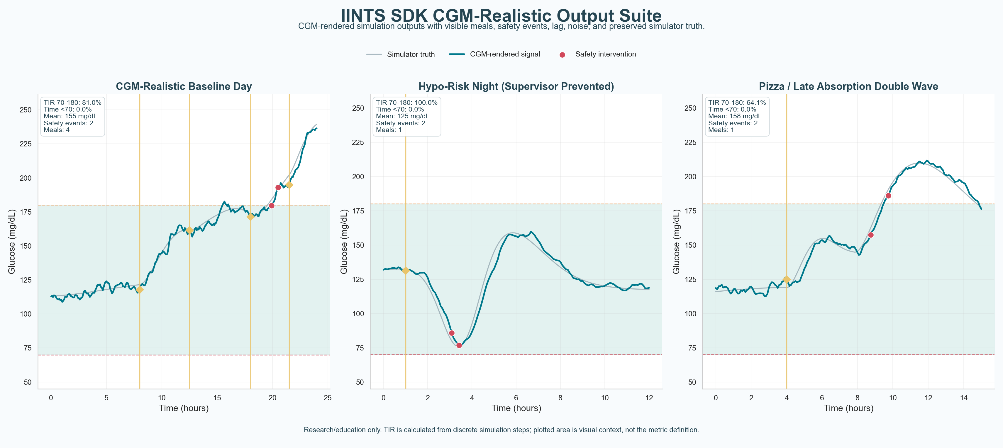
EXAMPLE OUTPUT
One view reveals physiology, sensor realism and safety events
This graph helps me see glucose changes, sensor delay, meals and safety checks across three examples.
SENSOR DELAY
MEALS + TARGET RANGE
SAFETY CHECKS
THREE TEST SCENARIOS
Actual SDK output. Research/education only; this chart supports inspection, not clinical proof.
EDUCATIONAL / RESEARCH ONLY · NOT A MEDICAL DEVICE
07
Notes:
Use the figure as evidence that the SDK makes behaviour inspectable. The grey line is latent simulator truth, the teal line is the CGM-rendered signal, yellow markers are meals and red markers are supervisor interventions. The purpose is to notice delayed, aggressive or unsafe responses—not to claim clinical performance.

Slide 8
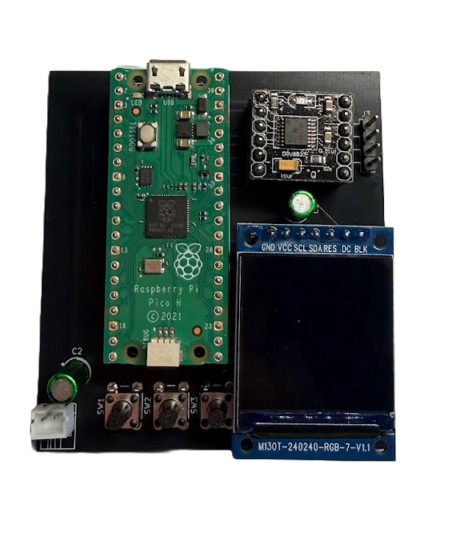
OPTIONAL HARDWARE COMPANION
The SDK works without
this hardware
A bench-only interface that makes software states visible and easier to explain.
Optional educational companion
SDK runs fully without this board
Shows interface and system states
No real insulin delivery
Not connected to a person
BENCH-ONLY · OPTIONAL · NO DELIVERY
USER-PROVIDED BENCH PROTOTYPE
BENCH-ONLY · ZERO DELIVERY · NOT FOR THERAPY
08
Notes:
This is not the core project and it is not a real insulin pump. The IINTS-SDK runs fully without this board. The board is only an optional embedded demonstrator that makes software states and a pump-like interface tangible. It has no real insulin delivery, is not connected to a person, and is used only for education and demonstration.

Slide 9
DIGITAL HEALTH RELEVANCE
Why transparency matters in medical AI
01
02
03
04
UNDERSTAND
STRESS-TEST
TRACE
TEACH
Show how physiology, sensors and algorithms interact.
Explore failure cases before real-world deployment is discussed.
Keep decisions and results reviewable.
Make complex technology accessible to students, patients and makers.
The challenge is not only building models. It is making their behaviour understandable, testable and trusted.
EDUCATIONAL / RESEARCH ONLY · NOT A MEDICAL DEVICE
09
Notes:
Connect the project to trustworthy AI and digital health. Simulation creates a safe place to inspect failure modes. Open-source evidence and explicit limits help other people challenge the work. Education is not secondary: it is part of making medical AI understandable.

Slide 10
SCIENTIFIC HONESTY
Current limitations and open questions
Knowing what is missing is part of the research contribution.
WHAT EXISTS NOW
WHAT I WANT TO IMPROVE
Open-source SDK
Virtual patient simulation
Scenario testing and AI experiments
Safety checks and visual reports
More realistic physiology
Better validation
Better uncertainty and safety explanation
Better metrics
1 REALISM
2 VALIDATION
3 METRICS
4 FRAMING
The simulator is not clinically validated. I am looking for expert feedback before EUCYS.
EDUCATIONAL / RESEARCH ONLY · NOT A MEDICAL DEVICE
10
Notes:
This is deliberately direct. I know the project is not clinically validated. I need stronger calibration, comparison with established models, uncertainty analysis and clearer safety metrics. That is why this conversation matters before EUCYS.

Slide 11
THE PURPOSE OF THIS MEETING
What I would value your feedback on
1
Digital twin
2
AI / time-series
What should I improve first in the patient model?
How should I test glucose predictions properly?
3
Safety
4
EUCYS
How can I show uncertainty and failure cases clearly?
What should I emphasise to make the project scientifically strong?
IINTS-AF is an open-source educational sandbox to simulate diabetes technology, test simple AI ideas safely, and make algorithm behaviour understandable.
iints.org · github.com/python35/IINTS-SDK
Thank you
Notes:
I would be very grateful for advice on where the project is scientifically strongest and what I should improve before EUCYS. I am especially interested in digital twin calibration, time-series evaluation, trustworthy-AI evidence and clear scientific framing. Then stop presenting and invite discussion.

