Slide 1
Big Hands e-NABLE Fremont
A chapter under e-NABLE the Future
By: Christopher Huang
(Senior at Irvington High School)
1/24/2026

Slide 2
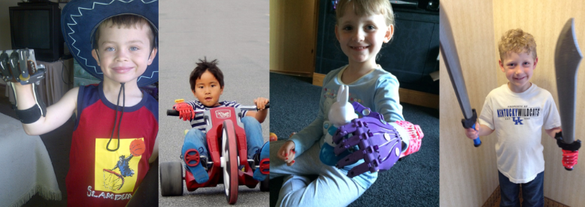
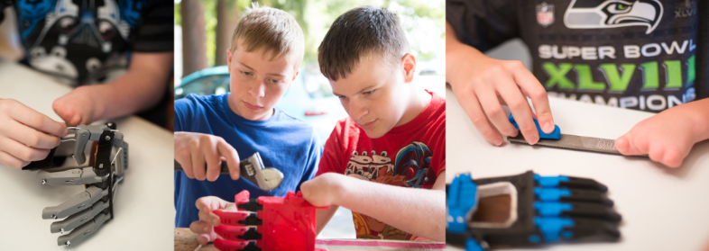
What is e-NABLE?https://enablingthefuture.org/
e-NABLE is a global network of volunteers
Uses 3D printing & digital fabrication to create free assistive devices
Focused on upper-limb differences (hands, arms)
Operates in 100+ countries with thousands of volunteers
Devices are provided at no cost to recipients

Slide 3
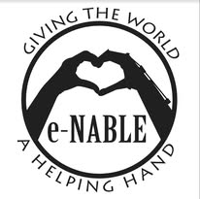
The Mission of e-NABLE
Increase access to assistive devices
Empower individuals with limb differences
Connect makers, engineers, students, clinicians, and families
Promote open-source design, education, and community service

Slide 4
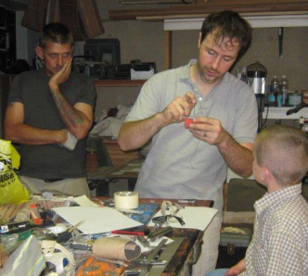
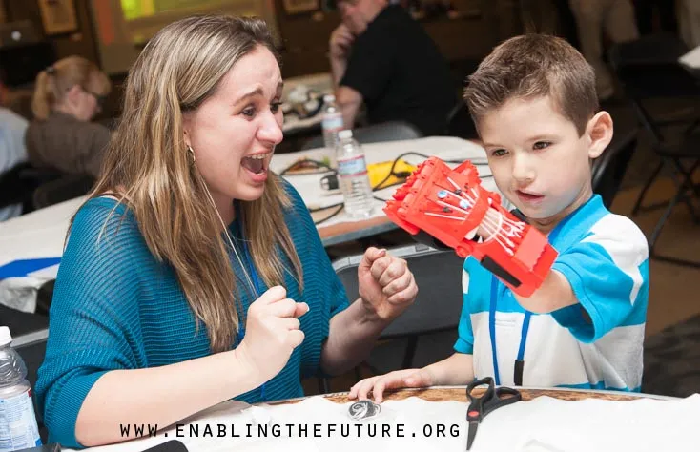
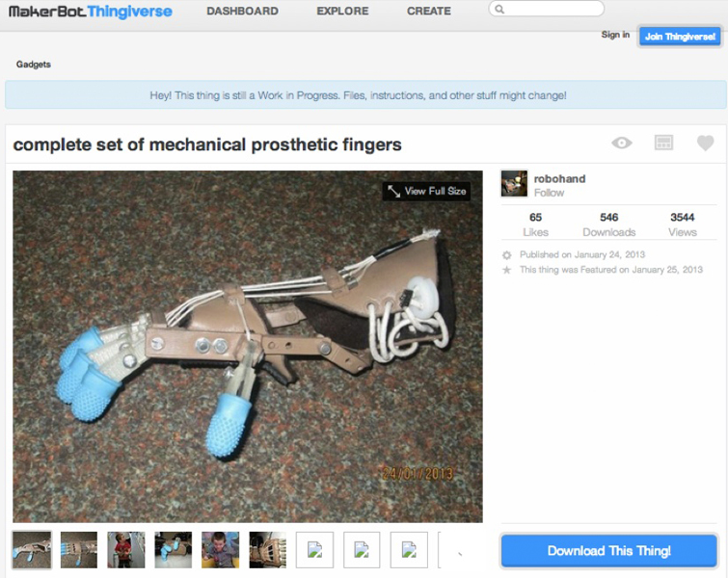
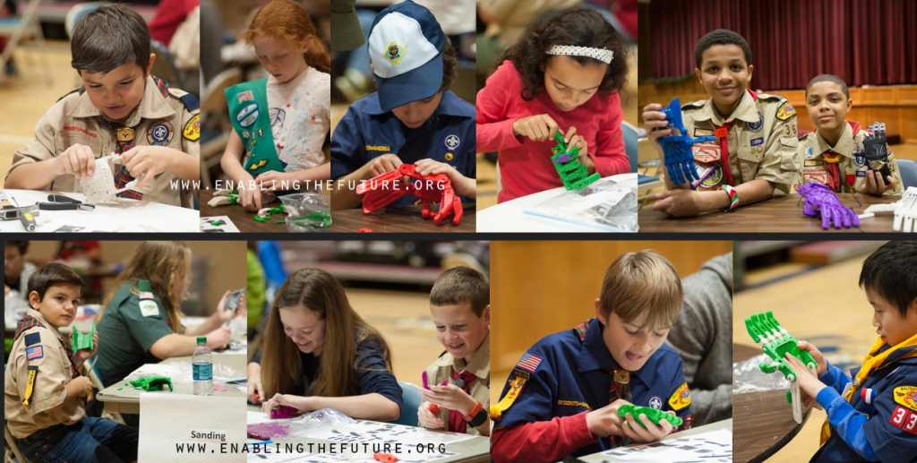
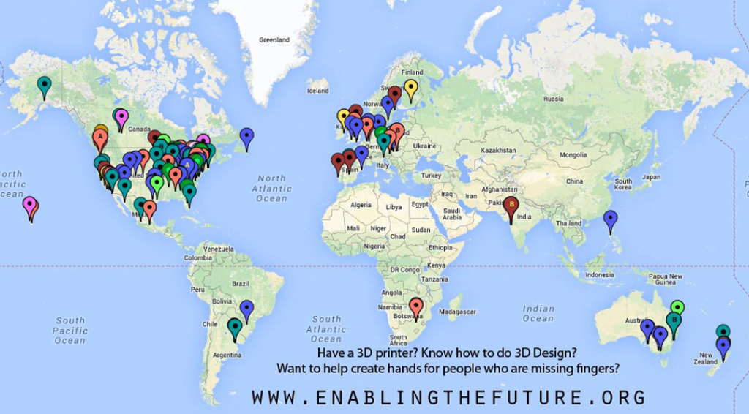
e-NABLE Timeline
First
Helping Hand
e-NABLE Community is Born
Rapid Global Growth
Chapters Around the World
A Global Network of Hope
2011
2013
2014-15
2016+
Today
First prototype designed by Ivan Owen and Richard Van As
Designs released open-source; e-NABLE community founded
Explosive growth, schools and libraries join in
Emergence of chapters globally, custom designs created for unique cases
Strong global presence, innovative designs, cross-continental collaborations
Notes:
e-NABLE Timeline
2011: First prototype designed by Ivan Owen and Richard Van As - Ivan Owen (Seattle, USA) and Richard Van As (South Africa) collaborate remotely to create the first 3D printed mechanical hand for a young boy named Liam.
2013: Designs released open-source; e-NABLE community founded -After releasing the design files open-source, volunteers around the world begin building devices and improving the designs.
The first informal "e-NABLE" community takes shape online.
2014–2015: Explosive growth, schools and libraries join in - Schools, libraries, and makerspaces join the movement. Hundreds of volunteers, students, and families start chapters, building devices and hosting "build-a-thons."
2016+: Emergence of chapters globally, custom designs created for unique cases - Makers develop specialized devices for unique needs — including arms, partial-hand designs, and devices for children with atypical anatomies.
Today: Strong global presence, innovative designs, cross-continental collaborations - Over 100,000 volunteers, ~200 chapters, and devices delivered in more than 100 countries.
e-NABLE continues to innovate, collaborate, and transform lives — all powered by open-source sharing and compassion.

Slide 5
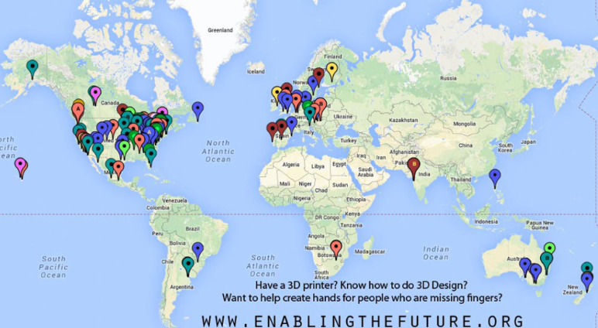
What is an e-NABLE Chapter? https://enablingthefuture.org/e-nable-community-chapters/
A local volunteer group operating under e-NABLE guidelines
Works with: Makerspaces; Schools; Non-profits; Community organizations
Handles local fabrication, outreach, and events

Slide 6

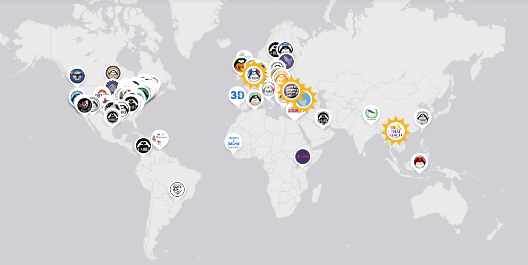
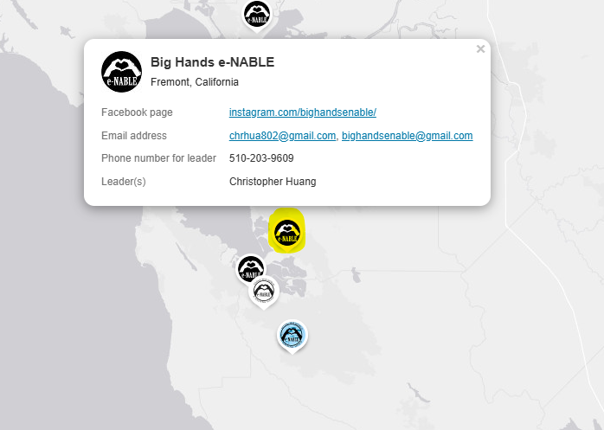
Map of Volunteers
e-NABLE by the Numbers
Over 100,000 volunteers globally
200 + official chapters in over 100 countries
Explore the Map
Notes:
e-NABLE Community Chapters (from Enabling the Future Website)
With the e-NABLE Community of volunteers growing rapidly in recent years, there are numerous chapters that have been formed by students, groups, libraries, schools and makerspaces, who are all participating in creating free 3D printed hands and arms for those in need. Our local chapters are critical since they work face-to-face with communities in a shared language and cultural context. This allows us to deliver individualized devices that recipients love rather than “one size fits all”.

Slide 7
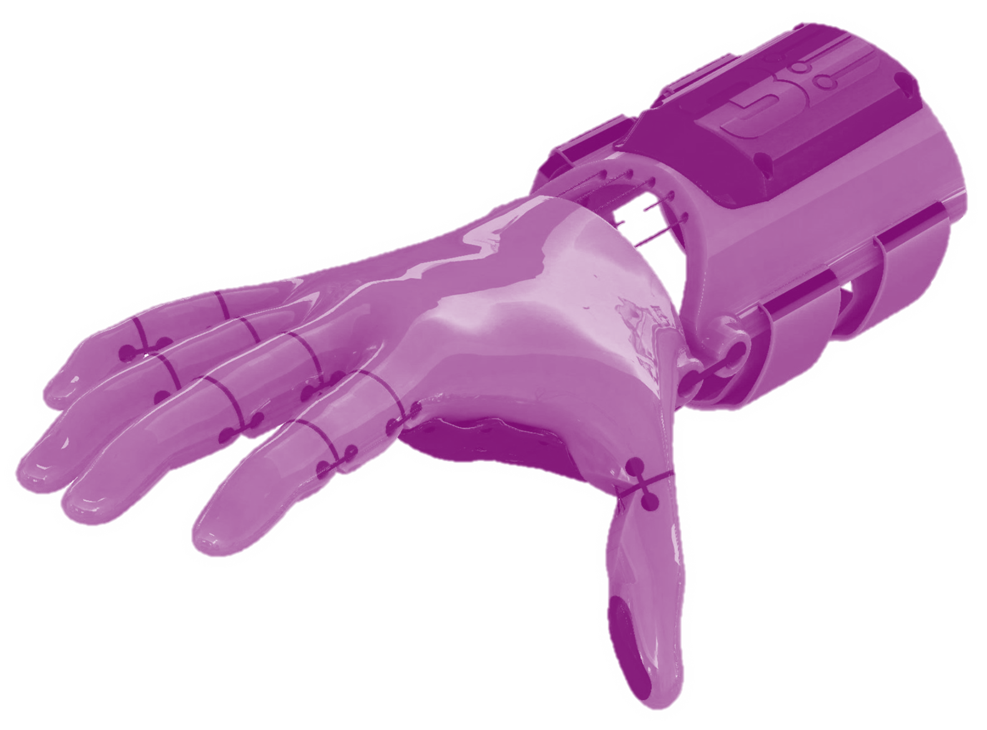
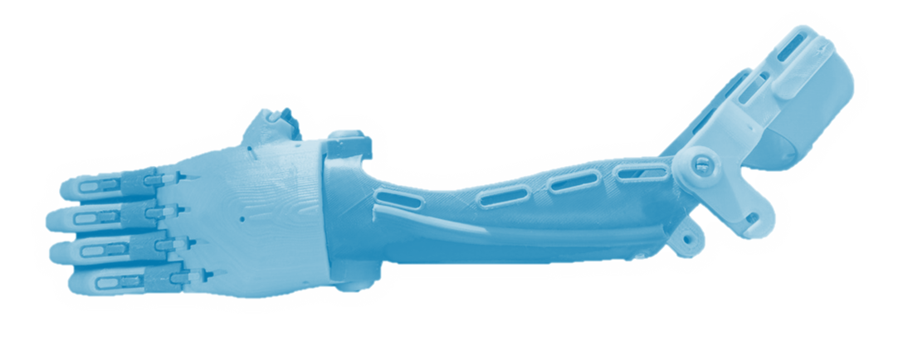
e-NABLE Devices
Which Design?
Wrist-Powered Devices
Elbow-Powered Devices
Wrist-Powered Devices
Elbow-Powered Devices

Slide 8
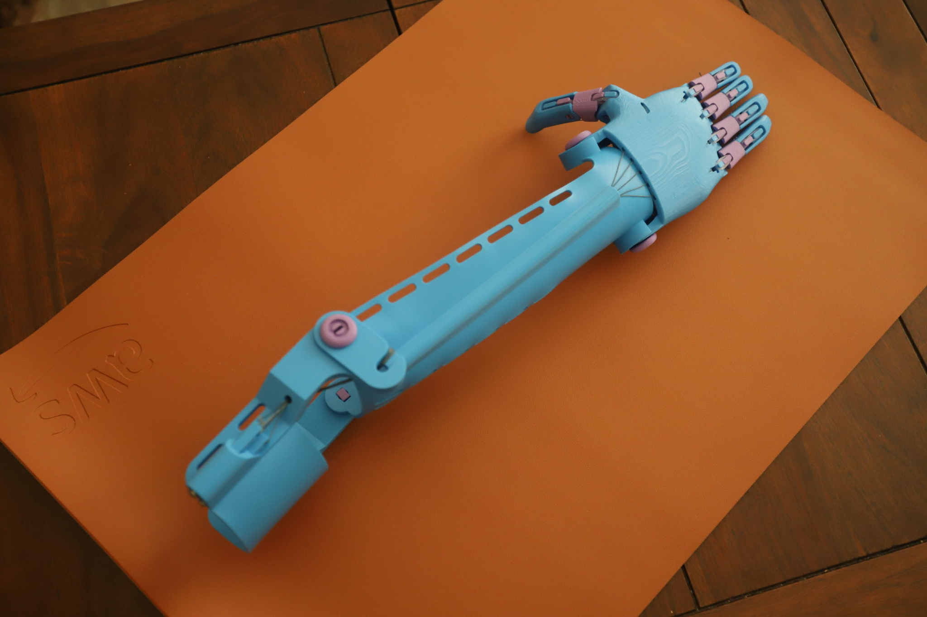
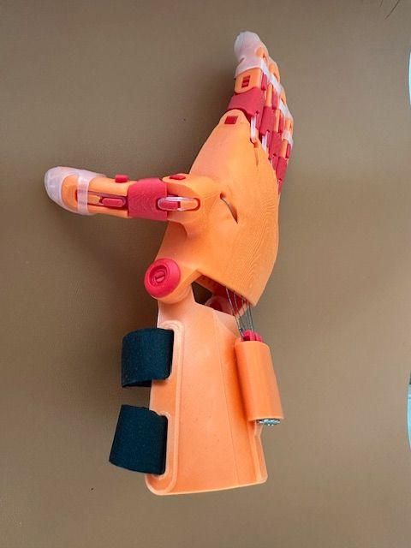
Big Hands e-NABLE Fremont (Our Chapter)
Location: Fremont / Bay Area
Target audience:
Children and adults with upper-limb differences (local and global)
Local schools & youth volunteers
Focus on:
Education
Service
Engineering-for-good

Slide 9
Volunteer Roles
3 existing groups:
Technical
Finance
Social Media (Instagram & Gmail)
Future:
Outreach
Logistics

Slide 10
Chapter Growth
Phase 1 (Launch) - Jan., 2026
Finalize e-NABLE chapter approval
Build core volunteer team
Coordinate with Sparkhub leadership
Phase 2 (Outreach) - Feb., 2026
Contact:
  Schools
  Hospitals & clinics
  Therapists
Spread awareness via:
  Events
  Workshops
  Social media (Instagram page ready)

Slide 11

Phase 3 (Real Cases) - present
Identify real e-NABLE recipients
Approach local recipients
Collaborate with UEC group (United e-NABLE Coalition) to make devices with their guidance for recipients in Uganda
Perform:
  Measurements
  Device selection
  Custom fitting
Deliver devices & collect feedback

Slide 12
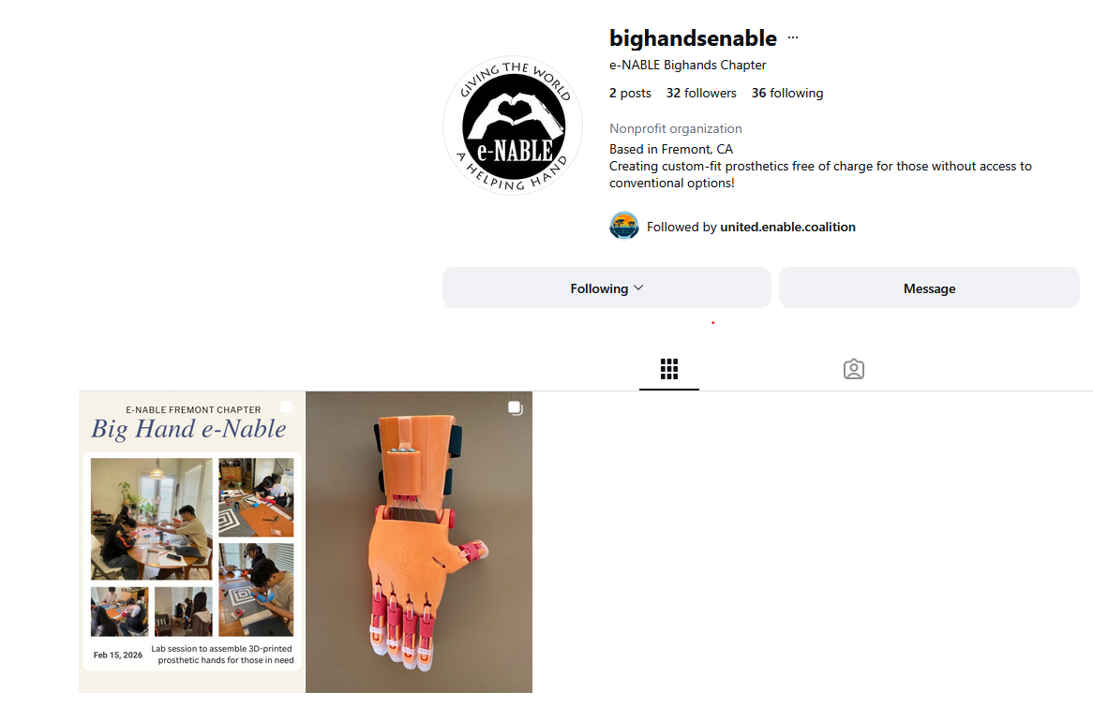
Instagram:

Slide 13
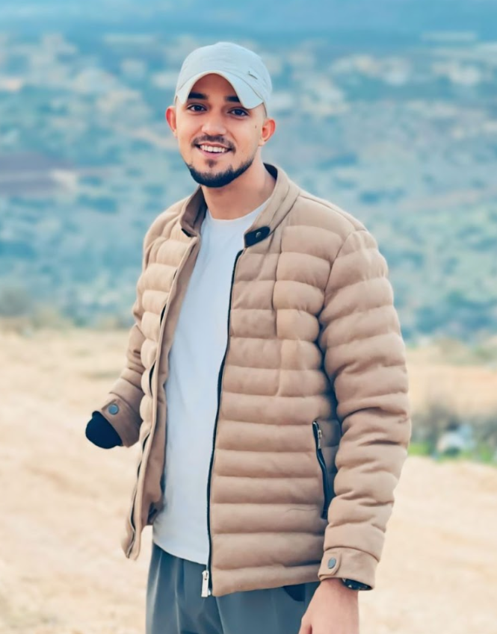
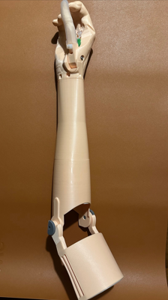
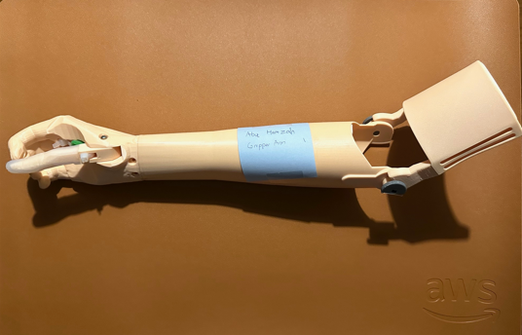
Real Case (West Bank):

Slide 14
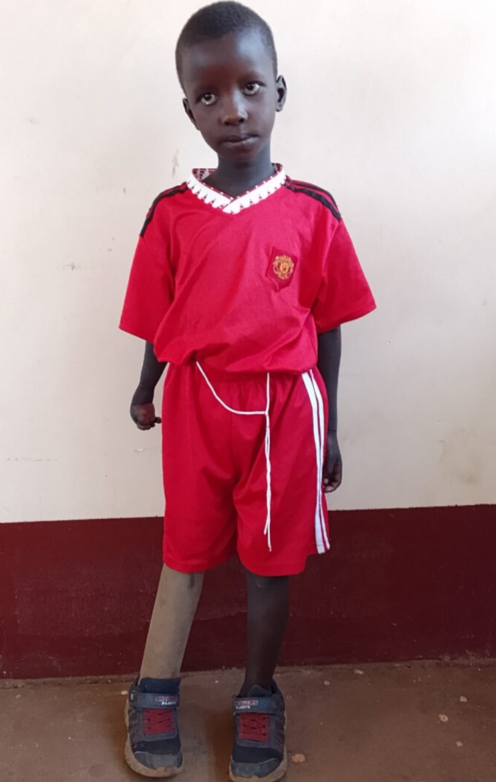
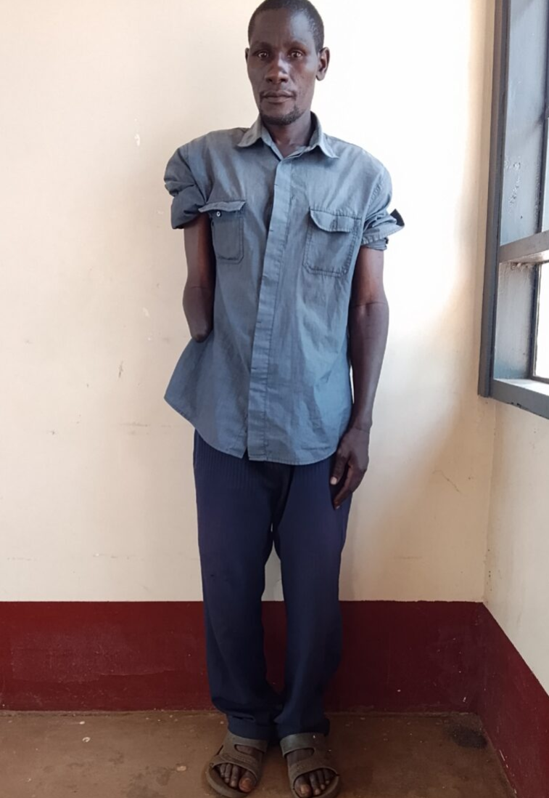
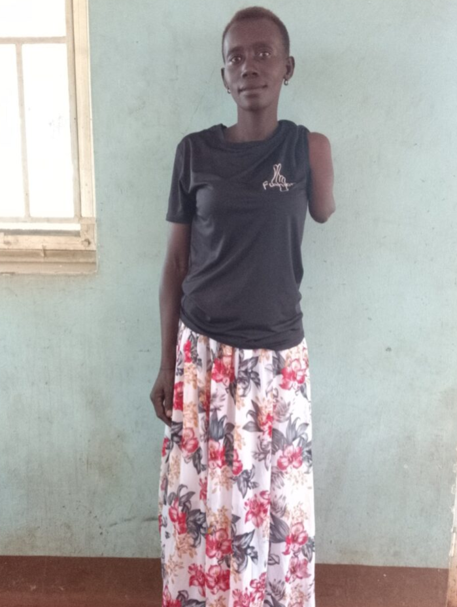
Real Cases (Uganda):

Slide 15
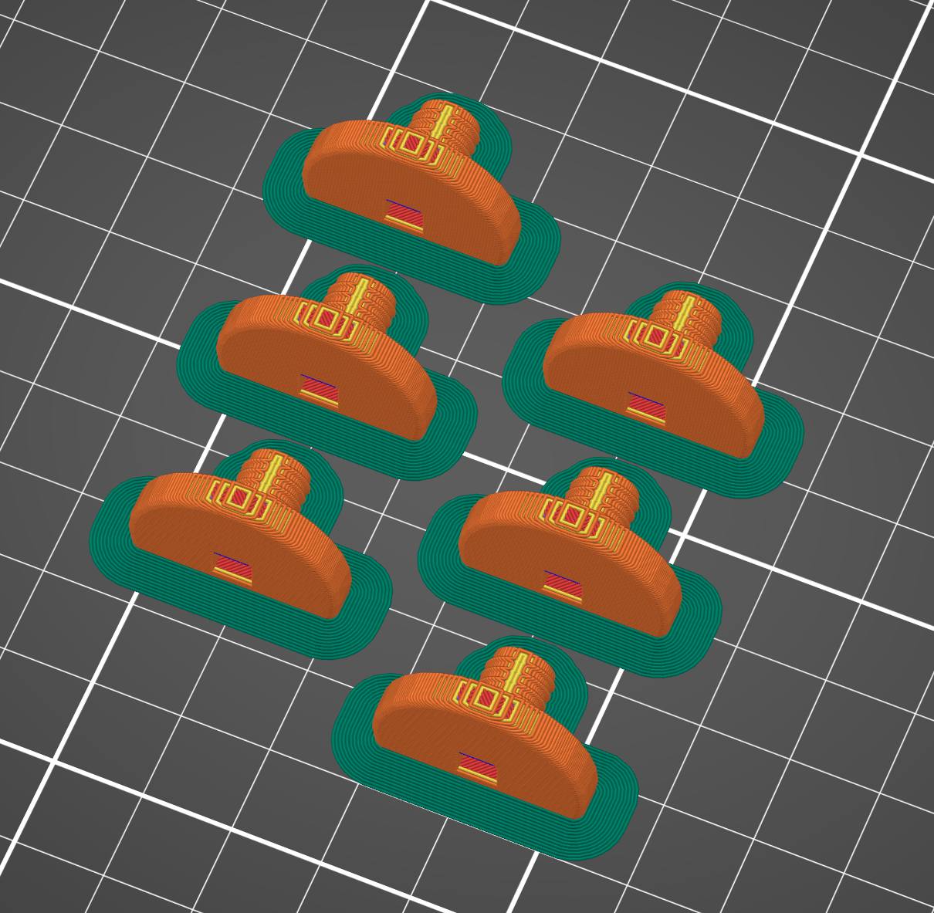
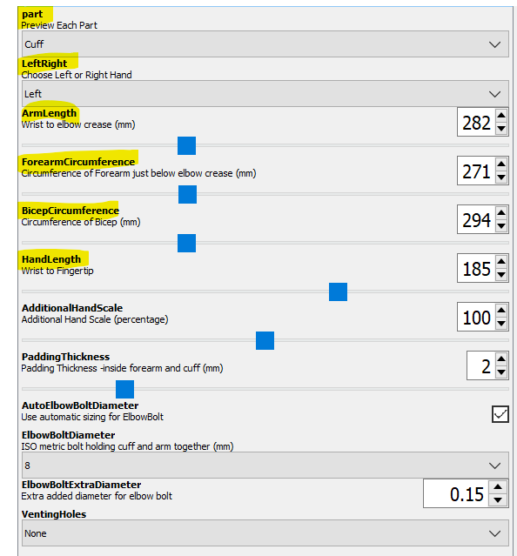
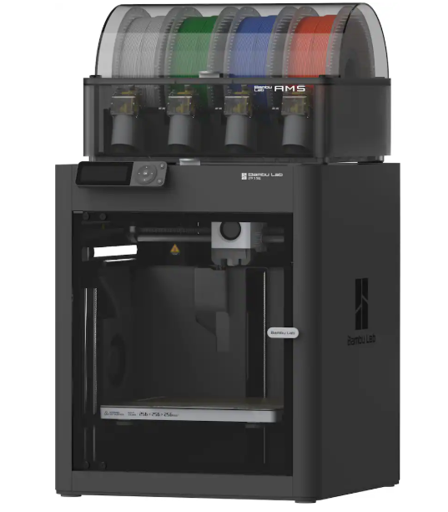
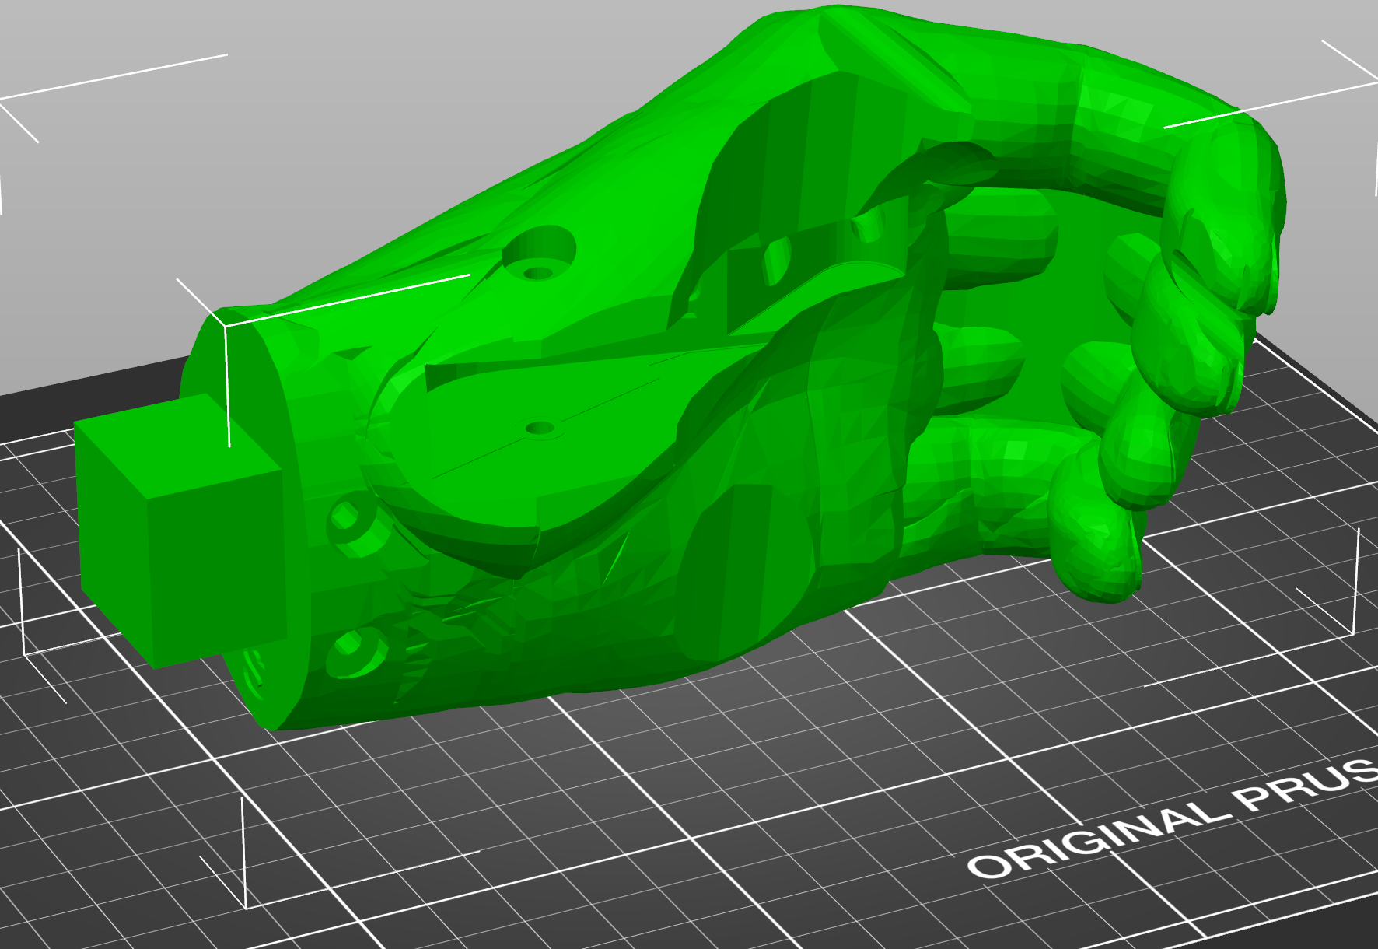
3D Printing Technologies:

Slide 16
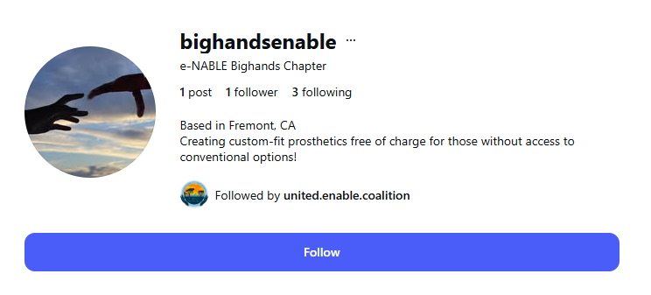
Contact Information
Christopher Huang
Founder – Big Hands e-NABLE Fremont
Personal Email: chrhua802@gmail.com
Chapter Email: bighandsenable@gmail.com
Cell: 510-203-9609
Personal Instagram: wiseeees
Chapter Instagram: @BigHandsEnable

Slide 17
The End
Thank you!

Slide 18
To‑Do List (1/31/2026)
Technical Team (Christopher)
Send a follow‑up email to the Uganda E‑NABLE Coalition (regarding potential recipients).
Contact the NorCal E‑NABLE chapter (to inquire about potential recipients).
Determine and recommend a suitable 3D printer for the Sparkhub Organization, including a price quote.
Create a tutorial on how to become an E‑NABLE volunteer (with links), how to print and assemble a Phoenix V3 hand, and how to earn E‑NABLE badges. (Optional but helpful)
Follow up on the chapter request and confirm when we will be added to the E‑NABLE volunteer map.
Media Team (Claire & Irene)
Maintain the Instagram and Gmail accounts (provide logins and verify access at the next group meeting).
Design a logo for Big Hands e‑NABLE Fremont. (Optional but good to have)
Review other chapters on the E‑NABLE volunteer map and propose best practices we can adopt.
Finance Team (Audrey)
Raise initial funds to purchase a 3D printer and filaments.
Plan fundraising activities.
Contact local organizations and community groups—such as MSJ Rotary, FUSD schools & libraries, Nextdoor, hackathons, etc.—to promote our chapter.

Slide 19
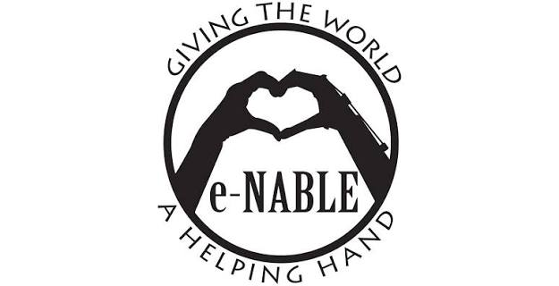

E-nable (big organization)
E-nable Bighands
chapter (us)
Other e-nable chapters
E-nable nextgen chapter
E-nable NorCal chapter

Slide 20
What we’ve done since 1/30/26
- Made 7 cases
- established partnership w/ WAF in uganda
- had another team (e-nable bighands nextgen

Slide 21
- nextgen does practice cases
- we take the actual cases
before
proposal
- nextgen can take a majority of the actual cases (they have enough training and people now)
- we take a FEW actual cases
- lock tf in on research, dev, outreach

Slide 22
1. Design
2. Validation
3. Share designs

