Slide 1
3D Kinetic Energy Harvesting Shoe Sole
2025 FUSD and MSJ Rotary 3D Printing Maker Faire

Slide 2
3D Kinetic Energy
2025 FUSD and MSJ Rotary 3D Printing Maker Faire

Slide 3
Harvesting Shoe Sole

Slide 4


Christopher Huang
Irvington High School
10th Grade
Kevin Xia
Irvington High School 10th Grade
Team Member
Pic

Slide 5

Link:
QR Code:
Instructables.com
https://www.instructables.com/Piezoelectric-Shoe-Soles/

Slide 6
Problem Statement
• Our planet faces an energy crisis due to climate change and pollution.
• Traditional energy sources contribute to greenhouse gases and are unsustainable.
• Kinetic energy from human movement is wasted every day.
• Sedentary lifestyles contribute to health problems like obesity and heart disease.

Slide 7
Mission
• Integrates piezoelectric sensors into 3D-printed shoe soles to harvest energy.
• Converts mechanical energy from walking into electrical energy.
• Energy can be stored in batteries or capacitors to power devices like fitness trackers and smartphones.
• Encourages sustainable energy generation and reduces reliance on fossil fuels.

Slide 8
Vision
• Create a sustainable and healthy future through kinetic energy harvesting.
• Develop energy-harvesting shoes as commercially viable products.
• Imagine cities powered by kinetic energy from walking citizens.
• Integrate a smart tracking system for real-time energy monitoring and motivation.
• Combine energy sustainability with personal fitness for global impact.

Slide 9

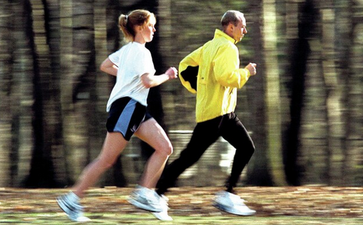

Rotary Values
Protecting Environment
Promoting
Lifestyles
Supporting Education
Reduces reliance on fossil fuels
Promotes healthier lifestyles by motivating people to walk and exercise more and generate energy.
Provides an excellent tool for teaching renewable energy and sustainability.
Converts wasted kinetic energy into usable electricity
Encourages greener living and raises awareness of personal energy consumption.

Slide 10
Project Summary
Our project focuses on developing sustainable kinetic energy harvesting shoes by integrating piezoelectric sensors with 3D technology.
Our project utilizes a 3D-printed shoe sole to house the electrical components.
The piezoelectric sensors generate power when people walk or run.
The generated power can be stored in an embedded battery to charge wearable devices and cell phones.
NinjaFlex 3D Printer Filament (85A) housing ensures comfort and durability.

Slide 11
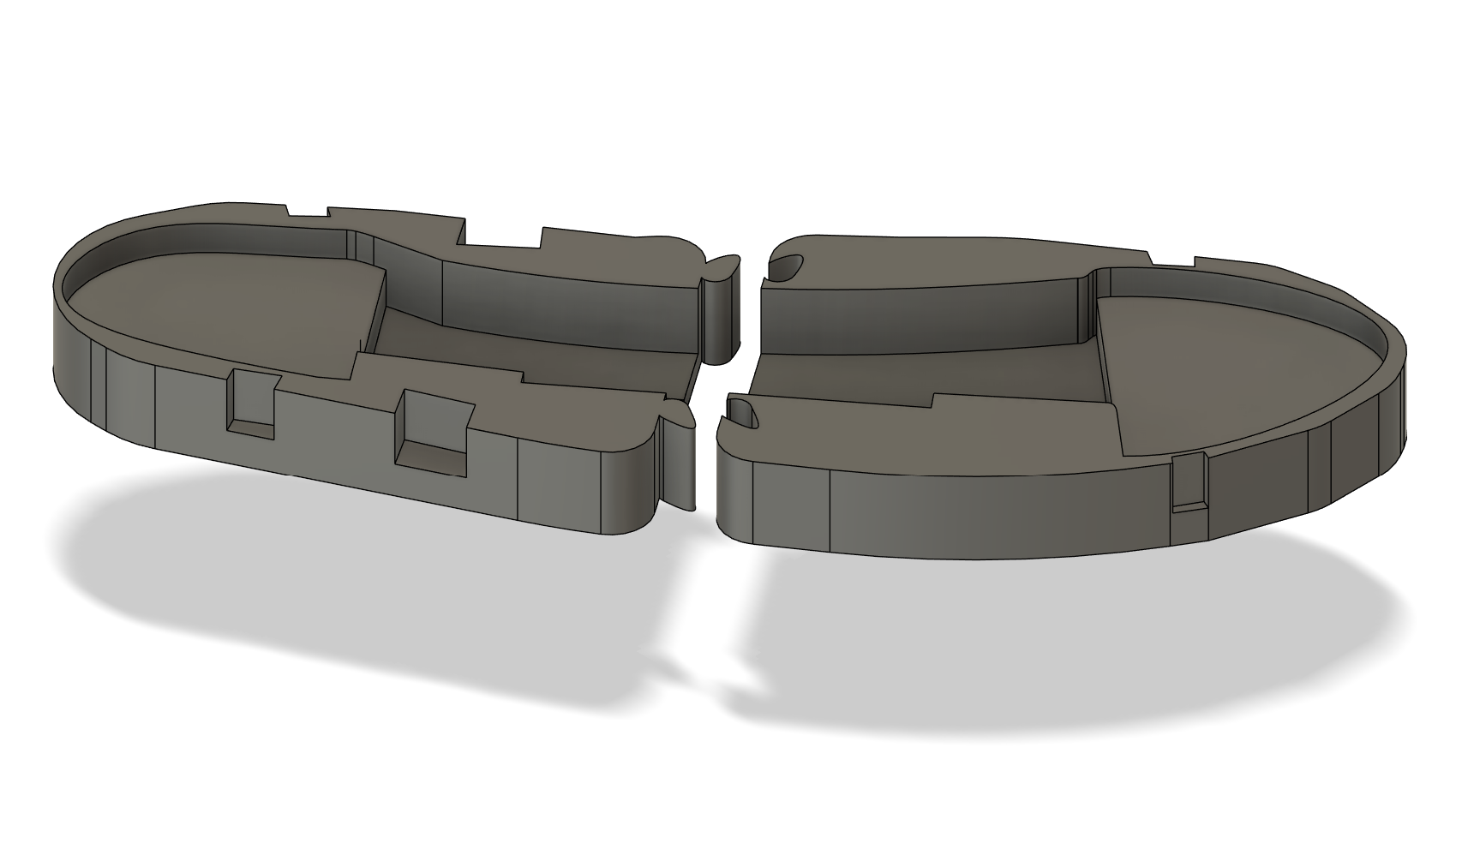
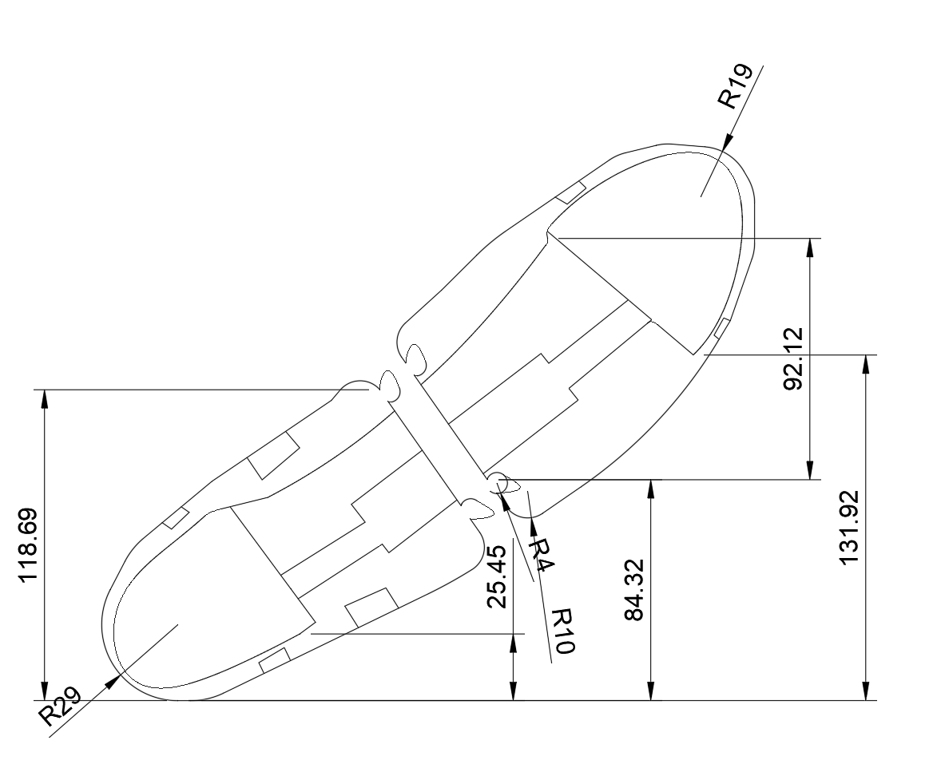
Shoe Sole
3D Design:

Slide 12
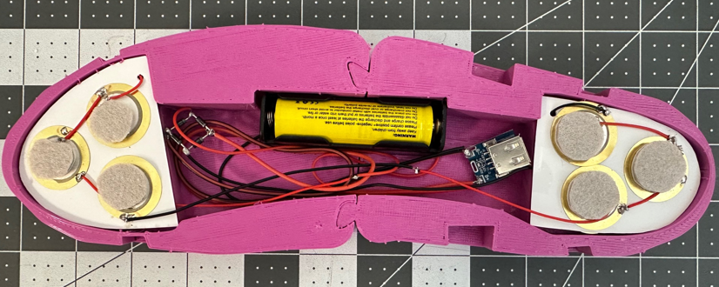
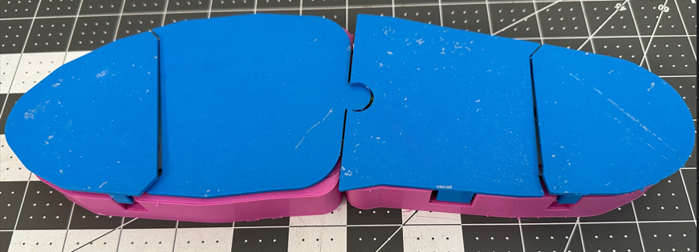
Power from Piezoelectric Discs
Energy Storage
(Battery)
Charging Module
(USB Output)
Diode Rectifier

Slide 13
Electrical Component Connections
Electrical Components
Connect Piezo Discs in Series:
Take Piezo Disc #1 and connect its negative (-) lead to the positive (+) lead of Piezo Disc #2.
Repeat the wiring pattern on the rest Piezo Discs.
The remaining positive lead of Piezo Disc #1 and the negative lead of Piezo Disc #12 will be the final output.
Connect to a Bridge Rectifier:
Final Positive Lead (Piezo #1) → Connect to AC1 input of the bridge rectifier.
Final Negative Lead (Piezo #12) → Connect to AC2 input of the bridge rectifier.
Rectify AC to DC Using Schottky Diode Bridge:
Bridge Rectifier DC Output (+) → Connect to Boost Converter IN+.
Bridge Rectifier DC Output (-) → Connect to Boost Converter IN-.
Charge the Battery:
Boost Converter 5V OUT+ → Connect to Battery Charging Board IN+.
Boost Converter Ground → Connect to Battery Charging Board IN-.
Connect to 18650 Battery:
Battery Charging Board Output → Connect to Battery Holder + and -.
12 x 27mm Piezoelectric Discs
4 x Schottky Diodes (1N5819) for a Bridge Rectifier
5V Boost Converter (Power Supply Module Lithium Battery Li-ion Charging Protection Board 134N3P)
18650 Battery Storage Case/Charging Board
18650 Rechargeable Battery

Slide 14

Previous Electrical Connection Diagram
Piezo Discs
(Parallel wiring)
Full wave rectifier with schottky diodes (1N4007)
+
Battery
+
Full wave rectifier with schottky diodes (1N4007)
Charging Module
_
_

Slide 15
Improved (Current) Electrical Connection Diagram
+
Battery
+
Full wave rectifier with schottky diodes (1N5819)
+
Piezo Discs
(Series Wiring)
Charging Module (134N3P)
_
_
_

Slide 16
Improvements of the Electrical Circuit
Increased Piezoelectric Discs from 6 to 12:
  Higher Energy Output: Increased the total harvested kinetic energy, leading to improved efficiency.
Changed Wiring from Parallel to Series:
  Voltage Boost: Series configuration noticeably increases voltage output
  Efficiency Improvement: Reduces current losses, enhancing overall efficiency of energy conversion.
Replaced 1N4007 Diodes with 1N5819 Schottky Diodes:
  Reduced Voltage Drop: Lower forward voltage drop (0.3-0.4V vs. 0.7-1.0V) increases efficiency.
  Faster Switching Speeds: Allows more efficient rectification, improving energy harvesting efficiency.
Presentation Title
Slide Title

Slide 17
Replaced 1N4007 Diodes with 1N5819 Schottky Diodes:
Increased Piezoelectric Discs from 6 to 12:
Higher Energy Output: Increased the total harvested kinetic energy, leading to improved efficiency.
Changed Wiring from Parallel to Series:
Voltage Boost: Series configuration noticeably increases voltage output
Efficiency Improvement: Reduces current losses, enhancing overall efficiency of energy conversion.
Presentation Title
Slide Title
Improvements of the Electrical Circuit
Reduced Voltage Drop: Lower forward voltage drop (0.3-0.4V vs. 0.7-1.0V) increases efficiency.
Faster Switching Speeds: Allows more efficient rectification, improving energy harvesting efficiency.

Slide 18
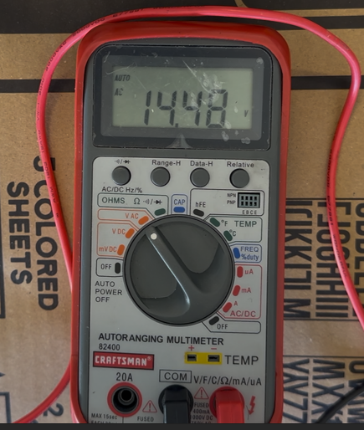
Experiment #1: Open-Circuit Voltage Measurement
Objective: Measure peak voltage generated by the piezoelectric discs.
Procedure:
  Connect the piezoelectric discs (series configuration) to the multimeter set to AC voltage mode.
  Set multimeter to AC Voltage mode.
  Apply repeated pressure or simulate footsteps at our assumed frequency (~1.5 steps/sec).
  The maximum voltage measured: 14.48V

Slide 19
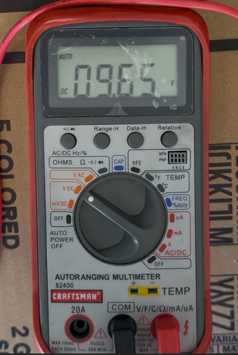
Experiment #2: Rectified DC Voltage Measurement
Objective: Measure voltage after the diode bridge rectifier.
Procedure:
  Connect the multimeter to the output of the diode bridge.
  Repeat simulated footsteps; measure and record the stabilized DC voltage.
  The maximum voltage measured: 9.65V

Slide 20
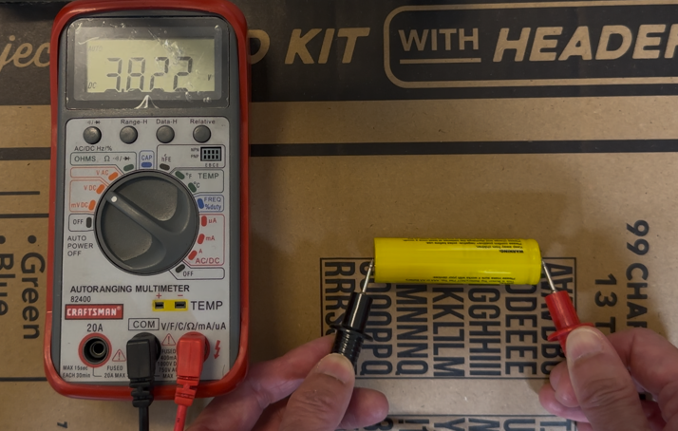
Experiment #3:
Energy Accumulation and Battery Charging Test
Objective: Determine the energy the battery stored during the 30-minute walk by taking the 3D shoe sole.
Procedure:
  Set the multimeter to DC Voltage mode.
  Measure and record battery voltage before the experiment (3.81V).
  Simulate walking for a fixed duration (e.g., 30 mins) to generate energy.
  Immediately after a 30-minute walk, take the battery out of the battery holder, measure and record battery voltage after the walk (3.823V).
  Connect a 220 Ω resistor across battery terminals to start a discharge test.
  Measure and record battery voltage every 10 minutes during discharge until reaching our original voltage (3.81V).
  Calculate the energy stored by integrating power (P = V²/R) over time (E=P×t).

Slide 21
Calculations in Experiment #3
Presentation Title
Slide Title
Joule’s Law (Power Equation):
P=V^2/R
P: Power (Watts)
V: Voltage (Volts)
R: Resistance (Ohms)
E.g., P=(3.817V)^2/220Ω=0.0662W
Energy: E= P×t = (V^2 / R) * t
E: Energy in Joules
t: Time in seconds per interval (600 sec = 10 min)
E.g., E=0.0662W×600s=39.72Joules
Energy Over Time:
Integration of power over time gives the total energy (in joules).
Note: In our 3D piezoelectric shoe sole experiment, the current output is extremely low. These tiny currents are too small to be reliably measured with standard multimeters during discharge. Therefore, we can’t directly use I=V/R (Ohm’s Law) because I (current) is not directly measurable (I: Current (Amps), V: Voltage (Volts), R: Resistance (Ohms)).

Slide 22
Battery Discharge Experiment 1
 | Time (min) | Voltage (V) | Voltage² (V²) | Power (W) | Energy per Interval (J) | Cumulative Energy (J)
Post-Walk Voltage | 0 | 3.823 | 14.615329 | 0.06643331364 | 0 | 0
 | 10 | 3.82 | 14.5924 | 0.06632909091 | 39.79745 | 39.79745
 | 20 | 3.821 | 14.600041 | 0.06636382273 | 39.81829 | 79.61574
 | 30 | 3.822 | 14.607684 | 0.06639856364 | 39.83914 | 119.45488
 | 40 | 3.822 | 14.607684 | 0.06639856364 | 39.83914 | 159.29402
 | 50 | 3.822 | 14.607684 | 0.06639856364 | 39.83914 | 199.13316
 | 60 | 3.819 | 14.584761 | 0.06629436818 | 39.77662 | 238.90978
 | 70 | 3.82 | 14.5924 | 0.06632909091 | 39.79745 | 278.70723
 | 80 | 3.819 | 14.584761 | 0.06629436818 | 39.77662 | 318.48385
 | 90 | 3.818 | 14.577124 | 0.06625965455 | 39.75579 | 358.23964
 | 100 | 3.818 | 14.577124 | 0.06625965455 | 39.75579 | 397.99543
 | 110 | 3.817 | 14.569489 | 0.06622495 | 39.73497 | 437.7304
 | 120 | 3.816 | 14.561856 | 0.06619025455 | 39.71415 | 477.44455
 | 130 | 3.815 | 14.554225 | 0.06615556818 | 39.69334 | 517.13789
 | 140 | 3.814 | 14.546596 | 0.06612089091 | 39.67253 | 556.81042
 | 150 | 3.811 | 14.523721 | 0.06601691364 | 39.61015 | 596.42057
 | 160 | 3.812 | 14.531344 | 0.06605156364 | 39.63094 | 636.05151
 | 170 | 3.811 | 14.523721 | 0.06601691364 | 39.61015 | 675.66166
Initial Battery Voltage | 180 | 3.81 | 14.5161 | 0.06598227273 | 39.58936 | 715.25102
 | voltage drop | battery energy | energy drop
 | 0.34% | 26640 | 2.68%

Slide 23
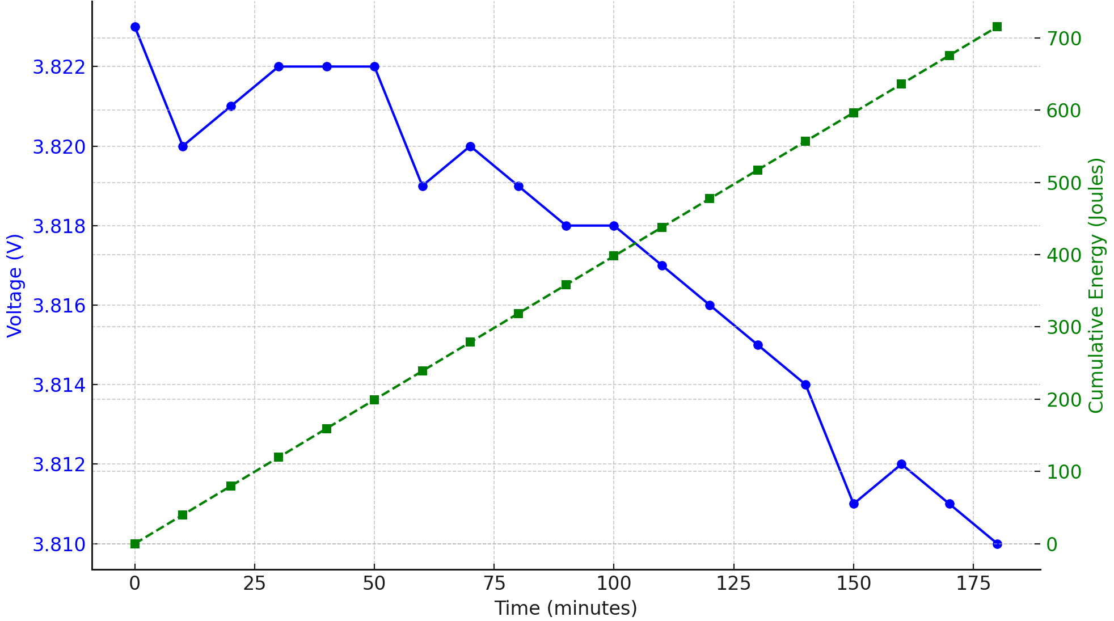
Battery Discharge Test 1: Voltage & Cumulative Energy vs. Time

Slide 24
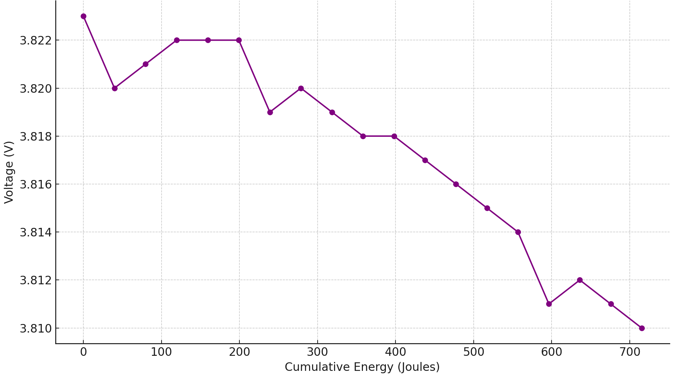
Battery Discharge Test 1: Voltage vs. Cumulative Energy

Slide 25
Battery Discharge Experiment 2
 | Time (min) | Voltage (V) | Voltage² (V²) | Power (W) | Energy per Interval (J) | Cumulative Energy (J)
Post-Walk Voltage | 0 | 3.819 | 14.584761 | 0.06629436818 | 0 | 0
 | 10 | 3.816 | 14.561856 | 0.06619025455 | 39.71415 | 39.71415
 | 20 | 3.817 | 14.569489 | 0.06622495 | 39.73497 | 79.44912
 | 30 | 3.816 | 14.561856 | 0.06619025455 | 39.71415 | 119.16327
 | 40 | 3.815 | 14.554225 | 0.06615556818 | 39.69334 | 158.85661
 | 50 | 3.816 | 14.561856 | 0.06619025455 | 39.71415 | 198.57076
 | 60 | 3.815 | 14.554225 | 0.06615556818 | 39.69334 | 238.2641
 | 70 | 3.814 | 14.546596 | 0.06612089091 | 39.67253 | 277.93663
 | 80 | 3.814 | 14.546596 | 0.06612089091 | 39.67253 | 317.60916
 | 90 | 3.814 | 14.546596 | 0.06612089091 | 39.67253 | 357.28169
 | 100 | 3.814 | 14.546596 | 0.06612089091 | 39.67253 | 396.95422
 | 110 | 3.813 | 14.538969 | 0.06608622273 | 39.65173 | 436.60595
 | 120 | 3.813 | 14.538969 | 0.06608622273 | 39.65173 | 476.25768
 | 130 | 3.812 | 14.531344 | 0.06605156364 | 39.63094 | 515.88862
 | 140 | 3.813 | 14.538969 | 0.06608622273 | 39.65173 | 555.54035
 | 150 | 3.811 | 14.523721 | 0.06601691364 | 39.61015 | 595.1505
 | 160 | 3.811 | 14.523721 | 0.06601691364 | 39.61015 | 634.76065
Initial Battery Voltage | 170 | 3.81 | 14.5161 | 0.06598227273 | 39.58936 | 674.35001
 | voltage drop | battery energy | energy drop
 | 0.24% | 26640 | 2.53%

Slide 26
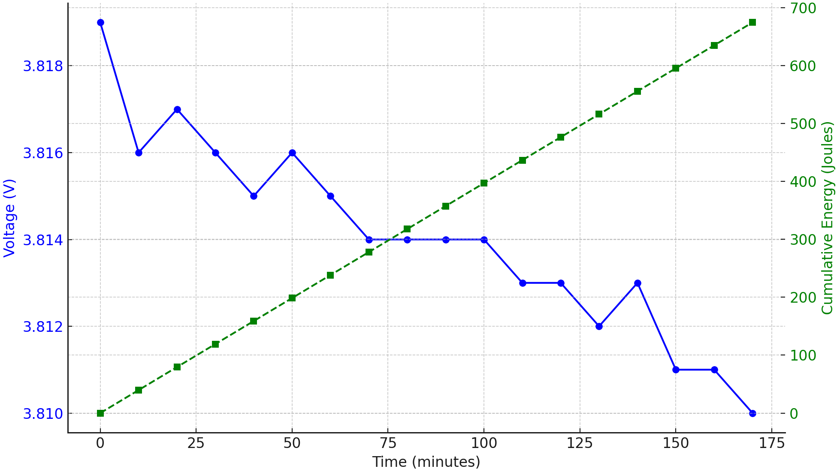
Battery Discharge Test 2: Voltage & Cumulative Energy vs. Time

Slide 27
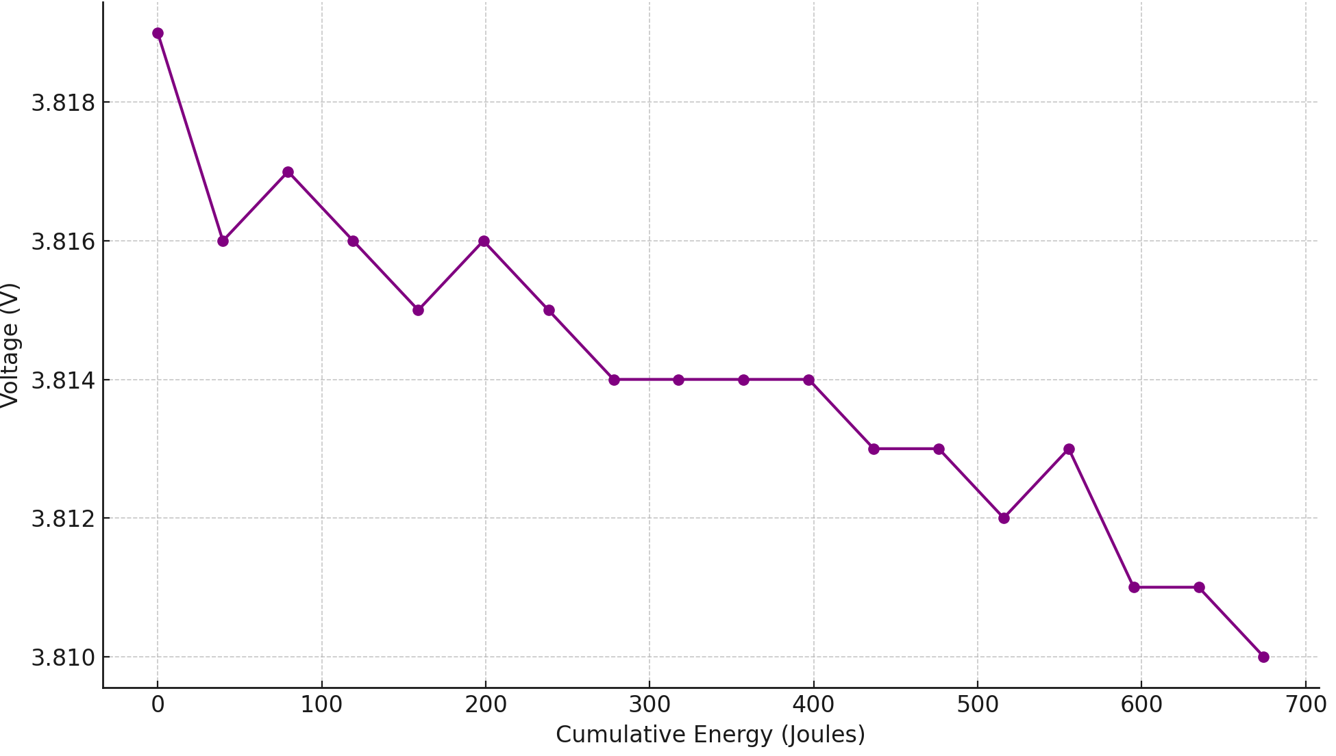
Battery Discharge Test 2: Voltage vs. Cumulative Energy

Slide 28
Experimental Conclusion
Experiment #1: Open-Circuit Voltage Measurement
Max Voltage Output (AC, no load): 14.48 V
Confirms that the piezoelectric discs can generate high instantaneous voltage under footstep simulation
Experiment #2: Rectified DC Voltage Measurement
Max Voltage After Bridge Rectifier: 9.65 V
Voltage drop observed due to diode losses (Schottky diode bridge)
Confirms AC-to-DC conversion works, with expected diode voltage drop (~4.8V total)
Experiment #3: Battery Charging & Energy Accumulation
Battery Voltage Increased: from 3.810 V to 3.823 V after 30-minute walk
Conducted controlled discharge test using 220 Ω resistor
Integrated energy calculated using:P = V² / R; E = P × t
Total Energy Measured: ~700 Joules

Slide 29
Conclusion
Our 3D shoe sole prototype successfully capture mechanical energy from walking.
A small voltage increase of about 0.009 V ~ 0.013 V (9 mV ~ 13 mV) indicates our piezoelectric system did indeed harvest and store a measurable amount of energy, albeit very small. The energy generated within 30 minutes of walking is enough to light a standard LED (3V, 20mA) for about 3 hours.
Brightness Level Voltage Current Power
Standard LED 3V 20 mA 0.06 W (60 mW)
Time = 700J​/0.06W = 11666.67seconds ≈ 194.4minutes ≈ 3.24hours
Harvested energy is small but can meaningfully power low-energy wearables, IoT sensors, or emergent lights in low-power applications.
To power high-energy devices (like a smartphone which requires on average two watts of energy), longer activity time or parallel harvesting mechanisms are required.
Future improvements of the 3D prototype can be done through: 1) Advanced piezo materials; 2) Optimized energy harvesting circuits.

Slide 30
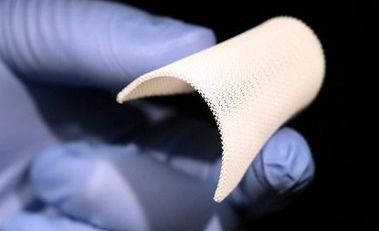
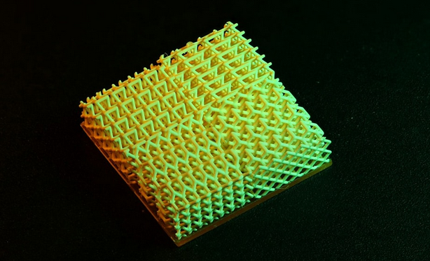
Trend In Real World
Pioneering Research:
Dr. Rayne Zheng's research team at UC Berkeley is at the forefront of developing advanced 3D-printed piezoelectric materials. https://www.raynexzheng.com/; https://www.youtube.com/watch?v=HwpPpnEb4Ok
Potential Collaboration:
  Our project team is actively reaching out to Dr. Zheng’s team for collaboration.
  We aim to gain expert insights, support, and potentially integrate cutting-edge methods from their groundbreaking research.

Slide 31
Major References
https://www.youtube.com/watch?v=PNjc9tUs96Y
https://www.youtube.com/watch?v=FXyyuW4YoVU
https://www.youtube.com/watch?v=zA0CCOYpnj4
https://www.youtube.com/watch?v=p-yxiSrDiqQ
https://www.youtube.com/watch?v=VcdIR3cuc0U
https://www.youtube.com/watch?v=jYLG9XTBL94
https://www.youtube.com/watch?v=svK6Gv7oM6U

