Slide 1


Signaling and reputation in repeated games I &Ⅱ:
Finite games & Stackelberg limit properties
韩大峰

Slide 2
abstract
In a repeated interaction, if the actions of an agent signal a private characteristic, or type, they will influence how he is expected to act in future, giving reputational incentives. If the signaler’s type can change over time, these incentives can persist.
A general model of repeated signaling is presented. The type space is finite or a continuum, and players have arbitrary supermodular payoffs. There is a unique equilibrium with continual (minimal) separation of types. It is selected by a recursive version of the equilibrium refinement D1. The equilibrium is calculable, showing a quantitative dependence of reputation on patience, the length of the game, and the random process on types.
In settings of repeated interaction, the question of reputation is often fundamental : how an agent’s current actions affect what he is expected to do in future. For example , the quality of a firm’s current products influences consumers’ expectations about the quality of future products.

Slide 3
System model
Three ways in repeated signaling model:
Players interact an arbitrary finite number of times
A wide range of payoff functions are allowed, making the model applicable across a range of settings. A supermodularity assumption is used instead of specific functional forms. This allows for a number of distinct strategic connections between players’ actions and the signaler’s type.
The type space is allowed to be any ordered finite or continuum of types. The simplification of a two type model, which distorts the quantitative and qualitative results, is not used.
In the repeated signaling game, there exists a continually separating equilibrium, in which the signaler’s current type is revealed at each stage. Reputational signaling occurs because types are correleated over time. This equilibrium is the unique such equilibrium and is selected by an iterated version of the D1 refinement. The equilibrium is easily calculable and has a clean recursive structure

Slide 4
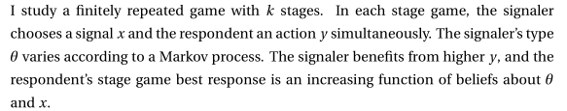
System model
Types
The model here allows for a continuum or arbitrary finite number of types. Any monotonic Markov process on types is allowed.
Stage game
Payoff
equilibrium
An equilibrium is found in which the signaler plays a separating equilibrium at every stage and the current strategy is taken to be the dominant separating equilibrium of this game

Slide 5
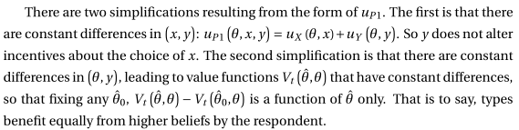

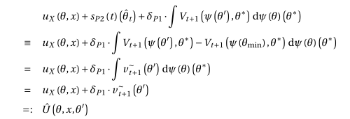
System model
Solving the repeated signaling game: value function iteration

Slide 6
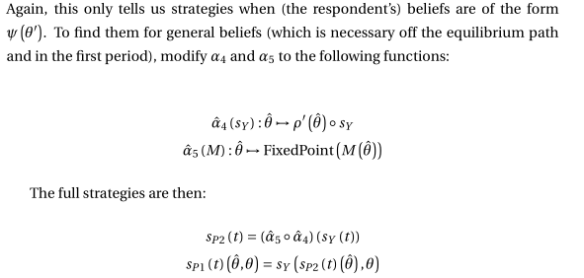
strategies
Complete strategies
Computed example: Cournot competition(古诺双寡头模型) & Equilibrium Refinement

Slide 7
abstract
Repeated signaling games are natural way to model reputation: past actions influence future expectations of actions via beliefs about an agent’s type. This paper studies continually separating equilibria of infinite horizon repeated signaling games
With a continuum of persistent types, if the signaler is patient he gains Stackelberg leadership, subject to separating from the lowest type. This remains true if the respondent cares directly about the signaler’s type in addition to his actions. If the signaler has additively separable utility and is impatient, his actions maximize a discounted form of Stackelberg payoffs. In contrast to the usual theoretical approach to reputation there is no reliance on behavioral types.
This paper shows that the signaling approach to reputation does in fact generate commitment properties, under appropriate limits. The model combines the advantages of a tractability, with rational types and a directional and calculable structure, with the strong commitment results characteristic of the behavioral type approach.

Slide 8
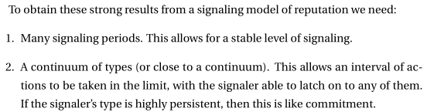

System model
reputation
directional and exact approaches
Taking a higher action generates higher beliefs about P1’s type, which results in higher expectations about what he will do in the future.
why previous reputational signaling models have not found these results.

Slide 9
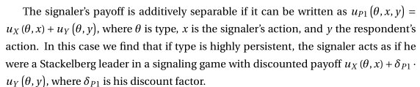
System model
impatience
In practice agents are not patient, and in a model with discounting we gain from understanding what happens with discount factors significantly different from 1.
The repeated signaling model is solvable under arbitrary discount factors of both players. Stackelberg results extend to the case when the signaler’s discount factor is less than 1

Slide 10
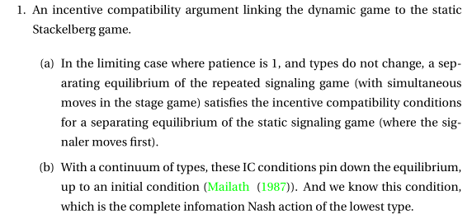
System model
Argument and results
This paper studies infinitely repeated signaling games and their limit properties. There are simultaneous moves in the stage game, and the value of signaling comes from the effect on future stages.
Notes:
考核要素结构化 面试试题结构化 评分标准结构化 什么是胜任素质模型 描述某个岗位人所应具备各种素质的是

Slide 11
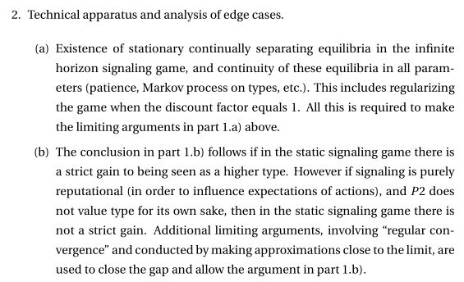
System model
Argument and results
Notes:
考核要素结构化 面试试题结构化 评分标准结构化 什么是胜任素质模型 描述某个岗位人所应具备各种素质的是

Slide 12
Thanks!

