Slide 1
Wikipedia,
Dead Authors,
Naive Bayes
& Python
Abhaya Agarwal

Slide 2
Outline
Dead Authors : The Problem
Wikipedia : The Resource
Naive Bayes : The Solution
Python : The Medium
  NLTK
  Scikits.learn

Slide 3
Authors, Books & Copyrights
Authors write books.
Books are published.
Authors earn royalty.
Authors hold copyright of their works which prevents unauthorized use.

Slide 4

As time goes by..
Then one day authors die...
Image from: http://www.flickr.com/photos/adamcrowe/4071096483/

Slide 5

The copyright clock
Once they die, a clock starts ticking!
Image from: http://www.flickr.com/photos/31332713@N04/3086719615/

Slide 6
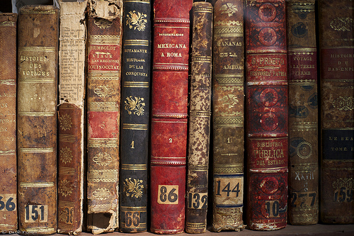
After 60 years..
60 years after the death of an author, his works enter the public domain.
Image from: http://www.flickr.com/photos/magdav/5399905776/

Slide 7

What does that mean?
Image from: http://www.flickr.com/photos/-bast-/349497988/

Slide 8
Public Domain works
This means that anyone is free to
Translate them
Digitize them
Record Audio books
Create derivative works
Publish cheaper editions
Anything else you can think of!

Slide 9
Project Gutenberg
Project Gutenberg (PG) is a big repository of digitized out of copyright books.
(http://www.gutenberg.org/)

Slide 10
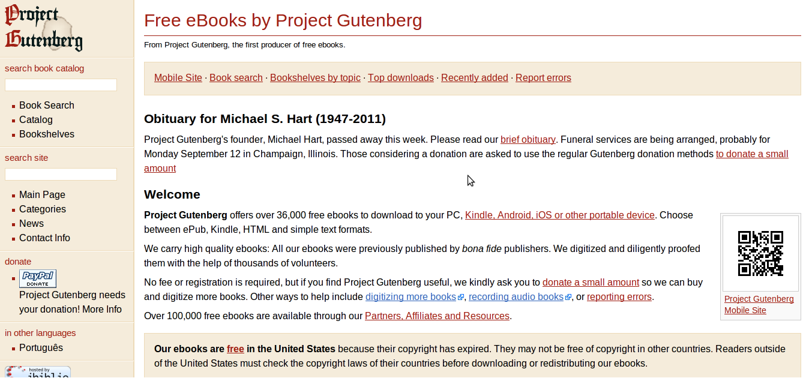
Project Gutenberg

Slide 11
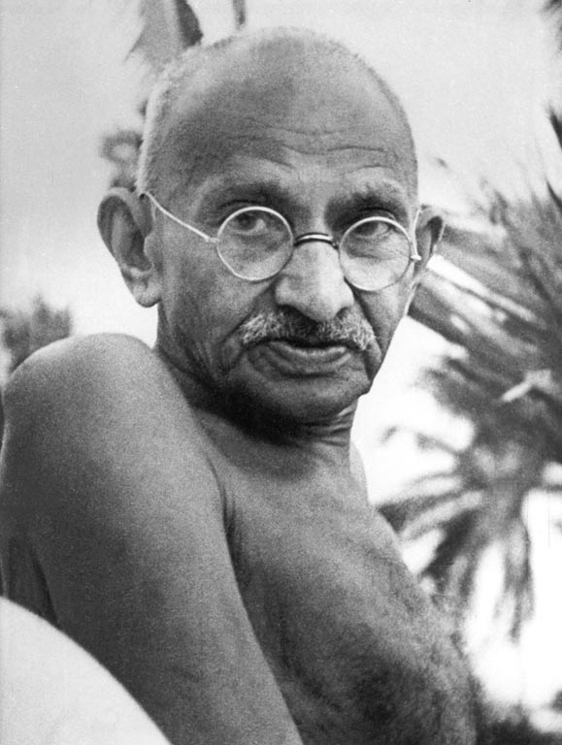
Closer Home: Mahatma Gandhi
My Experiments with Truths (Gujarati version)
Hind Swaraj

Slide 12
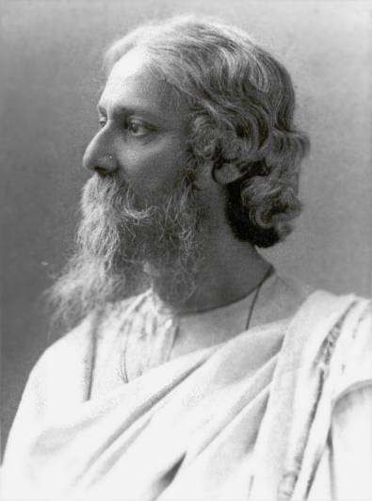
Closer Home: Rabindranath Tagore
Geetanjali
Autobiography ( My Reminiscences)
Gora

Slide 13
Public Domain in India
No such resource exists for India.
PG follows US copyright policy => only books published before 1923 can be added.
In India, if the author died before 1950, his works are in public domain.

Slide 14
Why?
But why should we,
as hackers and geeks,
care?

Slide 15
Reasons
Hackers like to fix things that are broken!

Slide 16
Reasons
OCR
Large datasets are the necessary ingredients for building Machine Learning based NLP tools
Transliteration
Machine
Translation
Spell
Checkers
Information
Retrieval

Slide 17
Reasons
Hackers love free things!

Slide 18
Identifying Public Domain
First step is to identify the Indian authors who are out of copyright.
But how do we find out when did an author die?
There are websites that maintain author lists by year of death but coverage of Indian authors is low
(http://www.authorandbookinfo.com/)
So where can we get this information from?

Slide 19
Wikipedia!

Slide 20
Wikipedia Solution
WP has a category for Indian Writers!
WP has categories by the death years!
Voila! we can just look at pages belonging to both the categories!

Slide 21
But..
WP categories are not comprehensive. Many author pages are not tagged.
Also, we are looking for everyone who wrote a book. Even if he may not be a full time writer.
So gleaning all the yearwise death categories is required.

Slide 22
Wikipedia Solution cont
Some stats for death year categories
  Typically 1800-2000 entries for each year
  Around 25-30 Indians
  Around 10-12 Indian authors (~0.5%)
Very few records of interest!
This is a time consuming, tedious and hence an error prone task for humans.

Slide 23
In search of a better solution
Also WP is a work in progress. Information is continually updated.
So we may want to look again every few months
Can we train a machine to do this for us?

Slide 24
Being Naive!

Slide 25
Aren't we Naive?
This is a classic document classification problem.
Given all the pages listed in <year>_deaths category, classify them as Indian authors or not.
Use the articles in 'Indian writers' category as positive examples (~3600 articles)
Use articles in 1950-1955 death years categories as negative examples.

Slide 26
Aside: Document Classification
Document classification is a well studied problem.
Two dominant approaches:
  Supervised: classification using NB, SVM
  Unsupervised: Topic Modelling using LDA
Naive Bayes (NB) is a simple supervised Machine Learning Model that is known to perform nicely on this problem.

Slide 27
Naive Bayes : An Intro
NB is a generative classifier
Two components
  Prior probabilities
  Feature probabilities
Let's build a classifier for identifying if a person in the room came from Bangalore
  Prior
  Features – wearing a green tee, used a taxi to come here

Slide 28
NB: Continued
The ”Naive” in NB refers to the assumption that all the features being used are independent
In real life datasets, not easy to find completely independent features
  Words in a document are not independent of each other!
NB works well even when the features are not independent.

Slide 29
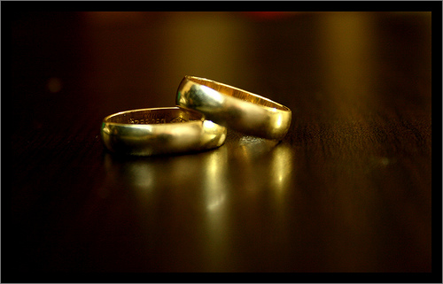
Python
One ring to bind them all
Image from: http://www.flickr.com/photos/thecaucas/2232897539/

Slide 30
Overview of supervised learning
Labeled Data
Pre-processing
Feature
Extraction
Feature
Selection
Unlabeled Data
Features
Training
Model
Yes
Classification
No

Slide 31
Collecting data from WP
WP data is available is various ways:
  Crawl the HTML pages
  Use WP API to get wikitext
  Download the entire WP dump
Wikitools (http://code.google.com/p/python-wikitools/) is a Python client for MediaWiki API.
Exposes a simple API and is robust to delays and errors. Backs off properly.

Slide 32
Wikitools Example
from wikitools import wiki, category
site = wiki.Wiki('http://en.wikipedia.org/w/api.php')
cat = category.Category(site, 'Category:1949_deaths')
for p in cat.getAllMembers(namespaces=[0]):
print p.title
print p.getWikiText()
Only fetches common pages Ignoring talk pages, subcategories etc

Slide 33
Wikitools gotcha
There are two variations available
  getAllMembers (self, titleonly=False, reload=False, namespaces=False) – returns a list
  getAllMembersGen (self, titleonly=False, reload=False, namespaces=False) – returns a generator
The second variation does not filter correctly on the namespaces. So stick with first one.
Trivial to fix the second one if you must use the generator!

Slide 34
Preprocessing
wikitext needs cleaning before feature extraction
  Stripping out markup, Tokenization, Decoding entities
Build a library of functions each doing exactly one transformation.
  Allows for quickly putting together different preprocessing schemes and evaluating them.

Slide 35
Preprocessing Examples
import re
from htmlentitydefs import name2codepoint as n2cp
# '&(lt|gt|mdash);'
ne_regex = r'&(%s);' % '|'.join(n2cp)
def htmlentitydecode(txt):
# Named entities &lt;
txt = re.sub(ne_regex, \
lambda m: unichr(n2cp[m.group(1)]), txt)
# Hexadecimal entities &#x2665; &#x30A;
txt = re.sub(r'&#x([0-9A-Fa-f]+);', \
lambda m: unichr(int(m.group(1),16)), txt)
return txt

Slide 36
Aside: Text processing in Python
The str and unicode modules have many handy functions
  lower, startswith, index, split, join, strip
Let's say we want to throw away the stopwords from a sentence and lower case it.
sw = set(['the', 'of', 'in', 'and', 'a', 'to'])
def filter_sw_lower_case(sen):
return ' '.join([w for w in sen.lower().split() \
if w not in sw])

Slide 37
re module
Regular expressions are the power tools of text processing.
Once you know the basic syntax, you can use them with
  Grep, sed and many other tools as well
re module has methods for search, replace, findall
Ex: remove all URLs appearing in the text
def remove_urls(txt):
''' Remove URLs '''
return re.sub(r'https?://[^ ]+',' ',txt)

Slide 38
String vs re
sw = set(['the', 'of', 'in', 'and', 'a', 'to'])
def filter_sw_lower_case(sen):
return ' '.join([w for w in sen.lower().split() \
if w not in sw])
import re
sw_re = r'\b(%s)\b' % '|'.join(sw)
def filter_sw_lower_case_re(sen):
return re.sub(r' +', '', \
re.sub(sw_re, '' , sen.lower())).strip()

Slide 39
What to use?
Use the least powerful tool that will get the job done.
Rule of thumb
  If there is unbounded nesting of patterns, you need a parser. Ex: parsing XML
  If there are patterns which can materialize in large number of ways (potentially infinite) or there is bounded nesting, use re. Ex: wikitext
  If there is a fixed set of things to be matched with no apparent pattern, use str methods.

Slide 40
Feature Extraction
A feature is a measurement of some aspect of your data
  Number of unique words in an article
Features can be numerical or boolean.
  Does the word ”Indian” appear in this article?
  How many times does the word ”Indian” appear in this article?
Exercise: How do we use the first word of the article as a feature?
  feats['First-'+wrd] = 1.0

Slide 41
Example of features
Typical features employed in NLP
  Words and phrases (Unigram, bi-gram)
  Part of speech tags
  Dictionary Features. Ex: if a word is present in a given list of place names

Slide 42
Feature Extraction
Typically you will be iterating over the text to count something or match something.
  Think iterators and itertools
def binary_bigram(feats, msg):
wrds = msg.split()
for w in izip(wrds, wrds[1:]):
feats[w] = 1
return feats
Two iterators joined elementwise
For trigrams: izip(wrds, wrds[1:], wrds[2:])
For k-skip-bigrams: izip(wrds, wrds[j+1:]) for j in xrange(k+1)

Slide 43
Iterators FTW!
Avoid making copies when handling large amounts of text
  dict.iterkeys, dict.iteritems instead of dict.keys and dict.items
  re.finditer instead of re.findall
  itertools.izip instead of zip

Slide 44
Feature Selection
I currently use unigram features.
  My training data of ~13500 documents has ~270,000 unique words.
  Only ~33,500 of these occur > 1 time
For most datasets, using all the features is not a good idea.
Select top n features based on some criteria like information gain
  I use top 5000 features currently

Slide 45
Classification
Various open source implementations of NB classifier are available.
I used the following two:
  NLTK
  Scikits.learn

Slide 46
NLTK
NLTK is Natural Language Toolkit written in Python. (http://www.nltk.org)
An excellent library with
  Implementations of wide variety of NLP algorithms for tagging, parsing, stemming etc.
  Various trained models for Part of Speech tagger, sentence splitter etc.
  Wrappers for various ML libraries. Ex: Weka
NLTK Book (http://www.nltk.org/book) is a good place to start

Slide 47
Naive Bayes in NLTK
NLTK has an implementation of NB classifier.
Very easy to use.
Assume data is a list of tuples of article text and corresponding lable
fsets = [(unigrams(txt),lbl) for (txt, lbl) in data]
clsfr = nltk.NaiveBayesClassifier.train(fsets)
print nltk.classify.accuracy(clsfr, fsets)

Slide 48
Beware!
But the implementation doesn't look correct.
In general, NLTK is good for NLP stuff but for ML, try to use one of the specialized libraries.

Slide 49
Scikits.learn
Python module integrating classic machine learning algorithms in the tightly-knit world of scientific Python packages (numpy, scipy, matplotlib)
Actively developed and has good documentation.
(http://scikit-learn.sourceforge.net/stable/)
If I had discovered it earlier, would have implemented in this framework

Slide 50
Scikits.learn
Easy to use though interface differs from NLTK
Assuming X contains the feature sets and Y, the corresponding labels
from scikits.learn.naive_bayes import BernoulliNB
clsfr = BernoulliNB()
clsfr.fit(X,Y)
print clsfr.score(X,Y)

Slide 51
Scikits.learn
X & Y need to be numpy arrays. Assuming we are using 5000 features:
X = np.zeros((len(fsets), 5000), dtype = 'float64')
for docid, fset in enumerate(fsets):
for fname, fval in fset.iteritems():
if fname in featd:
X[docid][featd[fname]] = fval
Creates an array
filled with zeros

Slide 52
Scikits.learn
Learning curve is steeper
  Needs familiarity with basic numpy concepts. (Totally worth it if you are planning to do any serious numerical work in Python.)
  Unlike NLTK, uses more technical vocabulary like estimator, likelihood etc which can thorw you off initially if you are not familiar with them

Slide 53
Demo
Demo

Slide 54
Notes
Since there is a huge class skew (only ~0.5% positive), it is a hard problem!
But if we can cut down the number of articles to be classified by human to 40-50 per year without loosing on any valid records, the task becomes very doable.
Still exploring other variations of NB which are supposed to perform better on such problems. Plan is to release their implementations as open source.

Slide 55
Impressions
I have earlier used Perl and Java to build NLP applications.
Perl is nice for text manipulation and Java has an amazing set of open source libraries available for NLP/ML.

Slide 56
Impressions
But Python makes writing code a lot of fun!
Availability of set, dict and list make the code easier to read and reduces boilerplate. (Think HashMap<String, String> in Java)
With NumPy, SciPy and friends, future is looking good for ML libraries.
Eric Frey has released Pretty Fast Parser (pfp), a C++ port of Stanford parser with Python bindings (https://github.com/wavii/pfp)

Slide 57
Thanks for listening this far!
Questions?
Abhaya Agarwal abhaya@pothi.com
@abhaga
Co-Founder @ http://pothi.com
TweetMiner @ http://wisdomtap.com
Blog @ http://abhaga.blogspot.com

