Slide 1
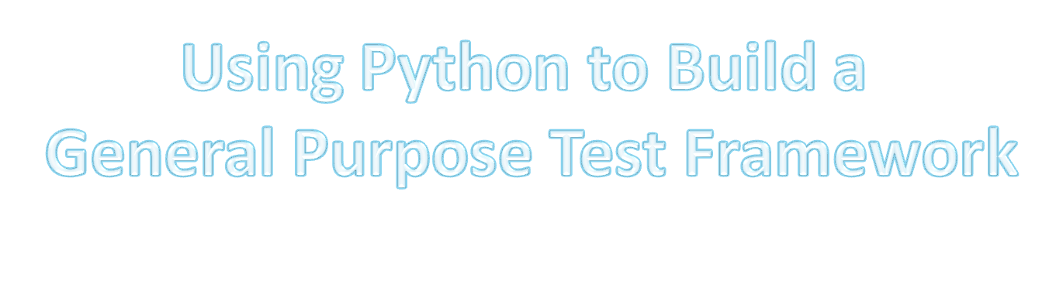
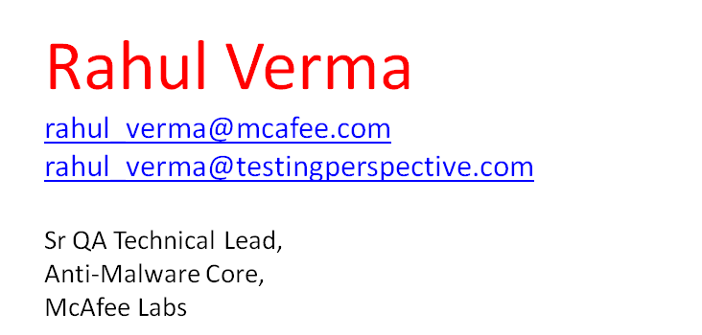



Slide 2


Rahul Verma is a Sr QA Technical Lead with McAfee Software India, with special interest in performance testing, security testing, Python and design of test automation frameworks. Rahul has presented at several conferences, organizations and academic institutions including CONQUEST, STeP-IN, ISQT, TEST2008, Yahoo! India, McAfee, Applabs, IIT Chennai and STIG.
He runs the website – Testing Perspective (www.testingperspective.com ) for which he got the Testing Thought Leadership Award. His paper on the subject of “Design of Fuzzing Frameworks” won the “Best Innovative Paper “Award at TEST2008. He also recently launched a website Python+Testing (http://www.pythontesting.com ) powered by Google AppEngine

Slide 3
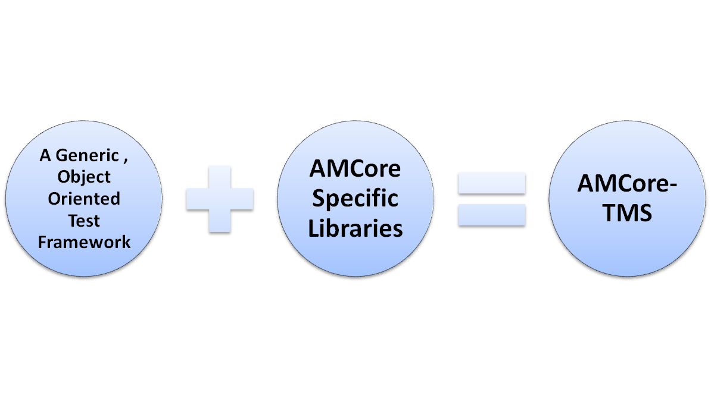

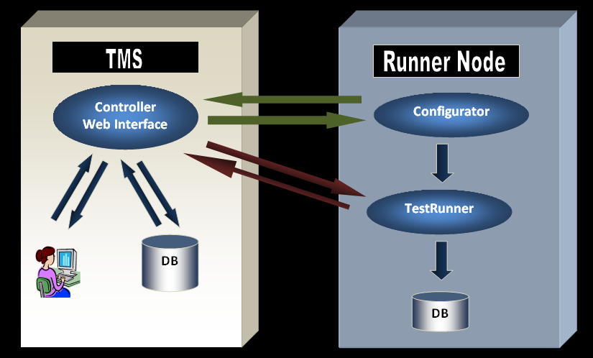
Testing Non-AMCore Products
Testing AMCore
Any Product
Any Tool(s)
Any Language
Unit Tests
API Tests
Black –Box Tests
Python/C++
Django
SQLite
Matplotlib

Slide 4
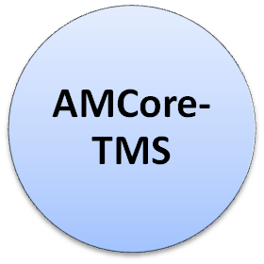

Unit Tests
C/C++
Use:
AMCore White-box and Test Double (DLL Mocking) Library
OR
CPPUnitLite framework
BullsEye Coverage for tests measured against – “Unit Tests Code Coverage”
Component Tests
C/C++
Use:
AMCore White-box and Test Double (DLL Mocking) Library
- BullsEye Coverage for tests measured against – “Component Tests Code Coverage”
System Tests
Python/Perl/AutoIt
Use:
AMCore Python Utilities Library
- BullsEye Coverage for tests measured against – “System Tests Code Coverage”
Non-Functional Tests
Python/Perl/AutoIt
Use:
AMCore Python Utilities Library
- Include performance and fuzzing tests
Python Library
All of these use the underlying Python library for
Scheduling/Running/Script Generation and Reporting

Slide 5
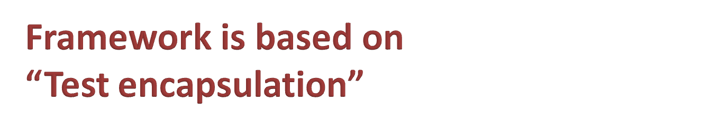
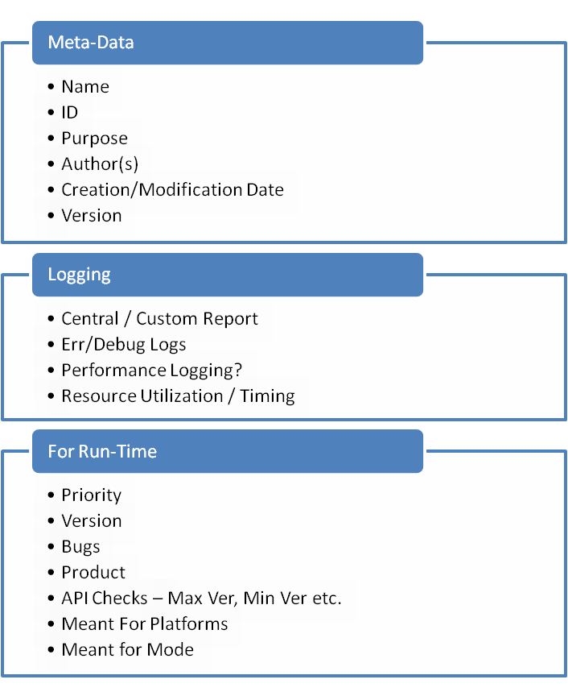
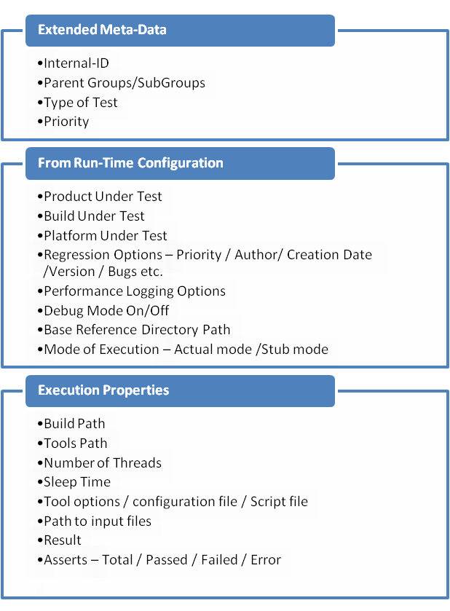
There are a lot of things a test would like to KNOW for itself at run time…

Slide 6
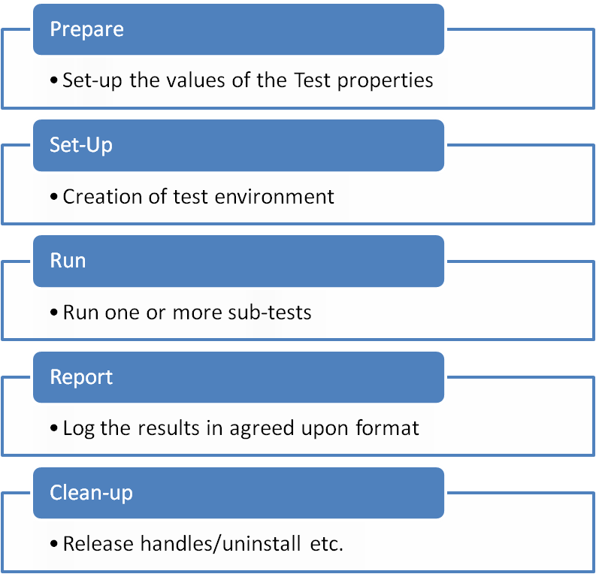
There are a lot of things a test would like to DO at run time…

Slide 7
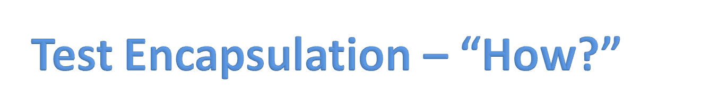
The properties and methods discussed in the previous slides are common across most tests but their values/implementation would vary for different tests.
Framework should support:
Populating test properties provided as constants e.g. Test Author / Creation Date etc.
Populating test properties that are known at run time e.g. Platform under test
Execute the Test API in the expected sequence. E.g.
Test.prepare()
Test.setup()
Test.run()
Test.report()
Test.teardown()
via the framework.

Slide 8
Notes on Key Aspects of AMCore-TMS
  Built on top of a general purpose object-oriented library
  Has library to support DLL Mocking as well as the white box test library
  Runs in three modes – Offline/Runner/Controller
  Supports offline development with Script generation
  Pickling is employed for configurations/results/interface state management
  Tests are scheduled for a given “platform-label” and not a particular machine IP or name.
  For each platform-label there could be multiple runner machines configured and a machine could belong to multiple platform-labels
  Runner names are logical and do not map to the actual machine name. So, is the platform of a given runner name.

Slide 9
Notes on AMCore-TMS
  Groups tests into Test-Group, Test Sub-Group, Type (Black-box/whitebox) and Test Category.
  Class names and purpose map to the testing theory – Test Category, Test, TestOracle, TestResults, TestRunner etc.
  All information that is required to run a test is contained in a test – via properties
  Any run-time errors in a test are confined to the test and does not stop execution.
  Reports detailed information for a test category right to the level of timestamp, oracle, actual result, employed tool etc. for an individual check

Slide 10
Notes on AMCore-TMS
  Employs Pull Model of execution – a runner machine pulls execution details by sending a single parameter i.e. its name (logical)
  State of execution of a runner machine is maintained on the controller machine so that tests are managed across multiple restarts or even fresh snapshots.
  Apache web server is used as the controller side multi-threaded daemon. So, no socket programming involved.
  Runners use HTTP protocol to pull execution settings, intermittent reporting of status and fetching state information
  Status of execution for current or past test cycles can be seen in the web interface
  Easy archiving because everything is file based including the DB.

Slide 11
AMcore-TMS – What it employs
  Programming:
    Python 2.5 (controller)/2.6(test nodes) as the base language
    C/C++ for white-box lib (utilities and test doubles)
    AutoIt for behavior generation
  Apache web server (2.2) + mod_python
  SQLite as the database (file based)
  Following Python modules are used:
    Django for Web interface (based on MVC design pattern)
    Matplotlib for plotting test cycle status and performance statistics
    API-documentation for the package is done using epydoc
    WMI is used for performance stats logging
    Urllib2 for http communication

Slide 12
Q/A
I hear and I forget. I see and I remember. I do and I understand. - Confucious

