Slide 1
pydicom – A pure python module for handling DICOM
Arun B

Slide 2
Outline
Introduction to DICOM
Open source and DICOM
pydicom introduction
Demo
Future project ideas

Slide 3
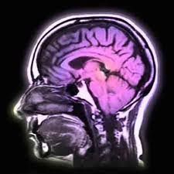
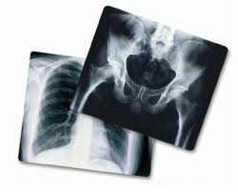



DICOM Overview
Digital Imaging and COmmunication in Medicine
Film and Network [Communication protocol]
Images and Media
[File format]
De-facto standard in medical imaging systems

Slide 4
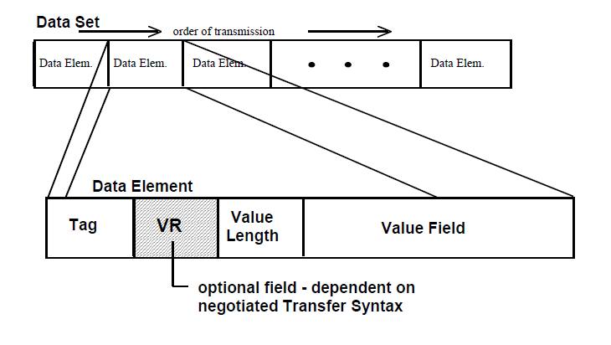
DICOM Basics
dicom.nema.org
Ordered pair of Group & Element No.
e.g. 0x10,0x10
Value Representation
Data type and format
e.g. PN
Value
e.g. “Python^Monty”

Slide 5



Open source and DICOM
Pixelmed (www.pixelmed.com)
C/C++
dcmtk (dicom.offis.de)
Wireshark DICOM plugin (wireshark.org)
OsiriX (www.osirix-viewer.com)
... but I am a Pythonista ... !!!

Slide 6
Pure python bliss - pydicom
code.google.com/p/pydicom
Read and write DICOM data
class DataSet isA Python dict
>>> import dicom
>>> plan=dicom.read_file("rtplan.dcm")
>>> plan.PatientsName
'Last^First^mid^pre'
>>> plan.dir("setup") # get a list of tags with "setup" somewhere in the name
['PatientSetups']
>>> plan.PatientSetups[0]
(0018, 5100) Patient Position CS: 'HFS'
(300a, 0182) Patient Setup Number IS: '1'
(300a, 01b2) Setup TechniqueDescription ST: ''
>>> plan.PatientSetups[0].PatientPosition = "HFP"
>>> plan.save_as("rtplan2.dcm")

Slide 7
DEMO

Slide 8
Project ideas
Pick up features/todo's for pydicom
DICOM validator on App Engine
DICOM Network client/server (twisted plugin?)

