Slide 1
Python In The Wild - Enabling voices of children
Jeff Wishnie
Diptanu Choudhury
ThoughtWorks Inc

Slide 2
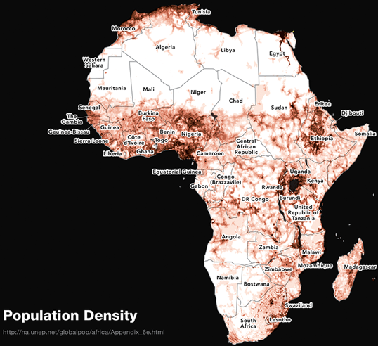
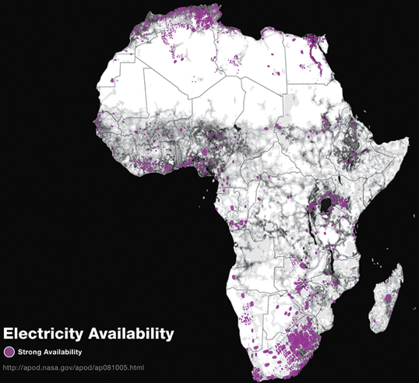
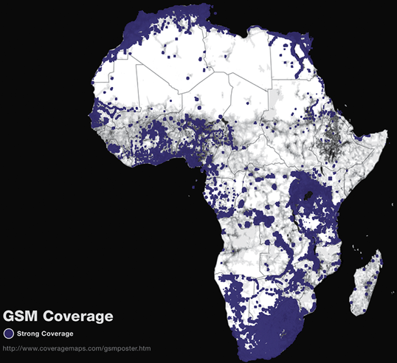
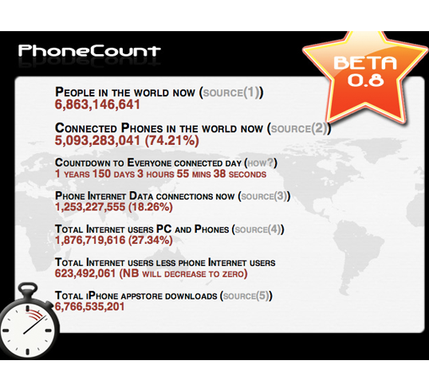
Why SMS in International Development?
Mobile networks are ubiquitous
Mobile phones are common
But they are ‘feature’ phones
SMS means ubiquitous:
data collection
realtime analysis
realtime feedback

Slide 3





RapidSMS/PyGSM: Python for SMS Applications
UNICEF Malawi: Malnutrition Management
MVP/Columbia: ChildCount
UNICEF Nigeria: Bednet distribution
Tostan Senegal: Community organization & Literacy
Toyola/E+Co: Cookstove Registration

Slide 4
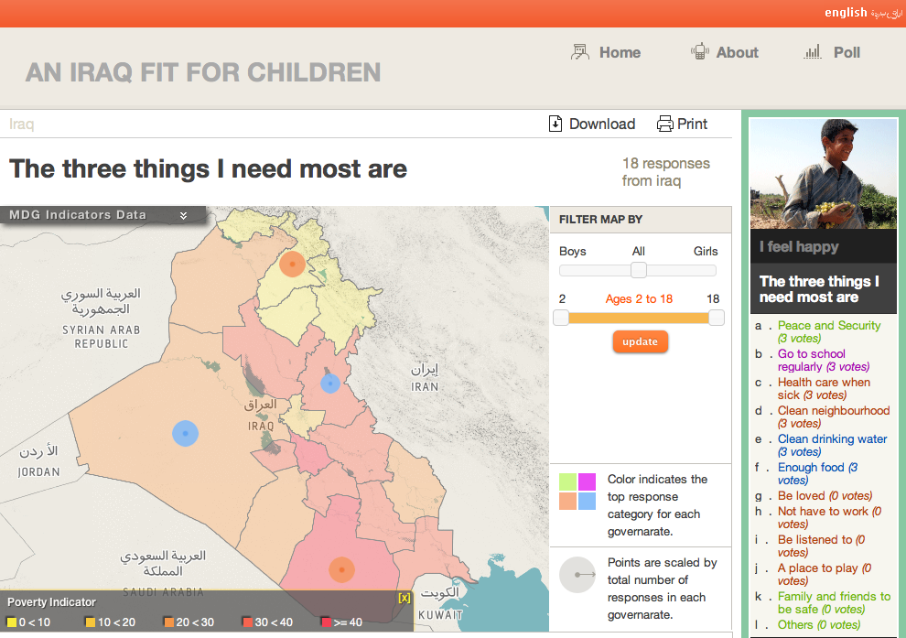
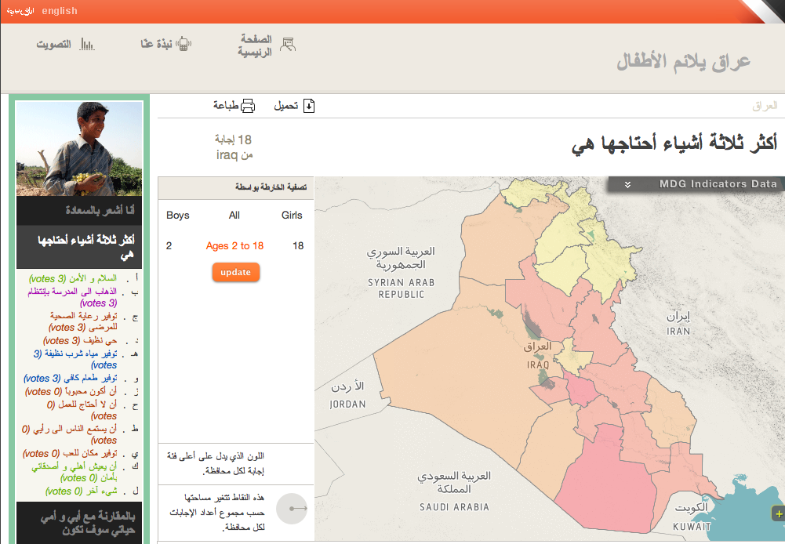
Iraq Children's’ Happiness Poll:
The Problem
UNICEF’s mission:
“…advocate for the protection of children's rights, to help meet their basic needs and to expand their opportunities to reach their full potential.”
UNICEF workers are locked in the ‘International Zone’
50% of Iraqis are 18 and under (~15 million people)
>1 mobile phone per Iraqi household
Use mobiles to hear the ‘Voice of the Children’: SMS/IVR/Visualization

Slide 5
System Diagram
Django
RapidSMS Backends
Kannel
GeoDjango
RapidSMS
Visualization
Py GSM
Geo Server
PostGIS
IVR System

Slide 6
The Technology Stack
Django
RapidSMS
GeoServer, OpenLayers
PostGIS
VirtualEnv and Buildout
BuildBot, Git and Github
i18n

Slide 7
Django
The De-Facto web framework in Python
Awesome documentation
Supports modular architecture with apps.

Slide 8
RapidSMS
Supports a lot of backends including HTTP, Kannel etc.
Integrates with Django very conveniently for administrative and reporting tasks.
Battle tested in the field at a lot of developing countries

Slide 9
Maps and User Interface
Openlayers is a very comprehensive javascript library for showing maps on web pages.
OpenLayers has support for KML files too
JQuery UI facilitated the visualization along with the maps

Slide 10
PostGres, PostGIS and GeoDjango
PostGres has the datatype Polygon which PostGIS extends to form other database types
PostGIS brings a whole lot of queries to developers making apps with geo-location support
Django models understands the datatypes of PostGIS

Slide 11
Version Control and Continuos Integration
Buildbot is very extensible in terms of setting up the build agents
Buildbot has listeners to post-commit hooks that GitHub triggers
Git is an exceptional SCM for distributed development
We started with shell scripts but then moved to Fabric

Slide 12
Lessons learned in production environment
Automate as much as possible
The scalability of the application has to be kept in mind right from the beginning.
The app is packaged with the required dependencies, easier it becomes for deployment

Slide 13
i18n
Django has a good scheme for internationalization.
Messages has to be compiled before the app is deployed.
We needed to add translations for questions and answers in the runtime.
Created the Internationalization app which lets users define codes and their associated translations in RapidSMS.

Slide 14

Questions?
Notes:
10:45 discussion on open SI issues for 2011:
more detail on how we are currently structured
what is a SI project and how to select?
africa office!

