Slide 1
Py Conf India 2010
Climate Data Analysis Tools
By,
Arulalan.T

Slide 2
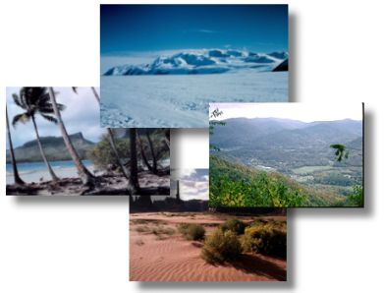
Climate
Data
Analysis
Tools

Slide 3
Thanks To . . .
Mr.Charles Doutriaux
CDAT Developer
Mr.Thyagarajan Shanmugham
FOSS Enthusiast

Slide 4
CDAT
Climate Data Analysis Tool

Slide 5
What is CDAT Library ?
How can we use it as a meteorologist ?
How can we write coding for meteorologist using CDAT as normal python programmers ?

Slide 6
How can we edit or create our continents region in the
CDAT world map ?
My Real Time Application of CDAT in Indian
Meteorological Department.
How can we write code for new markers in CDAT ?
My Contribution to CDAT in its core development
( created many new markers )

Slide 7
CDAT
Can Do . . .

Slide 8
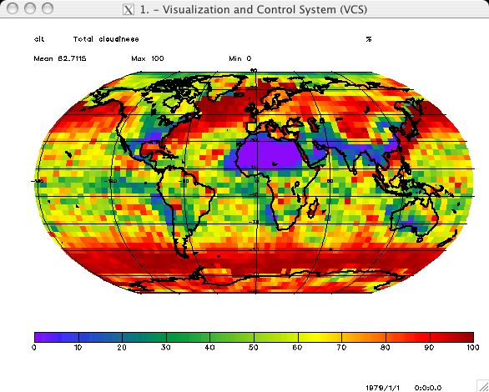

Slide 9
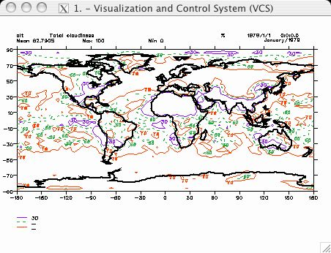

Slide 10
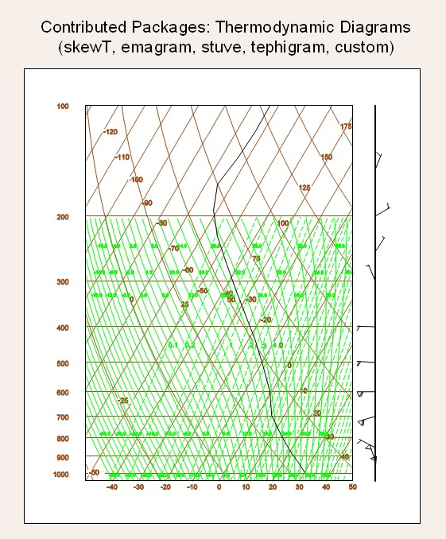

Slide 11
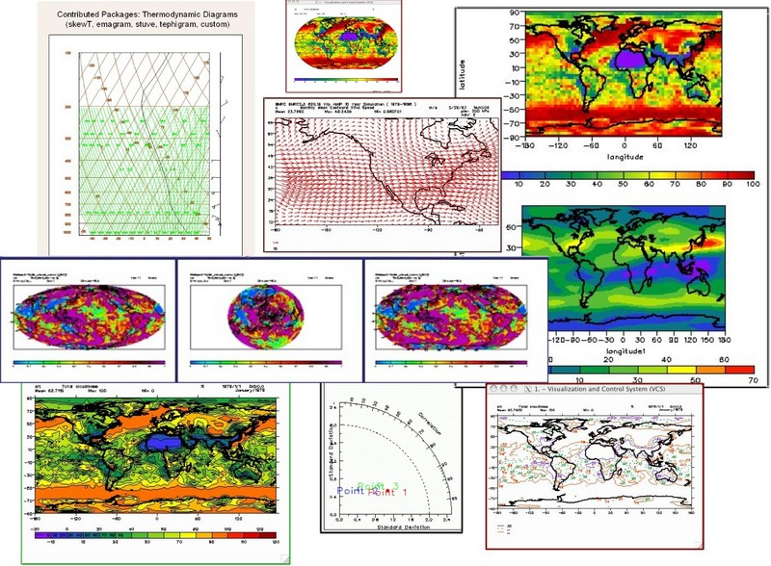

Slide 12
INSTALLATION

Slide 13
Dependencies :
# bison *
# byacc *
# flex *
# gawk *
# g++
# gfortran (for contrib packages)
# libxt-dev
# libx11-dev
# tcsh (just highly recomended)
# xorg-dev (also called xserver-xorg-dev)
#libpng (1.1 or later ) and freetype (1.4 or later)

Slide 14
Installation :
export CC=gcc
export FC=gfortran
export CXX=g++
svn export http://www-pcmdi.llnl.gov/svn/repository/cdat/tags/5.2 cdat-5.2-src
./configure --prefix=/usr/local/cdat5.2/
--with-externals=/usr/local/cdat5.2/cdat_ext.
sudo make

Slide 15
Cdat Working Directory :
# You can now start CDAT with the command
$ cd /usr/local/cdat5.2/bin
$ ./cdat

Slide 16
Cdat Working Directory :
# You can now start CDAT with the command
$ cd /usr/local/cdat5.2/bin
$ ./cdat

Slide 17
Example Program

Slide 18
#sample.py
import vcs, cdms2, cdutil, time, os, sys
import time
v = vcs.init()
filepath = os.path.join(sys.prefix,'sample_data/clt.nc')
cdmsfile = cdms2.open( filepath )
cf_asd = v.getboxfill( 'ASD' )
cf_asd.datawc(1e20,1e20,1e20,1e20)
cf_asd.level_1=1e20
cf_asd.level_2=1e20
cf_asd.color_1=240
cf_asd.color_2=240
data = cdmsfile('clt', longitude=(-180, 180), latitude = (-180., 180.))
#data = cdmsfile('clt', longitude=(60, 100), latitude = (5., 40.)) # For India
v.plot( data,cf_asd )

Slide 19
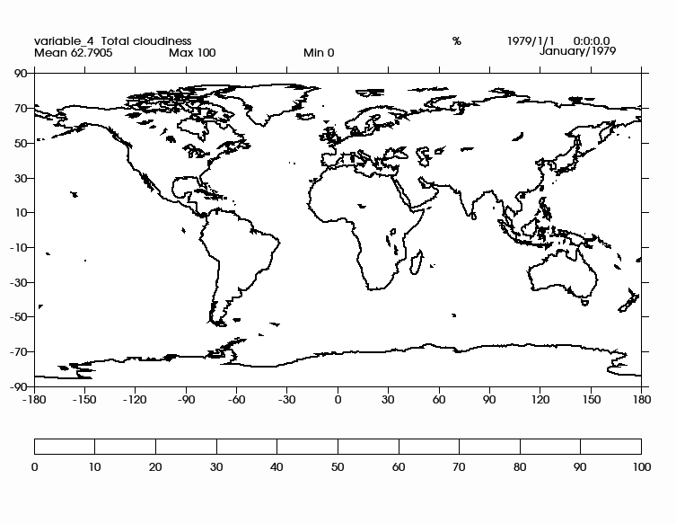
Cdat World Map - Outline

Slide 20
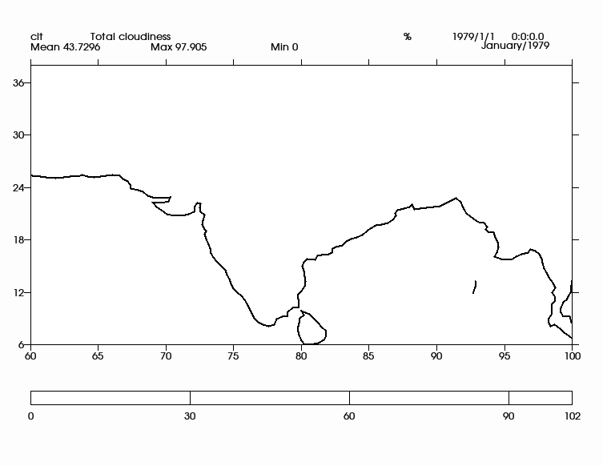
Cdat India Map - Outline

Slide 21
#sample1.py
import vcs, cdms2, cdutil, time, os, sys
import time
v = vcs.init()
filepath = os.path.join(sys.prefix,'sample_data/clt.nc')
cdmsfile = cdms2.open( filepath )
cf_asd = v.getboxfill( 'ASD' )
cf_asd.datawc(1e20,1e20,1e20,1e20)
cf_asd.level_1=1e20
cf_asd.level_2=1e20
cf_asd.color_1=240
cf_asd.color_2=240
data = cdmsfile('clt', longitude=(-180, 180), latitude = (-180., 180.))
#data = cdmsfile('clt', longitude=(60, 100), latitude = (5., 40.)) # For India
v.plot( data,cf_asd , continents=4 )

Slide 22
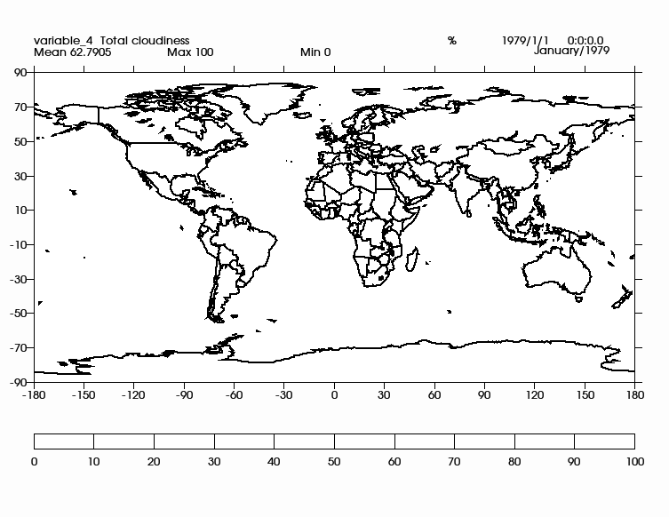
Cdat World Map - Continents

Slide 23
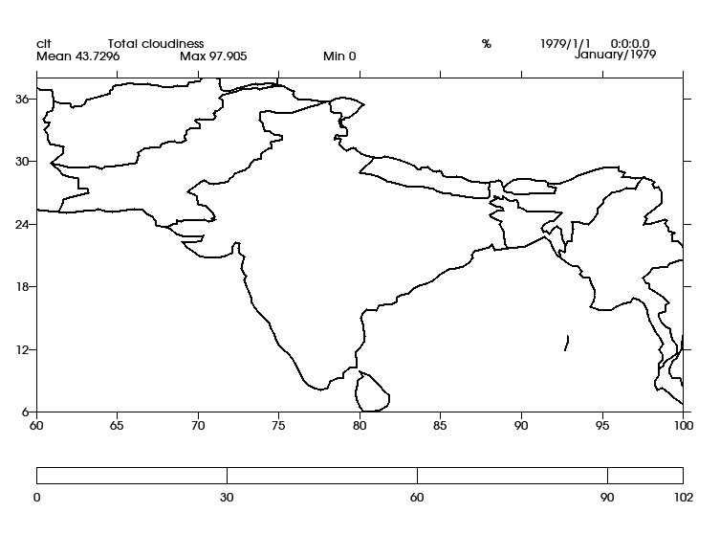
Cdat India Map - Continents

Slide 24
How To Edit Cdat Map

Slide 25
Our Indian Political Map wrongly depicted in CDAT as below

Slide 26
1) Correcting the Pakistan part , which belongs to India
2) Correcting the part of the land which is occupied by the Chinese in the state of jammu and kashmir
While asking help from Mr.Charles Doutriaux [ CDAT - Developer ] regarding edit map in cdat, he gave the source data of cdat world map in .shp binary file.

Slide 27
#make_world_co-ordinates.py
import vcsaddons
v = vcs.init()
world_continents = vcsaddons.continents.Guc(x=v)
data = world_continents.load_shapefile('/home/arul/Desktop/WORLD_COUNTRIES.shp')
#wrting the data into out.txt file
fileiter=open("/home/arul/Desktop/out.txt","w")
print >> fileiter, data[:]
fileiter.close()

Slide 28
out.txt
200 1 59.790276 83.623596 -72.830238 -12.204896
60.238045 -43.123886
60.174297 -43.109169
60.110275 -43.086662
60.082497 -43.124443
60.019024 -43.140419
59.989437 -43.193470
59.992493 -43.238892
60.023605 -43.331116
59.972763 -43.358894
59.928326 -43.395832
59.903320 -43.501945
59.954636 -43.488258
59.914711 -43.572777
59.947212 -43.724716
59.877213 -43.653885
59.804436 -43.849724
59.790276 -43.902222
59.811661 -44.006950
59.800545 -44.061943
59.813538 -44.109722
There are more than one lakh lines like this.
These are x,y co-ordinate points.
Simply says, these are Latitude and Longitude values of the whole [real] world.

Slide 29
My Hacks On Cdat Map

Slide 30
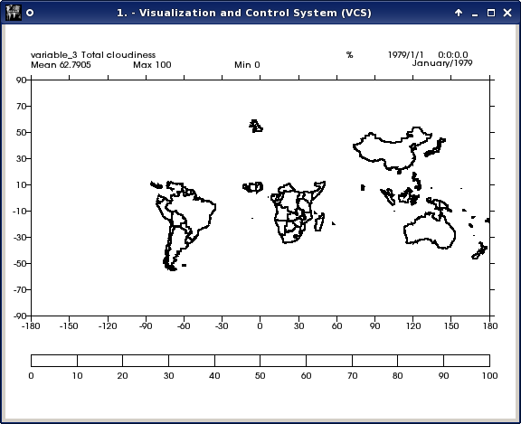
Over World

Slide 31
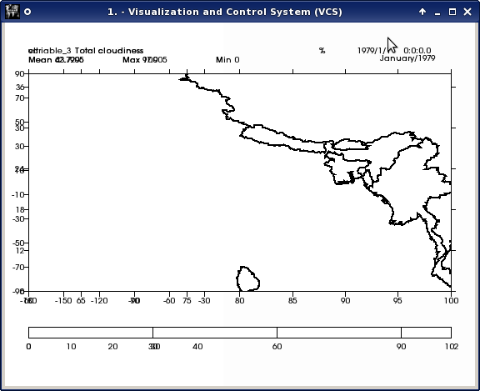
Over India

Slide 32
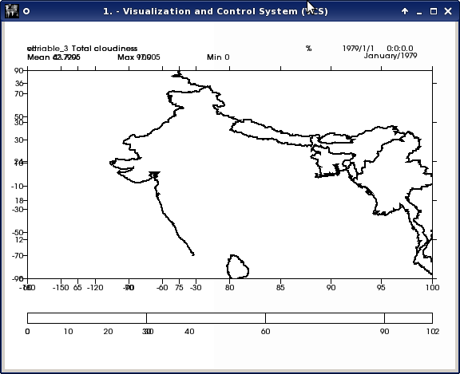

Slide 33
My Construction On Cdat India Map

Slide 34
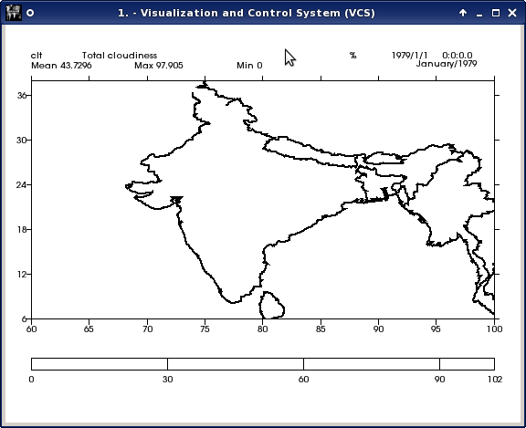

Slide 35


Slide 36


Slide 37
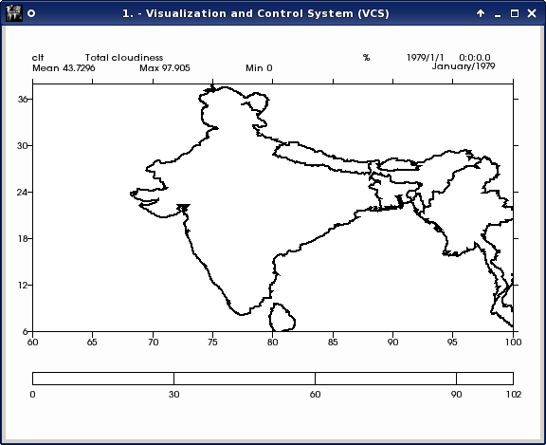

Slide 38
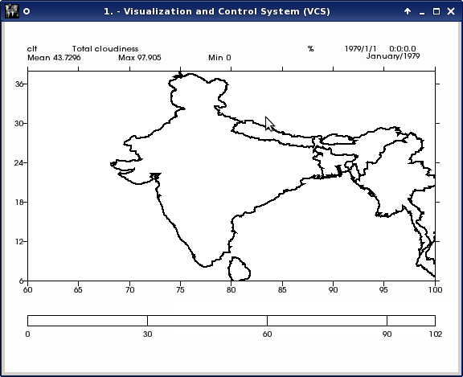

Slide 39
Finally

Slide 40
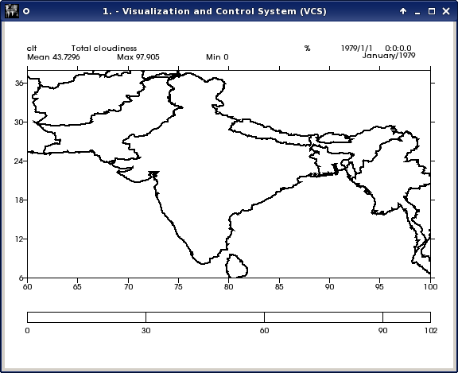
Our India

Slide 41
Now we have to save as the modified out.txt file i.e WorldContinent.shp's text file in the name of “data_continent_other7” in the path “/home/arul/PCMDI_GRAPHICS/”
v.plot( data,cf_asd , continents=6 )

Slide 42
#sample2.py
import vcs, cdms2, cdutil, time, os, sys
import time
v = vcs.init()
filepath = os.path.join(sys.prefix,'sample_data/clt.nc')
cdmsfile = cdms2.open( filepath )
cf_asd = v.getboxfill( 'ASD' )
cf_asd.datawc(1e20,1e20,1e20,1e20)
cf_asd.level_1=1e20
cf_asd.level_2=1e20
cf_asd.color_1=240
cf_asd.color_2=240
#data = cdmsfile('clt', longitude=(-180, 180), latitude = (-180., 180.)) # For the world
data = cdmsfile('clt', longitude=(60, 100), latitude = (5., 40.))
v.plot( data,cf_asd, continents=6 )

Slide 43
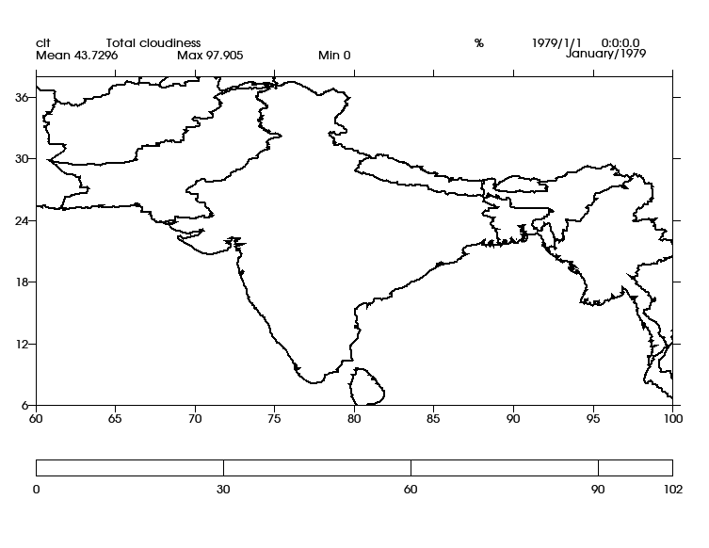
Corrected India Map in Cdat

Slide 44
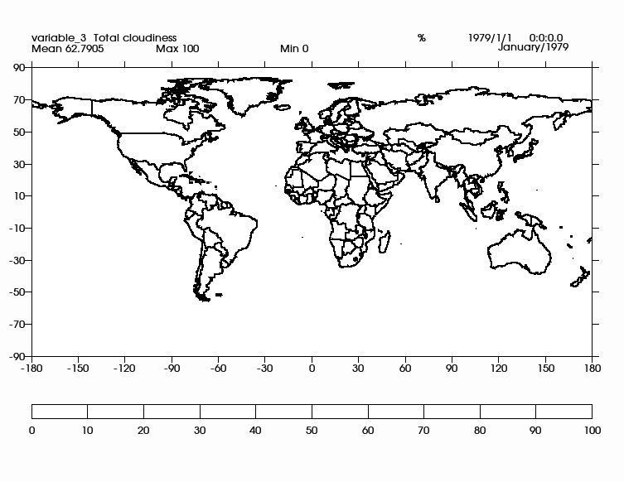
Corrected India region in Cdat-World Map

Slide 45
Application Of
CDAT
In
Indian Meteorological Department

Slide 46
Generating
Change Chart
In IMD

Slide 47
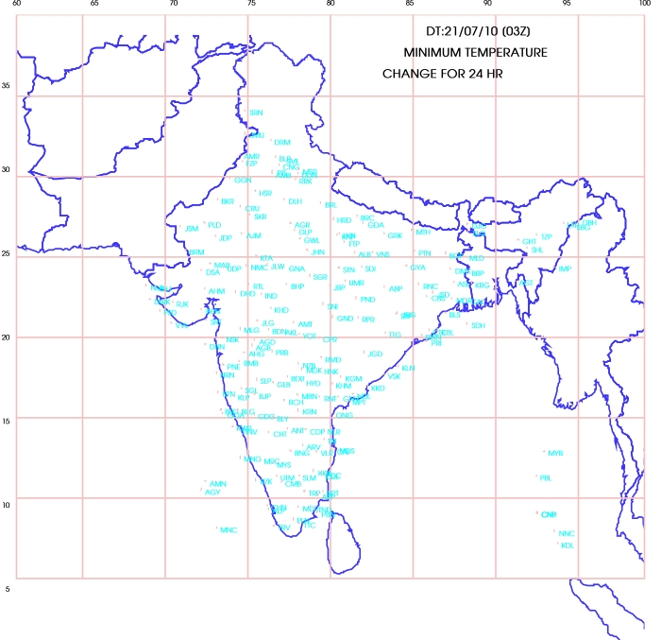

Slide 48
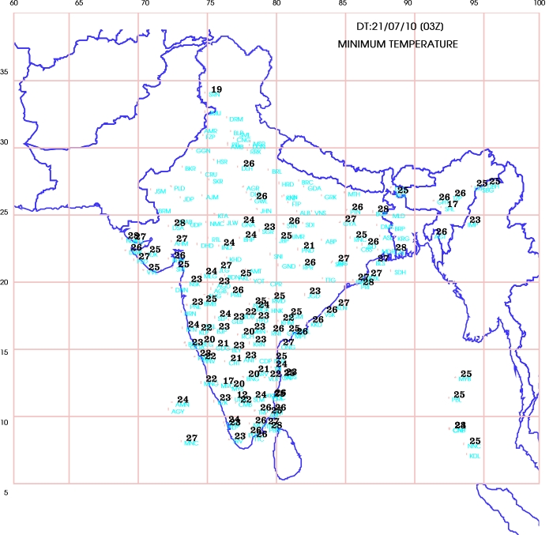

Slide 49
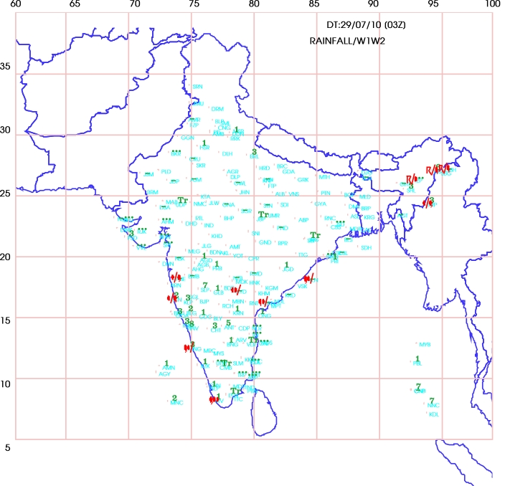

Slide 50
My Contribution
To
CDAT

Slide 51
Created 103 Weather
Symbol Markers
In CDAT

Slide 52
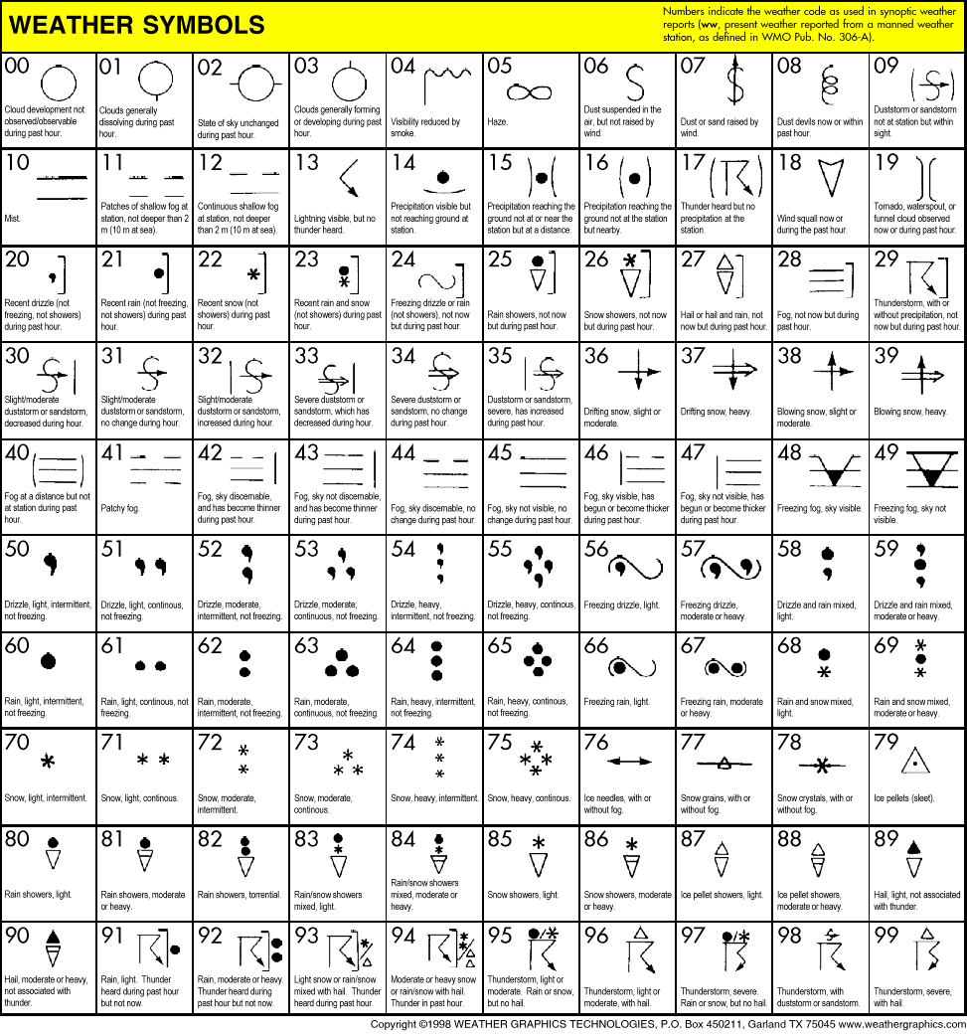

Slide 53
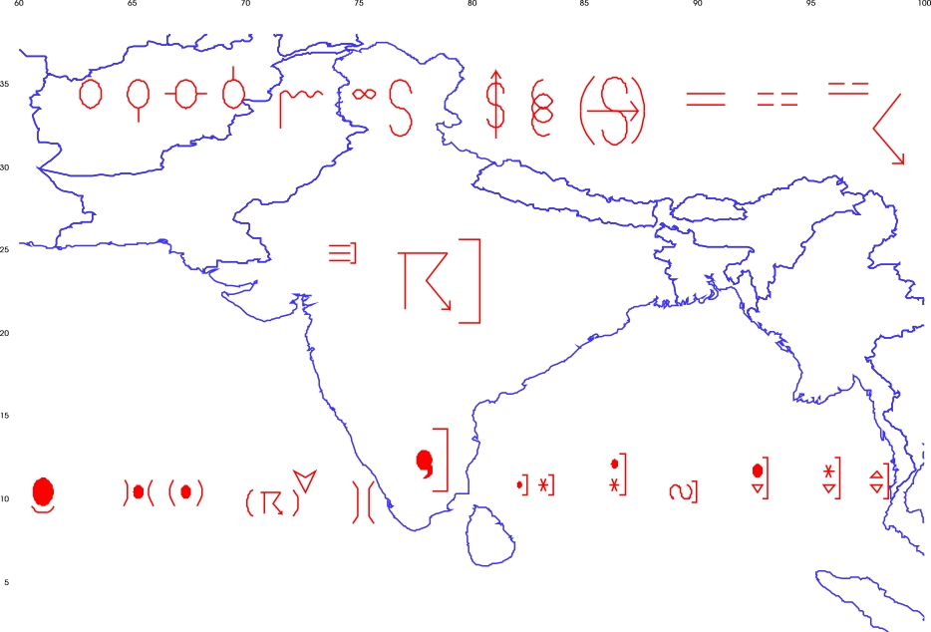
W00 to W29

Slide 54
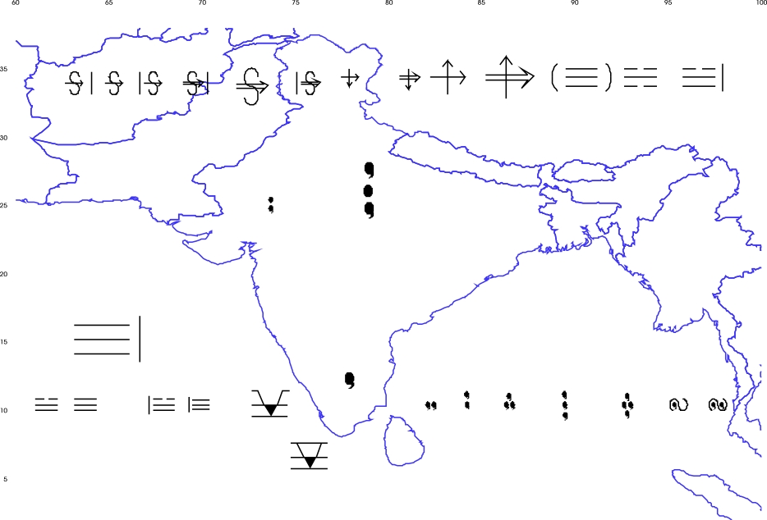
W30 to W59

Slide 55
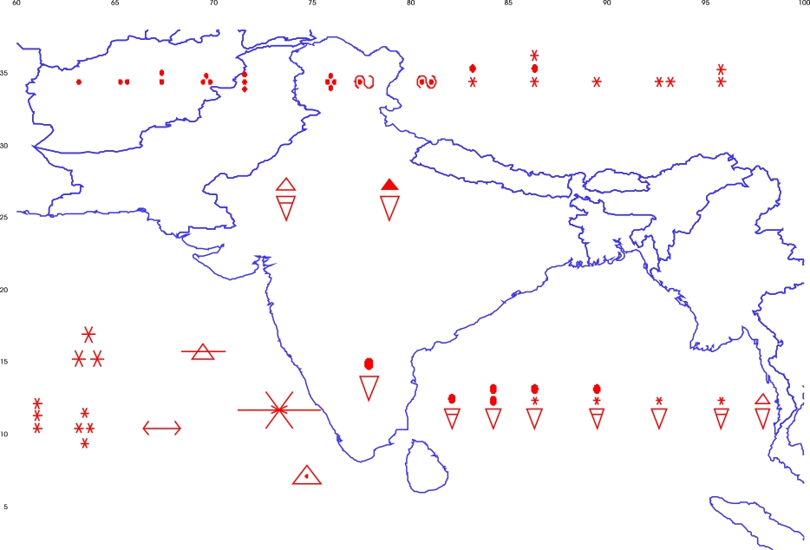
W60 to W89

Slide 56
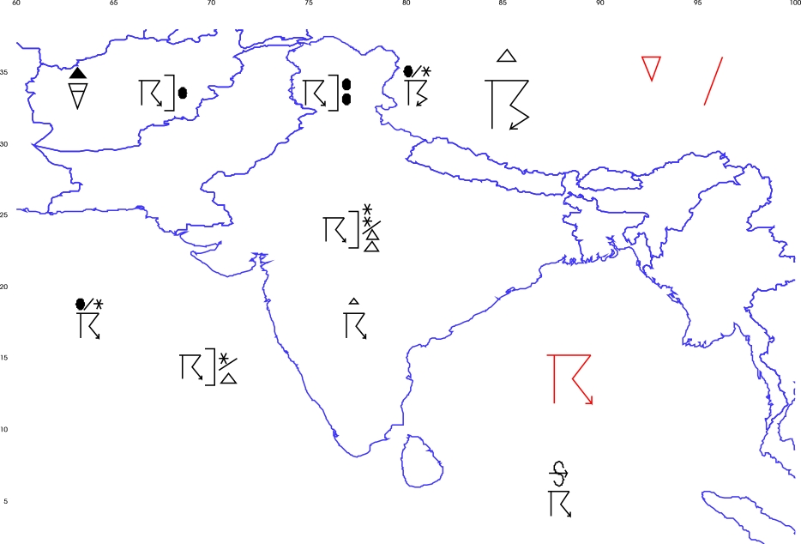
W90 to W99

Slide 57
Markers Coding

Slide 58
Isolines

Slide 59
Isolines
- Contour
- Isotherm
- Isobar

Slide 60
What is Contour ?
Contour is line drawn on a map connecting points of equal height .
Contour lines (also isolines) connect a series of points of equal elevation and are used to illustrate topography, or relief
on a map.
They show the height of ground above Mean Sea Level (M.S.L.) in either feet or meters and can be drawn at any desired interval.

Slide 61
Isolines in Cdat

Slide 62
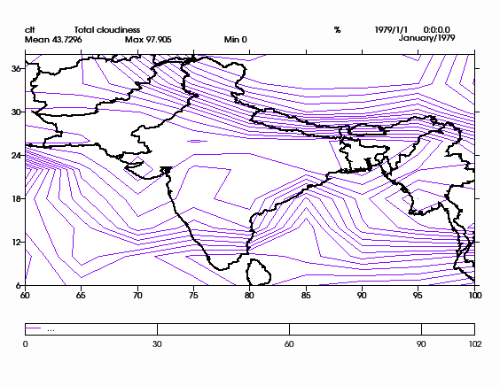
Iso Lines Over India Map

Slide 63
CDAT User :
How can a user create their own Isolines on cdat map?

Slide 64
CDAT User :
Generally we can't create our own isolines in cdat map.
We can set only levels on isolines.

Slide 65
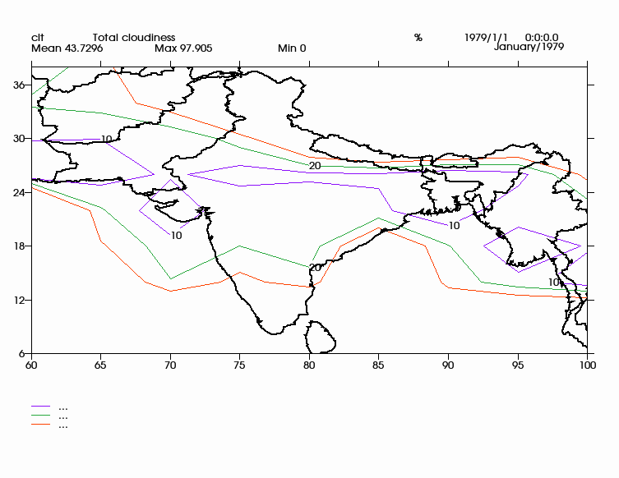
levels = [10,20,30]

Slide 66
Reason is . . .

Slide 67
NetCDF file

Slide 68
My Project
is going to create our own isolines on cdat map.

Slide 69
What is My Project ?
My Project is going to create the isotherm lines, which will be plot on India Cdat Map.
We have 4 processes to do this . . .
.

Slide 70
Process 1:
1.1 WebScrape the current temperature and barometer (millibar) of all over cities in India and its surroundings countries from the Internet.
1.2 Store the city name, temperature, millibar into the file.

Slide 71
Process 2:
2.1 Combine the temperature and mb values with latitude and longitude of corresponding cities, which is already collected info file.
2.2 Make decision and covert lat into 4 intervals & lon into 5 intervals

Slide 72
Process 3:
3.1 Create the binary iso.nc file which contains current temperature values along with lat & lon.
3.2 Move the “iso.nc” to the cdat location in our system.

Slide 73
Process 4:
4.1 Run the “isotherm.py” to create our isolines on cdat India Map.
4.2 E-Mail to us with the attachment of the output image, which is created by “isotherm.py”

Slide 74
To automate all the 4 processes
we may use “crontab”
to get isotherm update on India
for every one hour or . . .

Slide 75
Data Flow Diagram For Generating Isothermal Lines From Google Temperature
Web Scraping
Program
Google Temperature Values
Store the Google
Temperature Values
into the File
Isothermal Lines
On Cdat Map
Draw Isothermal
Lines from the
File Values

Slide 76
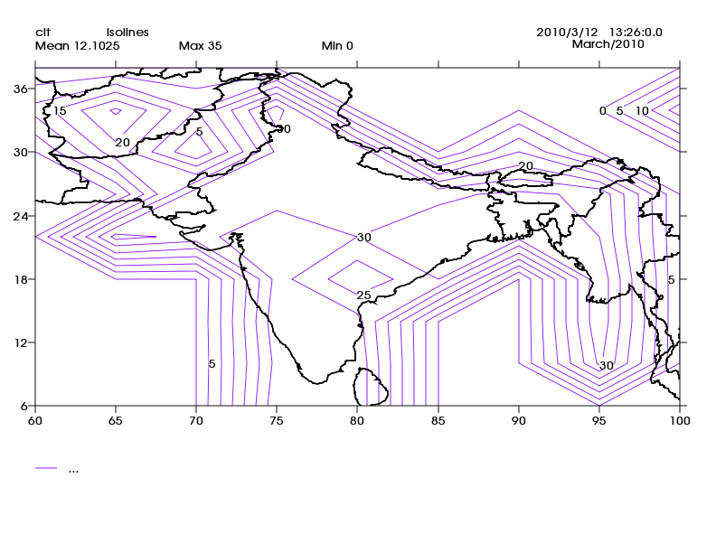
1 pm

Slide 77
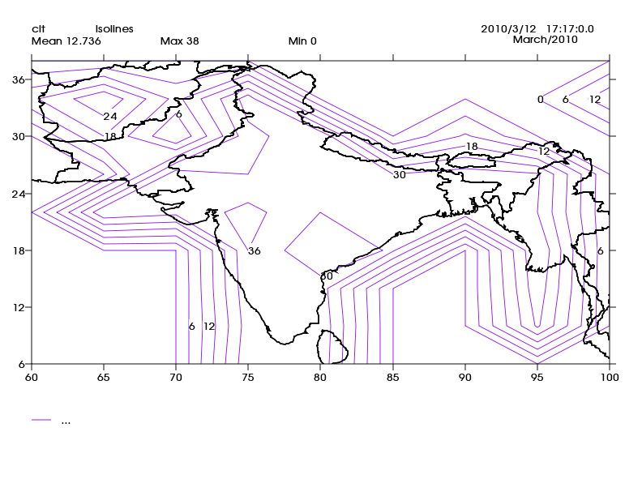
5 pm

Slide 78
Applications :
By the visualization of Isothermal lines on map, we can analyses and obtain the temperature and pressure values.
Using this we can analysis/predict the climate changes.

Slide 79
VCDAT

Slide 80
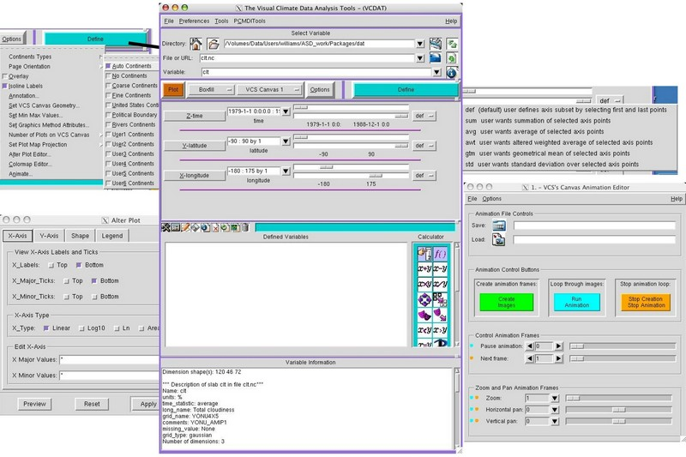

Slide 81

Web
Web

Slide 82
CDAT
http://www2-pcmdi.llnl.gov/cdat
Join In Mailing List
https://lists.sourceforge.net/lists/listinfo/cdat-discussion

Slide 83
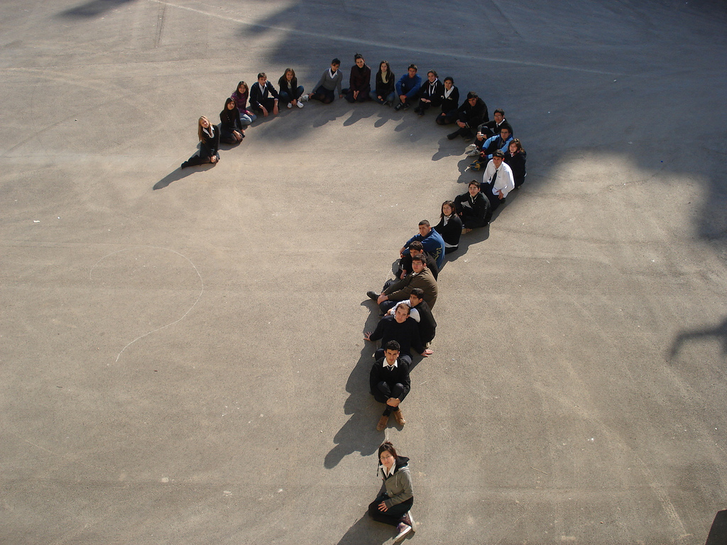

Slide 84


