Slide 1



AUSF
Agent based User Simulation Framework
Om Narayan

Slide 2












Outline
Introduction
What are Agents ?
Designing the Smart Agents
Agents on large scale
Present and Future

Slide 3
Introduction
AUSF is a multiple agent framework in Python -infrastructure to simulate user activity in goal oriented community.
This project started to overcome the traditional load testing.
Over a period of time, it has evolved as a generic solution for user simulation requirements.

Slide 4
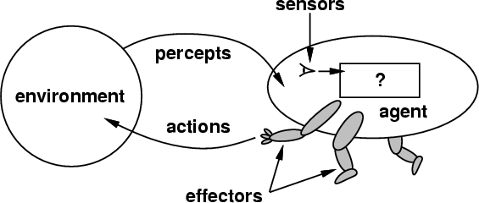
What are Agents?
Software entities that assist people and act on their behalf – IBM
An agent is a software component (object) which can perform one or more tasks in some predefined manner

Slide 5
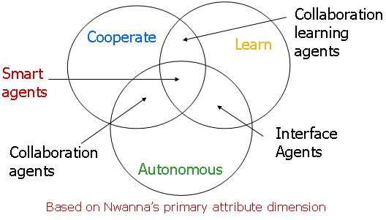
Designing Smart Agents
Autonomous
Goal-directed
Task-able
Situated
Cooperative
Communicative
Adaptive

Slide 6

Designing Smart Agents Autonomous
Taking the initiative as appropriate.
Pythonic Way :
Process entity which have predefine Object stage.
An independent process-of-control.
Object stage can be over-ridden.
Goal of Agent is set by process-controller.

Slide 7

Designing Smart Agents
Goal-oriented
Maintaining an agenda of goals which it pursues until accomplished or believed impossible
Pythonic Way :
All agents complete their life cycle by unregistering themselves.
Other goals are driven by process-control server.
Each Agents have task queue.
End of the all every task agent should have to notify the status of goal to monitoring server.
All agent complete their life cycle by unregistering them self.

Slide 8

Designing Smart Agents
Task-able
The agent acts to change one agent can delegate rights/actions to another
Pythonic Way :
Agents are capable of assigning some task(s) to other agent(s).
An independent process-of-control.
Object stage can be over-ridden.
Task of Agent is set by process-controller.

Slide 9

Designing Smart Agents
Situated
In an environment (computational and/or physical) which it is aware of and reacts to
Pythonic Way :
Each agent has unique Id.
Each agent community has its own process controller.
Agents are fully aware of it resource.
Whenever agent initiates or changes it’s object stage, it also gets access to required community.

Slide 10

Designing Smart Agents
Cooperative
With other agents (software or human) to accomplish its tasks.
Pythonic Way :
Agents can share their stage and task.
Agents learn in co-operative manner
In current mode agents share two layer of knowledge sharing.
Local resource appearances.
Global resource appearances.
Agents achieve their goal.

Slide 11

Designing Smart Agents
Communicative
To make agents understand each other they have to not only speak the same language, but also have a common ontology. An ontology is a part of the agent's knowledge base that describes what kind of things an agent can deal with and how they are related to each other. … Wikipedia
Pythonic Way :
Its based on xmpp.
Agent can send message to sever/Agents.
Communication is text based.
Message parsing by Agents.

Slide 12
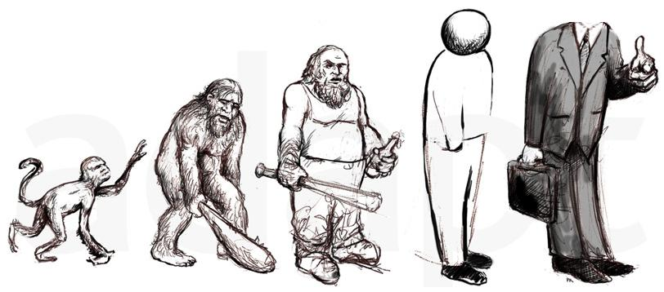
Designing Smart Agents
Adaptive
Modifying beliefs & behavior based on experience
Pythonic Way :
In current mode Agents adaptivity is based on 2 mode
Resource mode :
Master server stop sending particular commands after threshold limit based on the response analysis
Knowledge mode
Agents update common knowledge base

Slide 13
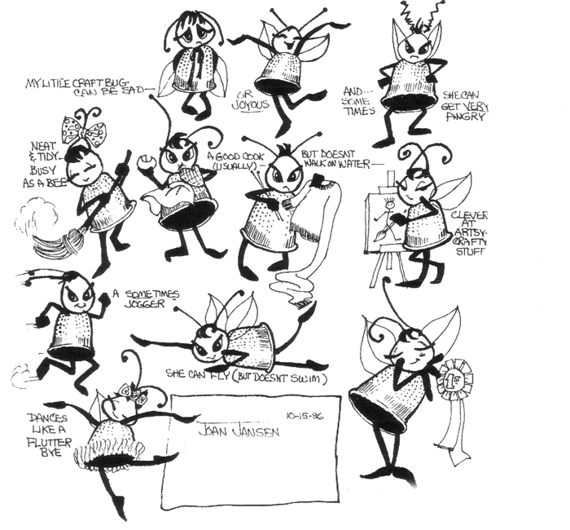
Agent on large scale
More agent more work
Pythonic Way :
Agents are divided in grid way.
All connected system can have their local controller server
Agent is a process and not a thread.

Slide 14
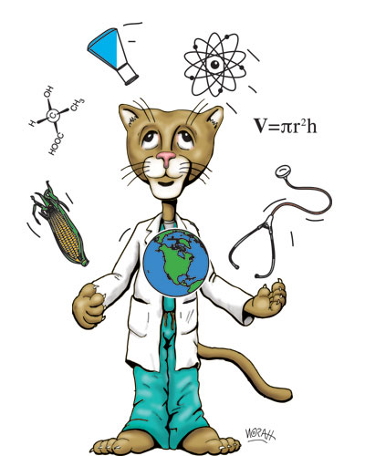
Present and Future
AULT : Agent based User simulation and Load Testing
VICA : Virtual Intelligent Chatting Agent
Pythonic Way :
Programming model and APIs.
Programming infrastructure and services.
Naming scheme for servers, agents, resources Agent transfer protocol.
Inter-agent communication protocol
Debugging facilities.

Slide 15


Slide 16


om.narayan29@gmail.com
http://twitter.com/omnarayan
http://in.linkedin.com/in/omnarayan

